Slide 1
The Church in the 4th century and beyond
(Ecumenical councils)

Slide 2
Major aspects
Three Ecumenical Councils
Monasticism
Chalcedonian Assembly in 451

Slide 3
Summary of the 4th century A.D.
Diocletian → King Constantine 313 A.D.
Christianity becomes the official religion of the Roman Empire 381 A.D.
Monasticism begins
Council of Nicea 325 A.D.
Council of Constantinople 381 A.D.
Council of Ephesus 431 A.D.

Slide 4
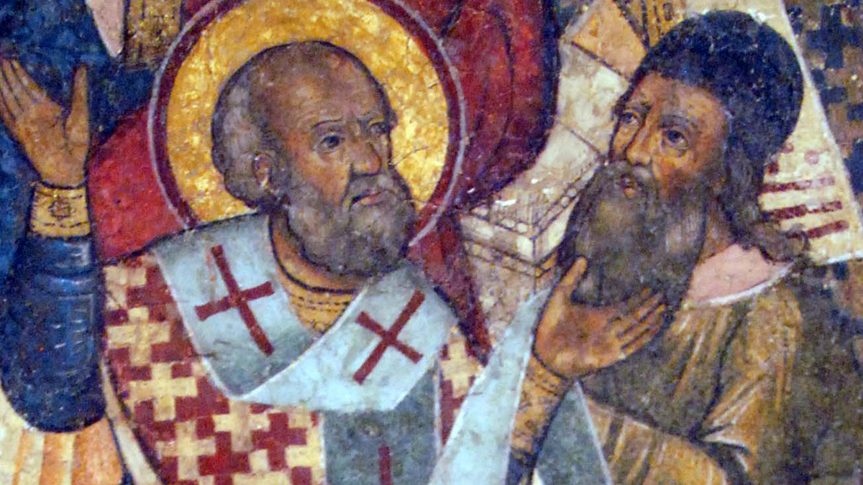
The Council of Nicea
Who was there?
  318 Bishops of the church form all around the world!
  St. Macanus of Jerusalem, St. Eustathius of Antioch, St. Leontius of Caesarean, St. Hypatius of Gangra, St. Alexander, St. Athanasius.
Why were they there?
  Arius: Jesus is created not born, God the Father is greater than the Son.
What was their conclusion?
  The Creed & its careful wording. Eg. Homeiousios vs Homeiousious.
  The anathema
  Arius is banished

Slide 5
“We believe in one God, God the Father the Pantocrator who created heaven and earth, and all things seen and unseen.
We believe in one Lord Jesus Christ, the Only-Begotten Son of God, begotten of the Father before all ages; Light of Light, true God of true God, begotten not created, of one essence with the Father, by whom all things were made; Who for us men and for our salvation came down from heaven, and was incarnate of the Holy spirit and the Virgin Mary and became Man. And He was crucified for us under Pontius Pilate, suffered and was buried. And on the third day He rose from the dead, according to the scriptures, ascended to the heavens; He sits at the right hand of his Father, and He is coming again in His glory to judge the living and the dead, Whose kingdom shall have no end.
Yes, we believe in the Holy Spirit”

Slide 6
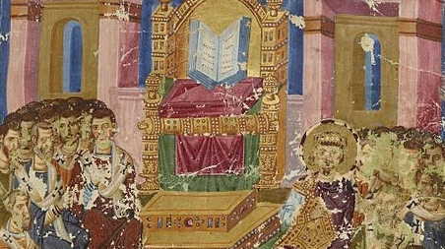
The Council of Constantinople
Who was there?
  150 Bishops from all over the world!
  Pope Timothy attends
Why were they there?
  Macedonius: denial of the divinity of the Holy Spirit
  Also for Sabellius (The trinity is one being and one person),
  and Apollinaris (humanity of Christ is just His flesh, and divinity is His soul and mind)
What was their conclusion?
  Addition to the Nicene Creed
  The 3 heretics are banished

Slide 7
Yes, we believe in the Holy Spirit, the Lord, the Life-Giver, Who proceeds from the Father, Who with the Father and the Son is worshipped and glorified, who spoke by the prophets.
And in one holy, catholic and apostolic church. We confess one baptism for the remission of sins. We look for the resurrection of the dead, and the life of the coming age. Amen.

Slide 8
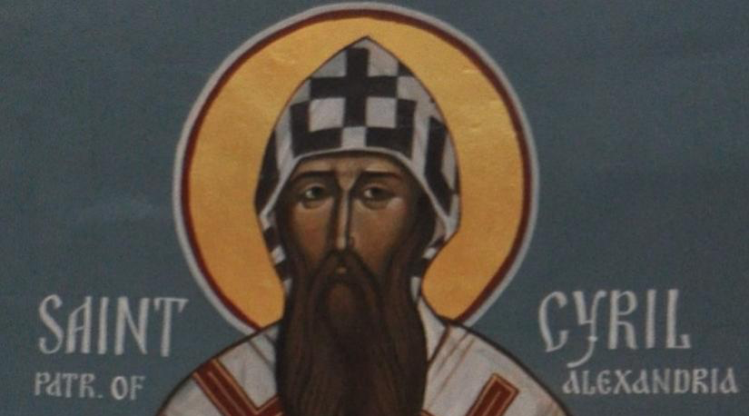
The Council of Ephesus
Who was there?
  200 Bishops from all over the world!
  St. Cyril the Pillar of Faith
Why were they there?
  Nestorius: Christ was of two separated persons & no to the term “Theotokos”
What was their conclusion?
  St. Cyril: Hot iron analogy
  Nestorius is banished

Slide 9
Workshop
Nicea | Constantinople | Ephesus
Jesus is created, not born | The Holy Spirit is not God | Jesus is made of 2 natures
Arius | Macedonius | Nestorius
Explain these concepts to a child in grade 3 and one in grade 12

