Slide 1

Visitation
Why?
1- Help them build a relationship with God
2- Keep connection with the church
3- Remind about meetings, liturgies and outings
4- A message of love and value
5- Check on health or studies
6- Concern over spiritual life
7- Discuss any concerns or problems they have as reasons not to go to church

Slide 2
Visitation
3 Ways:
Organized Visitation
There has to be a Registration Book
The Book should be organized and updated
The Book should be complete with all the information
The Book should be used
You need a Registration Book in order to reach everyone and bring them to God.

Slide 3
2) Visitation by Reminders
By phone
We can divide them among the servants.
By Mail
Send a card, a small booklet, a verse, a picture or a small note.
By going to their home

Slide 4
3) Individual Service
Organized, Committed and effective
Kids should be divided upon the servants
Servants should pray for their kids
Visitation should be done regularly
A typical visit should include:
a) Prayer and reading the bible
b) Follow up on practicing the church sacraments
c) Ask about health, school and how they are doing in general.
d) Agree on attendance and spiritual guidance tools

Slide 5
How to do an individual service?
1) Things to bear with you to visitation
a) Peace
The Lord Jesus said to His Disciples; “But whatever house you enter, first say, 'Peace to this house.’
And if a son of peace is there, your peace will rest on it; if not, it will return to you.” Luke 10:5-6
You get peace from being close to Jesus.
Do not go if you are upset, tired or in a bad mood.
Be cheerful and full of peace so you can transfer peace to them.
“Fill your heart with peace, thousands around you get saved” Seraphim of Sarov

Slide 6
b) Knowledge and Spirituality
“The law of truth was in his mouth, And injustice was not found on his lips. He walked with Me in peace and equity. And turned many away from iniquity. For the lips of a priest should keep knowledge, And people should seek the law from his mouth; For he is the messenger of the Lord of hosts.” Malachi 2:6-7

Slide 7
2) Holy Visitation
Holy intentions to bring them to The Lord Jesus Christ, not to anything or anyone else.
Not to have them favor you or to make divisions.
Chastity of sight and hand, do not look and desire anything in the house or gain anything from the visit.
3) Care Visitation
Solve problems
Help as much as you can
Be active and tend to their needs.
Pray for them
Keep them in your heart and mind
In happy or sad events

Slide 8
4) Defend Christ and Christians
Defend the church and its bible through knowledge by being meek and wise
Never go to social media and use bad words. This is not Christian behavior
Use spiritual weapons, like the bible and prayer.
“For I am not ashamed of the gospel of Christ, for it is the power of God to salvation for everyone who believes.” Romans 1:16
"knowing that I am appointed for the defense of the gospel”. Philippians 1:17

Slide 9
5) Study the books
“These were more fair-minded than those in Thessalonica, in that they received the word with all readiness, and searched the Scriptures daily to find out whether these things were so.” Acts 17:11
Prepare what you will read in the visitation
Pray before going on visitation and pray there as well
Get busy with studying the Holy Bible and the spiritual books.
Focus on the visitation not entertainment.
Take a small gift. It can be a picture, a cross, candy ..etc

Slide 10
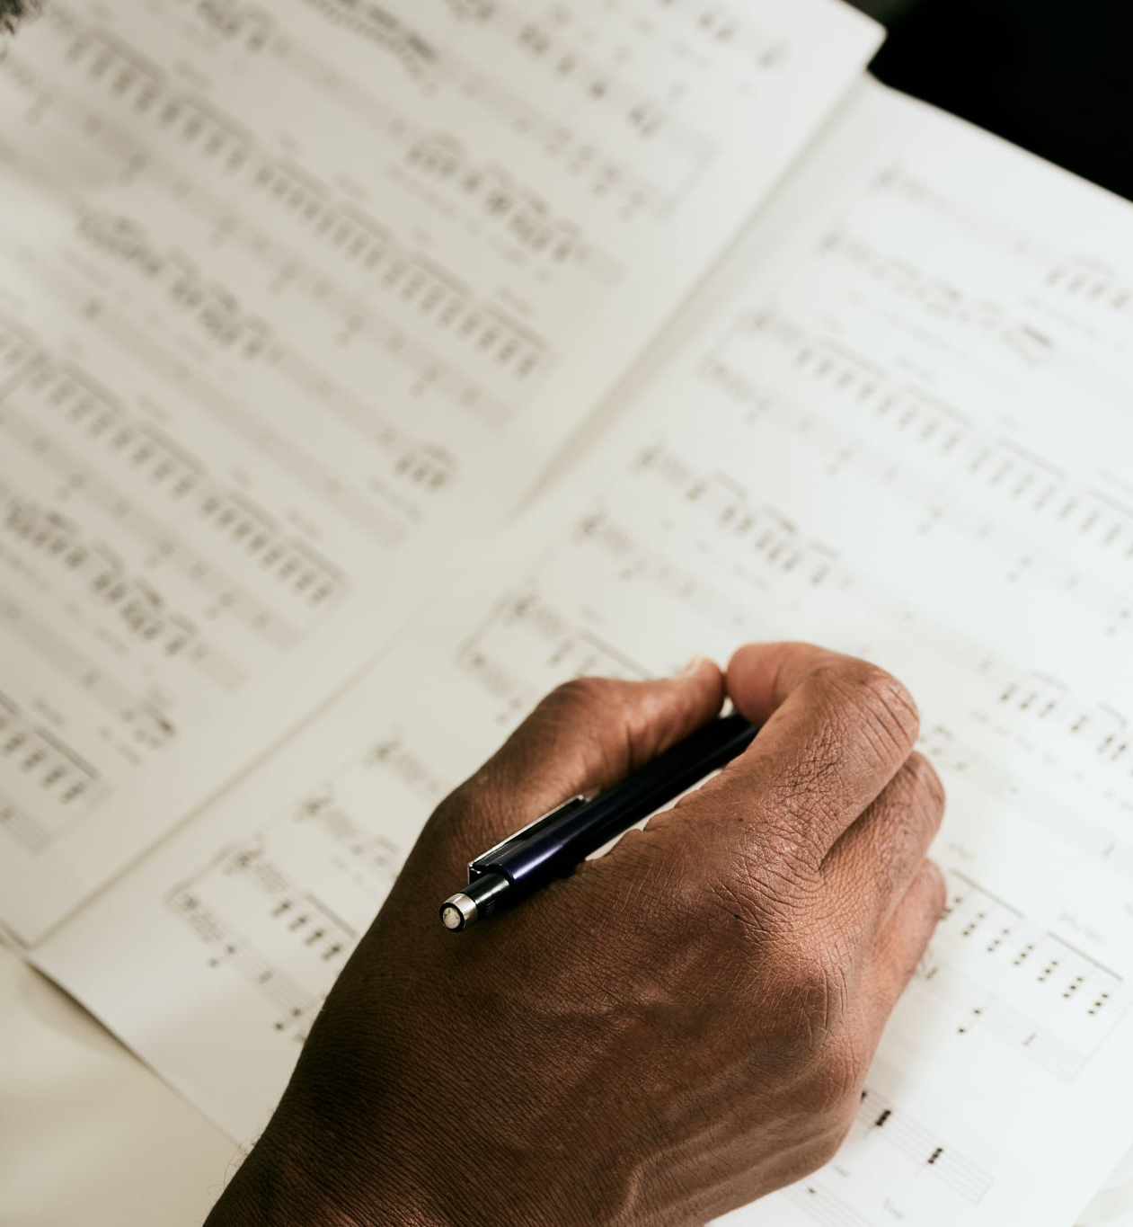
Sources
Lectures by:
Bishop Moussa
Bishop Pavly

