Slide 1

Influences on Child Development

Slide 2
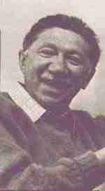
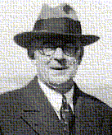
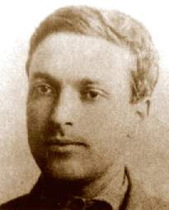
REVIEW TIME
Name the following mug shots and what their theory was
1 is missing because we need to talk about him

Slide 3
100 points if
You can remember the name of the coming mug shot…

Slide 4

Wanted for Spreading Development Theories
If found do not approach
Suspect may be…
Well…kinda dead

Slide 5
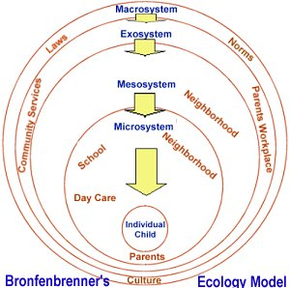
Influences
Influences come from all manners of the child’s life (Bronfenbrenner)
  And the child influences these manners right back

Slide 6
If you’ve heard this (or some form of it) stand up
Children are always on their phones
Video games cause violence
You should read more books
Children today have too much screen time
Technology is dangerous
Where’s my hot chocolate?
(seriously, where is it?)

Slide 7
Sure theories exist
This is an interesting time
There are many influences on children’s development
  Contrary to popular belief not all are bad
  Anyone care to name a few influences?

Slide 8
Let’s explore a few
Media is one of the biggest influences
We’re going to play a game it’s called name that sign
  I’m going to flash up a few pictures, tell me what you see

Slide 9


Slide 10


Slide 11


Slide 12


Slide 13


Slide 14


Slide 15


Slide 16


Slide 17
Hmm wondering...
You can say that you don’t see the other symbols/signs often
Is that not a reflection of the world we live in?

Slide 18

So what to do?
What can you do? Should we shut all this out?
Let me know how that goes for you...

Slide 19

It’s a tool
This hammer, like technology, can either build up a house or tear it down...
Use it wisely!

Slide 20
Just watch what you use
Media can mean many things when it’s shown
They can help push your beliefs forward, or enforce a stereotype against them

Slide 21
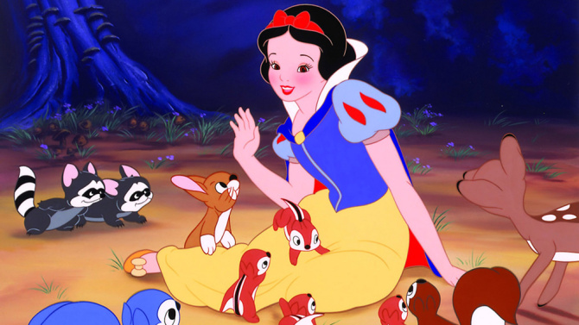
What do these photos say?

Slide 22
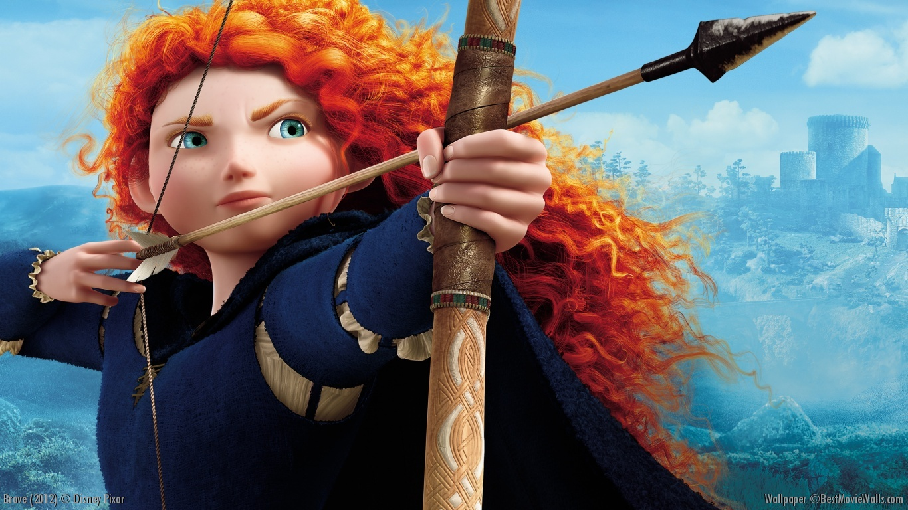

Slide 23
The same goes for Sunday School
There is a clear stereotype that exists on what it means to be Christian
  We can play the blame game all day on who’s fault but it is still there
What will you do?
  Bow to it pretend it doesn’t exist?
  Stand like a stiff tree and risk falling over by being firm?
  Push back by dissecting it properly?

Slide 24

Here’s what you fight against in Christianity

Slide 25
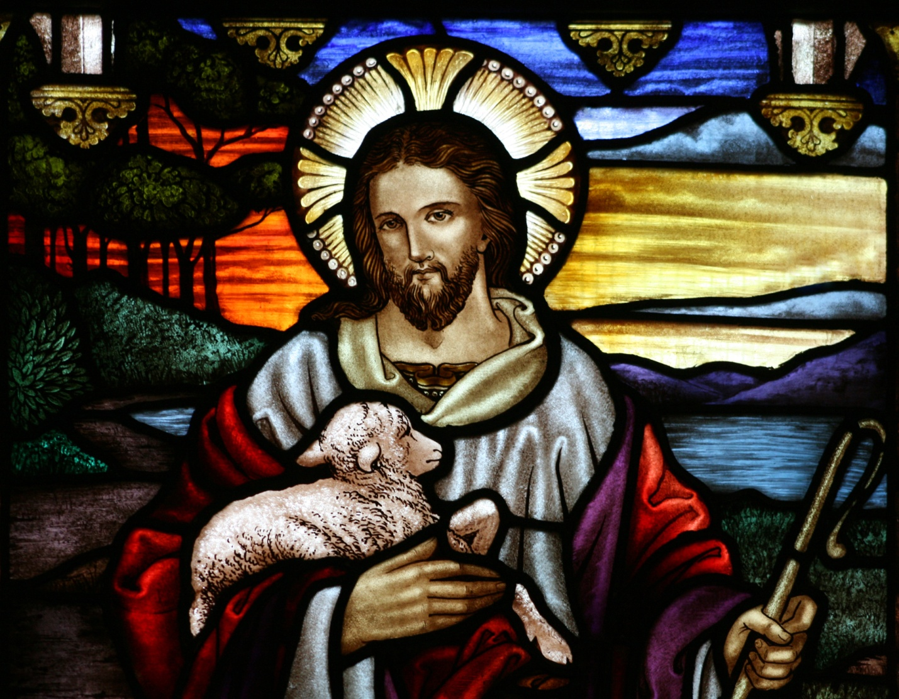
Let Children See this

Slide 26
Your children have interests
Your job is to take their interests and work with them to get your points authentically across
E.g. Anyone heard of game Nier Automata?
Not a magic formula, know what you want as a final message and work backwards to achieve it

Slide 27
True Christian themed Resources EXIST!
Just go looking!
Notes:
https://www.youtube.com/watch?v=MEEpavnk7Uw

Slide 28
And Now…
Go Out There And Be Amazing

