Slide 1
Children’s Development

Slide 2

Quick Intro Video
Notes:
https://www.youtube.com/watch?v=5JrtpCM4yMM

Slide 3
So what?
So having seen the video what do you get out of it?
(children see and they do what their role models show, being us)
How is this relevant to you as Sunday school teachers?

Slide 4
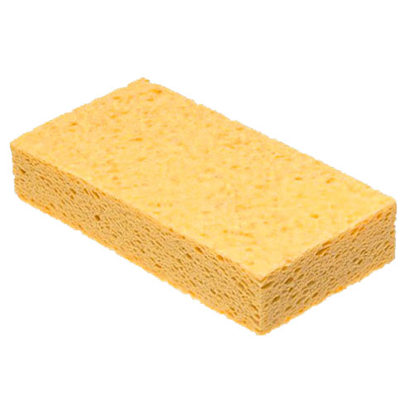
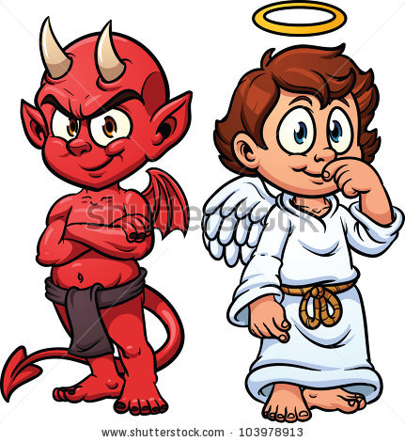
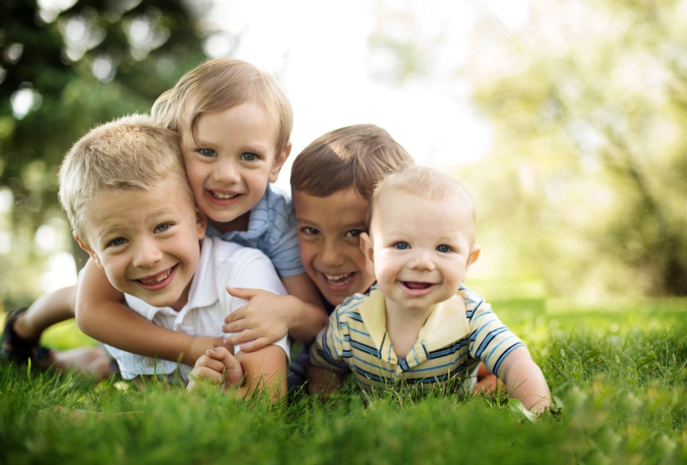
What is your view of the child?

Slide 5
Why are you here?
There are many reasons to want to teach children but before you can understand their development you must know your feelings first
Are you here because...
  You want to help children learn about God?
  You want to learn how to be a teacher for your future career?
  You are experimenting?
  You’re parents forced you to be here and right now you are making your weekend plans rather than listening...

Slide 6


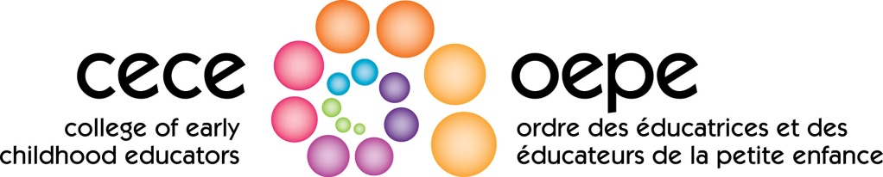
Each reason will give different results
No matter your reason there is always someone watching your every move with children

Slide 7
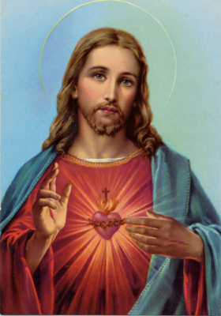
This would be your supervisor

Slide 8
It’s true
You might think you are ‘only’ a Sunday School teacher but you are more than that...
You might be the main point of contact between children and God. You’re job is to understand the children in order to give them a chance to know God
How can you teach about God in a true and authentic way if you don’t know how children develop? How will they remember what you said?
We’ll come back to view of the child later for now...let’s jump in...
  Today we’ll be talking mostly theories
  Next time we’ll be looking more at practical applications

Slide 9
So many theories...
We could talk about this for days...let’s look at a quick few highlights
Developmental theories
  Ages and stages (children learn as they age)
  Psychosocial (combination of mental and social development)
  Behavioural (everything can be taught...what you may have gotten in school)
  Ecological (the children’s environment)
  Cognitive (children learn through many avenues in the mind)

Slide 10
Ages and Stages
Briefly: Arnold Gessell developed developmental profiles
As a child ages they gain new skills that can be broken down into three domains
  Physical
  Motor
  Cognitive
  Social
The current school system is partly derived from this style of teaching
This style has some relevancy but children are rarely this cut and dry (essentially we can judge a child based on the date they were manufactured...)

Slide 11
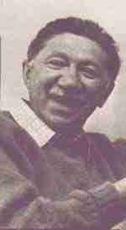
Psychosocial
Abraham Maslow...created the Hierarchy of Needs

Slide 12
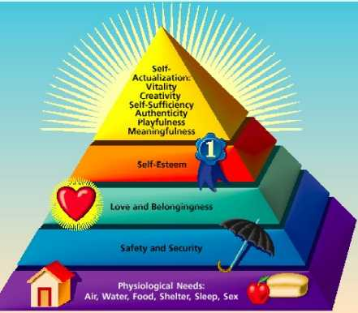

Slide 13
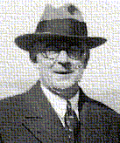
Behavioural
Anything can be taught through repetition (skills through drills)
The older school system tends to also use this method of teaching
John Watson and Little Albert
11 months old and made him afraid
of rabbits and fury creatures
through stimuli
Notes:
Would bang a gong every time a small rabbit was near him, would cause the child to cry. By the end of it Albert was afraid of everything that was furry

Slide 14
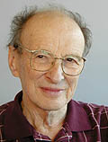
Ecological
Children influence and are influenced by their environment
Urie Bronfenbrenner

Slide 15
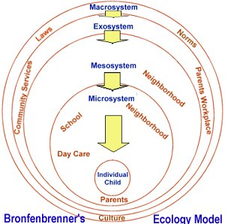
Bronfenbrenner’s spheres of influence

Slide 16
Each Sphere
Microsystem: things in direct contact with the child like school, or parents
Mesosystem: the middle and the interaction of the microsystem to the exosystem (e.g. How involved are the parents with the child’s school?)
Exosystem: Indirectly affect the child (e.g. Parent gets a promotion and must move due to work, indirectly will affect the child)
Macrosystem: Large scale out of child’s direct control (e.g. Child lives in a country full of war)
Systems influence the child and child influences the systems

Slide 17
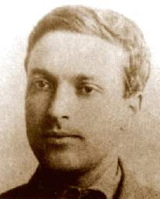
Cognitive
Children learn through interactions of the mind.
Lev Vygotsky, took it a step forward and added a social aspect
Created the theory of Zone of Proximal Development (ZPD)

Slide 18
Zone of Proximal Development
Create learning through scaffolding
Child is at a point of learning and through social interactions of peer-to-peer and child-to-teacher is able to move up to next point of learning through active engagement
Learning must be done in a way that encourages hands on learning and multiple avenues of understanding (memorization alone is not good enough)
If learning is not done properly ZPD will collapse and child will be set back
School systems have started using this system

Slide 19
Example
Orange

Slide 20
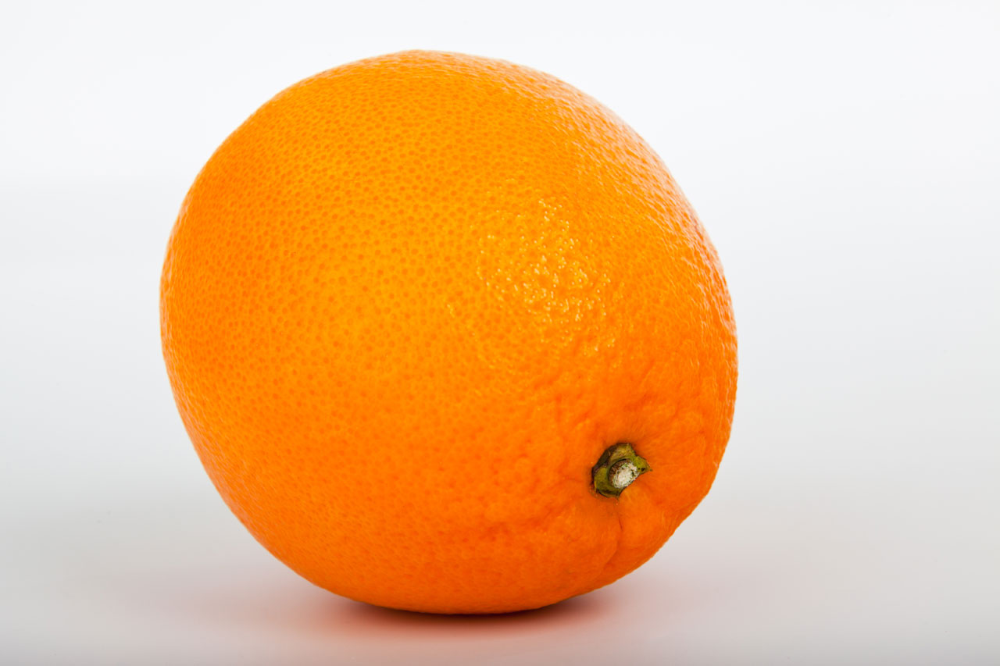
Describe an Orange
Only using the picture (no drawing on prior knowledge)

Slide 21
Describe an Orange
Using a real orange, describe it
A strong ZPD is done through more than just pictures or memorization
A VERY strong ZPD is done through social interactions with others

Slide 22
Have I put you to sleep yet?
Turn and talk to an elbow partner
Which theory do you like and identify with the most? Why is that?
I’m going to ask you to share openly next...

Slide 23

How is this relevant?
Why am I telling you this?
How would you use the theory you identify with in your Sunday School teaching?

Slide 24
Thanks for listening! I’ll be seeing you all again!

