Slide 1
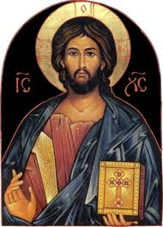
The Holy Traditions
Notes:
Today we discuss a very important topic in the Orthodox faith- the topic of the Holy Tradition- it’s a big reason of how the orthodox faith has remained the same- unchanged and untainted- since the time of Christ.

Slide 2
Outline
The foundation of Christian teaching
Definition of The Holy Tradition
Holy Tradition
Examples
The Timelessness of Holy Tradition
Holy Tradition in the 21st century

Slide 3
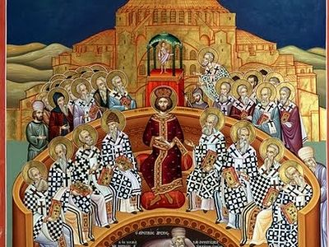
The Christian Teachings
3 important sources:
  The Holy Scriptures (written)
  The Holy Tradition of the church (verbal)
  The Ecumenical councils
These 3 sources must be consistent so that the Christian ecclesiastical teaching may be truthful
Notes:
First, we will talk about what comprises Christian teaching because it’s important in our conversation about tradition and we’ll understand why throughout the presentation.
Christian teaching is based on 3 important sources- the scriptures, the holy tradition of the church and the ecumenical councils.
All are important- we can’t have one without the other and they all must be consistent with one another so that the Christian ecclesiastical teaching may be truthful.
We’re going to talk about the relationship between the 3 and why they’re all necessary throughout the presentation but we’re going to talk about Tradition next.

Slide 4

What does tradition mean to you?
Notes:
When you think of tradition, what comes to mind?

Slide 5

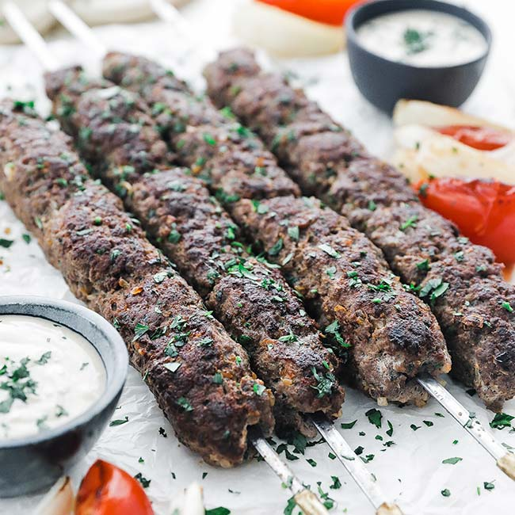
Big T and little t ”tradition”
Thoughts?
Notes:
Today we are talking about Big T tradition, not little t tradition

Slide 6
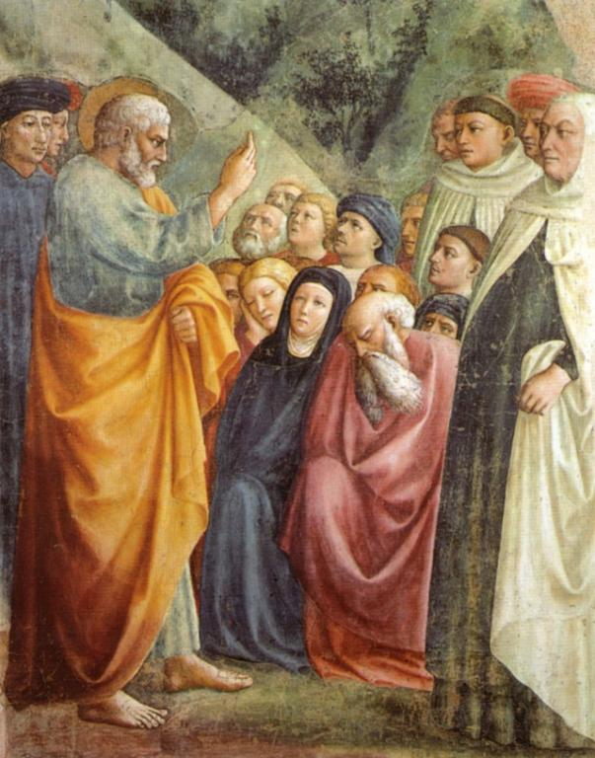
Tradition: A Definition
Translation from the Greek word Paradosis, which means: “Something that is handed on from one person to another”
  Websters dictionary: “Tradition is the handing down orally of customs, beliefs, stories, etc… from generation to generation”
Western view of tradition= blind obedience, mechanical transferring of information without modification
Orthodox view of tradition= the handing over of the inner life- faith in Christ-from generation to generation- unchanged, untainted
Notes:
Tradition is translated from the Greek word paradosis, which literally means something that is handed on from one person to another, in the same way that a baton is handed over in a relay race. Something that is ‘traditioned’ is passed on from one person or group of people to another. It’s the handing over of the orally*
The western view of tradition sees tradition as blind obedience, or mere mechanical and barren transfer of information without modification (modernization). The orthodox view of tradition is much different- it’s the handing over of the inner life- the life of our faith in Christ- from generation to generation, remaining unchanged and untainted!

Slide 7
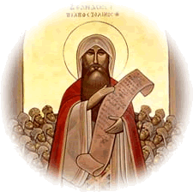
St Athanasius on Holy Tradition
“Beyond these things, let us look at the very tradition teaching and faith of the catholic (universal) church from the very beginning which these three aspects are essential: That which the lord gave, The apostles preached, The fathers kept; Upon this the church is founded and he who shall fall away from it shall not be a Christian and shall no longer be so called.”
Notes:
St Athanasius in his letter to st. serapion gives a textbook definition of tradition: He says “beyond these things let us look at the very tradition teaching and faith of the catholic (universal) church from the very beginning which these three aspects are essential: That which the lord gave, The apostles preached, The fathers kept. Upon this the church is founded and he who shall fall away from it shall not be a Christian and shall no longer be so called.
So when we talk about Holy Tradition, this is what we are exactly talking about
We have the same faith today as we did since Christ taught his disciples. How do we know that? We’ll talk about that in a little bit!

Slide 8
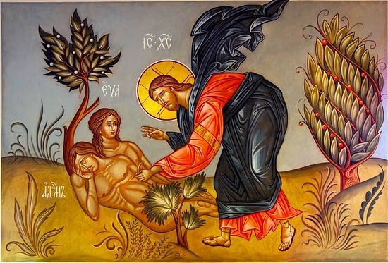
1) Tradition: Before the Written Law
Years Between Adam & Eve and Moses= ~2000 years
Between this time, all of creation lived a life that depended on verbal tradition as the only source regarding its knowledge of God and His commandments
God delivered it to Adam→ delivered it to his descendants→ who delivered it to their descendants
  Faithful men and women (Abel, Abraham, Sarah, Isaac, Rebecca, Jacob, Rachel ect..) passed down the faith via oral tradition
Verbal tradition lasted many years
Notes:
From the beginning, the whole creation lived a life that depended on the verbal tradition in regards to its knowledge of God and His commandments— theres about 2000 years between creation and the written law
Adam, our father, received it and delivered it to his descendants from generation to generation.
How did Abel learn of the idea of the altar and the sacrifice that he offered as an acceptable offering to God? He had no written law. Doubtlessly, he learned it from Adam his father.
Adam received the idea from God Himself. Before the law there were heroes of the faith like Abraham, Isaac, Jacob, Joseph and others. Whence they had such a strong faith? They had no written law, but they received this life from God Himself and delivered it to the next generations
Likewise, they learned of the altar. Abraham used to build a tent and an altar. The altar and the sacrifice indicate their faith in redemption as the only path to salvation. All these generations awaited the coming of Christ the Savior. He saves His people from their sins through the great redemption.
Why was the written law needed then? Because of human corruption and the depravity of the human spirit- the effect of verbal tradition grew weaker and thus the written law was necessary to clarify the characteristics of the divine law that is engraved in mankind

Slide 9
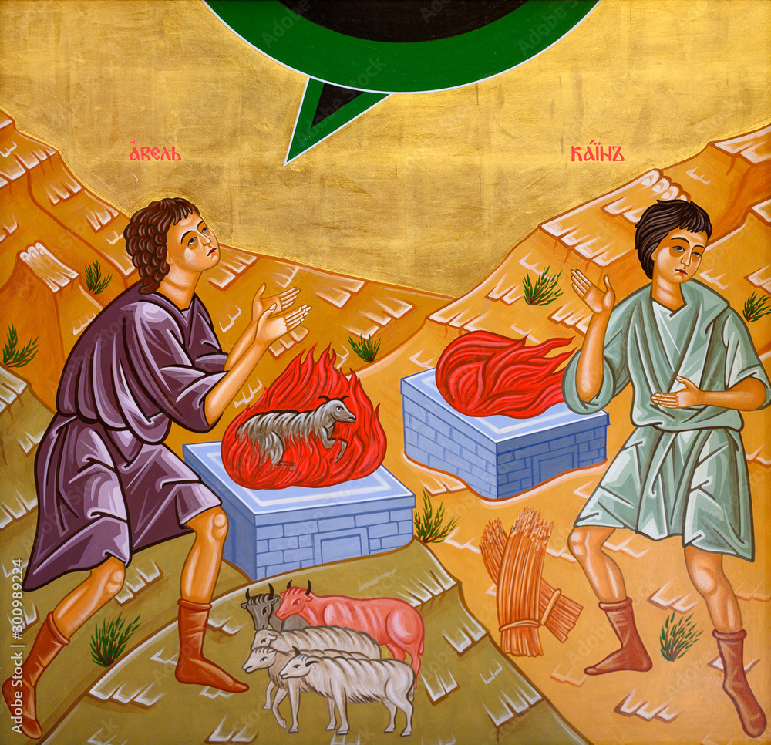
Examples
“And Abel also brought an offering—fat portions from some of the firstborn of his flock. The Lord looked with favor on Abel and his offering (Genesis 4:4)
God gave Abraham the commandment of circumcision and it spread by Holy Tradition throughout the generations (Genesis 17: 9-14)
Joseph knew adultery was “great wickedness” long before it was written in the commandments (Genesis 39:7-10)
Notes:
(Gen 4:4) It is mentioned that Abel offered to God a sacrifice from his best sheep and St. Paul said, “By faith Abel offered to God a more excellent sacrifice than Cain.” (Heb 11:6) Now Abel lived 14 centuries before the written commandments. So, where did he get that faith? How did he learn about offering animal sacrifices? Surely from his father Adam who received it from God Himself. (Gen 3:21)
(Gen 17:9-14) God gave our father Abraham the commandment of circumcision and it spread by Holy Tradition from generation to the next.
(Gen 39:7-10) Joseph the Righteous knew that adultery was ‘a great wickedness’ through Holy Tradition long before Moses the Prophet wrote the seventh commandment.

Slide 10
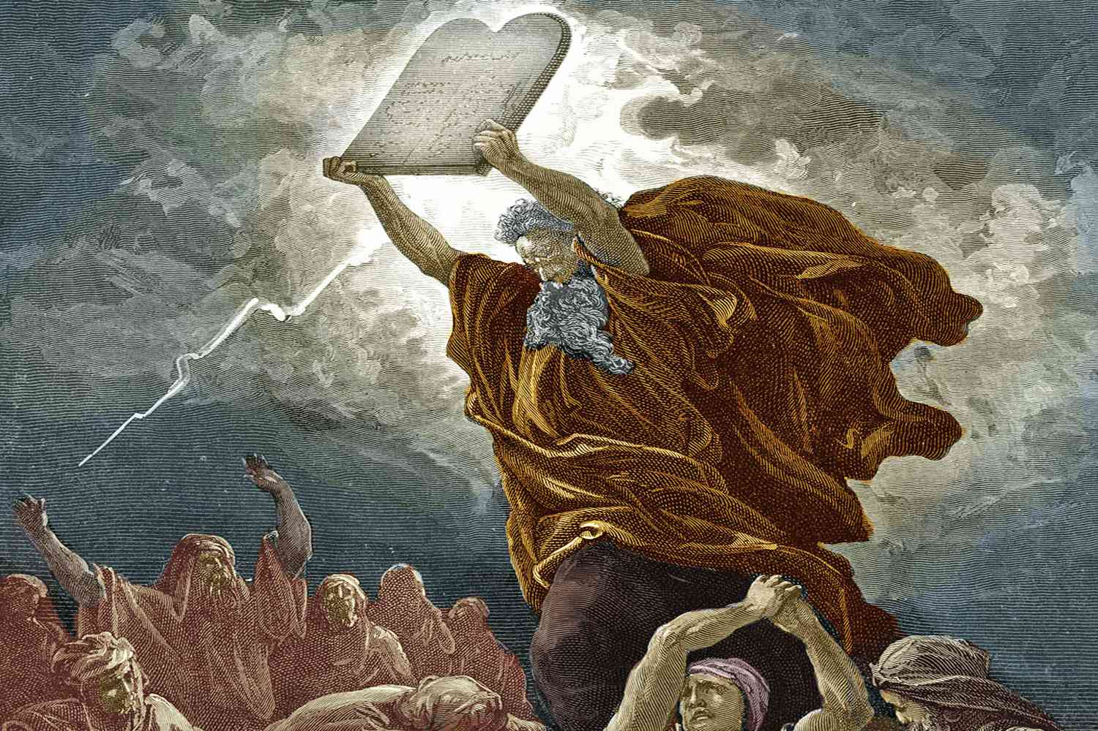
Why was Written Law Needed?
The effect of verbal tradition grew weaker due to human corruption
Written law necessary to clarify the characteristics of the natural divine law engraved in the hearts of mankind
Did the tradition stop once the written law came?
  No!
  Many incidents are mentioned in the NT while they aren’t in the OT- they were taken from tradition
Notes:
Why was the written law needed then? Because of human corruption and the depravity of the human spirit- the effect of verbal tradition grew weaker and thus the written law was necessary to clarify the characteristics of the divine law that is engraved in mankind
The important question now is: did the tradition cease when the law was given? No, it did not. The proof is that many incidents are mentioned in the New Testament while they are not mentioned in the Old Testament. Hence, they were taken from tradition.

Slide 11
Examples
“and he went and lived in a town called Nazareth. So was fulfilled what was said through the prophets, that he would be called a Nazarene.” (Matthew 2:23)
“The sight was so terrifying that Moses said, “I am trembling with fear.” (Hebrews 12:21)
Many others not mentioned
Notes:
“(Mt 2:23) St. Matthew quoted a prophecy about our Lord Jesus Christ that was not written in any of The Old Testament Holy Books but was transmitted from one generation to the other through Holy Tradition.
(Heb 12:21) St. Paul described how the people received the Law and how the mountain was blazing with fire. Then he wrote, “Moses said, I am exceedingly afraid and trembling”. These words ascribed to Moses the Prophet are not mentioned in the Old Testament.

Slide 12
2) Tradition: Preaching of Christ
Christ chose His disciples- who followed Him intimately and learned from Him
“ The time is fulfilled, and the kingdom of God is at hand. Repent and believe in the gospel” (Mark 1:15)
  No written gospel at the time, so what was the gospel?
  His verbal teachings
“In as much as many have taken in hand to set in order a narrative of those things which have been fulfilled among us, just as those from the beginning were eyewitnesses and ministers of the word delivered them to us, it seemed good to me also, having had perfect understanding of all things from the very first, to write to you an orderly account, most excellent Theophilus..” (Luke 1:1-3)
Notes:
In Galilee, the Lord Christ was preaching the gospel saying: “The time is fulfilled, and the kingdom of God is at hand. Repent and believe in the gospel.” Mk 1:15.
What gospel was that? Was it not His verbal preaching and teaching? Our Lord Jesus Christ did not write a book, He did not document His blessed teachings on paper, but He chose His disciples who accompanied Him day and night. They absorbed His teachings and learned directly from Him.
St. Luke begins his gospel: “In as much as many have taken in hand to set in order a narrative of those things which have been fulfilled among us, just as those from the beginning were eyewitnesses and ministers of the word delivered them to us, it seemed good to me also, having had perfect understanding of all things from the very first, to write to you an orderly account, most excellent Theophilus..”
=Lk. 1:1-3. Then, St. Luke received, followed, and wrote the Gospel being inspired by the Holy Spirit

Slide 13
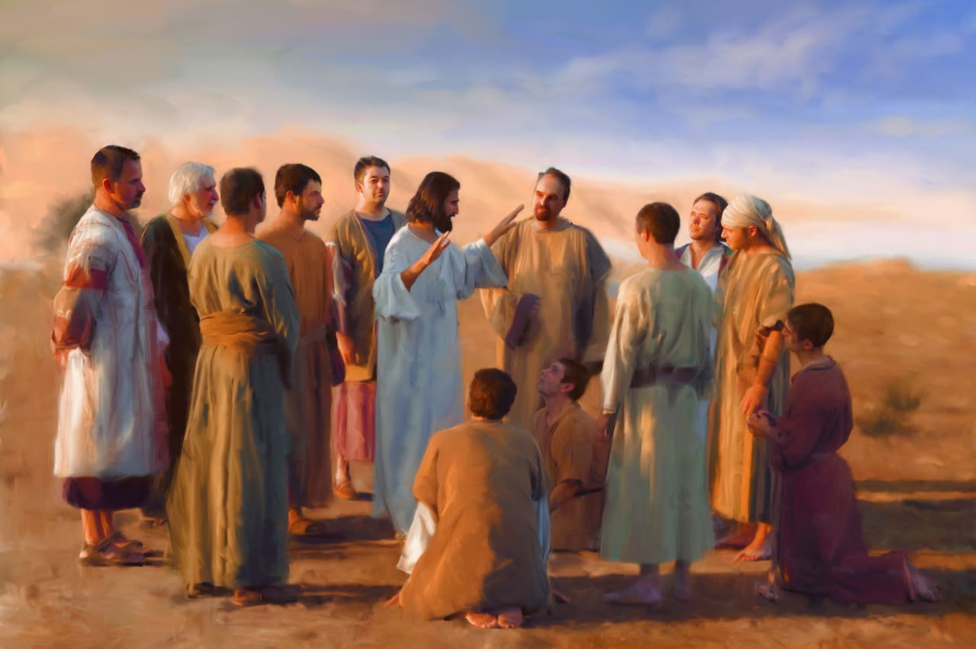
The Lord delivered the Christian life to His disciples and said: Go therefore and make disciples of all the nations, baptize them in the name of the Father, and the Son and the Holy Spirit, teaching them to observe all things that I have commanded you (Matthew 28:19-20)
Making disciples= based on direct contact and verbal teaching
Notes:
After the Lord Jesus delivered the Christian new life to His disciples, He said to them: “Go therefore and make disciples of all the nations, baptize them in the name of the Father, and the Son and the Holy Spirit, teaching them to observe all things that I have commanded you.” Mat. 28:19-20. Thus, Making disciples is based primarily on direct contact with the person and on verbal teaching:

Slide 14
3) Tradition: Preaching of the Apostles
The Apostles revealed that one of the sources of authority of their apostleship was the Holy Tradition they received from Christ
  That which was from the beginning, which we have heard, which we have seen with our eyes which we have looked upon and touched with our hands, concerning the word of life” (1Jn 1:1).
Their purpose- verbal handing over of the faith, the new way of life, from generation to generation
What was the purpose of the writing gospels?
  Keep records of the big things overtime- not everything is written- ”And there are also many other things which Jesus did, the which, if they should be written every one, I suppose that even the world itself could not contain the books that should be written. Amen” (John 21:25)
  All the apostles taught verbally, some wrote things down
Notes:
The holy apostles received the Christian life, being the love of God and the enjoyment of the richness of His abundant grace, through the work of the Holy Trinity in their lives. They used the same principle in their preaching. They went out and were filled with the Holy Spirit: “Their sound went into all the earth, and their words unto the ends of the world.” Rom. 10:18.
The Apostles revealed that one of the sources of the authority of their apostleship was the Holy Tradition they had received through their discipleship to our Lord Jesus Christ. They were eyewitnesses to the events of His life and His saving deeds. · St. John states, “That which was from the beginning, which we have heard, which we have seen with our eyes which we have looked upon and touched with our hands, concerning the word of life” (1Jn 1:1). In his Holy Gospel he says, “He who saw it has borne witness.” (Jn 19:35) · St. Peter talked about the Transfiguration of our Lord Jesus Christ (Mt 17) saying; “We heard this voice which came from heaven when we were with Him on the holy mountain.” (2Pet 1:18) · St. Luke pointed out that “those who from the beginning were eyewitnesses and ministers of the word” (Lk 1:2) delivered to him the accounts of the events of our Lord’s life. ·

Slide 15
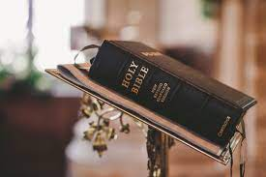
Isn’t the Bible enough?
Sola Scriptura= Scripture alone (held by many protestant denominations)
It’s essential, however, Holy Tradition is necessary
Why?
  What is the source of scripture?
  Scripture is a function of Holy Tradition
Notes:
Recap on Christian teachings- what are the 3 important sources?
Scripture
Holy tradition
Ecumenical councils
Isnt the bible enough?
Because sometimes people will say “well it’s not written in the bible, so its not part of Christian teaching” ie. Facing the east during prayer is not in the bible, signing the cross is not in the bible, praying the liturgy like we do is not written in the bible” but we say its part of Tradition- so whats more important?
- The source of scripture is tradition! The church! Tradition predates scripture- scripture is a function of holy tradition

Slide 16
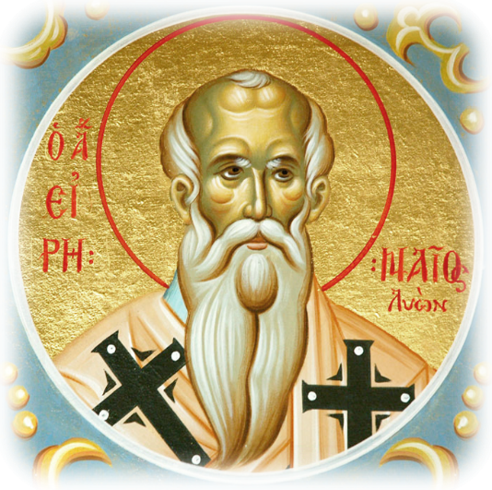
Role of the Early Church Fathers
Heresies started coming out in the 1st and 2nd century
Apostolic fathers defended the faith in their writings against heretics
  St. Irenaeus of Lyons- against heresies (Gnosticism)
Ecumenical councils were called and created the dogma and rituals we have today in response to heresies
Notes:
St. Iraneus of lyons- against heresies
Wrote it against Gnosticism in the 2nd century
He says that those who were Gnostics would come, take the same scripture, imagine scripture is like a mosaic, the pieces of the mosaic are taken apart and then reconstructed and form it in the image of a dog or a fox
He says this is what the herectics are done- that’s why its important to hold on to scripture and traditions of the church
A herectic would come out and say “XYZ” and the church would respond and say no its not XYZ its ABC- so these expressions of faith became dogmas and they were a reaction to a heretic
Church adapted to heresy by creating dogma, rituals, liturgies and things got more complex than in the early church (ie liturgical calendar, church building and shape (cross, star, circle, arch ect)

Slide 17
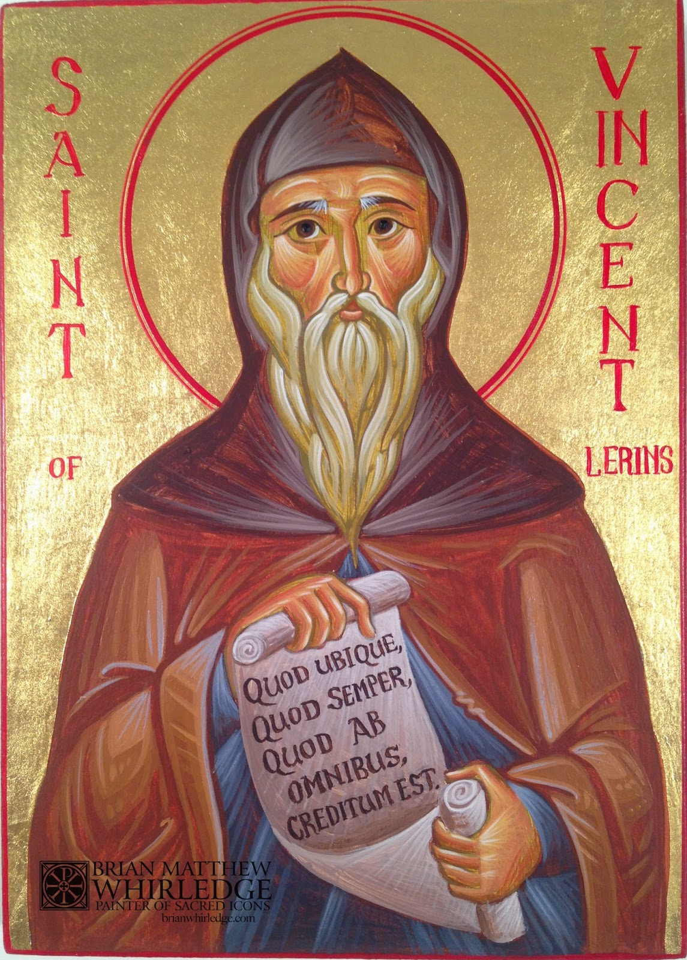
St. Vincent of Lerins
  But here some one perhaps will ask, Since the canon of Scripture is complete, and sufficient of itself what need is there to join with it the authority of the Church's interpretation?
  For this reason—because, owing to the depth of Holy Scripture, all do not accept it in one and the same sense, but one understands its words in one way, another in another; so that it seems to be capable of as many interpretations as there are interpreters… Therefore, it is very necessary, on account of so great intricacies of such various error, that the rule for the right understanding of the prophets and apostles should be framed in accordance with the standard of Ecclesiastical and Catholic interpretation. Moreover, in the Catholic Church itself, all possible care must be taken, that we hold that faith which has been believed everywhere, always, by all.
Notes:
This is long, but basically he’s saying if 15 of us read the same thing we can interpret it 15 different ways- so how do we know how to interpret scripture as it was meant to be received by God? Today it’s very easy to interpret the gospel in a 21st century way- a way that’s is being preached by many cultures and denominations today, but we want it the orthodox way
He’s saying that it’s not enough for only one person to say it- it has to be preached everywhere always by all- its not sufficient for it to be preached only in Alexandria- it had to be preached everywhere.

Slide 18
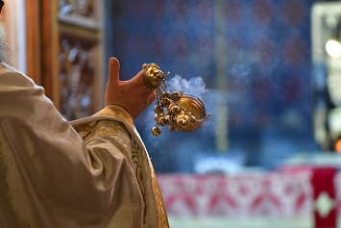
How do we know Holy Tradition has reached us unchanged?
The church has guarded the tradition strictly through the patriarchs, bishops, metropolitans
The apostolic teachings and sayings of the church fathers, who were direct disciples of the apostles
Historians of the early church- Eusebius- recorded details of the early church
Canons of the ecumenical councils
Liturgies and rituals of the church
Notes:
The church, through its leaders and teachers, greatly guarded the divine oracles which once were delivered to the saints. The patriarchs, the metropolitans, the bishops, the priests, and the deacons rejected every foreign teaching or idea that turned aside from the apostolic spirit, which they received from generation to generation.
The apostolic teachings and the sayings of the holy fathers of the church are greatly honoured. They record the teachings of the Lord Himself as He delivered them to His holy apostles. Also, the apostolic fathers of the first and the second century and the fathers of the third, fourth and fifth century.
The historians of the early church: The writings of the historians of the early church are valuable as a treasure. These historians, like Eusebius, were diligent to record the details of the life of the early church.
The canons of the ecumenical councils: These are the councils held in the first four centuries. The three ecumenical councils were held to refute some heresies and to investigate certain problems.
These Ecumenical Councils became instruments for formulating the dogmatic teachings of the Church- and unified the church
The liturgies and the rituals of the church: The Coptic Orthodox Church practices its prayers according to a definite system of rituals established by and received from the fathers of the church generation after generation. These liturgies and rituals kept for the church are a great and valuable treasure of the ecclesiastical tradition. For example, the divine liturgy of the Eucharist, the seven sacraments, the harmony of the readings with the church seasons, and its feasts which provide the believers with a rich spiritual meal and deep message to all.

Slide 19
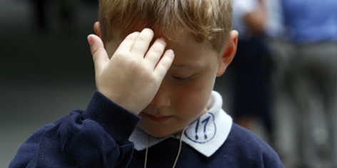
Examples of Holy Tradition and Rituals
Facing the east during prayer that we may remember that every man will give account of his deeds in the second coming of Christ, who will come from the east.
The sign of the cross, to receive a blessing from the holy cross and to cast out evil spirits which fear the sign of the cross
The sanctification of Sunday. Sunday is the new Sabbath that is rest for God and for man through the resurrection of the Lord of glory Jesus; His victory over death.
Fasting on Wednesday and Friday
The ritual of the funeral prayer

Slide 20
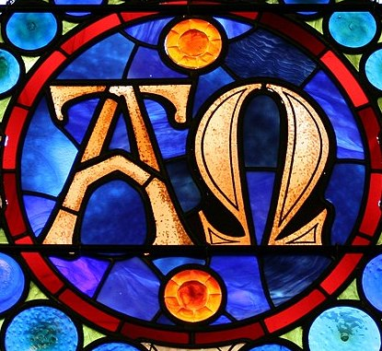
Timelessness of Holy Tradition
Holy Tradition lived in history and is beyond history- they have eternal value because Christ, the Founder of the Church, has no beginning and no end
Tradition= expresses the common Orthodox mind of the entire church against all heresies at all times
Tradition= gift of the Holy Spirit, a living experience that is renewed through time
Notes:
The Church and Her Tradition, although they live in history, are beyond history. They have eternal value, because Christ, the Founder of the Church, has no beginning and no end. In other words, when the universality of the Church Tradition is mentioned, it refers to the gift of the Holy Spirit, which enables the Church to preserve until the end of time the Apostolic truth unadulterated, unbroken, and unaltered. This is true because Tradition expresses the common Orthodox mind of the whole Church against all heresies and schisms of all times. In other words, Tradition is a gift of the Holy Spirit, a living experience, which is relived and renewed through time. It is the true faith, which is revealed by the Holy Spirit to the true people of God. Tradition, therefore, cannot be reduced to a mere enumeration of quotations from the Scriptures or from the Fathers. It is the fruit of the incarnation of the Word of God, His

Slide 21
Holy Tradition & 21st Century
Is Tradition Living or dead?
“The term traditional theology can also denote a dead theology if it means identifying traditionalism with simple repetition. Such a theology may prove to be incapable of recognizing the issues of its own age while it presents yesterdays arguments against new heresies”
John Meyendorff, living tradition
=Traditionalism is NOT simple repetition
Notes:
Dogma was created as a reaction to heresis- the church is constantly changing (look at what happened in Covid- some churches stopped using the spoon for communion, ect).
Tradition HAS to be alive- because the church is Christ and Christ is not dead!
Traditionalism is not repetition- it doesn’t mean imitate! It doesn’t mean copying someone in the past- tradition must be alive and flowing- if we use yesterdays solutions for todays problems, it may or may not be effective
Example: organ donation (modern topic of debate that was not presented in the past) some bishops will disagree with organ donation, some agree but it doesn’t matter what we all think- the church supposedly should council (like they did in the past with ecumenical councils) to decide because in the absence of guidance, heresies come about – Tradition needs to continue with the SAME SPIRIT*
When people think of tradition they think “conservative”
Someone may assume that “Tradition” means “Conservation” and “Solidification” as if any development in the life of the Church is forbidden. In our Orthodox point of view, Holy Tradition is the life of the Church throughout the history, which is guided and renewed by the Holy Spirit
Holy Church Tradition does not put the voice of the past in the place of the voice of the present; in it the past does not kill the present but gives it full force. Holy Tradition must be creative and at the same time conservative. There is no contradiction between these two elements but they are essential and are indispensable to each other. Holy Tradition cannot be conserved unless it continually matures. This maturation takes place on the shoulder of the past.
“Conservatism” and “Maturation” are two facets of the same process, which we call Holy Tradition

Slide 22
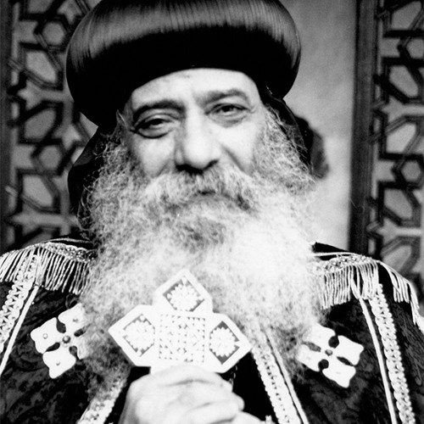
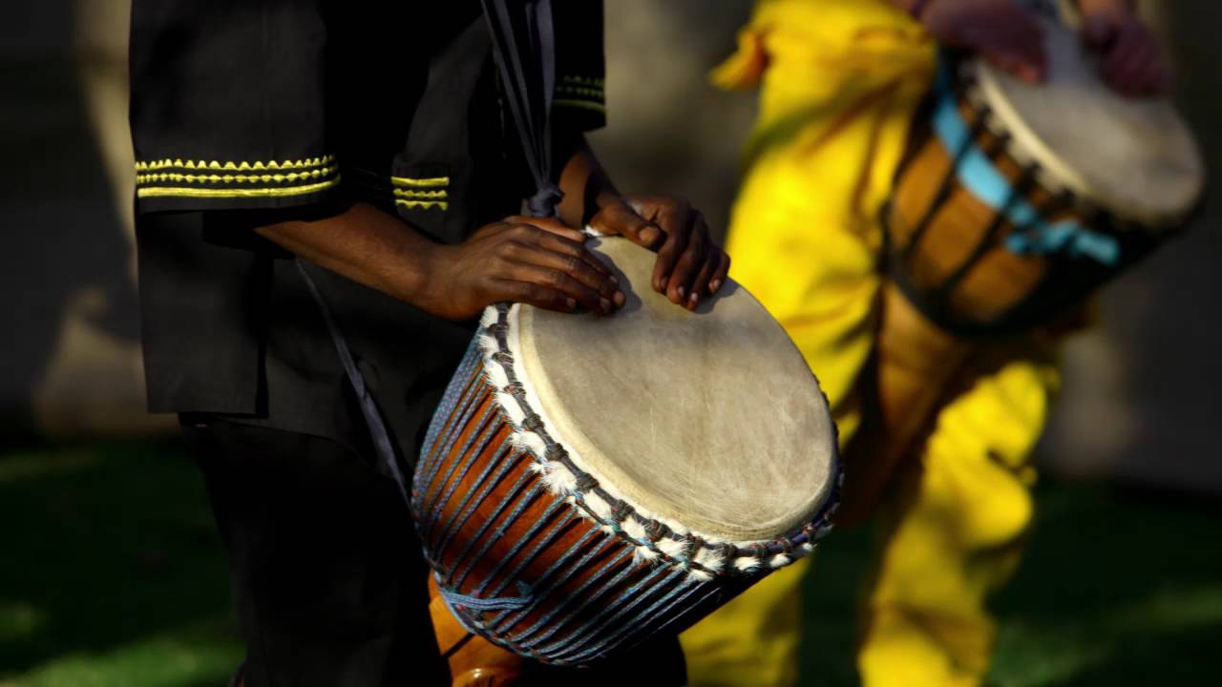
Holy Tradition is dynamic- it must be creative but also conservative
It cannot be conserved unless it matures- what does that mean?
  “Being traditional is imitating the fathers in their creative work and saving human beings from error”- John Myendorrf
  Examples
    Pope Shenouda III establishing Sunday school in Egypt via theological seminary
    Language- praying in different languages
    Music
Notes:
John myedonforff was a theologian in the orthodox church of America
Tradition does not change in its essences but its adapting to the environment
Example- when pope shenouda created Sunday school for the prupose of teaching people something about the faith- this was essential in Egypt in the 1950’s when there were very few resources- he reacted to a need
Missionaries in Africa- use the their culture and adapt it with Christian teachings- using their tribal songs and add Christian words to it- traditional and creative

Slide 23
Recap
The Christian teaching is based on Holy Scripture, Holy Tradition and Ecumenical Councils- all need to be consistent to ensure true ecclesiastical teaching
Holy Tradition is a living experience of the revelation of God and is orally and textually handed down through generations- its untainted in its essence and nature
Holy Tradition is alive- it must be creative and conservative while undergoing maturation in order to serve the people, the church

Slide 24
References
‘Comparative Theology’ by H.H. Pope Shenouda III
‘Tradition & Orthodoxy’ by Fr. Tadros Y. Malaty
Suscopts.org
Living Tradition- John Myendorff

