Slide 1
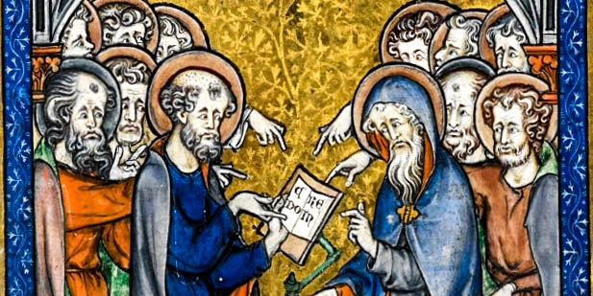
The Creed
The essence of our faith

Slide 2
Overview
Introduction
Analyzing the final addition to the Creed
The Holy Spirit
The Church
Baptism
The Life of the Coming Age
Conclusion
How to Approach Theology
How the Church Approached Theology

Slide 3
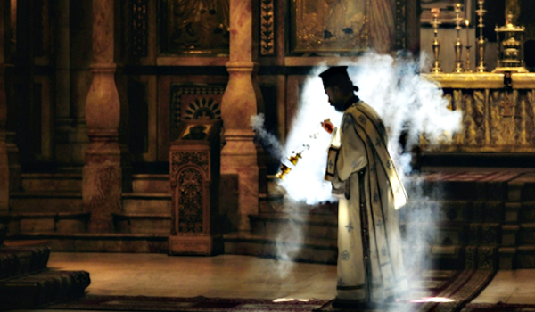
How to Approach Theology
“The secret things belong to the Lord our God, but those things which are revealed belong to us and to our children forever, that we may do all the words of this law.” – Deuteronomy 29:29
“We cannot explain what God is but candidly confess that we have not exact knowledge concerning Him. For in what concerns God, to confess our ignorance, is the best knowledge.” – St Cyril of Jerusalem
Introduction
Analysis
Conclusion

Slide 4
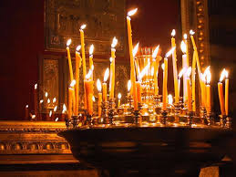
How to Approach Theology
“For only the power of God is great, and he is honored by the humble. You should not seek the things that are too high for you, and you should not examine the things that are beyond your ability. But as for the things that God has entrusted to you, consider these always. But you should not be curious in too many of His works.” – Wisdom of Sirach 3:21-22
Introduction
Analysis
Conclusion

Slide 5
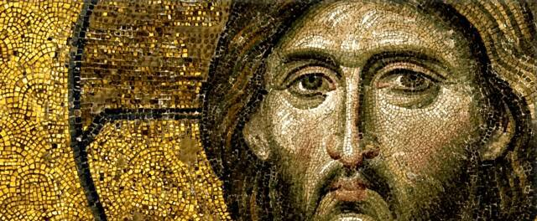
How does the church approach the knowledge of the divine and defining the faith?
Introduction
Analysis
Conclusion

Slide 6
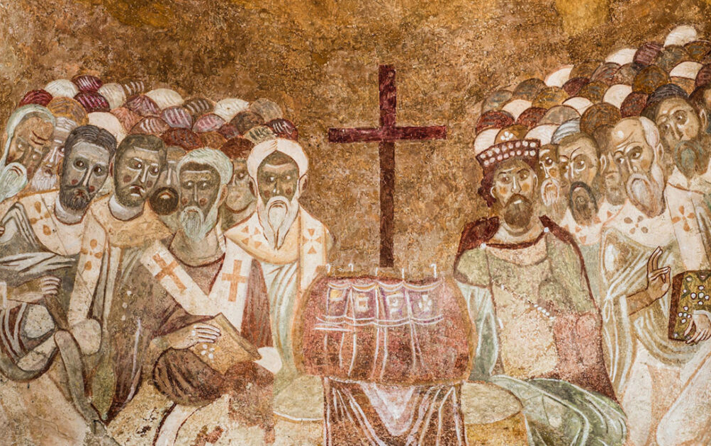

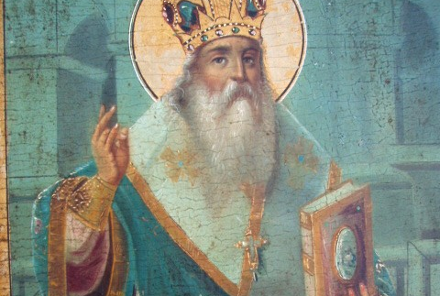
Review of the Nicene Creed and the issues it addressed
Introduction
Analysis
Conclusion

Slide 7
The Nicene Creed (325)
We believe in one God, the Father almighty, maker of all things visible and invisible.
And in one Lord, Jesus Christ, the Son of God, begotten of the Father, only-begotten, that is, from the substance of the Father, God from God, light from light, true God from true God, begotten not made, of one substance with the Father, by Whom all things were made, in heaven and on earth, Who because of us men and our salvation came down, became incarnate, became man, suffered, and rose again on the third day, and ascended into the heavens, and will come to judge the living and the dead.
And in the Holy Spirit.
But as for those who say, there was when He was not, and, before being born He was not, and that He came into existence out of nothing, or who assert that the Son of God is of a different hypostasis or substance, or created, or is subject to alteration or change – these the Catholic and apostolic Church anathematizes.

Slide 8
“Pneumatomachians”—“those who fight against the Spirit” (or Macedonianism)

Slide 9
The Nicene-Constantinopolitan Creed (381)
We believe in one God, the Father almighty, maker of heaven and earth, and all things visible and invisible.
We believe in one Lord, Jesus Christ, the only-begotten Son of God, begotten of the Father before all ages, light of light, true God of true God, begotten not made of one substance with the Father, by Whom all things were made; Who because for us men and our salvation, came down from heaven, and was incarnate of the Holy Spirit and of the virgin Mary, and became man; He was crucified for us under Pontius Pilate, and suffered and was buried, and the third day He rose again, according to the scriptures, and ascended into the heavens, and sits at the right hand of the Father; from there he shall come again, with glory, to judge the living and the dead; whose kingdom shall have no end.
We believe in the Holy Spirit, the Lord and Giver of life, who proceeds from the Father, who with the Father and the Son together is worshiped and glorified, who spoke by the prophets. And in one holy catholic and apostolic church; we confess one baptism for the remission of sins; we look for the resurrection of the dead, and the life of the age to come. Amen.

Slide 10

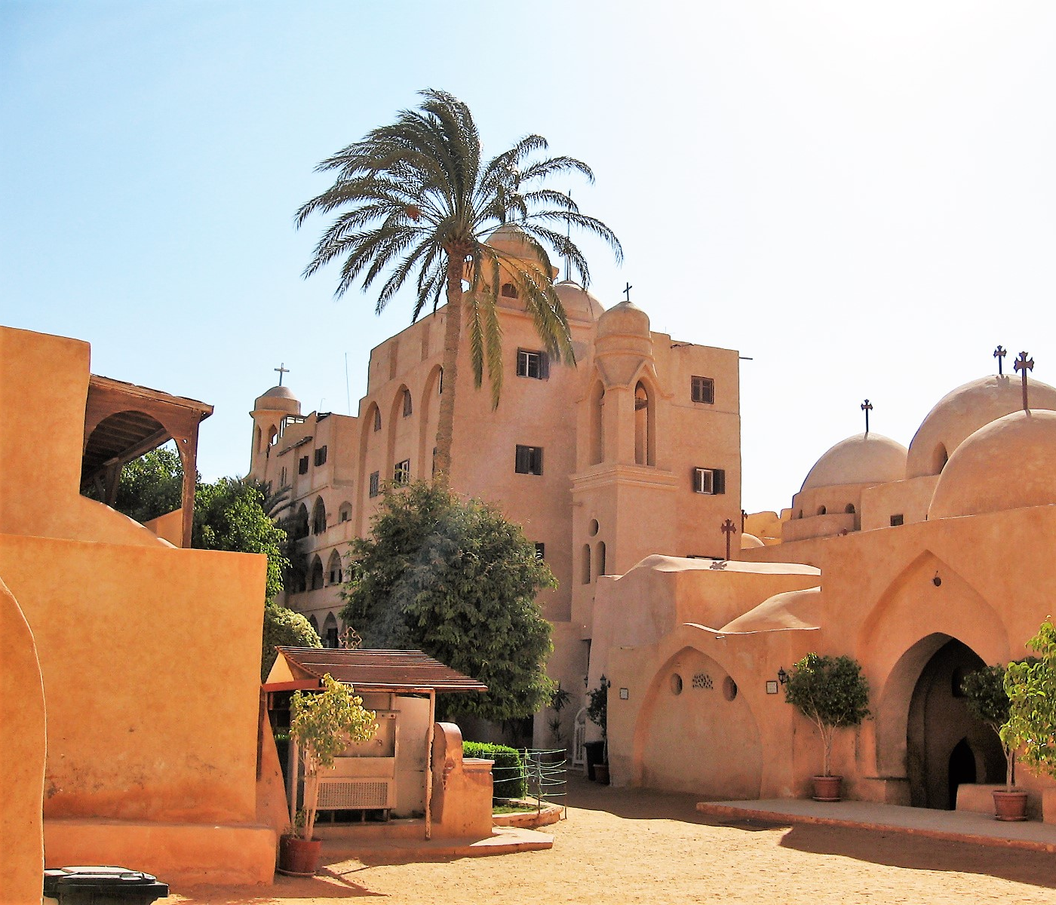
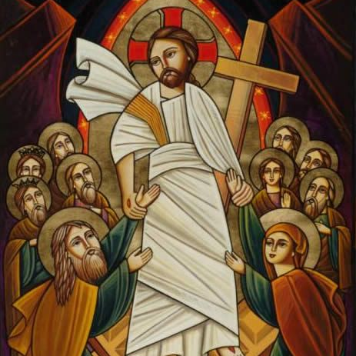
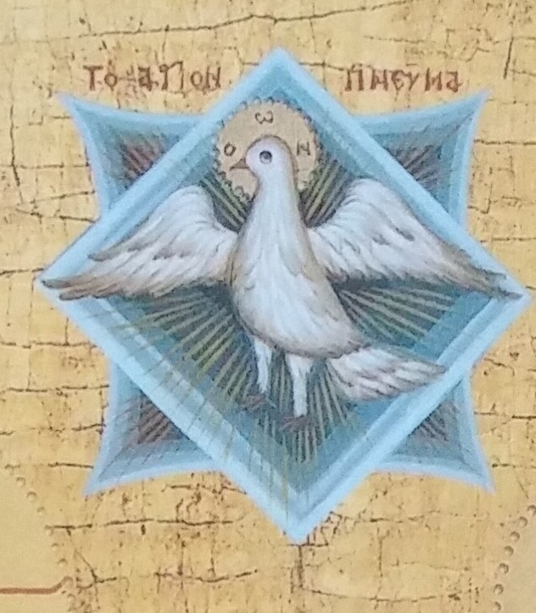
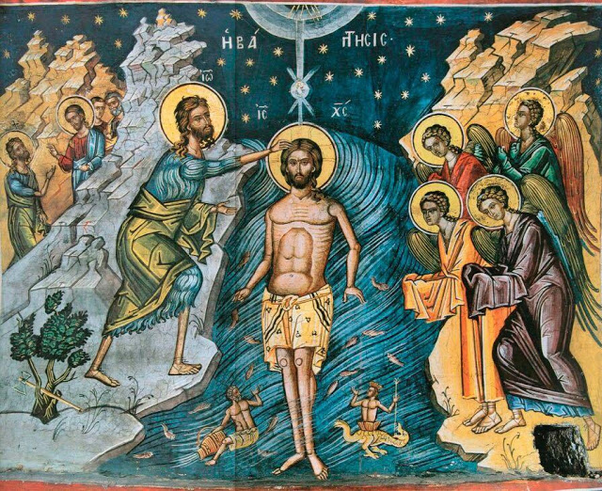
Main focus of the additions in the Nicene-Constantinopolitan Creed
The Divinity of the Holy Spirit (Belief in the Holy Spirit)
The Church
Baptism
Resurrection of the dead and the life of the coming age
Introduction
Analysis
Conclusion

Slide 11
“We believe in” the Holy Spirit
The third hypostasis of the Trinity (hypostasis?)
  Father (Being/Existing)
  Son (Logos)
  Spirit (Giver of Life)
“Therefore go and make disciples of all nations, baptizing them in the name of the Father, the Son, and the Holy Spirit…” Matthew 28:19
Analysis
1/5
Holy Spirit
Church
Baptism
Coming Age

Slide 12
The Holy Spirit, “The Lord the Giver of life”
The Divinity of the Holy Spirit:
  The Lord
    “Now the Lord is the Spirit; and where the Spirit of the Lord is, there is liberty.” 2 Corinthians 3:17
    Biblical weight
    Acts 5:3,4
  The Giver of life
    Life can only come from God
Analysis
2/5
Holy Spirit
Church
Baptism
Coming Age

Slide 13
The Holy Spirit, “Who proceeds from the Father”
Procession
  A coming out of
    Sending?
    The unity of the Holy Spirit with the Father
“But when the Helper comes, whom I shall send to you from the Father, the Spirit of truth who proceeds from the Father, He will testify of Me.” John 15:26
Analysis
3/5
Holy Spirit
Church
Baptism
Coming Age

Slide 14
The Holy Spirit, “who is worshiped and glorified…”
Analysis
4/5
Holy Spirit
Church
Baptism
Coming Age

Slide 15
The Holy Spirit, “who spoke by the prophets”
Acknowledging the role of the Holy Spirit throughout history and the present
“For prophecy never came by the will of man, but holy men of God spoke as they were moved by the Holy Spirit.” 2 Peter 1:21
Analysis
5/5
Holy Spirit
Church
Baptism
Coming Age

Slide 16
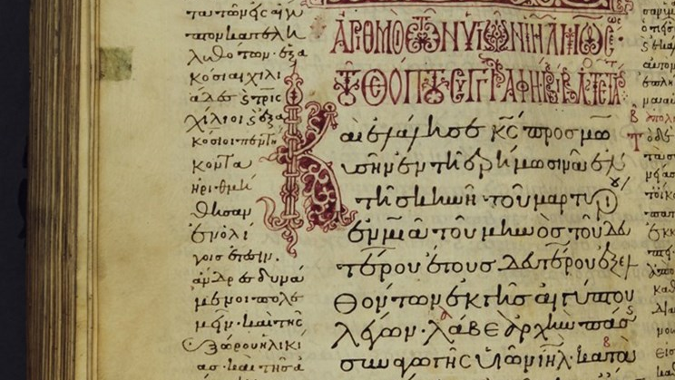
The Holy Spirit
Were these beliefs always present, or were they an innovation?
Present in written and oral tradition
Present in daily liturgical life
Literature on the Holy Spirit
St Athanasius – Letters to Serapion
St Basil – On the Holy Spirit
St Gregory the Theologian – 5th Homily
St Didymus – On the Holy Spirit
Analysis
Holy Spirit
Church
Baptism
Coming Age

Slide 17
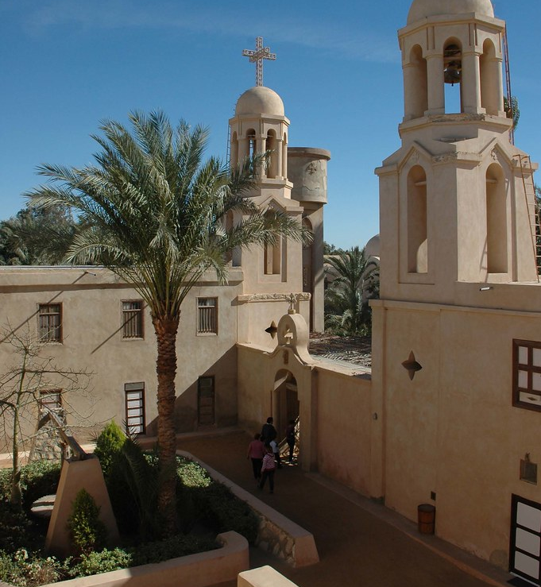
The Church
“And in one, holy, catholic, and apostolic church.”
Why is it included?
“When the Comforter, the Holy Spirit, whom the Father will send in My name has come, He will teach you all things and bring to your remembrance all things I have said unto you.” John 14:26
  When was this?
Analysis
Holy Spirit
Church
Baptism
Coming Age

Slide 18
The “One” Church
What does “one” mean?
  One Lord, one faith, one baptism
  The One Body, belonging to the One Head, Christ
What doesn’t “one” mean?
  Uniformity in expression
Analysis
1/4
Holy Spirit
Church
Baptism
Coming Age

Slide 19
The “Holy” Church
Define “holy”
What is the church?
  (1 Corinthians 1:2, Romans 1:7, Ephesians 1:1, Colossians 1:2)
Analysis
2/4
Holy Spirit
Church
Baptism
Coming Age

Slide 20
The “Catholic” Church
“universal”
κατα ολος
  “Wherever Christ Jesus is, there is the catholic church” – St Ignatius
    Has the whole Christ and therefore the whole truth
Analysis
3/4
Holy Spirit
Church
Baptism
Coming Age

Slide 21
The “Apostolic” Church
Based on the teaching of the apostles (from Christ)
  What else does this imply?
  (2 Thessalonians 2:15, 1 Corinthians 11:1-2, 34, John 21:25, 2 Peter 1:20, Wisdom of Sirach 39:1,2, Nehemiah 8:7,8, 2 Peter 3:16)
Analysis
4/4
Holy Spirit
Church
Baptism
Coming Age

Slide 22
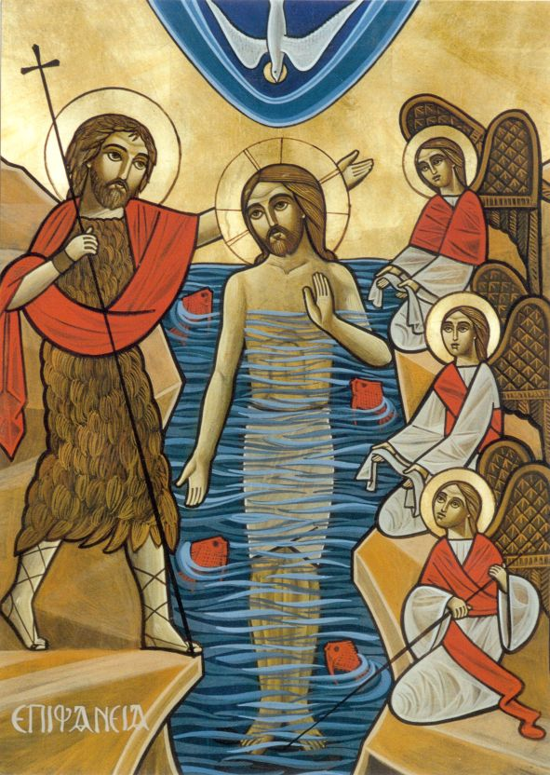
Baptism
“We confess one baptism for the remission of sins”
“For as many of you as were baptized into Christ have put on Christ” Galatians 3:27
Another work of the Holy Spirit; the entry into the life of the church and receiving the Holy Spirit
  “…be baptized… and you shall receive the gift of the Holy Spirit.” – Acts 2:38
“But if the Spirit of Him who raised Jesus from the dead dwells in you, He who raised Christ from the dead will also give life to your mortal bodies through His Spirit who dwells in you.” Romans 8:11
Analysis
Holy Spirit
Church
Baptism
Coming Age

Slide 23
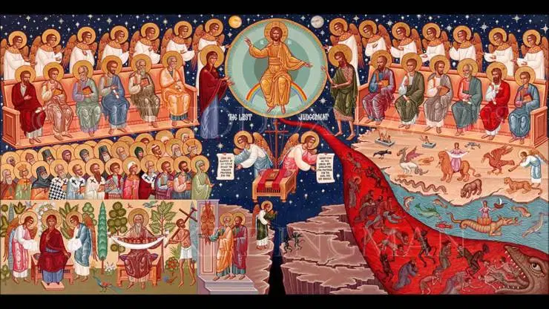
The Life to come
“We look for the resurrection of the dead and the life of the age to come.”
No reason for faith without the eternal life
“The Spirit Himself bears witness with our spirit that we are children of God, and if children, then heirs—heirs of God and joint heirs with Christ, if indeed we suffer with Him, that we may also be glorified together.” Romans 8:16,17
Analysis
Holy Spirit
Church
Baptism
Coming Age

Slide 24
Summary
Addition of final paragraph of the creed in Constantinople (381)
  Divinity of the Holy Spirit
    The Church
    Baptism
    The Life to Come
Introduction
Analysis
Conclusion

