Slide 1
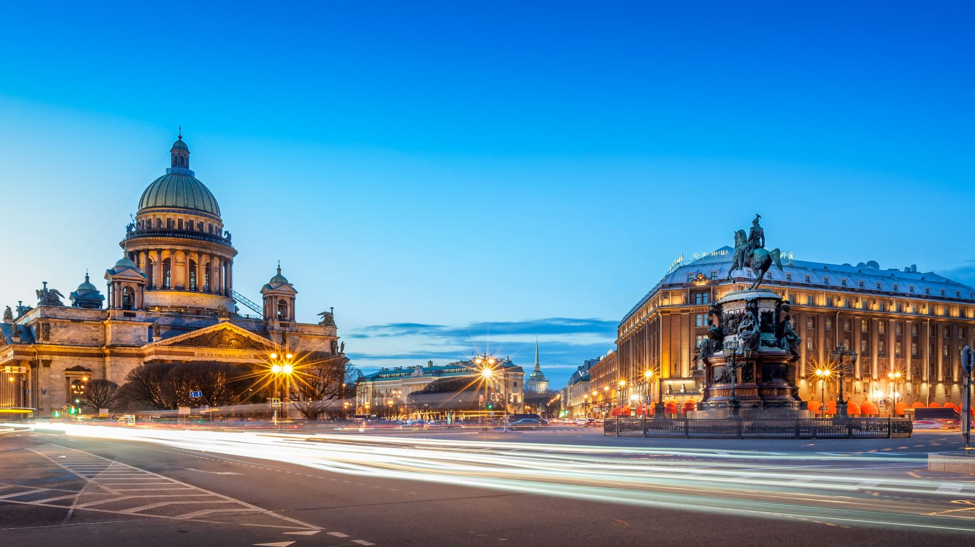
St Athanasius

Slide 2
Early Life
He was born to pagan parents about the year 295 - 298 A.D.
It happened that when he was in school, he saw some Christian children acting the Christian rituals
They made him a patriarch over them in the play, they enthroned him on a high place, and they offered him honor and respect
Notes:
some as priests, some as deacons and one of them as a bishop. He asked their permission to participate with them, but they refused saying: "You are pagan, and you are not allowed to mix with us." He answered them: "I am from now on a Christian."
At that time pope Alexandros passed by, when he saw them, he said to those who were with him about Athanasius: "This child would be in a great position one day.” he took him to be his secretary, and latter ordained him as a deacon.

Slide 3
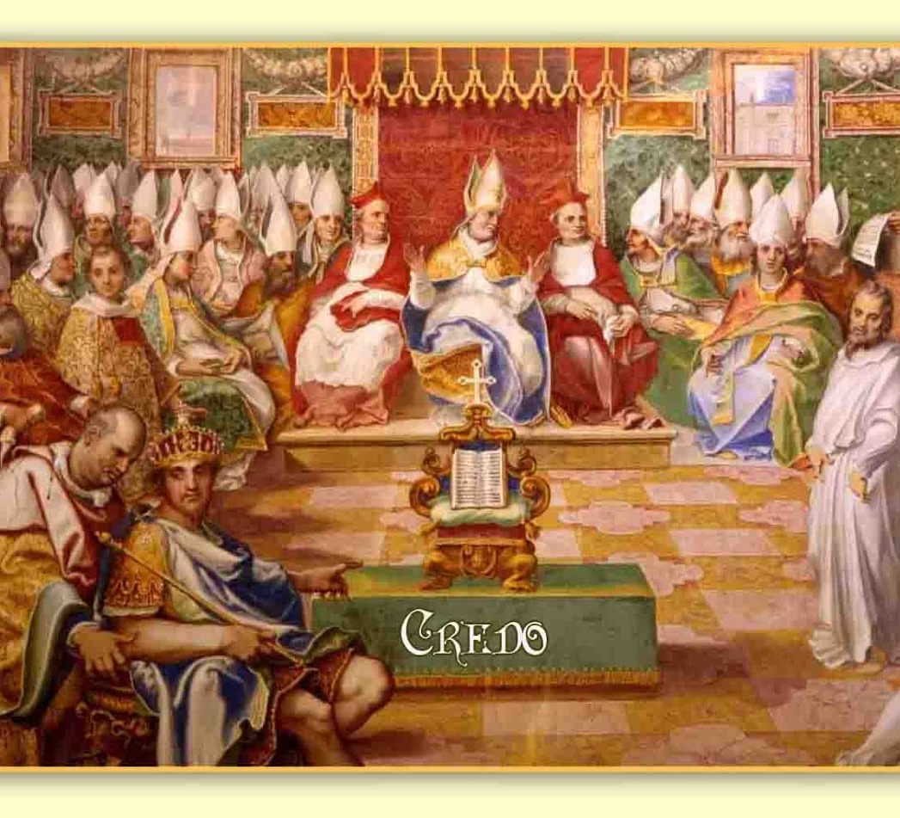
The arian heresy
Arian Heresy – Jesus is a “created God” or a “half God”
Arius was excommunicated on 321 AD. In a local assembly in Alexandria
In the year 325 the Nicean council took place, in the presence of 318 bishops.
The term “ομοουσιος” (oomoseos) which was translated in the creed as “one in the essence with the father”. Or in other word “of the same essence”. This was adopted
Notes:
when Arius said about Christ that he was "similar" in essence with the Father, St. Athanasius said: "One in essence with the Father." In this fashion he manifested his excellence.
By the council of Nicea, to explain the unique unity and equality in the one essence. → only arians refused to accept this
When Pope Alexandros reposed, Athanasius was elected in 3 years to face
all the difficulties which was predicted by his ancestor.

Slide 4
Arian starts again
Arian started again under Eusabious from Nicomedia. Who succeeded to promote the heresy and get the emperor to revisit the case of Arius
The Emperor asked Pope Athanasius to take him back. Athanasius refused to accept him because that would be a contradiction to the decision of the Universal Council since he was excommunicated
The Arians accused Pope Athanasius with these charges:
1. That he supported pope Philominus who rebelled against the government.
2. That he broke the communion cup of the priest Eskira, and destroyed his altar.
3. That he killed bishop Arsanius, and used his arms in sorcery.
4. That he also raped a nun.
Notes:
The following were charges against St.Athanasius
As a result the emerpror exiled st athansius to France

Slide 5

Arius died a horrible death as Socrates said: "God made Arius to die in a public washroom, where his bowels poured out of his body, and the people regarded his death as a punishment from the Divine Justice.”
2 years later When the Emperor heard about the death of Arius, he recognized the innocence of Athanasius, and recommended while he was on his death bed, in the year 337 A.D. that Athanasius be returned to Alexandria and reclaim his throne

Slide 6
The second exile
The Arians kept on trying to excommunicate St.Athanasius
Pope Athanasius assembled a council in Alexandria in 340 A.D. where he protested against the Arians, then he wrote a letter to all the churches to declare his innocence.
However, the Arians influenced Philogorius to help to install their appointed Patriarch Gregory to take over the churches of Alexandria, and they also influenced Emperor Constantius.
The people of Alexandria were horrified, and decided to resist, but the Arians attacked the churches in Alexandria on Good Friday, raped and slained many worshipers.
Pope Athanasius sought the help of all the churches in the world, left his Chair, and traveled to Rome

Slide 7
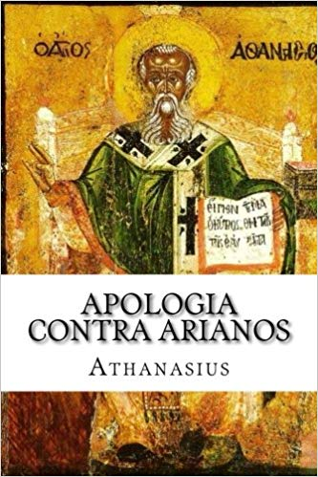
Some Egyptian radicals rose up and killed Gregory in 349 A.D. Athanasius returned for the second time to his Chair, and the people received him with joy. Gregory the Theologian, the writer of the liturgy, described this reception saying: "The people came as the flood of the Nile," and he also pointed out to the palm branches, the carpets, and the many clapping hands.
4 years later Constance dies and Constantious becomes emperor where he reconvicted St.Athanasius
He would come back and would be re-exiled an additional 2 times before he finally returned to his throne for 7 years before he reposed in 373 AD
Notes:
He spent 7 years in hiding During this period he wrote his famous homilies “against the Arians”

Slide 8
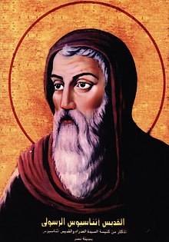
St athanasius theology
The main theme in his theology is to seek and keep the divine truth.
He never gave up on the faith and he realized the poison of the Arian heresy and how it would destroy the faith. The Arian theory of a “ created God to create the world” would have destroyed all the salvation of mankind
Notes:
The whole Christian world owes it to St Athanasius for keeping the orthodox faith of the divine unity.
He has worked very hard to make the Nicean council adopt this orthodox teaching.
He refused (rightfully) to accept Arius back, because his (Arius) teaching was not just a simple error, but a whole doctrine, a new philosophy that would change the Christian dogma from it’s roots

Slide 9
The orthodox dogma
This new dogma is based on polytheism
The orthodox dogma is based on the “one divine essence” where the three hypostasis are one and equal.
St Athanasius concentrated all his apologetic works on the core of the Arian heresy without getting distracted to other side points.
Heresy comes from the Greek word “herassis” «αιρεσις» which is denial and putting doubts in the teaching of the church which is handed down from the apostles.
Notes:
Usually a heresy is a full philosophical doctrine that depends on a mistake or deviation in one or more subjects of the orthodox teaching. In return the orthodox response will have a point or more to correct and fix this wrong doctrine. An example of this is the Nicean creed and what was added after the Constantinople council.

Slide 10
The core of st athanasius philosophy
According to st Athanasius salvation means: To be saved from eternal death and be in union with God.
In the incarnation of the Logos (the word) He took flesh, a perfect human, and a perfect God in unique mystical union, this what brought the human nature to salvation, this is the core of st Athanasius teaching.
Notes:
The church can live –according to him- on this truth “the true God and savior Jesus Christ”
This same and true Jesus is taught and offered by the church in a miraculous way through the sacraments.

Slide 11
St athanasius teachings
Essay against heathen, and one on the incarnation: this goes back to his early life 317-319 AD. There was no mentioning of Arius in these two books.
Other writings include, his interpretation of the bible books, unfortunately many of them are lost, with few esceptions found on the psalms, as well as Matthew and Luke in a series called the “Catenae” which include many interpretation of the fathers on the liturgical Gospel readings.
The 4 essays against the Arians: most of these were written during his 3rd exile from 356 – 362 A.D.
4 letters to Serabion bishop of Teme on the Holy Spirit and His equality in the essence, in response to some Arien teaching that the Holy Spirit is created. There is a 5th letter about blasphmy against the Holy Spirit.
Notes:
In the first he talks about the falsehood of idols, and the true way to God through meditation in God’s creation and its magnificence. In the second he talks about the truth in the incarnation and how it is the fulfillment of the prophecies.

