Slide 1
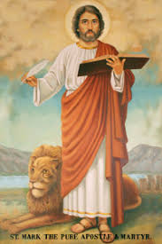
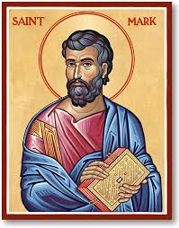
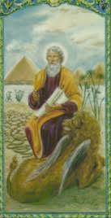
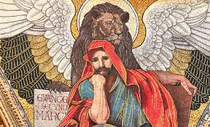
St. Mark
The writer of one of the Four Gospels
The founder of the Church in Egypt and first Patriarch of Alexandria
Helped St. Paul in his missionary work in Europe

Slide 2
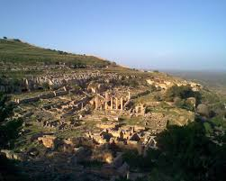
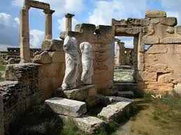
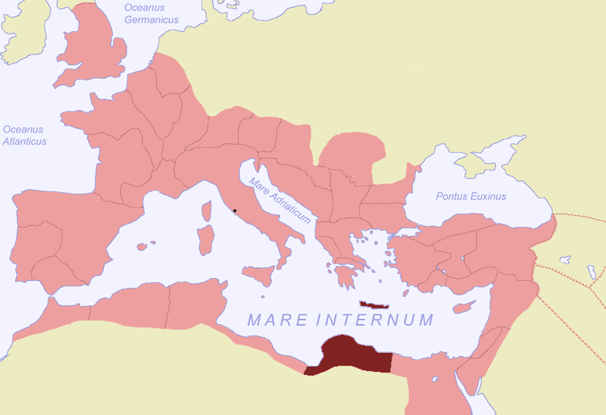
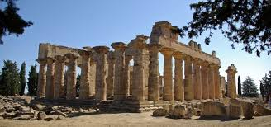
St. Mark
Born of righteous and wealthy Jewish parents, in Cyrene, one of the 5 cities of north Africa called Pentapolis.
They suffered loss of most of their possessions and migrated to Jerusalem, where Mark was brought up.

Slide 3
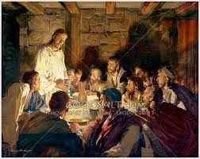
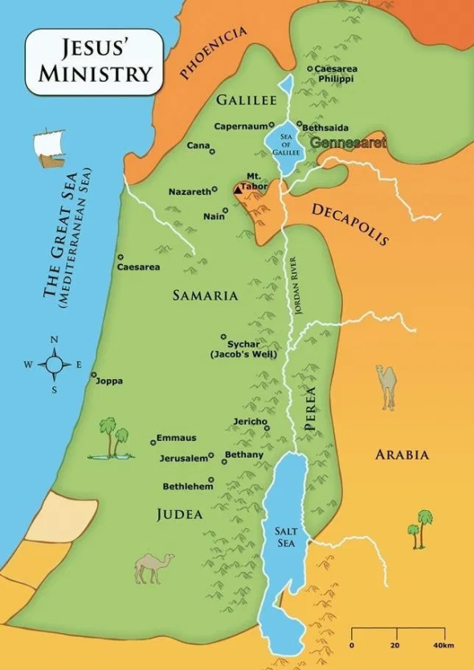
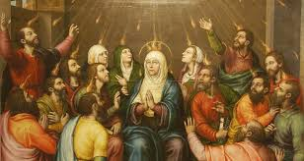
St. Mark
The Lord Jesus chose St. Mark as one of the Seventy Apostles, and his house for the Last Supper. To emphasize his role as an eye-witness of the Lord Jesus, the Church gave him the title "Beholder-of-God".
The same house was the meeting place of the Apostles where the Holy Spirit descended on them on the Pentecost.

Slide 4
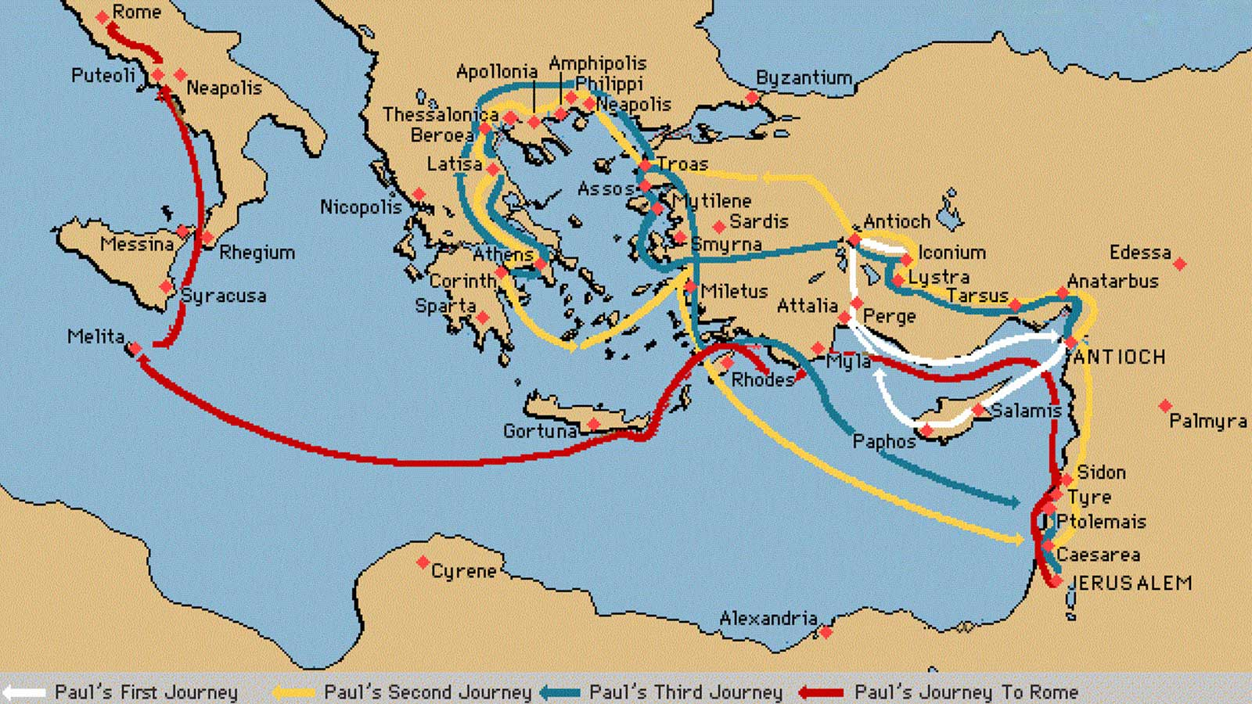
St. Mark
Mission Work
St. Mark accompanied St. Paul and St. Barnabas on their first missionary journey but left them at Pamphilia and returned to Judea.
On the second journey, he went with St. Barnabas to Cyprus.
He then went to Pentapolis, his birthplace in north Africa; then to Egypt.
He entered Alexandria in 61 A.D., when it was the most outstanding center of culture and a home for many philosophers and the famous library.

Slide 5
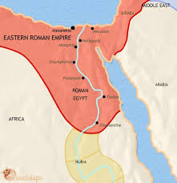
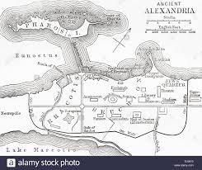
St. Mark (Alexandria)
He preached to Anianus, an Alexandrian shoe-repairer, after he healed Anianus’ pricked finger, and spread the Good News in Alexandria.
He ordained Anianus as Bishop for Alexandria with 12 priests and 7 deacons. Then he left to Pentapolis, then to Rome where he joined St. Paul, once more, in his ministry (Col. 4:10, 2 Tim. 4:11, Phil. 1:24)
When he returned he found that the Christians had already built a Church and increased significantly in number. He continued to serve them until 68 A.D.
On Easter eve, 68 A.D., he was seized by the pagan mob and was dragged around the city of Alexandria until he passed away. Thus, he received the crowns of Apostleship, Evangelism and Martyrdom.

Slide 6
The Apostolic Church in Egypt
St. Mark
1. List three of St. Mark's major achievements.
2. When and how did St. Mark's life end? Who succeeded him?
The writer of one of the Four Gospels
The founder of the Church in Egypt and first Patriarch of Alexandria
Helped St. Paul in his missionary work in Europe
On Easter eve, 68 A.D., he was seized by the pagan mob and was dragged around the city of Alexandria until he passed away. Thus, he received the crowns of Apostleship, Evangelism and Martyrdom.
Anianus an Alexandrian shoe-repairer, who was the first Christian in Egypt

Slide 7
St. Mark's Successors
Pope Enthroned Years Months
1. St. Mark, The Evangelist 61 A.D. 7 8
2. Abba Anianus 64 A.D. 22 7
They are titled "PAPA" (POPE) which means "Father"
Pope and Patriarch of the Great City of Alexandria, all of Egypt, Ethiopia, Nubia, the Pentapolis and land of immigration.
It was said about Anianus and the nine prelates who succeeded him that they were "wise and good, meek and simple, and they taught the people with diligence and singleness of heart."
Therefore, they succeeded in greatly increasing the number of the believers.
The first 2 centuries were characterized as the era of teaching and growth.

Slide 8
First and Second Centuries
Pope Enthroned Years Months
1. St. Mark, The Evangelist 61 A.D. 7 8
2. Abba Anianus 64 A.D. 22 7
3. Abba Melius 94 A.D. 12 9
4. Abba Kardonos 108 A.D. 10 9
5. Abba Primus 120 A.D. 12 1
6. Abba Yustus 132 A.D. 10 10
7. Abba Omanius 143 A.D. 11 3
8. Abba Marianus 154 A.D. 9 2
9. Abba Cladianus 163 A.D. 14 6
10. Abba Agrippinus 177 A.D. 11 7
11. Abba Ylianus 189 A.D. 10 1
12. Abba Demetrius, The Vine-Dresser 199 A.D. 22 7

Slide 9
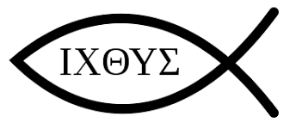
Teaching in the Early Church
They used Catechistic Schools to teach elementary catechism, hence the name catechumen for the people who were being taught the new faith.
The School of Alexandria played a critical role in that era in spreading the faith and leading the Christian teaching worldwide.
The Greek word for fish (ichthus, spelled: Iota Chi Theta Upsilon Sigma) was used as an acrostic for "Jesus Christ, Son of God, Savior“
[Iesous (Jesus) CHristos (Christ) THeou (God) Uiou (Son) Soter (Savior)]

Slide 10
The Apostolic Church in Egypt
St. Mark’s Successors
3. What is the title of St. Mark's successors and what does it mean?
4. What are the main characteristics of the first two centuries for the Church in Egypt?
They are titled "PAPA" (POPE) which means "Father“
Pope and Patriarch of the Great City of Alexandria, all of Egypt, Ethiopia, Nubia, the Pentapolis and land of immigration.
Era of teaching and growth – catechism
The School of Alexandria played a critical role in that era in spreading the faith and leading the Christian teaching worldwide

Slide 11
The School of Alexandria
Pre-Christian school encouraged and funded by Ptolemy, 323 B.C.
Ptolemy also ordered the Greek translation of the Old Testament known as the "Septuagint" by 70 of the Jewish rabbis.
It started as a school of science and literary, then expanded into philosophy and theological matters.
The deans of the Theological School were great scholars, philosophers and leaders in many aspects:
Athenagoras "Apology", teacher for Pantaenus & Clement
Pantaenus Preaching in India, St. Matthew's Gospel
Coptic Language
Clement of Alexandria Teacher and philosopher

Slide 12
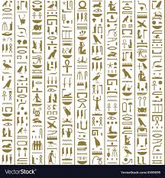
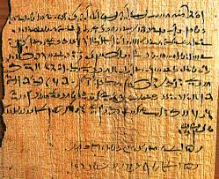
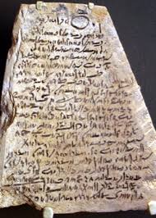
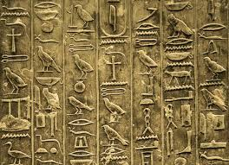
  Pantaenus was attributed with developing the Coptic alphabet using the Greek alphabet with the addition of 6 or 7 signs from the Demotic script (which was used to write the ancient Egyptian language, Hieroglyphic), and translated the Bible to Coptic.

Slide 13
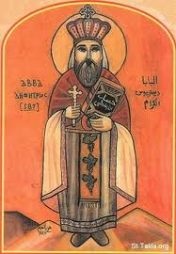
Abba Demetrius, The Vine-Dresser
Selected by a vision to become the 12th Pope while he was married.
Later on, it was revealed, by a miracle, that he lived in celibacy (like a monk) all the time.
He had little education but sought learning diligently specially after he was chosen.
Under his auspices the "Epact" was devised to calculate the date of Easter.
He was exiled under the persecution of Emperor Severus and returned to his throne after the persecution ceased.
He appointed Origen dean to the School of Alexandria but had to excommunicate him when Origen accepted to be ordained to Priesthood in Palestine (some wrong teachings were also attributed to Origen.)
He never ceased to teach and seek learning until his death at the age of 105 years.

Slide 14
Origen
Born of Christian parents. His father was martyred while he was young. Despite his young age and the burden of his family (six younger brothers and a mother), he wrote encouraging his father saying, "Change not your resolution because of us."
He became the dean of the School of Alexandria at the age of 18 years.
He supported the martyrs and confessors throughout the persecution endangering his own life.
He organized the study in the School of Alexandria considerably and wrote numerous books (some say 6,000 manuscripts). One of his major works is the “HEXAPLA”.
He interpreted the scripture in allegorical and spiritual sense; versus the Jewish and Gnostic literal interpretation.
His writing aimed at showing: (1) God as a the loving and beneficent Creator, and (2) People as the free creatures.
He went to Palestine to teach where he spent the rest of his life teaching and preaching.
Although he was excommunicated by Abba Demetrius, he had supporters and was pardoned by both Abba Heraclas and Abba Dionysius who were his students at the School of Alexandria.

Slide 15
The Apostolic Church in Egypt
The School of Alexandria
5. Name five of the famous leaders of the School of Alexandria.
6. Who developed the Coptic Language and how?
7. What are the major achievements of Abba Demetrius?
8. Origen was one of the best Church writers and teachers, how?
Athenaghoras Pantaenus Clement of Alexandria
Origen Heraclas St. Dionysius
Theognostus Pierius St. Peter, the Seal of Martyrs
St. Athanasius, the Apostolic St. Didymius
Pantaenus established the Coptic script using the Greek alphabet (with 6 or 7 signs from the Demotic script – which was used to write the ancient Egyptian language, Hieroglyphic), and translated the Bible to Coptic
He devised the "Epact" to calculate the date of Easter
He was exiled under the persecution of Emperor Severus
He appointed Origen dean to the School of Alexandria
He never ceased to teach and seek learning until his death
He organized the study in the School of Alexandria considerably
He wrote numerous books (some say 6,000 manuscripts)
“HEXAPLA“ – comparison of OT manuscripts and translations – 28 years of study
He interpreted the scripture in spiritual sense

