Slide 1
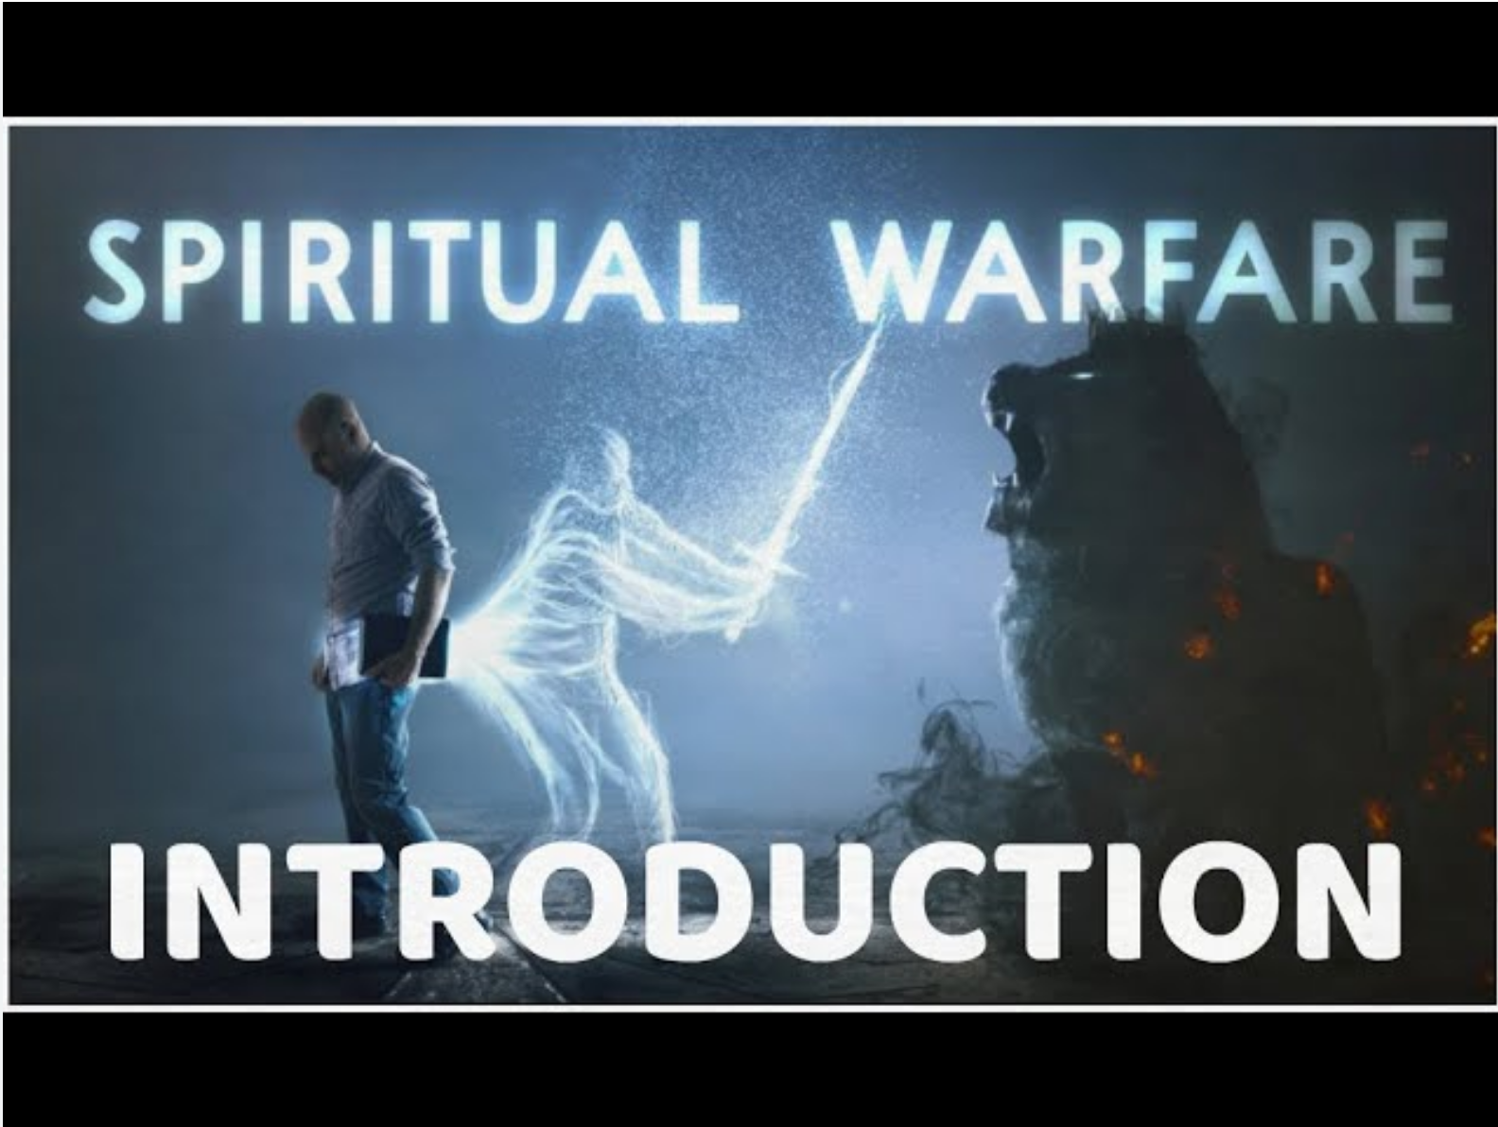

Slide 2

Is this a real war?
St. Peter says, “... your adversary the devil walks about like a roaring lion, seeking whom he may devour” (1 Peter 5:8).
“Son, when you apply yourself to the service of God, stand in Justice and in fear, and prepare your soul for temptation” (Sirach 2:1)

Slide 3
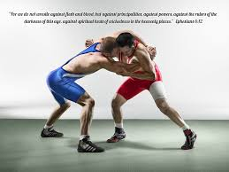
Ok, there is a warfare, but it is with whom??!
For we do NOT wrestle against flesh and blood, but against principalities, against powers, against the rulers of the darkness of this age, against spiritual hosts of wickedness in the heavenly places.
Ephesians 6, 12

Slide 4


Slide 5
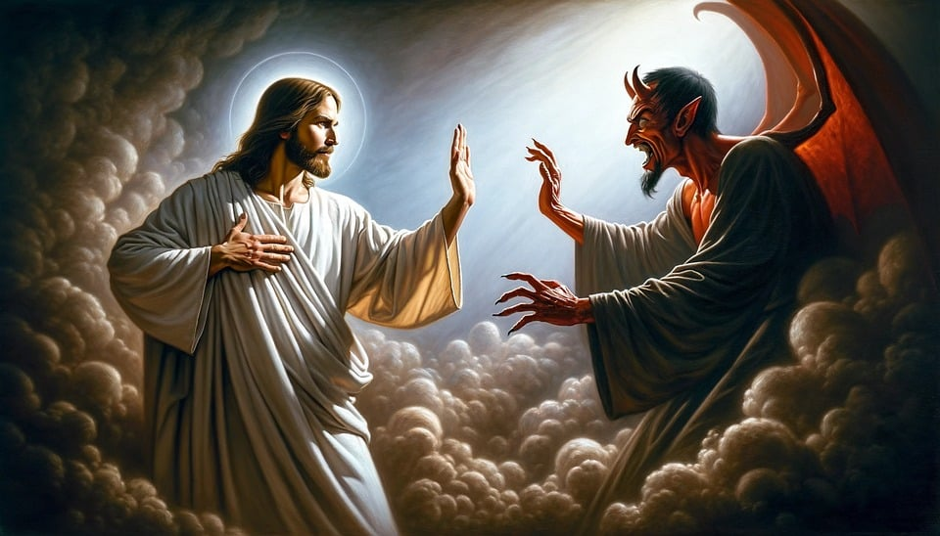
It is especially critical for a servant to fight off the devil to be fruitful in their service. The devil tries to wear the servant down using his many diabolic weapons, for his main goal is for us to not serve and become failures at service.

Slide 6
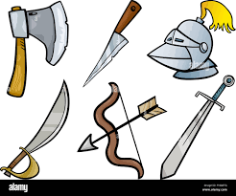
"If there is a war, may I know my weapons and those of my enemy?

Slide 7

Let us start with our enemy’s weapons so that we can defend ourselves quite well.

Slide 8
1. Cares, Worries, Affairs of this World, and People
When a person gets caught up in the things of this world, their worldly cares increase and their spiritual desires decrease. Things of the world include careers, vacations, making money, buying and selling, cleaning, fixing, cooking, busy work, and material possessions.
• The devil increases our worldly desires by always giving us convincing excuses to prefer the things of the things of this world over the will of God, that is service.
The devil then convinces us that we are far too busy to serve.
• Once a person starts leaning toward the things of this world, they lose their desire, energy, and zeal for service.
• Excuses from the devil often come in the form of people. People often get in the way of our service: our spouse, our kids, our friends, or our relatives.
• Jesus says “But take heed to yourselves, lest your hearts be weighed down with carousing, drunkenness, and cares of this life, and that Day come on you unexpectedly” (Luke 21:34).

Slide 9
2. Pleasures
Entertainment, hobbies, socializing, vacations or “wanting a better and more exciting life” may hinder us from serving God.
• The Scriptures tell us of Demas. He was a follower of Paul. But then Satan tempted him with the pleasures of this world. It is written “for Demas has forsaken me, having loved this present world, and has departed for Thessalonica” (2 Timothy 4:10).
• We also read “For men will be lovers of themselves, lovers of money, boasters, proud, blasphemers, disobedient to parents, unthankful, unholy, unloving, unforgiving, slanderers, without self-control, brutal, despisers of good, traitors, headstrong, haughty, lovers of pleasure rather than lovers of God” (2 Timothy 3:2-4).
• A great enemy of Christianity is the “cult of comfortableness.” Beware. Following Jesus may not be the path of the least resistance, but it is the one that leads to eternal life.

Slide 10
3. Problems and Hardships in Life
• Sometimes when we face hardships in life, at home, at work, or at church, the devil penetrates our minds and tries to use these problems as stumbling blocks in our service.
• Even the smallest of problems that the devil tries to magnify to get in the way of our service.
• Sickness often is a stumbling block to service.
• Moses said to the Israelites, “and evil will befall you in the latter days, because you will do evil in the sight of the Lord, to provoke Him to anger through the work of your hands” (Deuteronomy 31:29).

Slide 11
4. Lusts
Jesus said, “But seek first the kingdom of God and His righteousness and all these things shall be added to you” (Matthew 6:33).
Impure thoughts and an impure way of life are major barriers to service. Sexually provocative music, videos, television, language or clothing.

Slide 12
5. Riches
The desire for a better job.
• The desire for more money.
• The desire for more possessions.
• Jesus told the rich young man, “sell what you have and give it to the poor” (Matthew 19:21).
• Matthew 6:19-21.
• Philippians 3:8.

Slide 13
6. Separation from God’s People
Satan pulls us from service by pulling us from church.
• Satan pulls us from service by encouraging us to mingle and make friends with the wrong crowd.

Slide 14
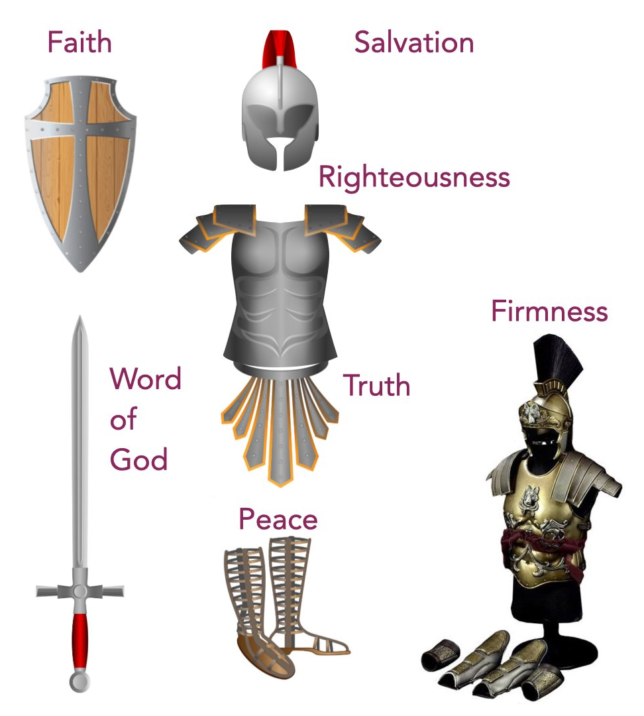
Ok, I am ready for the warfare, what are my weapons?
¹³ Therefore take up the whole armor of God, that you may be able to withstand in the evil day, and having done all, to stand.
¹⁴ Stand therefore, having girded your waist with truth, having put on the breastplate of righteousness, ¹⁵ and having shod your feet with the preparation of the gospel of peace; ¹⁶ above all, taking the shield of faith with which you will be able to quench all the fiery darts of the wicked one. ¹⁷ And take the helmet of salvation, and the sword of the Spirit, which is the word of God’
Ephesians 6:13-17

Slide 15
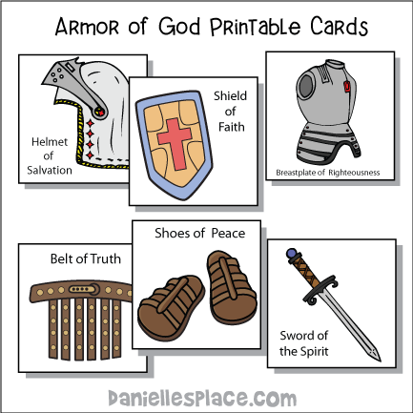
Hey, let us wear it up?

Slide 16
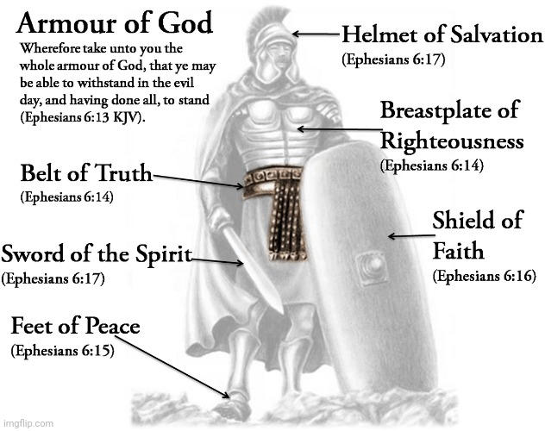
I am READY

Slide 17
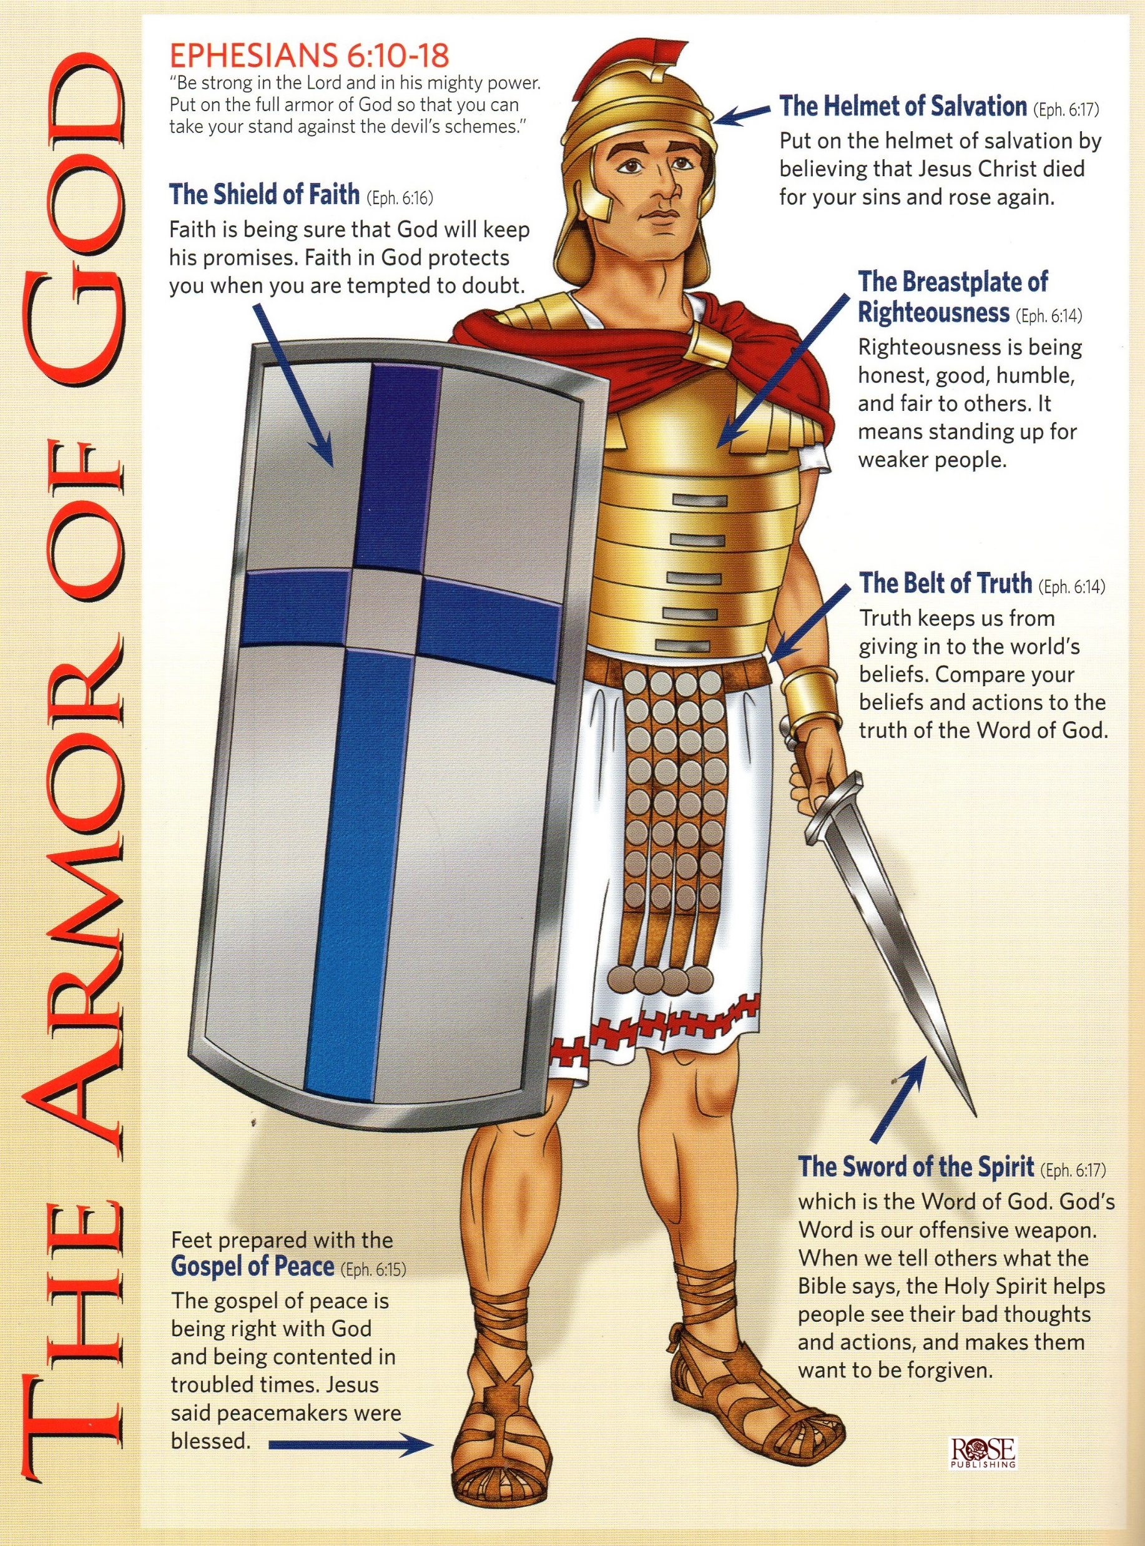

Slide 18
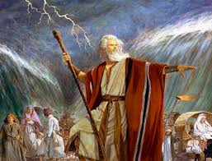
Hey, am I really going to fight?
-----------NOT YOU--------------
“The Lord is my strength and song, And He has become my salvation; He is my God, and I will praise Him; My father’s God, and I will exalt Him. ³ The Lord is a man of war” The Lord is His name. (Exodus 15:2-3)

Slide 19
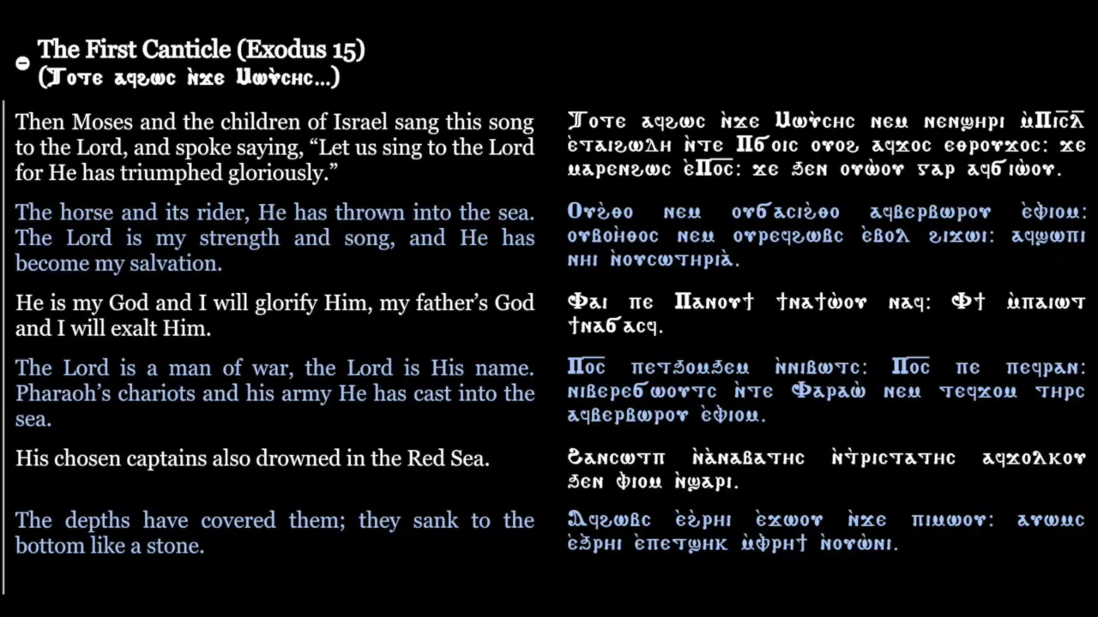

Slide 20
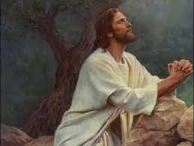
Any other promises?
⁵ No man shall be able to stand before you all the days of your life; as I was with Moses, so I will be with you. I will not leave you nor forsake you. Joshua 1:5
⁴⁷ Then all this assembly shall know that the Lord does not save with sword and spear; for the battle is the Lord’s, and He will give you into our hands.” 1 Samuel 17:47
¹⁵ I do not pray that You should take them out of the world, but that You should keep them from the evil one. John 17:15
I am with you always, even to the end of the age.”Amen. Matthew 28:20

Slide 21
So what is my role? What can I do?
• Encouragement. “Get Mark and bring him with you, for he is useful to me for ministry” (2 Timothy 4:11).
• A Genuine concern (Philippians 2:1-4)
• Prayer (Acts 1:14, Acts 1:24-25)
• Spiritual unity and being of one accord (Acts 1:14, Acts 2:1)

Slide 22
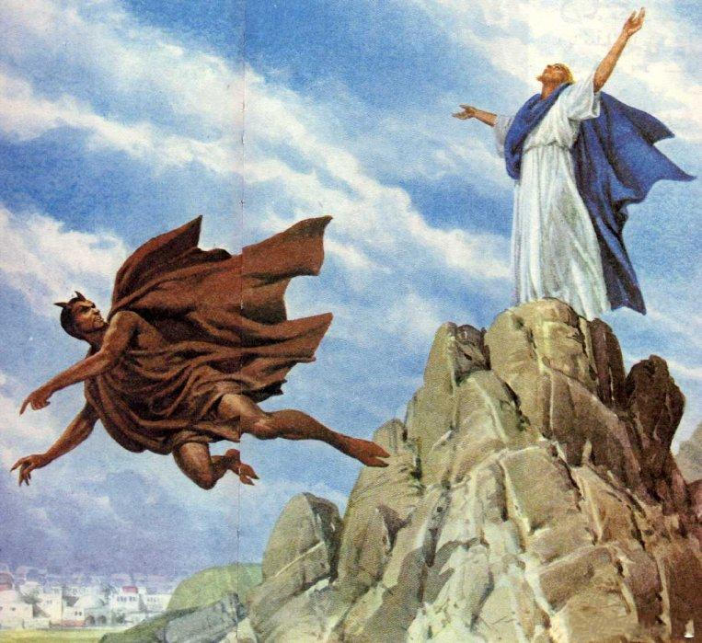
Victory in Christ
The devil tempted Christ and Christ defeated him, and thus I also can defeat the devil through Christ.
– Having entered such diabolic wars and knowing that my fellow man also suffers, I can love and forgive him/her.
– Diabolic wars are for my own good. I am allowed to fight the devil that I may be humbled (Job 5:17, Hebrews 12:11).

