Slide 1

Spiritual Life
Growth and Maturity

Slide 2

Growth: How does it work?

Slide 3
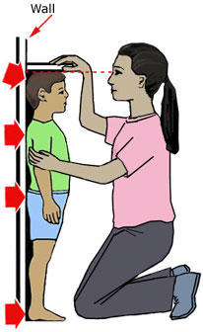

Slide 4
How have you grown in the last 5 years? 10 years?

Slide 5
Willful growth happens in the direction we choose

Slide 6
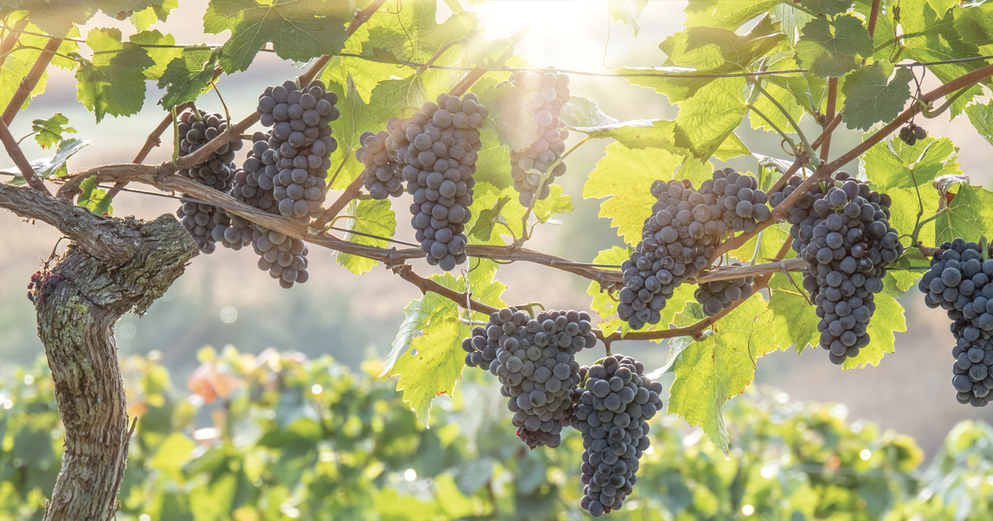

Slide 7
If you don’t know exactly where you’re going, how will you know when you get there?

Slide 8
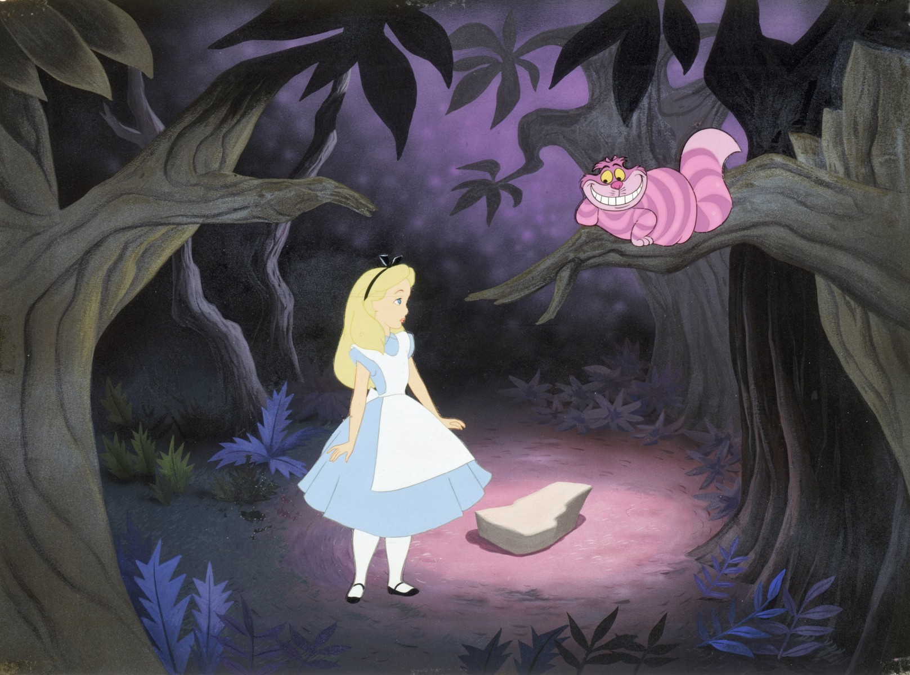
Alice: “Would you tell me, please, which way I ought to go from here?”
The Cheshire Cat: “That depends a good deal on where you want to get to.”
Alice: “I don’t much care where.”
The Cheshire Cat: “Then it doesn’t much matter which way you go.”
Alice: “…so long as I get somewhere.”
The Cheshire Cat: “Oh, you’re sure to do that, if only you walk long enough.”

Slide 9
Jesus answered, “I am the way and the truth and the life. No one comes to the Father except through me.
John 14:6

Slide 10
…so that the body of Christ may be built up ¹³ until we all reach unity in the faith and in the knowledge of the Son of God and become mature,
Ephesians 4:12-13

Slide 11
…so that the body of Christ may be built up ¹³ until we all reach unity in the faith and in the knowledge of the Son of God and become mature, attaining to the whole measure of the fullness of Christ.
Ephesians 4:12-13

Slide 13
According to the traditions of the church and the apostle Paul, our resurrection will --- be into a mature man and the stature of the fullness of Christ. This is the state in which the Jews claim that Adam was created and in which we have read that the Lord rose.
-Jerome (346-420AD)

Slide 14
The state in which Adam was created and in which we have read that the Lord rose.

Slide 15
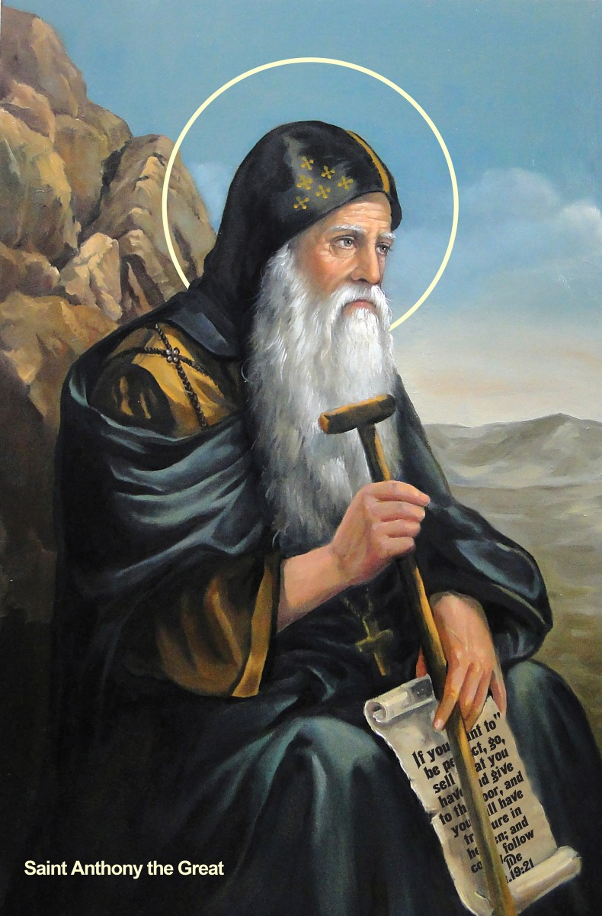
Saint Anthony
The Father of monks

Slide 16
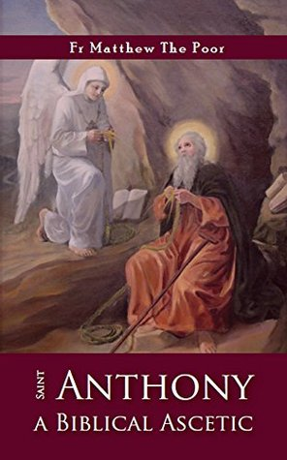

Slide 17
“The Holy Bible is the underpinning of the asceticism.”
“The Holy Spirit is a companion from beginning to end.”
-St Anthony the Great

Slide 18
Everything, absolutely everything… started in Him and finds its purpose in Him

Slide 19


Slide 20
“The Holy Books suffice for teaching”
-St Anthony the Great

Slide 21
“St. Anthony was questioned on the meaning of the Apostle’s proverb: “Rejoice in the Lord always” so he replied: If we delight in keeping the Lord’s commandments, then this is rejoicing in the Lord. Thus Let us rejoice in keeping the commandments of the Loard and in the success of our brethren, and keep ourselves from worldly joys and pleasures, if we wish to be our God’s elect.”

Slide 22
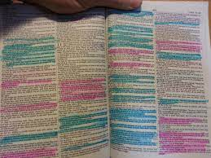

Slide 23
Jesus’ Commandments are what he is promising to do through you.

Slide 24
“that we may present everyone fully mature in Christ. To this end I strenuously contend with all the energy Christ so powerfully works in me”
Colossians 1:28-29

Slide 25

Commandments = Roadmap

Slide 26
“…no prophecy of Scripture came about by the prophet’s own interpretation of things. For prophecy never had its origin in the human will, but prophets, though human, spoke from God as they were carried along by the Holy Spirit.
2 Peter 1:20-21

Slide 27
“For the word of God is living and powerful, and sharper than any two-edged sword, piercing even to the division of soul and spirit, and of joints and marrow, and is a discerner of the thoughts and intents of the heart.”
Hebrews 4:12

Slide 28
“This Book of the Law shall not depart from your mouth, but you shall meditate in it day and night, that you may observe to do according to all that is written in it. For then you will make your way prosperous, and then you will have good success. Have I not commanded you? Be strong and of good courage; do not be afraid, nor be dismayed, for the Lord your God is with you wherever you go.”
Joshua 1:8-9

Slide 29

Union with Him

Slide 30

How many bars do you have?

Slide 31
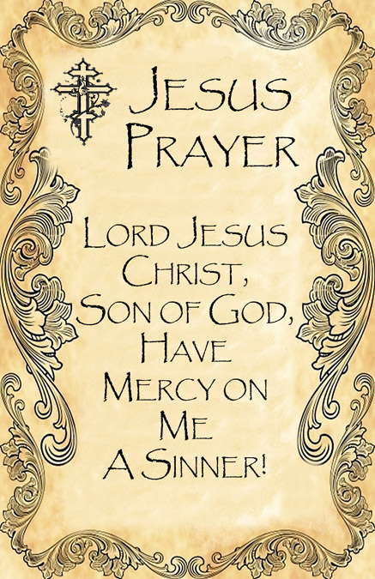

Slide 32
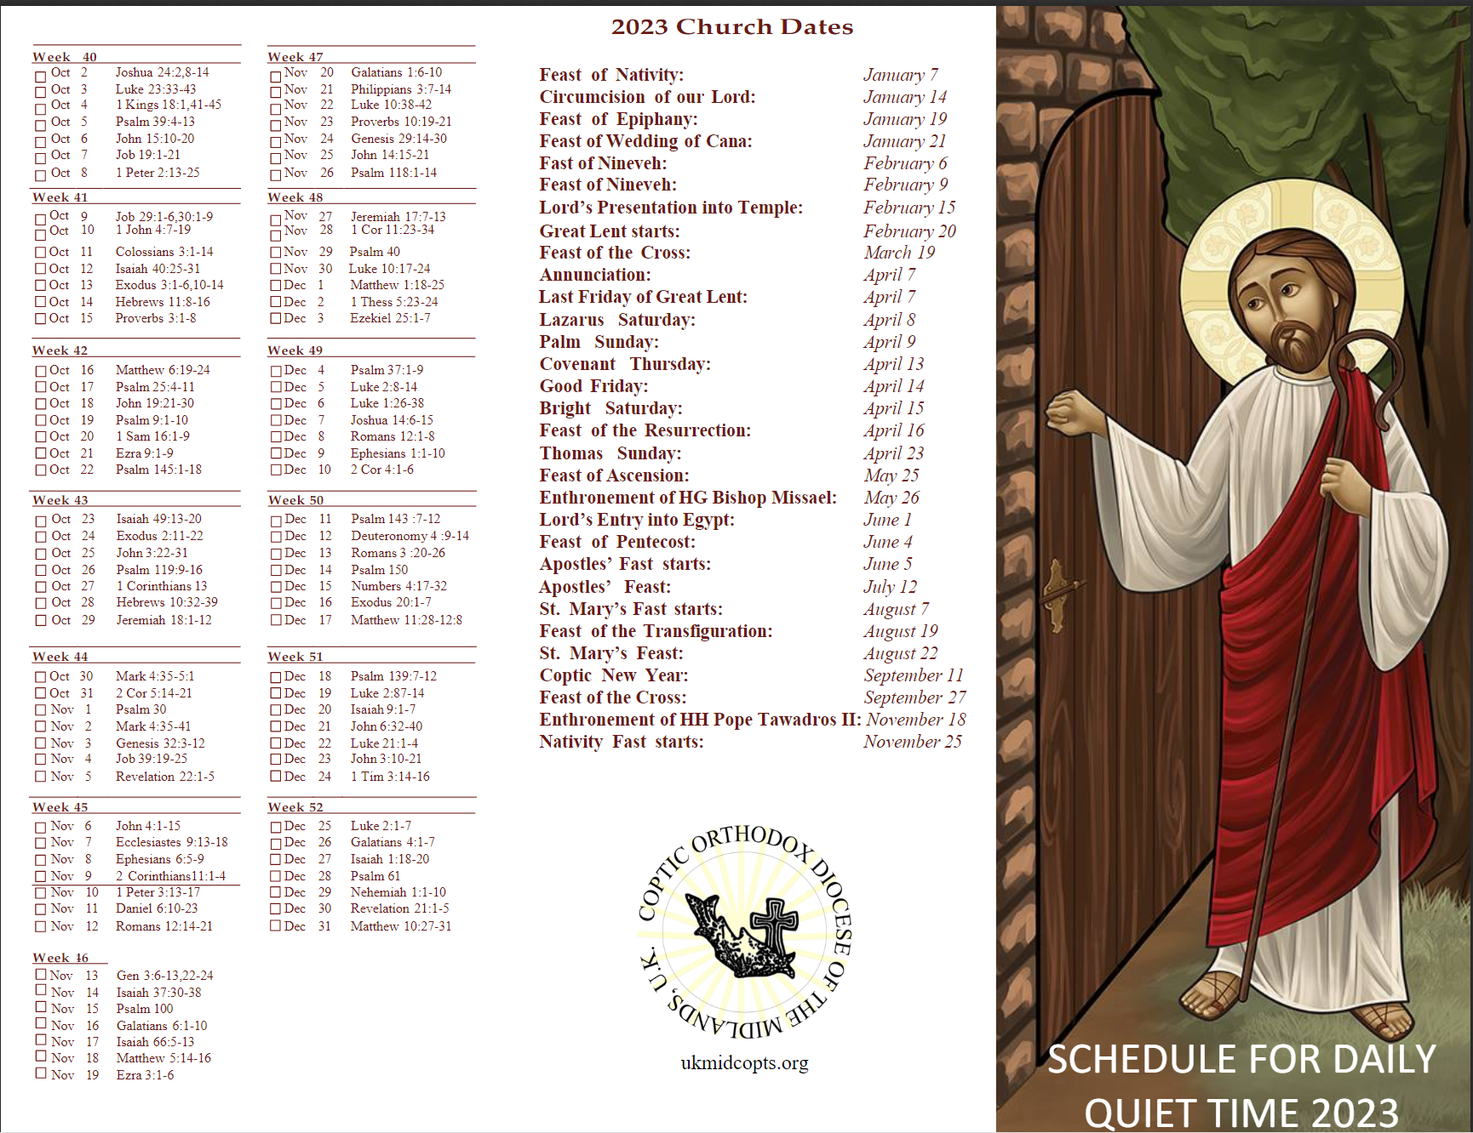
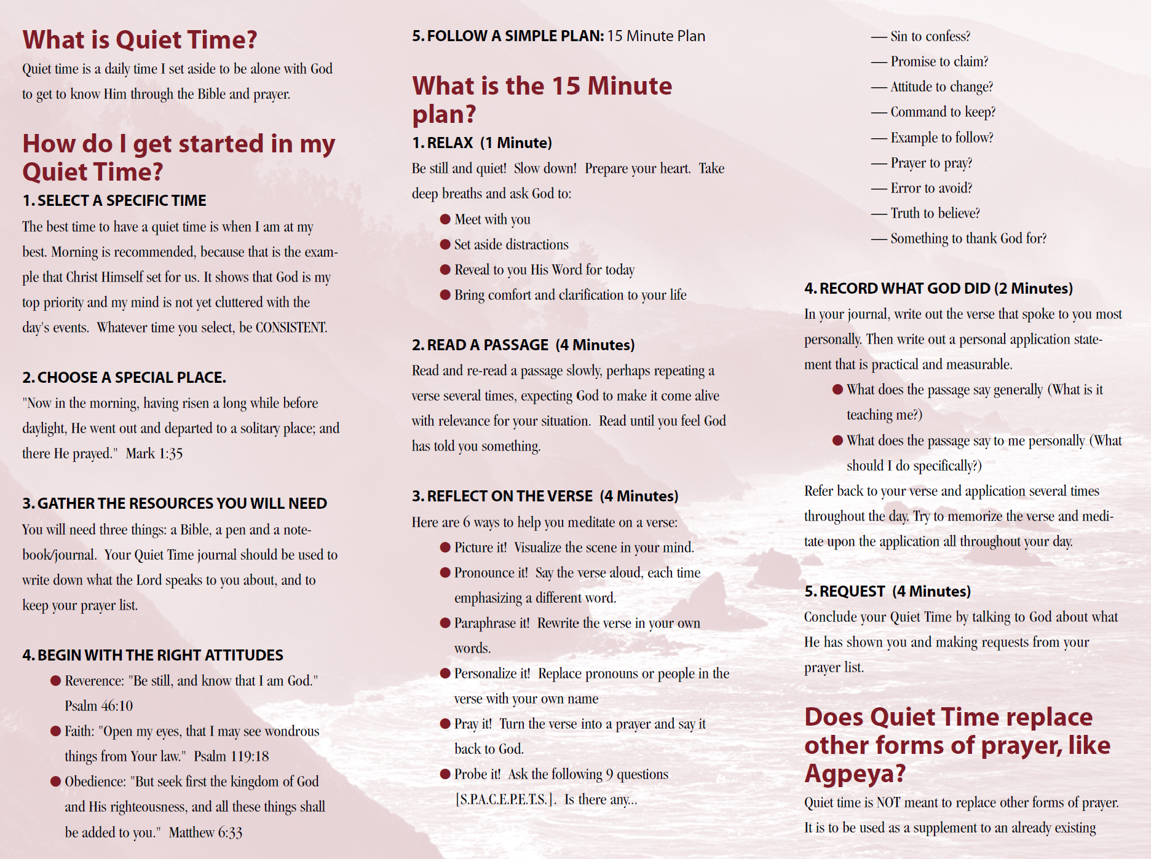
Guide to Quiet Time
Only 15 minutes of your day!

Slide 33
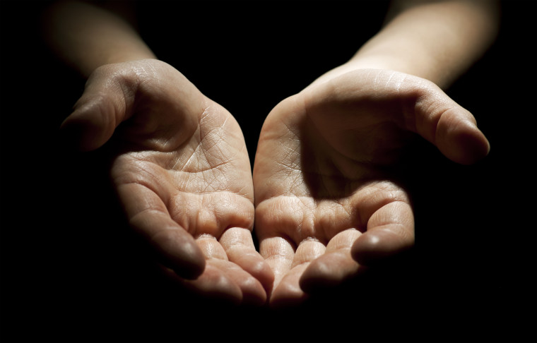
Serve with an open hand

