Slide 1

Introduction To The New Testament Epistles

Slide 2
What are “the Epistles”?
The word epistle means “letter,” and in New Testament studies it refers to letters written by the apostles to churches or individuals.

Slide 3
Writers and Divisions of the Epistles
21 Epistles (letters) from Romans – Jude were addressed to Christians
The known authors were Paul, Peter, James, John & Jude
3 principal groups of letters:
  Paul’s epistles (13) – Romans through Titus
  Hebrews – St Paul as well, although not frank
  General epistles (7) – James through Jude

Slide 4
The Purpose of the Epistles…
To give instruction to the church, “for the perfecting of the saints” (Eph.4:12).
  …to build up the church spiritually by encouraging, consoling, reproving, and exhorting the brethren;
  …by strengthening their faith, correcting false doctrine, and giving special instruction in doctrine and practical duties

Slide 5
+ It is advisable to read each epistle entirely several times to get the theme then study it in details.
+ The epistles are useful to all churches in all times.
Reasons that Necessitated Writing the New Testament Epistles:
1. Writing gives a precise explanation of ideas and teachings discussed.
2. It is also a way of conserving the teachings and unifying the churches.
3. The spread of faith over the Roman Empire and the great increase in number of believers which rendered verbal teachings alone impossible.

Slide 6
Introduction to the New Testament Epistles:

Slide 7
+ The New Testament epistles include the Pauline epistles and the Catholic epistles.
+ The Pauline epistles are 14 epistles written by St. Paul, while the Catholic epistles are 7 epistles, of which St. James wrote one epistle, St. Peter two, St. John three and St. Jude wrote one epistle.
+ The epistles are not a series of writings, focusing on certain topics but the Holy Spirit guided their author to write regarding certain matters according to church needs.
+ This leads to the importance of knowing the circumstances of writing each epistle.

Slide 8
What Facilitated their Spread?
1. The widespread Greek language, a language of theology and philosophy.
2. The many transportations and roads created by the Roman Empire.

Slide 9
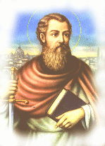
Who is Saint Paul?
+ St. Paul was born in A.D. 5 at Tarsus, the capital of Cilicia, located at the south of Asia Minor.
+ His Hebrew name was ‘Saul’ and his Roman name was ‘Paul.’
+ He is a Jew, a Benjamite and a Pharisee, and he was a student of Gamaliel, who taught him the law.
+ He carried a Roman citizenship.
+ He Studied Greek language and sciences.

Slide 10
From Saul of Tarsus to Paul the Apostle:
1. He used to persecute Christians.
2. He witnessed the stoning of Stephen (Acts 7).
3. He never followed Christ in His mission on earth but He appeared to him after His resurrection in A.D. 36:
“Saul Saul, why are you persecuting Me?...
Who are you, Lord?…
I am Jesus, whom you are persecuting. It is hard for you to kick against the goads…
Lord, what do you want me to do?...
Arise and go into the city and you will be told what you must do” (Acts 9:4-6)

Slide 11
4. The Lord appeared to Ananias, the bishop of Damascus, and told him:
“Go, for he is a chosen vessel of Mine to bear My name before Gentiles, kings and the children of Israel. For I will show him how many things he must suffer for My name’s sake” (Acts 9:15-16)
5. From Damascus, he went to Arabia and stayed there for three years (A.D. 36-38). He spent these years studying the Old Testament, being lead by the Spirit to accept many facts.

Slide 12
6. The Lord Christ appeared to him and delivered to him the Sacrament of the Holy Eucharist:
“For I received from the Lord that which I also delivered to you: that the Lord Jesus on the same night in which He was betrayed took bread; and when He had given thanks, He broke it and said: Take, eat; this is My body which is broken for you; do this in remembrance of Me” (1 Corinthians 11:23-24)

Slide 13
Introduction to the Pauline Epistles
St. Paul’s Service:
1. St Paul went back to Damascus:
“Immediately he preached the Christ in the synagogues, that He is the Son of God” (Acts 9:20)
2. The Jews plotted to kill him then he escaped to Jerusalem.
3. He spoke boldly at Jerusalem and they plotted to kill him then he was sent to Tarsus.
4. He spent 6 years there, preaching in Syria and Cilicia, and founded many churches. It is most believed that he went through all the hardships he talked about in (2 Corinthians 11:23-26) during this period.
5. Barnabas sought Paul at Tarsus till he found him then brought him to Antioch.

Slide 14
Introduction to the Pauline Epistles
6. At Antioch:
“As they ministered to the Lord and fasted, the Holy Spirit said: Now separate to Me Barnabas and Saul for the work to which I have called them. Then, having fasted and prayed, and laid hands on them, they sent them away” (Act 13:2-3)
- And that was the start of St Paul’s Missionary Trips.
7. St Paul had three Missionary Trips in between the years: A.D. 45-58.
8. He did not start writing till A.D. 52, during his 2nd missionary trip, when he wrote the 1st and 2nd Thessalonians, while being in Corinth.

Slide 15
St. Paul’s Missionary Trips
 | 1st Trip | 2nd Trip | 3rd Trip | Journey to Rome
Reference | Acts (13,14) | Acts (15-18) | Acts (18-21) | Acts (21-28)
Time | A.D. 45-50 | A.D. 51-54 | A.D. 54-58 | A.D. 58-63

Slide 16
St. Paul’s 1st Missionary Trip

Slide 17
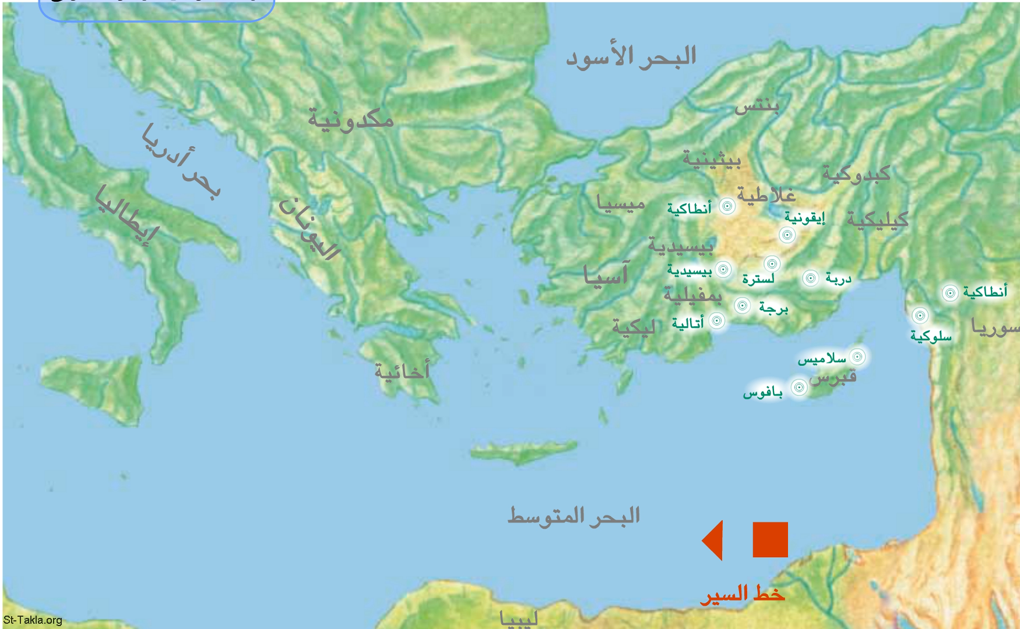

Slide 18
St. Paul’s 2nd Missionary Trip

Slide 19
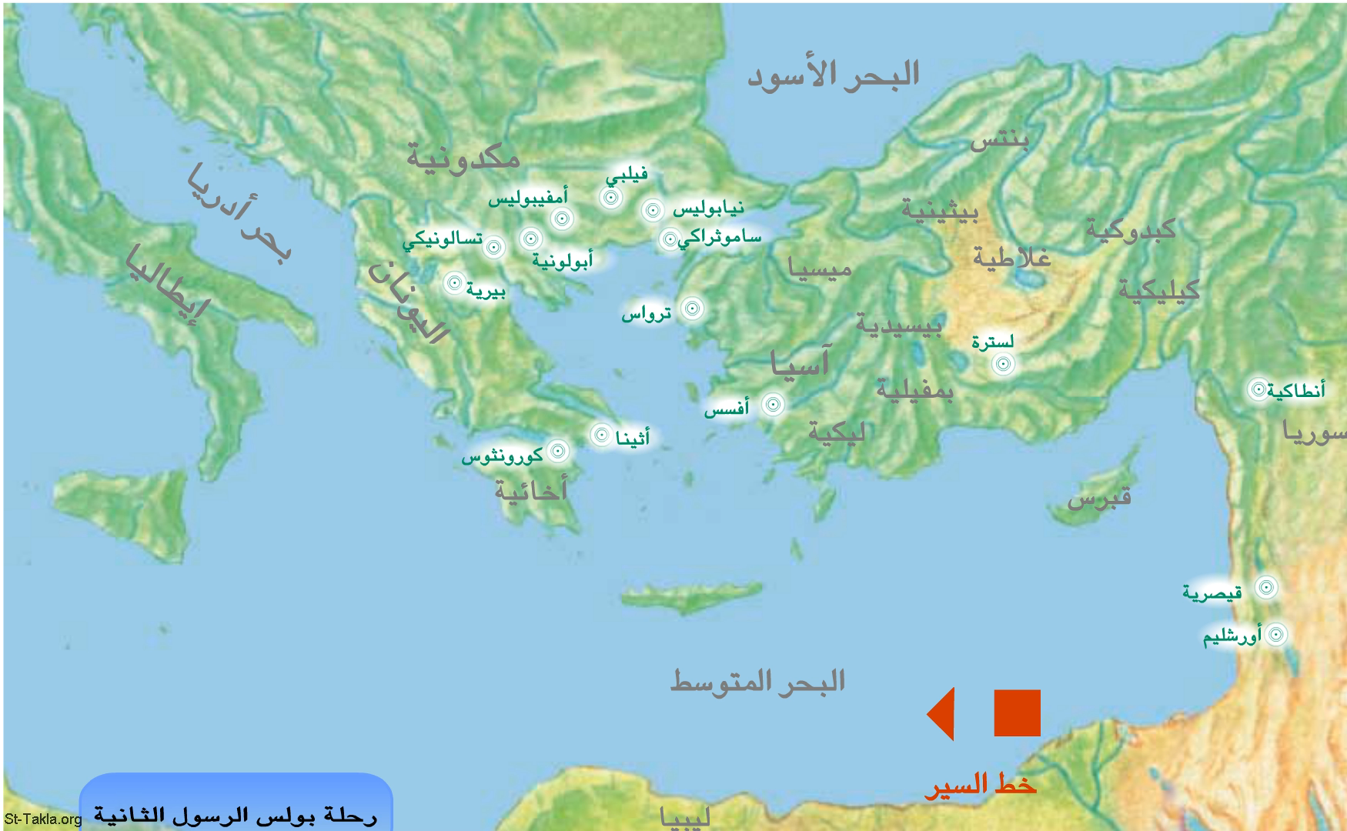

Slide 20
St. Paul’s 3rd Missionary Trip

Slide 21
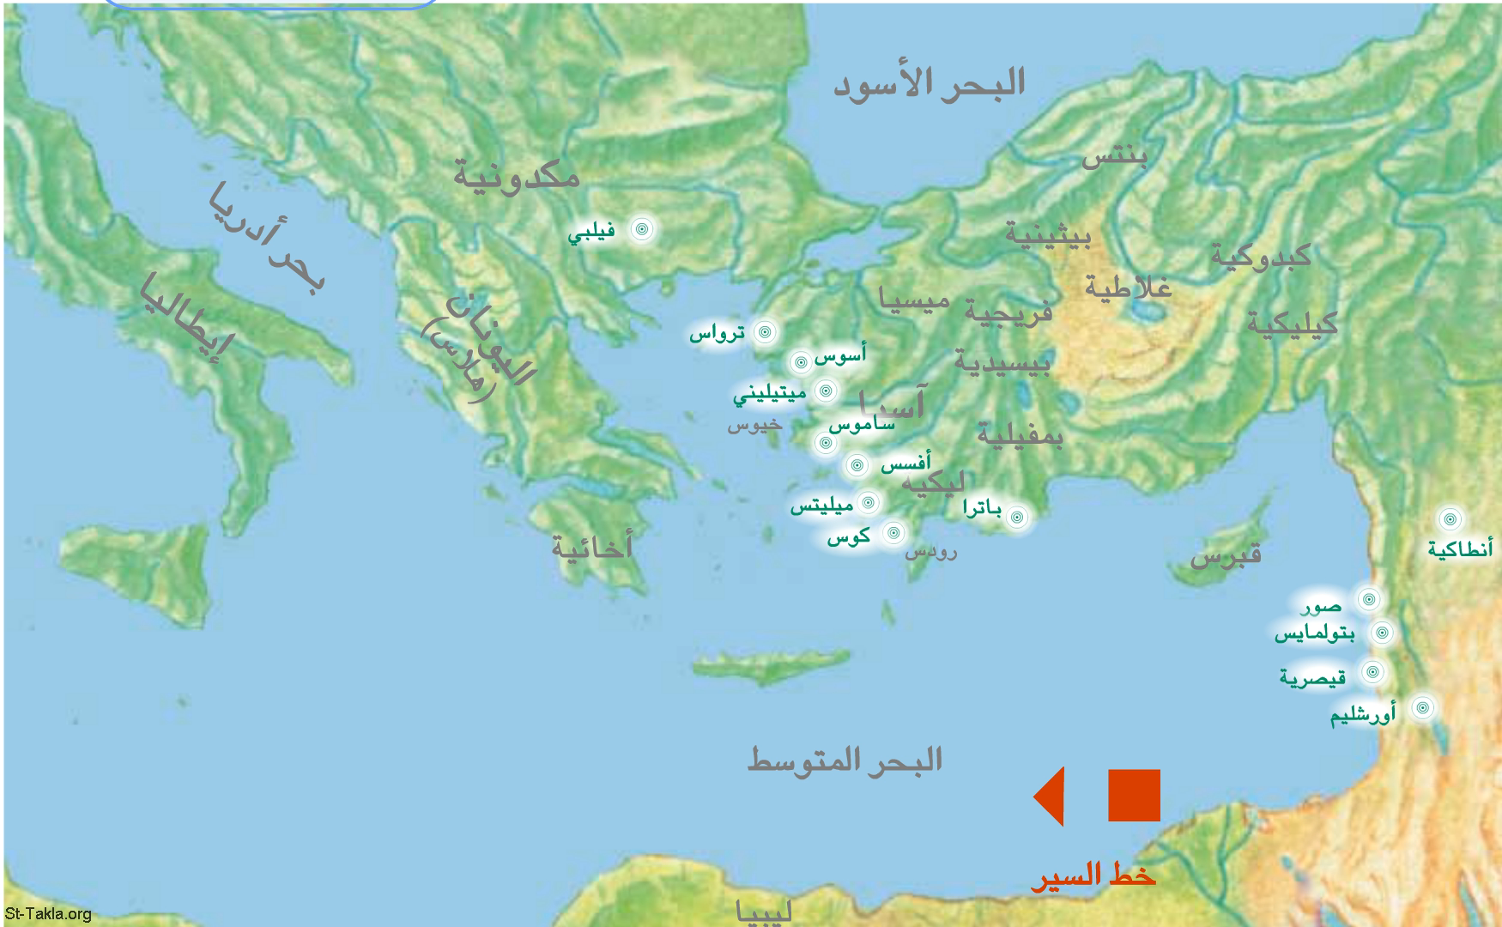

Slide 22
St. Paul’s Journey to Rome

Slide 23
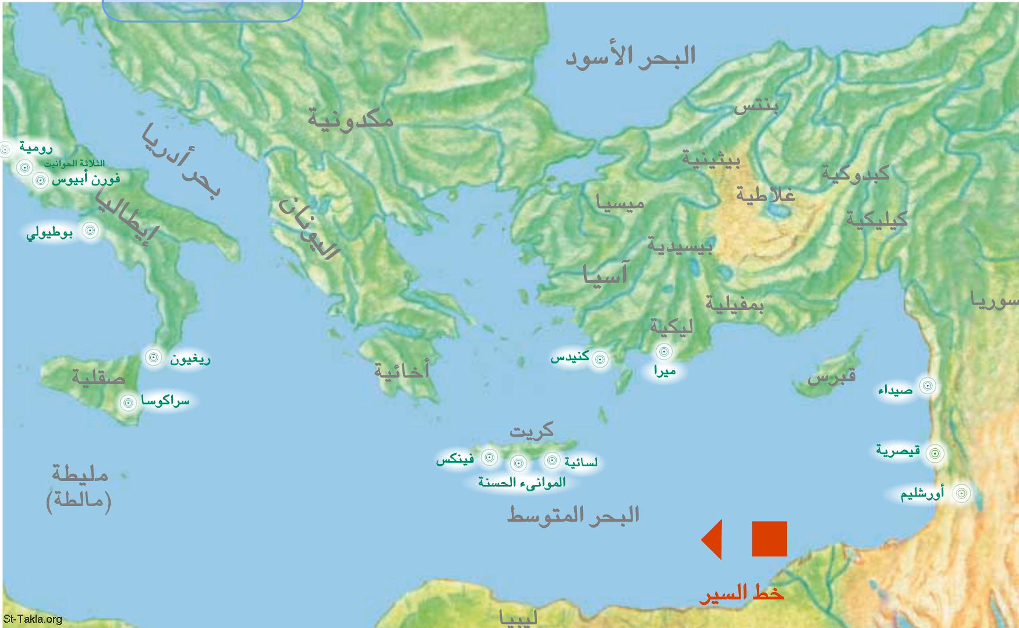

Slide 24
The Pauline Epistles

Slide 25
Introduction to the Pauline Epistles
The Outline of the Epistles:
1. The name of the Sender.
2. The name of the targeted Church or Person.
3. The Apostolic Greeting: ‘Grace and Peace.’
4. Encouraging introduction.
5. Theoretical or Doctrinal part or solving Problems.
6. Practical Commandments.
7. The Closure.

Slide 26
Romans is written by Paul to the church in Rome, systematically explaining the Gospel and its implications.
1 Corinthians is Paul writing to the church in Corinth to repent from their many sins and advising how to navigate the particularly pagan culture they lived in.
2 Corinthians follows with Paul commending the Corinthian church for their repentance, but also responding to claims that he doesn’t care about them.

Slide 27
Galatians is Paul writing to the church in Galatia, rebuking them for drifting into false teaching and reminding them grace removes the need for legalism.
Ephesians is Paul writing to the church in Ephesus about the need for Christian unity and how to achieve it.

Slide 28
Philippians is Paul writing to the church in Philippi about finding joy in Christ and the freedom that comes from that new life.
Colossians is Paul telling the church in Colossae to avoid pagan ideas about Jesus that downplay his divinity, along with instructions about living well.

Slide 29
1 Thessalonians is Paul commending the church in Thessalonica for their great faith and telling them how to continue on that path.
2 Thessalonians follows up the previous letter with Paul encouraging the Thessalonian church to stand amidst persecution.

Slide 30
1 Timothy is Paul writing to his disciple Timothy about how to avoid false teachings and operate a church well.
2 Timothy is apparently written by Paul in his last years, now in prison and suffering, describing what he’s gained and warning Timothy about the last days.

Slide 31
Titus is Paul writing to a disciple pastoring a church on Crete, advising him on how to pastor well.
Philemon is Paul writing to a Christian named Philemon, letting him know he’s met Philemon’s runaway slave Onesimus and asking Philemon to treat Onesimus as a brother when he returns.

Slide 32
Hebrews reminds Christians who had initially practiced Judaism why Christianity is a better covenant. Explain Priesthood of Jesus Christ.

Slide 33
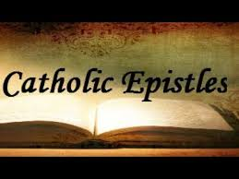

Slide 34
James gives Jewish Christians “scattered abroad” practical principles on how to live for Christ.
1 Peter tells Christians (living mostly in modern-day Turkey) to place their trust and hope in Christ, even amidst persecution.
2 Peter tells Christians to watch out for scoffers and false prophets and affirms that Jesus will return soon.

Slide 35
1 John tells Christians that Jesus was human as well as divine, appealing to the fact the apostles actually saw and touched Jesus. Teaching to “walk in the Light”
2 John encourages “the chosen lady and her children” to practice Christian love and watch out for deceptive people.
3 John encourages a Christian named Gaius who was going through a church dispute.
Jude warns believers to watch out for false prophets.

Slide 36
Introduction to the Pauline Epistles
# | Epistle | Place of Writing | Time of Writing | Main Theme
1 | 1st Thessalonians | Corinth | A.D. 52-53 (2nd Trip) | The Lord’s Second Coming
2 | 2nd Thessalonians | Corinth | A.D. 52-53 (2nd Trip) | The Lord’s Second Coming
3 | 1st Corinthians | Ephesus | A.D. 57 (3rd Trip) | Solving Problems e.g. (Divisions)
4 | 2nd Corinthians | Macedonia | A.D. 57 (3rd Trip) | Christian Ministry
5 | Galatians | Corinth | A.D. 58 (3rd Trip) | Justification by Faith
6 | Romans | Corinth | A.D. 58 (3rd Trip) | Salvation through Christ
7 | Ephesians | Rome | A.D. 61-63 (1st Captivity) | Church (Body of Christ)
8 | Philippians | Rome | A.D. 61-63 (1st Captivity) | Rejoice in the Lord
9 | Colossians | Rome | A.D. 61-63 (1st Captivity) | Christ (Head of the Church)
10 | Philemon | Rome | A.D. 61-63 (1st Captivity) | Appeal for Onesimus
11 | Titus | Ephesus | A.D. 63-64 | Church Order
12 | Hebrews | Italy | A.D. 63-64 | Christ’s Heavenly Priesthood
13 | 1st Timothy | Macedonia | A.D. 64-65 | Pastoral Duties
14 | 2nd Timothy | Rome | A.D. 67-68 (2nd Captivity) | Farewell Discourse

Slide 37


Slide 38


Slide 39
