Slide 1
What is a sacrament?
The Church Sacrament is an invisible grace we receive by practicing a visible rite, and a visible sign or substance performed by a priest.

Slide 2
Purpose of Sacraments
The Holy Spirit works in the Church through the Sacraments, giving us His gifts, blessing and comfort, and teaches us and guides us to the way of truth.
(John 14:26)“ but the comforter, the Holy Spirit, whom the father will send in My name, He will teach you all things ….I said to you”

Slide 3
What Are The Sacraments?
What are the visible substances of the Sacraments?

Slide 4
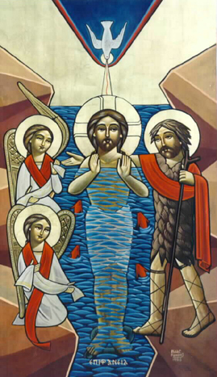
Sacrament of Baptism
In the Baptism the substance is Water by which we receive the second birth from water and Spirit.

Slide 5
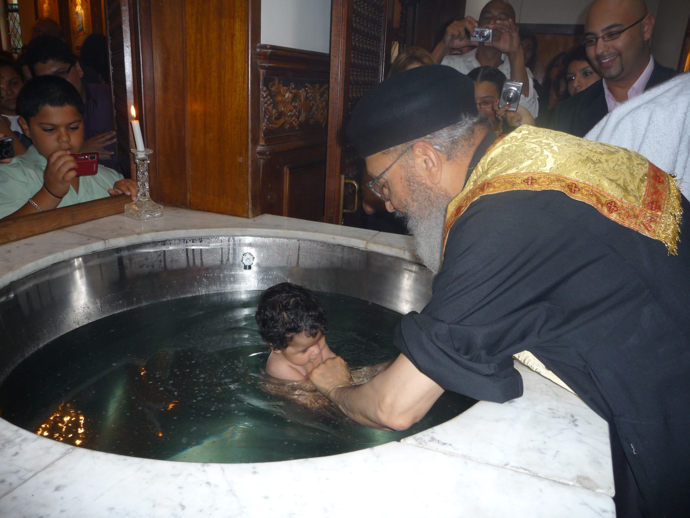

Slide 6
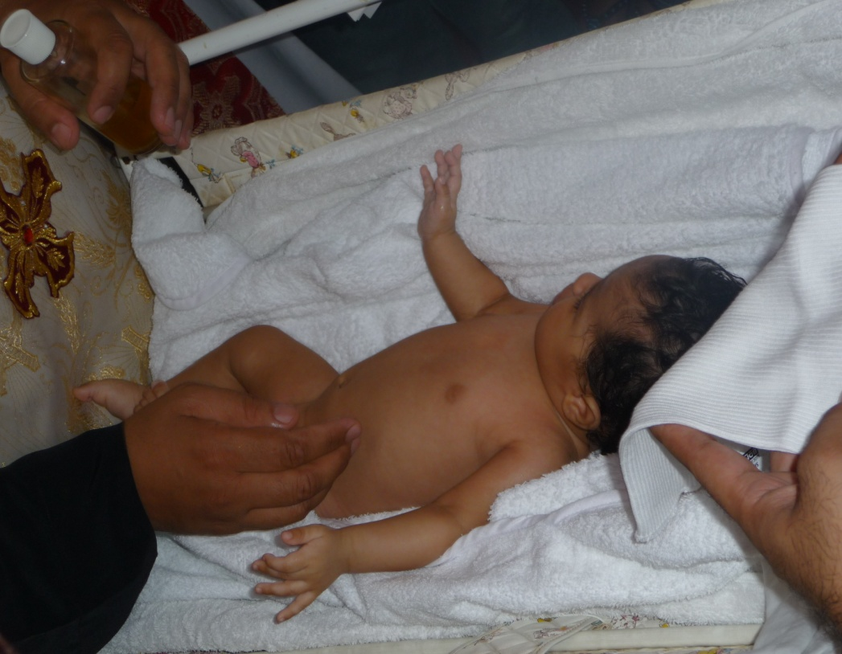
Sacrament of Confirmation.
In the confirmation the substance is the oil of Myron, by which the Holy Spirit dwells in us.

Slide 7
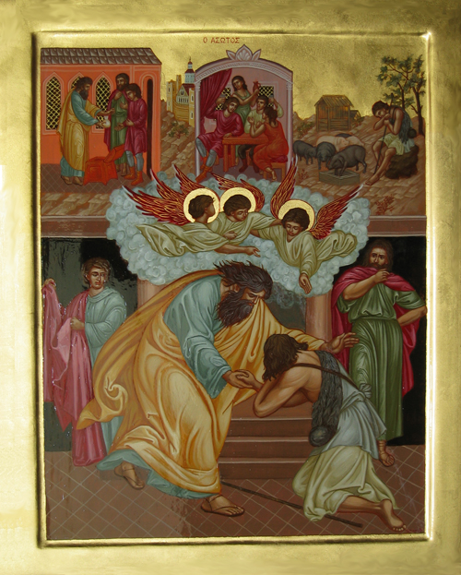
Sacrament of Confession.
The sign of the Sacrament of confession is the confessing person, who accepts the prayer of absolution at the end of Confession to gain forgiveness of sins.

Slide 8
Repentance and Confession

Slide 9
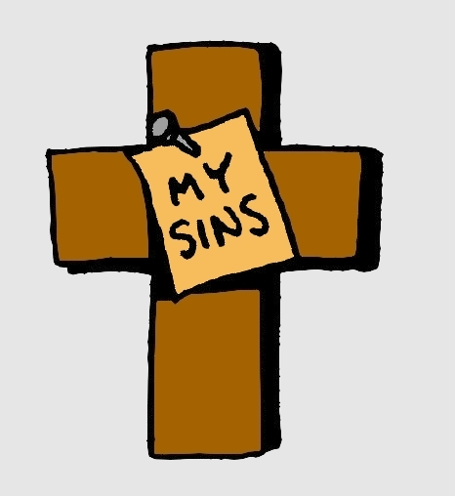
SIN
Do we all sin?
Is anyone without sin?
“If we say that we have no sin, we deceive ourselves, and the truth is not in us. (1 John 1:8)
What does sin do?
Separates me from God.
Hurts my relationship with God.
Must learn to see my sins in order to overcome them.
When we confess our sins, Christ carries them on our behalf.

Slide 10
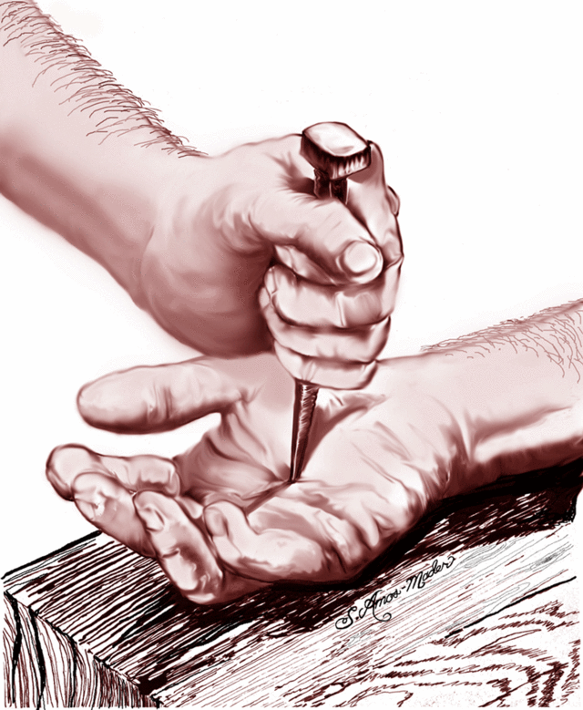
Repentance
Do we feel bad that sin hurts my relationship with God?
Do we feel bad that my sin breaks God’s heart?
Do we feel bad that our sin is what caused Jesus to be nailed to the Cross, suffer, and die for us?

Slide 11
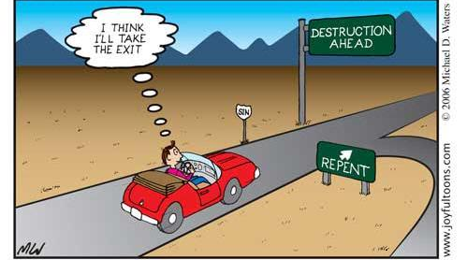
Repentance means changing direction.
Can’t say I’ve repented if I’m not planning on changing or stopping my sin.
Can’t say I’ve repented from lying, if lie again tomorrow!

Slide 12
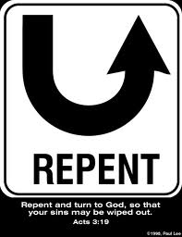
Repentance
Sin is something that God hates, and that we should hate too!
Must be sad over our sin!
Must stop that which causes me to sin.
Must go to the root.
Need to CHANGE
The feeling we get after sinning, (repentance), makes us not want to do the sin again!

Slide 13
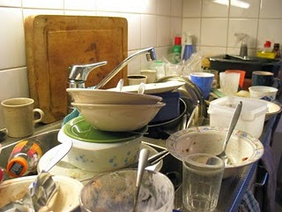
Repentance
Have you ever seen dishes that were really dirty for days and weren’t washed?
Isn’t it harder to wash them the longer they have stayed dirty?
The longer we leave dishes unwashed, the harder it is to remove the stains.
If I keep living with my sin, it is going to be harder to overcome it.
If I repent and get rid of it right away, it’s a lot easier to overcome it!

Slide 14


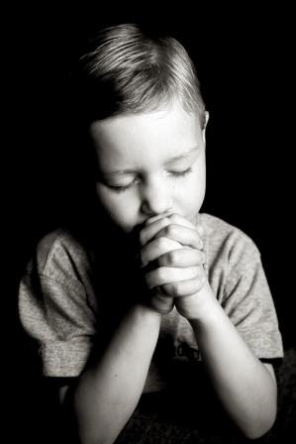
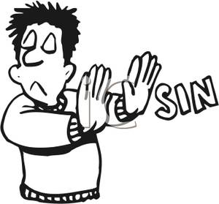

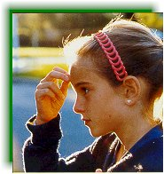


Repentance
Pray and ask God for forgiveness and strength to never do the sin again!
Pray and as God to forgive us and help us never do it again.
must examine ourselves daily
Decide with all your heart to stay away from the sin and not go back to it.
Stay away from anything that makes you sin
Fight any sinful thoughts with the sign of the cross and don’t think about it.
→Check senses
thoughts,
deeds…

Slide 15
He who covers his sins will not prosper, but whoever confesses and forsakes them will have mercy. (Proverbs 28:13)

Slide 16
If I did something bad to someone, must apologize!
“If I have taken anything from anyone by false accusation, I restore fourfold.” (Luke 19:8)

Slide 17

Confession
Comes only after true repentance.
Not just saying sorry I did this... must FEEL sorry.
Confession without repentance is something just on the outside. God looks to our HEART!

Slide 18


Confession
Don’t make excuses
→ “I didn’t meant to”
→ “It wasn’t my fault”
→ “Someone made me do it”...
Don’t justify your sin by telling stories around it
Confess everything, don’t hide anything.
At the end, could ask Abouna to give you a spiritual exercise to overcome the sin.

Slide 19
Confession
Must be regular.
We are confessing to God in the PRESENCE of the priest.
It is God who forgives us our sins.
This is why it’s a sacrament, a mystery.
→ A visible act, with an invisible gift.
When the priest prays the absolution, Jesus takes away our sins.
“The LORD also has put away your sin” (2 Samuel 12:13)

Slide 20
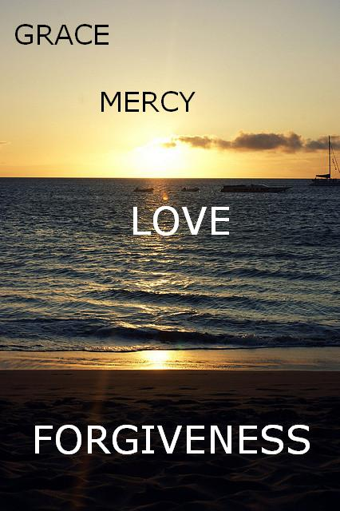
“If we say that we have no sin, we deceive ourselves, and the truth is not in us. If we confess our sins, He is faithful and just to forgive us our sins and to cleanse us from all unrighteousness.” (1 John 1:8-9)

Slide 21
Repentance Confession
AND
Repentance MUST come before confession.
Confession without repentance is useless.
Shouldn’t be going to confession just because that’s what everyone else does.
Must feel bad about my sin, pray and ask God to help me change and try to STOP the sin.
Confession MUST come after repentance.

Slide 22

Wrong things people sometimes say...
X. I can’t go
back to God...
X. There’s no point
confessing after
what I did.
X. God will
never forgive
me.

Slide 23
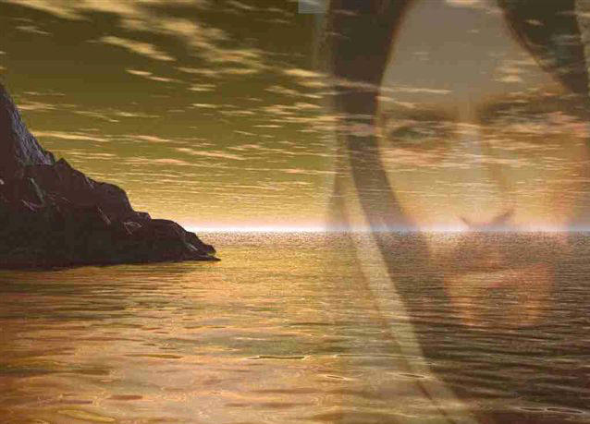
“The Lord is merciful and gracious, slow to anger, and abounding in mercy.” Psalm 103:8
After repentance and confession, sins are completely forgiven!
As far as the east is from the west, So far has He removed our transgressions from us. (Psalm 103:12)

Slide 24
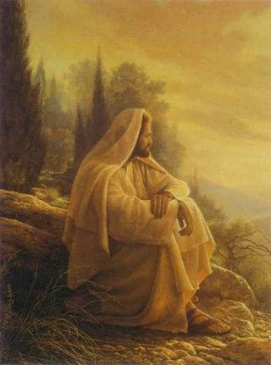
How amazing is it that our Lord is waiting patiently for us, wanting us to go to Him, ready to forgive us our sins!

Slide 25
It’s a great blessing that God gives us that we have a father of confession who will listen to us with love and can guide us to overcome our sins, and bring us closer to Jesus.

Slide 26
Summing it up....
Examine myself.
Admit my sins.
Pray to God and ask for forgiveness and strength.
Apologize to anyone I wronged
Make a decision to change and stop my sin.
Confess my sin in the presence of Abouna.
Thank God for His mercy, love and forgiveness.
repentance

Slide 27
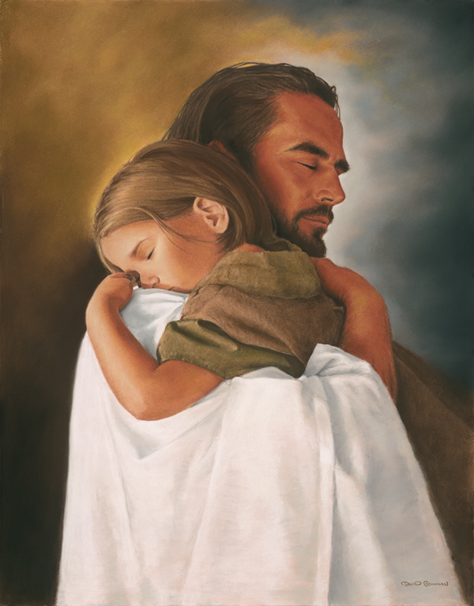
And the one who comes to Me I will by no means cast out. (John 6:37)
Memory verse

Slide 28
To Practice
Praying and asking the Holy Spirit to help me examine myself.
Examine myself every night.
Checking my thoughts, senses, deeds.
→Where did I sin, and what’s causing me to sin.
Asking God for forgiveness and strength to hate the sin and overcome it.
Going to Confession where I confess my sins to God in front of Abouna.

