Slide 1

NUMBERS &
DEUTeRONOMY

Slide 2
Numbers
Leviticus ends with building of Tabernacle
Israelites had been living at mount Sinai for 1 year
They restart journey to the promised land
The book is in sequence
Three main sections:

Slide 3
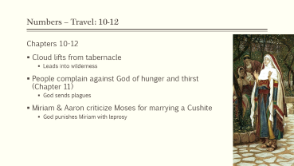
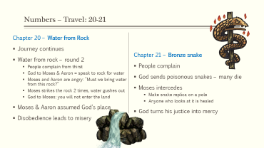
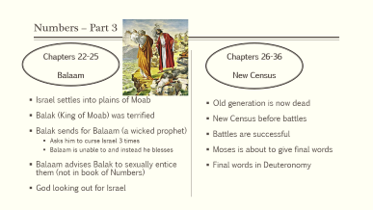
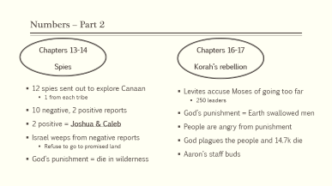
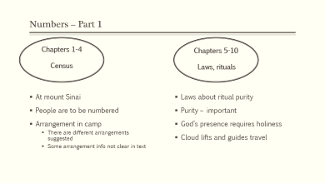
Part 1 - Chapters 1-10
Census & Laws
Part 2 – Chapters 13-19
At Paran, reject Canaan
Part 3 - Chapters 22-36
At Moab & New Census
Travel
Chapters 10-12
Travel
Chapters 20-21

Slide 4
Numbers – Part 1
Chapters 1-4
Census
Chapters 5-10
Laws, rituals
At mount Sinai
People are to be numbered
Arrangement in camp
  There are different arrangements suggested
  Some arrangement info not clear in text
Laws about ritual purity
Purity – important
God’s presence requires holiness
Cloud lifts and guides travel

Slide 5
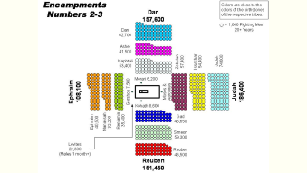
Part 1 - Chapters 1-10
Census & Laws
Part 2 – Chapters 13-19
At Paran, reject Canaan
Part 3 - Chapters 22-36
At Moab & New Census
Travel
Chapters 10-12
Travel
Chapters 20-21

Slide 7
Part 1 - Chapters 1-10
Census & Laws
Part 2 – Chapters 13-19
At Paran, reject Canaan
Part 3 - Chapters 22-36
At Moab & New Census
Travel
Chapters 10-12
Travel
Chapters 20-21

Slide 8
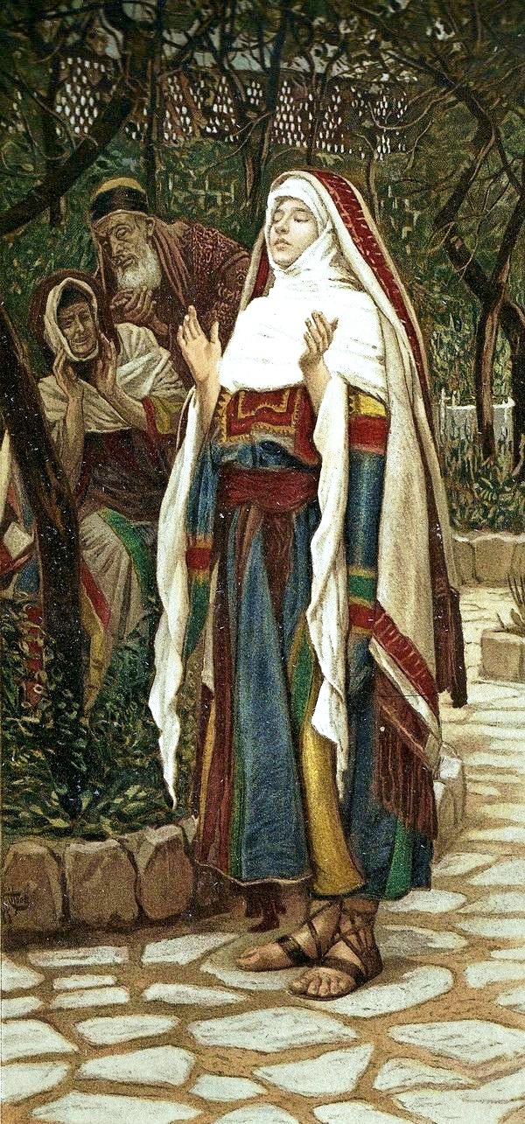
Numbers – Travel: 10-12
Chapters 10-12
Cloud lifts from tabernacle
  Leads into wilderness
People complain against God of hunger and thirst (Chapter 11)
  God sends plagues
Miriam & Aaron criticize Moses for marrying a Cushite
  God punishes Miriam with leprosy

Slide 9
Numbers – Part 2
Chapters 13-14
Spies
Chapters 16-17
Korah’s rebellion
12 spies sent out to explore Canaan
  1 from each tribe
10 negative, 2 positive reports
2 positive = Joshua & Caleb
Israel weeps from negative reports
  Refuse to go to promised land
God’s punishment = die in wilderness
Levites accuse Moses of going too far
  250 leaders
God’s punishment = Earth swallowed men
People are angry from punishment
God plagues the people and 14.7k die
Aaron’s staff buds

Slide 10

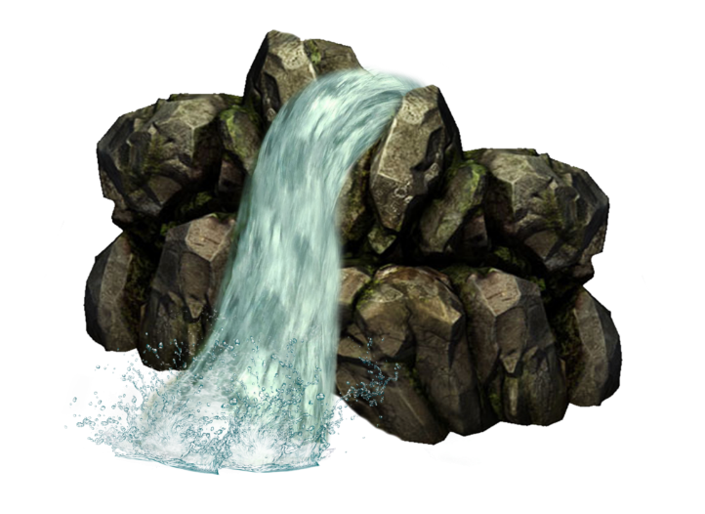
Numbers – Travel: 20-21
Chapter 20 – Water from Rock
Journey continues
Water from rock – round 2
  People complain from thirst
  God to Moses & Aaron = speak to rock for water
  Moses and Aaron are angry: “Must we bring water from this rock?”
  Moses strikes the rock 2 times, water gushes out
  God to Moses: you will not enter the land
Moses & Aaron assumed God’s place
Disobedience leads to misery
Chapter 21 – Bronze snake
People complain
God sends poisonous snakes – many die
Moses intercedes
  Make snake replica on a pole
  Anyone who looks at it is healed
God turns his justice into mercy

Slide 11
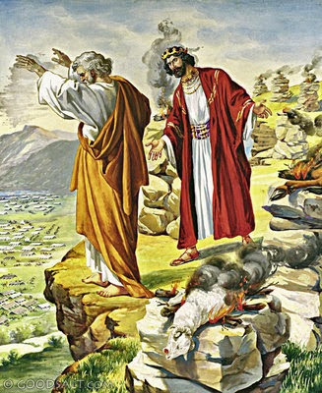
Numbers – Part 3
Chapters 22-25
Balaam
Chapters 26-36
New Census
Israel settles into plains of Moab
Balak (King of Moab) was terrified
Balak sends for Balaam (a wicked prophet)
  Asks him to curse Israel 3 times
  Balaam is unable to and instead he blesses
Balaam advises Balak to sexually entice them (not in book of Numbers)
God looking out for Israel
Old generation is now dead
New Census before battles
Battles are successful
Moses is about to give final words
Final words in Deuteronomy

Slide 12
Deuteronomy

Slide 13
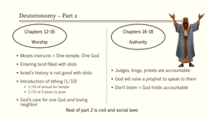
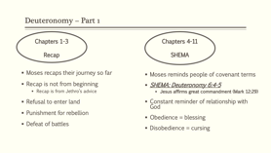
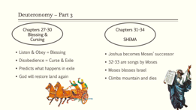
Part 1 - Chapters 1-11
Recap and SHEMA
Part 2 – Chapters 12-26
Second Law
Part 3 - Chapters 22-36
Conclusion

Slide 14
Deuteronomy – Part 1
Chapters 1-3
Recap
Chapters 4-11
SHEMA
Moses recaps their journey so far
Recap is not from beginning
  Recap is from Jethro’s advice
Refusal to enter land
Punishment for rebellion
Defeat of battles
Moses reminds people of covenant terms
SHEMA: Deuteronomy 6:4-5
  Jesus affirms great commandment (Mark 12:29)
Constant reminder of relationship with God
Obedience = blessing
Disobedience = cursing

Slide 15
Deuteronomy – Part 2
Chapters 12-16
Worship
Chapters 16-18
Authority
Moses instructs = One temple, One God
Entering land filled with idols
Israel’s history is not good with idols
Introduction of tithing (1/10)
  1/10 of annual for temple
  1/10 of 3 years to poor
God’s care for one God and loving neighbor
Judges, kings, priests are accountable
God will raise a prophet to speak to them
Don’t listen = God holds accountable
Rest of part 2 is civil and social laws
Notes:
Civil = family, marriage, business
Social = Widow, orphan, immigrants

Slide 16
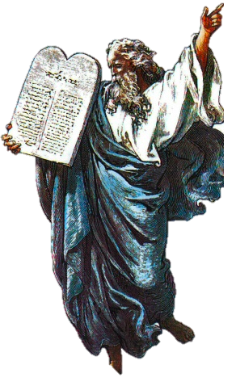
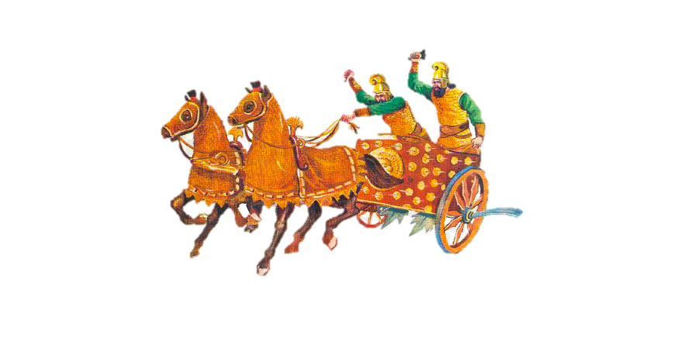
Deuteronomy – Part 3
Chapters 27-30
Blessing &
Cursing
Chapters 31-34
SHEMA
Listen & Obey = Blessing
Disobedience = Curse & Exile
Predicts what happens in exile
God will restore land again
Joshua becomes Moses’ successor
32-33 are songs by Moses
Moses blesses Israel
Climbs mountain and dies

