Slide 1
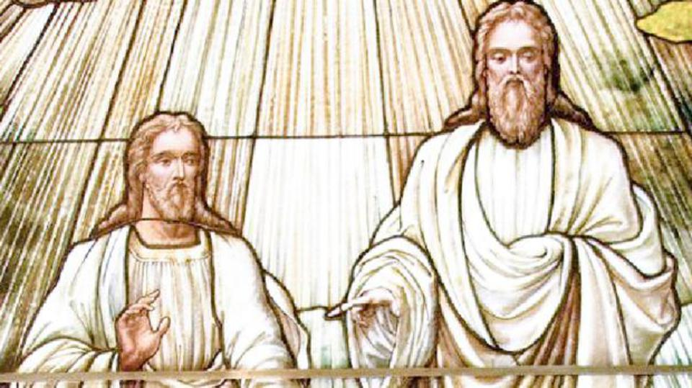
The Mormons

Slide 2
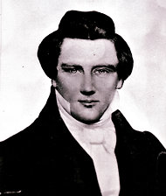
The Mormons, also known as the Church of Jesus Christ of Later-Day (Latter-Day)
Saints (LDS). They prefer to be addressed by this latter name. The founder of this religion is Joseph Smith who was born in 1805 in the state of Vermont in the United States. Since his adolescent years, he was said to have experienced heavenly visions.

Slide 3
In 1820, 14-year-old Joseph Smith, living in Palmyra, New York, questioned which religious denomination he should join. After reading James 1:5 in the Bible, he decided to ask God. He went to a grove of trees near his home and prayed out loud for the first time. As a result, a unique event happened:

Slide 4
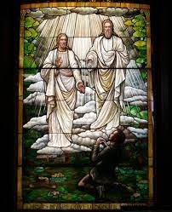
a unique event happened: God the Father and His Son Jesus Christ appeared to Joseph. He was instructed to join none of the denominations but to restore Jesus Christ’s ancient Church in modern times: The Church of Jesus Christ of Latter-day Saints.

Slide 5
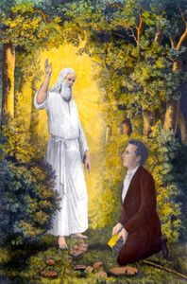
In another listing,
In 1820, when he was 15 years old, an angel (Called Moron)appeared to him and convinced him that all Christian religions and churches are wrong and far from the ways of God. Then the angel handed him golden tablets with certain writings. The angel explained the way these writings should be understood.
These writings became the book of Mormons, which was the name given to Joseph Smith by the angel. In 1829, three apostles visited Joseph Smith and gave him the power to establish the true church. The book of Doctrine and Covenants was written by Joseph Smith as an outcome of many visions. He then started correcting the Holy Bible.

Slide 6
The members of the Church of Jesus Christ of Latter-day Saints had been persecuted for their beliefs ever since Joseph Smith founded the church in New York in 1830. Smith’s claim to be a modern-day prophet of God and his acceptance of polygamy proved controversial wherever the Latter-day-Saints attempted to settle.

Slide 7
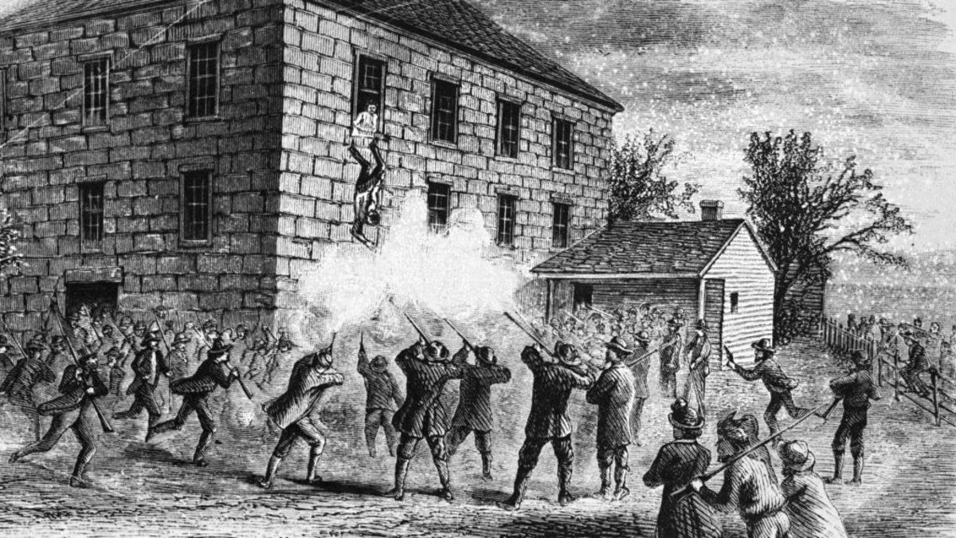
Expansion and growth for Mormons
The Mormon Church grew rapidly. On June 27, 1844, both Smith and his brother were murdered in jail by an anti-Mormon mob in Carthage, Illinois.

Slide 8
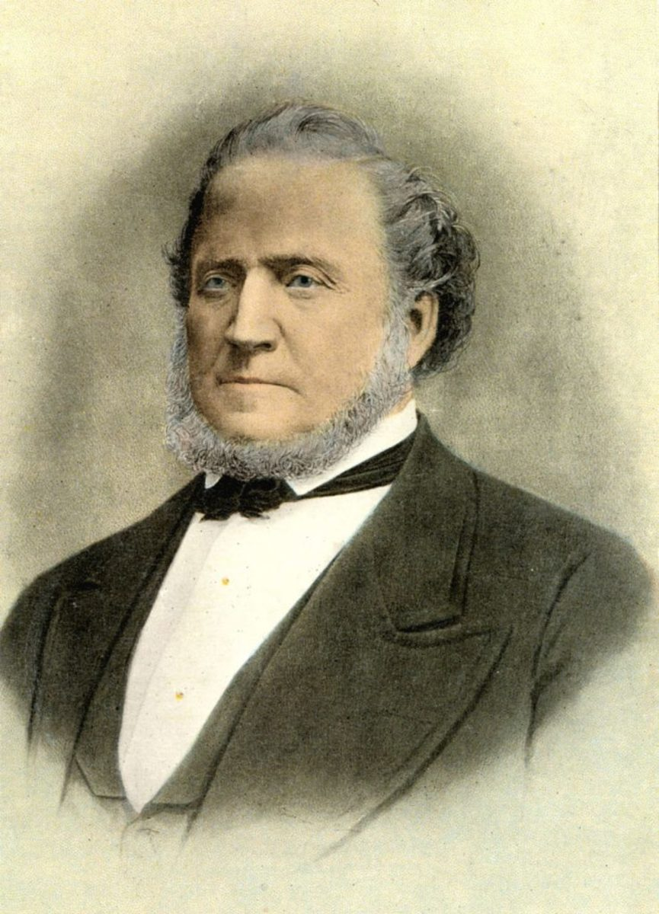
Expansion and growth for Mormons
.There was a disagreement on who should be Joseph Smith's successor. Some wanted one of his sons to take hi father's position and they rejected the fellowship of Birgham Young. Birgham Young became the new leader for the majority of Mormons
These groups established headquarters to themselves in Missouri under the leadership of Joseph Smith's family and were called the reorganized Church of Jesus Christ of Latter-day Saints and refused to be called Mormons.

Slide 9
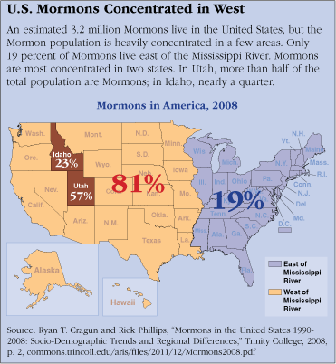
Young led a large group of persecuted Mormons from Illinois to search for religious freedom. In 1847, Young and the other pioneers reached Utah’s Salt Lake Valley.

Slide 10
Consequently, the Mormons are now divided into
two groups:
- the first big group has its headquarters in Utah
- and the smaller group is established in Missouri. This smaller group kept the book of Joseph Smith and rejected the beliefs shared by the big group. Consequently they became closer to the Protestant Church in their beliefs.

Slide 11
The Mormons' Sacred Texts:
The Book of Mormons: Is considered more important than the Holy Bible. This book also says that the Native Americans belong to the ancient Hebrew people and that Jesus Christ came to America after His resurrection in order to preach the Bible to those who came from Israel.
2. The Book of Doctrine and Covenants: Which was written by Joseph Smith, contains the divine visions
that God gave him.
3. The Book of The Pearl of Great Price: This book contains Joseph Smith articles regarding faith and his
personal life.
4. The Corrected Holy Bible: It is the version that includes the changes made by Joseph Smith done under
the guidance of the divine visions he received from God.

Slide 12
Are the Mormons Christians?
The Mormons consider themselves Christians. They even think that they are the only real Christians in
the world with a true religion. But in reality, they are not Christians because:
they reject all the fundamental beliefs of Christianity.
They reject the traditional concept of the nature of God which is shared by the other Christian churches.
They also reject the concept of the nature of Jesus Christ, the principle of the trinity, the existence of the original sin, human salvation through the blood of Christ and the Kingdom of Heaven.

Slide 13

Some of their beliefs and the answers to frequently asked questions.

Slide 14
• The possibility of the extension of the Bible and the vision according to the Mormons.
• The Mormons say that God will continue giving visions to humans and will speak to them. According to them it is possible to add to the bible as they have added the visions of Joseph Smith and his writings.
The Answer:
• “From Jerusalem and round about to Illyricum I have fully preached the Gospel of Christ”
(Romans 15:19).
• “I found it necessary to write to you exhorting you to contend earnestly for the faith which was once for all delivered to the Saints.” (Jude 3).

Slide 15
Creation According to the Mormons:
The gods prepared for the creation of heaven and earth with the leadership of a chief of the committee of gods.
The Answer:
• “In the beginning God created the heavens and the earth.” (Genesis 1:1).
• “You alone are the Lord; You have made heaven, the heaven of heavens, with all their host, the earth and all things on it, the seas and all that is in them, and you preserve them all. The host of heaven worships You.” (Nehemiah 9:6).

Slide 16
There are many gods. They have a temple, which is the temple of gods, and they have a chief.
The Answer:
• “Hear, O Israel; the Lord our God, the Lord is One.” (Deuteronomy 6:4).
• “Before Me there was no God formed nor shall there be after me.” (Isaiah 43:10).
• “I am the First and I am the Last; besides Me there is no God.” (Isaiah 44:6).
The many gods of the Mormons:

Slide 17
There is no Holy Trinity:
The Mormons believe that the Holy Trinity is absurd and that three in one and one in three is a wrong concept.
The Answer:
• “Hear, O Israel; the Lord our God, the Lord is One.” (Deuteronomy 6:4).
• “Go therefore and make disciples of all the nations, baptizing them in the name of the Father and of the Son and of the Holy Spirit.” (Matthew 28:19).

Slide 18
God is human in the Mormons’ Faith:
God is a physical being like us made of flesh and bones.
The Answer:
• “God is Spirit.” (John 4:24).
• “I am God and not man, the Holy One in your midst.” (Hosea 11:9).

Slide 19
There is no salvation outside the Mormon Church where heavenly visions are continuous:
There is no salvation for humans outside the Mormon Church where the heavenly visions are continuous and all the blessings and the new teachings are available.
The Answer:
• “For the grace you have been saved through faith and that not of yourselves; it is the gift of God; not of works, lest anyone should boast.” (Ephesians 2:8-9).
• “Not by works of righteousness which we have done but according to His mercy He saved us, through the washing of regenerating and renewing of the Holy Spirit.” (Titus 3:5).

Slide 20
A Human Being Can Become a God:
A person can learn how to become a god like all the previous gods; i.e. Abraham, Isaac, and Jacob.
The Answer:
• “Therefore, You are great, O Lord God. For there is none like You, nor is there any God besides You, according to all that we have heard with our rears.” (2 Samuel 7:22).
• “I am God, and not man, the Holy One in your midst.” (Hosea 11:9).

Slide 21
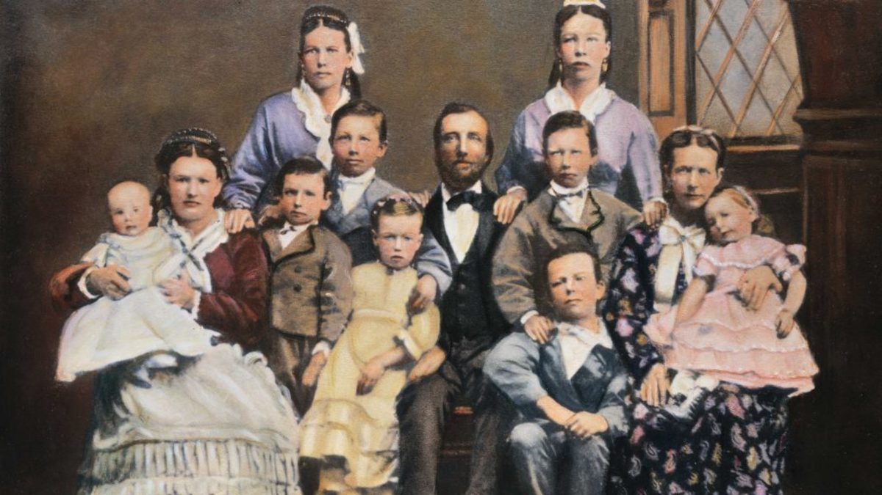
Other beliefs
Polygamy
As early as 1890, the practice of polygamy had come to its end when Church President Wilford Woodruff was inspired by God to issue a declaration.
A colorized photograph of a 19th century polygamous Mormon family with two wives and nine children. (Credit: Bettmann Archive/Getty Images)

Slide 22
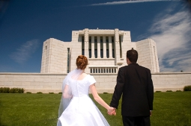
Other beliefs
Celestial marriage
In the LDS Church today, both men and women may enter a celestial marriage with only one living partner at a time
Celestial marriage (also called the New and Everlasting Covenant of Marriage, Eternal Marriage, Temple Marriage) is a doctrine that marriage can last forever in heaven. This is a unique teaching of the Church of Jesus Christ of Latter-day Saints (LDS Church) or Mormonism, and branches of Mormon fundamentalism

Slide 23
Are the Mormons Christians?
The Mormons consider themselves Christians. They even think that they are the only real Christians in
the world with a true religion. But in reality, they are not Christians because:
they reject all the fundamental beliefs of Christianity.
They reject the traditional concept of the nature of God which is shared by the other Christian churches.
They also reject the concept of the nature of Jesus Christ, the principle of the trinity, the existence of the original sin, human salvation through the blood of Christ and the Kingdom of Heaven.

Slide 24
SEVENTH DAY ADVENTIST
History.
They appeared in the nineteenth century through the leadership of a man named William Miller who was born in the year 1782 and died in 1849. However, the movement started around the year 1818.
Then, many leaders succeeded William Miller such as Hiram Edson, Joseph Bates, and Ellen White. Each one had a role in the Adventist movement.
At the beginning, the movement focused on the second coming of the Lord Jesus Christ and Miller talked about the coming of the Lord Christ. When the exact timing could not be determined, Hiram Edson spoke of the heavenly sanctuary.
O.R.L Crosier published a research paper about the heavenly sanctuary. Then, Joseph Bates spoke about the Sabbath day. Since then, the observance of the Sabbath on Saturday was added to their doctrine and were thus termed the Seventh Day Adventists.
Finally, Ellen White, who was born in 1827 and died in 1915, took leadership. She lived 88 years and is known as the founder. White excelled over her predecessors and became the leader.

Slide 25
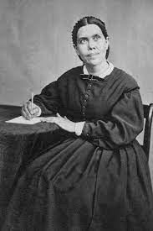
SEVENTH DAY ADVENTIST
History
Ellen White.
She was described as a visionary, in the literal sense as she spoke of seeing visions.
She said that her visions were the source of the Adventist teaching.
The Adventist movement started by William Miller teaching that the world will end after 25 years from the year 1818 or that the world will end in the year 1843 and Christ will come in 1843.
This belief had spread to an extent where students would not attend school and believers cast off their responsibilities, however Chris did not come. Ellen White explained to them that He came and ruled in the heavenly Jerusalem.
Of course, Christ rules in the heavenly Jerusalem ever since the creation of man and there is no specified time because He rules in heaven eternally.

Slide 26
What are their beliefs?
They believe that the Sabbath is the holy day and the person who does not observe it will not enter the Kingdom of God
b) They believe in three advents of the Lord Jesus Christ and with a heavenly sanctuary.
c) They believe that the Lord Christ is the Archangel Michael and they agree on this along with Jehovah's witnesses. They claim that Jesus Christ was born with the original sin, that His knowledge is incomplete, that He is susceptible to falling, that His sacrifice on the cross is insufficient, that He was separated from the Father, and that the Holy Spirit is the delegate of Christ on earth.
d) They do not believe in the imperishability/eternity of the spirit.

Slide 27
Sabbath is the holy Day???
Response:
There is a difference between the phrase “seventh day” and the word “Sabbath”.
The word seven means “rest”. God hallowed this rest when the Sabbath was exchanged with Sunday. Just because it is a divine commandment does not mean that we currently offer burnt offering, sin offering, iniquity offering, peace offering, and all other sacrifices pertaining to different issues? Truly it is a commandment but it was a symbol for what was going to happen in the New Testament and all sacrifices were symbolic for Christ’s sacrifice.
The Lord Jesus Christ resurrected on Sunday and His resurrection became a token for our resurrection and the core of the disciples’ preaching.

Slide 28
Christ is the Archangel Michael??
Perhaps what caused the mistake of the Adventist believing that Christ is the Archangel Michael is that the Holy Bible sometimes used the phrase “angel of the Lord” or “angel of God” in referring to God Himself, meaning that God appeared in the form of an angel
To summarize this point, we refer to Hebrews 1:5-8, “For to which of the angels did He ever say: “You are My Son, today I have begotten you?” And again: “I will be to Him a Father, and He shall be to Me a Son”? But when He again brings the firstborn into the world, He says: “Let all the angels of God worship Him.” And of the angels He says: “Who makes His angels spirits and His ministers a flame of fire” But to the Son He says: “You throne, O God, is forever and ever; A sceptre of righteousness is the sceptre of Your kingdom.”

Slide 29
They do not believe in the imperishability of the spirit
Response
Those Adventists in their assumption that there are no spirits and that the spirits do not feel or
recognize, are similar to the Sadducee which the Lord addressed in Matthew 22 and said to
them: “God is not the God of the dead but of the living.” So why does He say that I am the God of Abraham, the God of Isaac, and the God of Jacob, He is the God of the living and not of the dead. It is as if Abraham, Isaac, and Jacob are alive. Also, St. John in the book of Revelation saw the spirits of the martyrs under the altar crying out to God and He answered them which implies that they recognize and feel.

Slide 30
Coclusion
We must study comparative theology so that we can be familiar with these heresies and answer with confidence and understanding.
2) We must not be deceived with these heresies but be cautions from them and avoid fellowship with such examples.
3) The danger of relying on one verse concerning the doctrine is very clear. We must understand the entire Bible (both Testaments) and put all the verses and situations together. Then, with the guidance of God we will be able to reach the sound doctrine and this is what the Coptic Orthodox Church does.
4) The Adventists are from a protestant origin.
5) The Seventh Day Adventist is one of the contemporary cults that appeared in the 19th Century.

Slide 31

Take HEED
“For many deceivers have gone out into the world who do not confess Jesus Christ as coming in the flesh. This is a deceiver and an antichrist. Look to yourselves, that we do not lose those things we worked for, but that we may receive a full reward. Whoever transgresses and does not abide in the doctrine of Christ does not have God. He who abides in the doctrine of Christ has both the Father and the Son. If anyone comes to you and does not bring you this doctrine, do not receive him into your house nor greet him; for he who greets him shares in his evil deeds.” (2 John 7-10).

