Slide 1
Sacraments
By Daniel Haddad

Slide 2
What are Sacraments?
Notes:
A Church Sacrament is a holy ordinance through which the believer receives an invisible grace under the form of an outward sign, visible or audible. It is instituted by Christ, Himself.
But our Church believes that there is a real efficacy (desire) in the Sacraments themselves and that they truly bring invisible graces to the believers.

Slide 3
“When once the Divine long suffering waited in the days of Noah, while the ark was being prepared, in which a few, that is, eight souls were saved through water. There is also an antitype which now saves us.” (1Pet. 3: 20- 21)
“Unless you eat the flesh of the Son of Man and drink His blood, you have no life in you” (John 6:53)
“Whoever eats My flesh, and drinks My blood, has eternal life, and I will raise him up at the last day… He who eats this bread will live forever.” (John 6:54 - 58)
Notes:
Simple examples of how we believe that this is real. It is not fake, it is not a symbol we believe it to be Truth

Slide 4


Slide 5
How many Sacraments are there?
Notes:
Baptism, Chrismation/confirmation, Confession/repentance, Holy Communion, Unction for the Sick, Matrimony and Holy Orders/priestly orders.

Slide 6

Baptism, Confirmation, & Repentance
Notes:
Disclaimer: I will try my best with the Grace of God to highlight the key essential points within these three rights. I will be honest this is merely a drop of knowledge to how much more information there is. I highly recommend that each of you continue your learning. Please, do not stop seeking TRUTH.

Slide 7
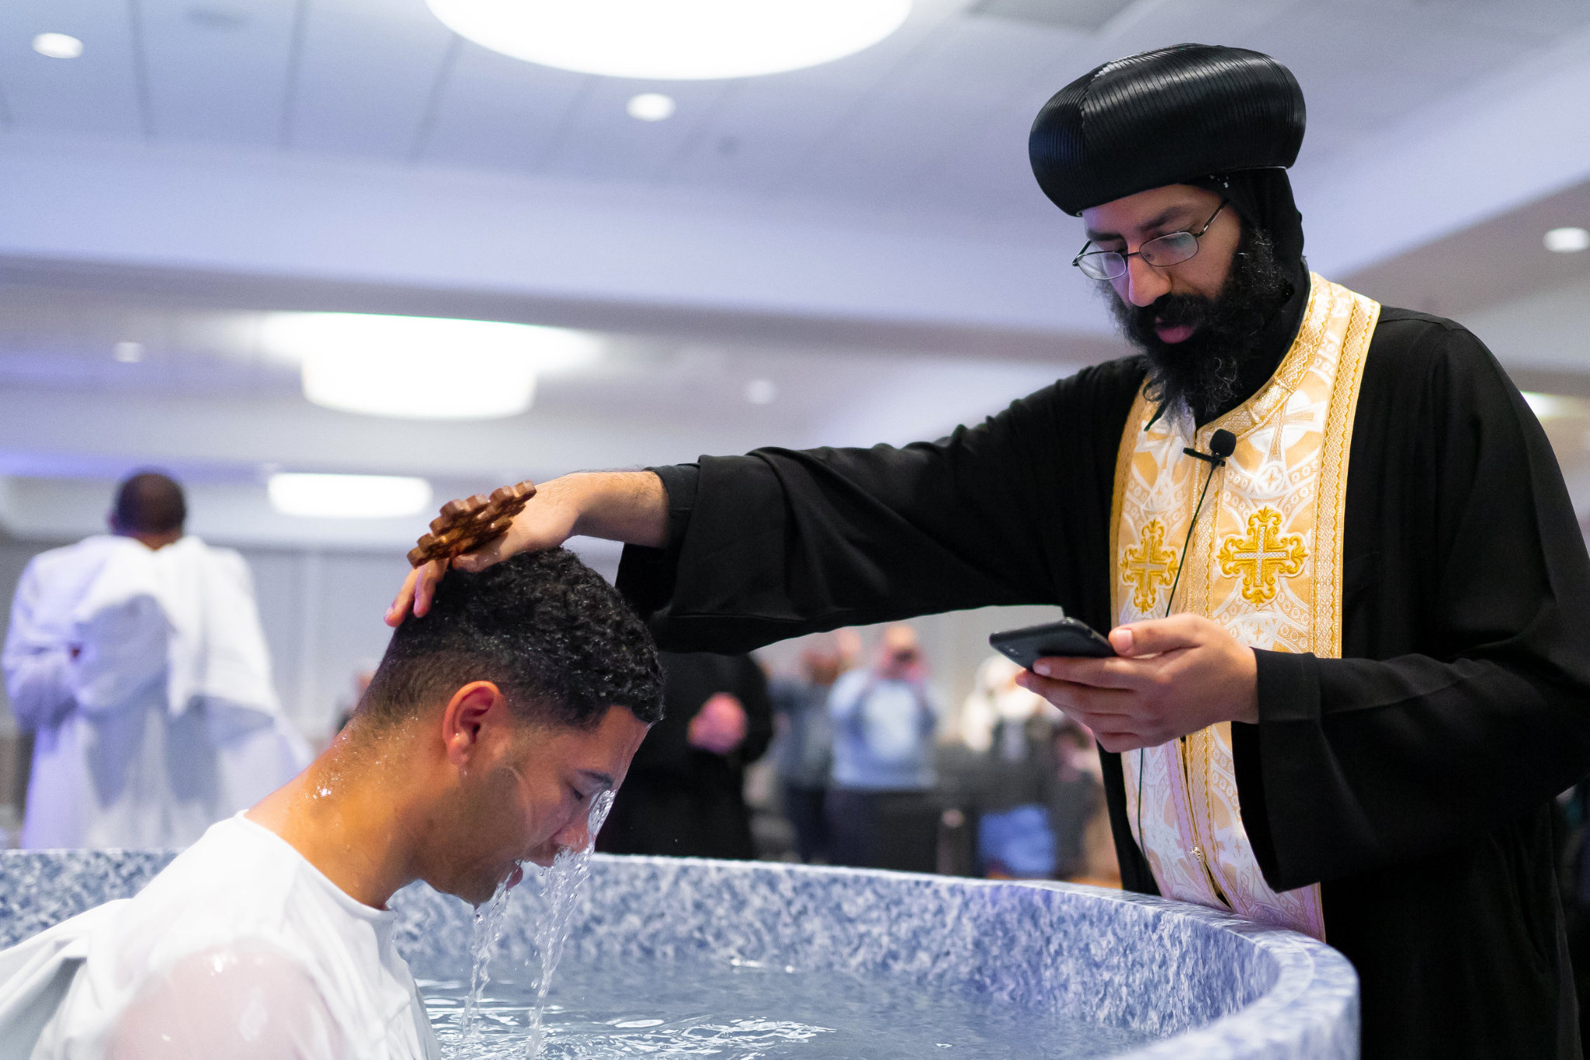
Baptism
Notes:
Baptism is the Sacrament through which a person is born again and accepted into the membership of the Church after being dipped into water three times, in the name of the Father, the Son and the Holy Spirit.
Of all the Sacraments it is the first because it is considered to be the door through which the believer enters the Church and the kingdom of grace according to what was said by the Lord “Most assuredly, I say to you, unless one is born of water and the spirit, he cannot enter the Kingdom of God.” (John 3:5).
Therefore, baptism must be received by believers before they can receive any other Sacrament.

Slide 8
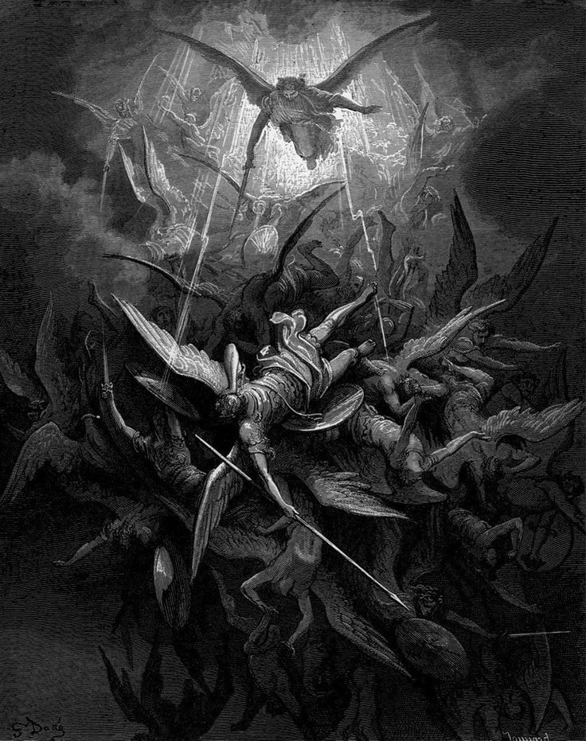
Notes:
I’ve quoted St. Andrew of Caesarea on this before, but he said that after the devil fell through envy, and that’s envy of humanity, because humanity was created for this destiny in Christ, that angels don’t have, that the devil didn’t have, and so that anger and resentment led him to try to destroy humanity.

Slide 9
Sponsor: I renounce you Satan, and all your unclean works, and all your wicked angels and all your evil demons, and all your power, and all your abominable service, and all your evil cunning and error, and all your army, and all your authority and all the rest of your impieties. I renounce I you. I renounce you. I renounce you.
Then, the priest breathes into his or her face and says the following three times,
Priest: Come out O unclean spirit.
Then, they turn to the East, with both of their hands uplifted, and say,
Sponsor: I confess You, O Christ my God, and all Your saving laws, and all Your living service, and all Your life giving works.
Then the priest teaches him or her the faith.
Priest: I believe in one God, God, the Father, the Pantocrator, and His only-begotten Son, Jesus Christ, our Lord, and the Holy Spirit, the Giver of Life, and the resurrection of the flesh, and the one, only, holy, catholic and apostolic Church. Amen.
And he asks him or her three times, saying,
Do you believe?
And he or she answers each time with,
Sponsor: I believe.
Notes:
Baptism vows

Slide 10

Why water?

Slide 11
The Ark of Noah, “When once the Divine longsuffering waited in the days of Noah, while the ark was being prepared, in which a few, that is, eight souls were saved through water. There is also an antitype which now saves us, baptism” (1 Pet. 3:20, 21)
The circumcision “In Him, you were also circumcised with the circumcision made without hands by putting off the body of the sins of the flesh, by the circumcision of Christ buried with Him in baptism” (Col. 2:11, 12)
Crossing the Red Sea “Moreover, brethren, I do not want you to be unaware that all our Fathers were under the cloud, and all passed through the sea, all were baptized into Moses in the cloud and in the sea” (1Cor. 10:1, 2).
Notes:
Old testament commentary

Slide 12
Because Christ said so.

Slide 13

Notes:
JOKES, I fooled yall

Slide 14
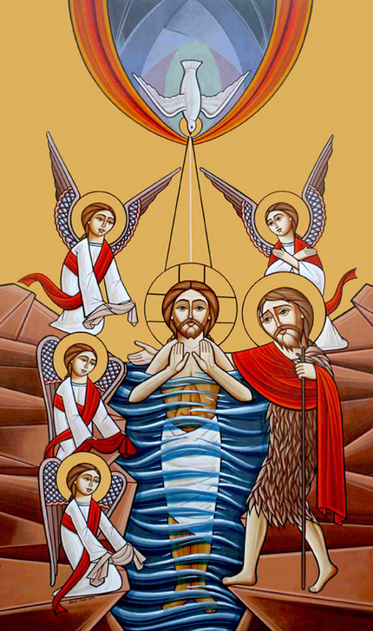
“All authority has been given to Me in heaven and on earth. Go therefore and make disciples of all the nations, baptizing them in the name of the Father, of the Son and of the Holy Spirit.” (Matt. 28:18-19)
Christ said, “Most assuredly, I say to you, unless one is born of water and the Spirit, he cannot enter the Kingdom of God” (John 3:5).
Notes:
It was thus used by the Apostles and the early Church in the apostolic age, “Then Peter answered, can anyone forbid water that these should not be baptized?” (Act 10:46, 47). “And both Philip and the eunuch went down both into the Water, and he baptized him” (Acts 8:3 8).
It has been used since the very beginning of the Church. Water cleans the dirt of the body and baptism cleans the dirt of the soul.
The dipping into water is because: Christ was thus baptized “When He had been baptized, Jesus came up immediately from the Water.” (Matt.3:16).
The early Church in the Apostolic Age thus baptized also. “And both Philip and the eunuch went down both into the water and he baptized him” (Acts 8:38). There is no doubt that the eunuch must have had some water with him in his chariot and Philip could have used some of it for sprinkling him had baptize with sprinkling been allowed.
The word “Baptism” comes from a Greek word, which means “to dye” or to dip into water. Baptism resembles death and burial with Christ, where burying a dead body is to put it down into the grave “... do you not know, that as many of us as were baptized into Christ Jesus were baptized into His death? Therefore we were buried with Him through baptism into death, that just as Christ was raised from the dead by the glory of the Father, even so we also should walk in newness of life” (Rom. 6:34).

Slide 15
Quick Recap

Slide 16
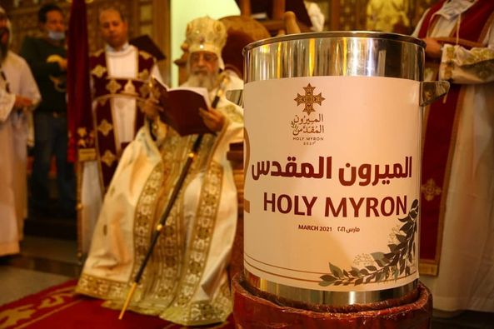
Confirmation/Chrismation
Notes:
Confirmation is the Sacrament through which the believer is granted the gifts of the Holy Spirit. The Holy Spirit alone can confirm him or her in the new life given through Baptism. Like the Sacrament of Baptism, this Sacrament can never be repeated for the same person.

Slide 17


Slide 18
What occurs?
Notes:
The newly baptized are anointed with the Holy Myron 36 times (over the top of the head, eyes, ears, nostrils, mouth, back (twice), heart (twice), and 6 times over the main joints in each of the arms and legs). In this way, the person is sealed with the Holy Spirit by being anointed with the Holy Myron.

Slide 19
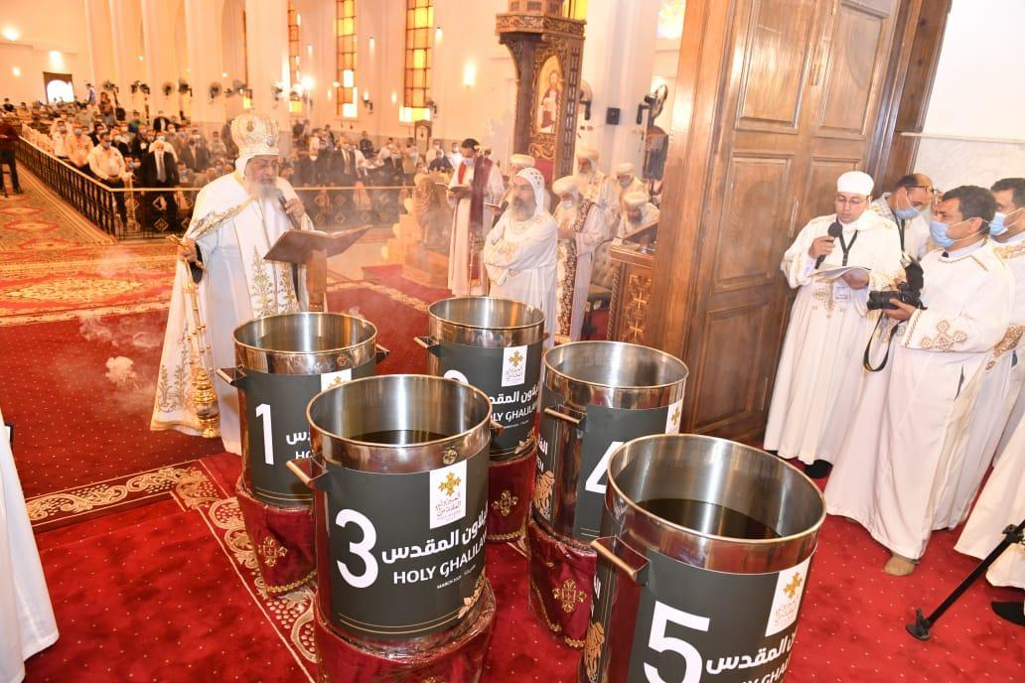
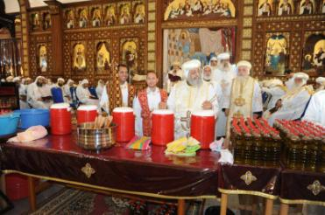
Notes:
It is related that the holy oil was first made by the Apostles using the spices and ointments that were prepared for the body of the Lord at the time of the burial and after the burial (Luke 23:56,24:1). St. Mark brought part of it to Egypt and since that time, fresh oil continued to be made and added to the rest of it.
It is now made of olive oil and certain spices and consecrated by the Patriarch, assisted by the bishops and accompanied by lengthy prayers.

Slide 20
What now?
“But you have an anointing from the Holy One, and you know all things. I have not written to you because you do not know the truth, but because you know it, and that no lie is of the truth.” (1John 2:20-21)
Notes:
Through this Sacrament the believer receives the gift of the Holy Spirit who confirms him or her in the new life given to him or her in baptism. The Holy Spirit gives the power of growth in that new life, enlightening and teaching all things, “But you have an anointing from the Holy One, and you know all things. I have not written to you because you do not know the truth, but because you know it, and that no lie is of the truth.” (1John 2:20-21) and keeps the individual firm in the way of truth.
The seven gifts of the Holy Spirit are: Wisdom, Understanding, Counsel, Might, Knowledge, Godliness, and the Fear of the Lord (Isaiah 11:2), and are given to the believers through this Sacrament.

Slide 21
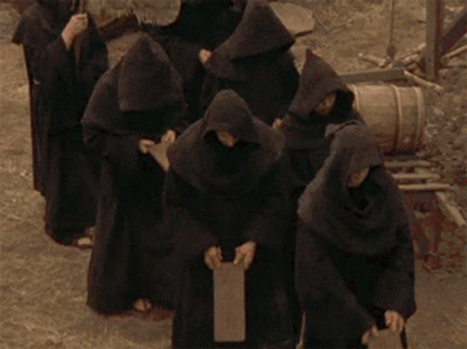
Repentance
Notes:
When viewed from a theological or liturgical point of view, the sacrament of repentance is understood to be an act of reconciliation with the church body. It is the possibility granted by the church to those who have alienated themselves from it due to sin to return to it. In general terms, repentance and confession were the new experience of man with the love and Grace of God the Father. He who repents and confesses offers the church gatherings his personal failure, as well as his sins, and asks for and receives in return the possibility of eternal life.

Slide 22
“Let a man examine himself, and so let him eat of the bread, and drink of the cup. For he who eats and drinks in an unworthy manner, eats and drinks judgment to himself, not discerning the Lord’s body” (1Cor. 11:28-29)
Notes:
Although believers are reborn through the Sacrament of Baptism and receive the Holy Spirit through the Sacrament of Confirmation, this does not mean that they have obtained immunity against sin. The Bible teaches us that even the best saint is vulnerable to sin. (Abraham, Isaac, Jacob, Moses, David etc. in the Old Testament; Peter, John, etc. in the New Testament).
All these Saints committed sin, even when they were at the pinnacle of their holiness. For this reason, the Sacrament of Penance was instituted in order that through it the sinner can return to God after confessing his ̸ her sins to the priest. Power given by Christ to his ministers absolves all sinners and guides them to repent and believe in Him. The penitent receives, through the mediation of the priest, forgiveness of sins when he repents and confesses sins.
Because it is critical that everyone ought to examine himself before accepting the Holy Communion, this Sacrament of Penance is therefore administered generally before accepting the Holy Communion.
“Let a man examine himself, and so let him eat of the bread, and drink of the cup. For he who eats and drinks in an unworthy manner, eats and drinks judgment to himself, not discerning the Lord’s body”. (1Cor. 11:28, 29).

Slide 23
“However, for us who ceaselessly depart from Christ and excommunicate ourselves from his life, it is necessary that we return to him and receive again and again the gift which he gave us once and for all. Remission is the sign that this return has been realised and completed. And, as the Eucharist is not simply a single repetition, but our elevation and reception to the same eternal feast, so the sacrament of repentance is not a repetition of our Baptism, but a return to the newness of life which God offered us once and for all” (Schmemann, 1963).
Notes:
“Therefore I say to you all, every sin and blasphemy will be forgiven men .” (Matt. 12:31) “Though your sins are like scarlet, they shall be as white as snow; though they are red like crimson, they shall be as wool.” (Is 1:18)
It also teaches that God is ready to pardon and accept everyone. “... the one who comes to Me I will by no means cast out;” (John 6:37)
“..God our savior Who desires all men to be saved and to come to the knowledge of the truth.” (1 Tim. 2:3-4)
David, who committed two grave sins, was pardoned. Peter, who denied the Lord three times in a very shameful way, was pardoned. Also the woman who was taken in adultery was pardoned,
“She said, ‘No one, Lord,’ and Jesus said to her, ‘Neither do I condemn you; go and sin no more,’” (John 8:11).

Slide 24
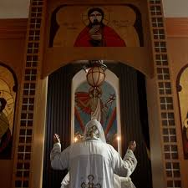
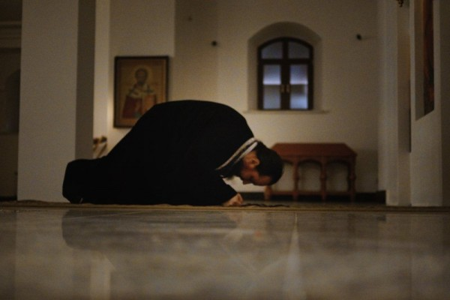
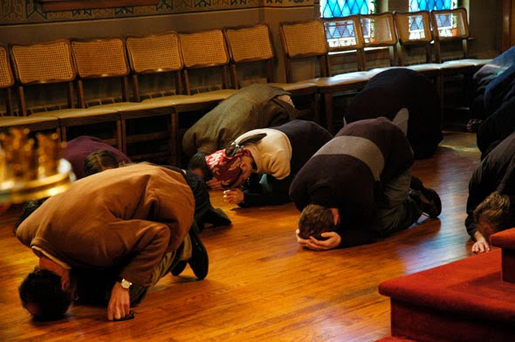
Notes:
The meaning of the Greek word, ‘metanoia’ for ‘repentance’ means, making amends (for guilt, including changing our attitudes) and effecting positive change. We are called to consider the moral implications of sin in our life, which includes a reformation of our ways. This is what it means to be truly repentant. Our heartfelt and mindful awareness is in accordance with God’s will, and will result in salvation. When we have come to this place of unhappiness due to our actions, and reflect upon what we have done, we repent of our sin, and we should then confess our sin to God

Slide 25


Slide 26
Questions?
Notes:
ONE BAPTISM
Our Church teaches that those who have been validly baptized must not be baptized again. This is what St. Paul affirmed “One Lord, one faith, one baptism” (Eph.4: 5).
Baptism is the rebirth or regeneration. As man is born bodily only once so we cannot be spiritually born more than once.
Baptism is the partaking of Christ’s death and resurrection (Rom. 6:4, Col. 2:12); Christ died and arose only once.
As such, even when Christians reject the faith and later return to the church, they will not be baptized a second time. In this case it is sufficient that they perform the two sacraments of penance and Holy Communion.
BAPTISM OF INFANTS
Some Churches say that Baptism should be given only to grown persons. But our Church believes that babies too should be baptized for the following reasons:
Babies inherited the original sing of Adam; as such it is necessary for them to be purified of it through baptism.
In the Old Testament babies had to be circumcised in order to be accepted into God’s covenant. And since circumcision was a type of baptism, therefore, babies should now be baptized in order to be accepted as members in the Church. It should be kept in mind that circumcision, which was a seal of faith (Rom. 4:11), was applied to children who were incapable of faith. This sign marked them out as recipients of the convenient blessings of God.
God did not prevent babies from accepting some of the great graces, e.g. Jeremiah was sanctified before coming forth out of the womb (Jer.1:5). John the Baptist was filled with the Holy Spirit even from his mother’s womb. (Luke 1:5).
In the Apostolic Age, whole families, including babies, were baptized. Examples of these include the family of Cornelius (Acts 10:48), of Lydia (Acts 16:14 - 15), of the prison guard (Act 16:33), and that of Stephanas (1Cor. 1:16).
This was the custom in the Church since the early centuries as is shown in history and the writings of the fathers.
Origin said “The Apostles handed over to the church the tradition of baptizing; Babies are baptized for the remission of sins to be washed of the inherited sin”. It was said that “Baptizing babies is an apostolic tradition”. In the Apostolic traditions we read, “They shall baptize the little children first. If they can answer for themselves let them answer. But if they cannot let their parents answer or someone from their family”. Christ’s Church on earth is composed of all those who profess faith in Him and obedience to His laws together with their children.
BAPTISM OF BLOOD
Martyrs who shed their blood for the sake of Christ before being baptized are considered to have received this kind of baptism according to the statement of our Lord “Therefore whoever confess Me before men, him 1 will also confess before My Father who is in heaven.”(Matt.10:32). Again “...But whoever loses his life for My sake will find it” (Matt. 16:25).
OBLIGATIONS OF THE BAPTIZED
Before receiving baptism, one must publicly declare:
Repentance “Then Peter said to them: Repent and let everyone of you be baptized in the nam of Jesus Christ” (Acts 2:3 8).His Faith in the Lord Jesus Christ. “He who believes and is baptized will be saved” (Mark 16:16). In his/her confession of faith he/she must recite the Creed.
But in the case of babies, who are of course unable to declare repentance or faith before baptism, their parents, godfathers or godmothers make that declaration instead of them as they promise to raise them in the nurture and admonition of the Lord.
Who has the Right to Anoint?
This right was primarily confined to the Apostles. From them, it was conveyed to the bishops— their successors. But due to the difficulties of travel and the impossibility of a bishop being able to confirm all over large dioceses, the custom arose in which the bishop blesses the oil and then allows the priest to anoint with the oil, thus conveying the blessing of the bishops.
ANOINTING OF KINGS
Christian Kings in Christian countries are anointed with holy oil in order that they may receive the special blessing of the Holy Spirit in order to help fill them with the wisdom and guidance of God in performing their duties. This was also the custom in the Old Testament when the Kings of Israel had to be anointed by the hands of the prophets.
When anointing David as king of Israel, it was said that he has been given the gift of the Holy Spirit. “Then Samuel took the horn of oil and anointed him in the midst of his brothers and the Spirit of the Lord came upon David from that day forward” (1Sam 16:13).
The Lord has chosen the Church and those who are appointed to Holy orders (Bishops and priests) to be his manifestations among us all. The mysteries of the Church are the gifts that God grants to the Christian believers and all of these are administered by the Lord Himself through those who have been granted the mystery of the priest hood. What this means is that when we partake of the mysteries, it is our Lord Jesus Christ who is present amongst us and His presence is manifested in the person of the Bishop or in the person of the Priest. This is manifested in confession.
For instance when our Lord Jesus was preparing His disciples and Holy apostles to go into the world and begin their ministry, the lord tells them when He appears to them after His resurrection: “So Jesus said to them again, “Peace to you! As the Father has sent Me, I also send you. And when He had said this, He breathed on them, and said to them, Receive the Holy Spirit. If you forgive the sins of any, they are forgiven them; if you retain the sins of any, they are retained.” John 20:21-23
The Lord could not be any clearer, He is saying what I have said and done for the world now you my disciples also do and He gives them the Holy Spirit and grants them the power of loosening and binding sins.
St John Chrysostom writes a book in the 4th century called ‘ On the priesthood’ and he comments beautifully saying the following: “ Priest have received a power which God has given neither to angels nor archangels. It was said to the, His disciples, whatsoever you shall bind in earth shall be bound in heaven and whatsoever you shall loose shall be loosed. Temporal rulers have indeed the power of binding but they can only bind the body, priests, in contrast, can bind with a bond which pertains to the soul itself and transcends the very heavens. Did God not give them all the powers of heaven? Whose sins you shall forgive He says they are forgiven, whose sins you shall retain they are retained. What greater power is there than this. The Father has given all judgment to the Son and now I see the Son placing all this power in the hands of men his priests his bishops. They are raised to this dignity as if they are already gathered up to heaven.”
When we build up the confidence to go see our father of confession the priest we are following a process that is instituted by God and has been observed since the very early church.

Slide 27
References
Schmemann, A. (1963). For the Life of the World, St. Vladimir’s Orthodox Theological Seminary, 118-119.
https://www.suscopts.org/resources/literature/539/the-holy-myron/
Of water and Spirit by Alexander Schmemann
The Birth From On High: Reflections on the spirituality and history of Baptism from the monastery of St. Macarius by Fr. Matthew the Poor
Repentance and Confession an Orthodox Perspective by Archbishop Ioannis Tsaftaridis
The Orthodox Study Bible

