Slide 1
Book of Revelations
*Interpretation is based on common views of Church fathers but is not guaranteed

Slide 2
A book of hope
Usually when people mention the book of Revelation, they immediately think about judgment.
Yes, judgment occurs in the book. However, Revelation does not end with judgment. Instead, it provides a striking bookend for the entire Bible, which begins in Paradise and ends in Paradise.
The Bible usually portrays the world as place of sufferings since the fall in Genesis 3.
The brilliance of Revelation is that it provides a final answer to this problem, a hope that Jesus will once and for all heal the wounds wrought by sin and re-create the world into a place that represents God’s original design (Revelation 21–22).
The Bible’s narrative is a simple one: creation, fall, re-creation.
Without the completion of the redeeming work of Jesus recorded in Revelation, we wouldn’t have the end of the story, leaving our hope for the future in serious doubt.
Ultimately, the book—and the world—end in a final victory for truth and goodness and beauty.

Slide 3
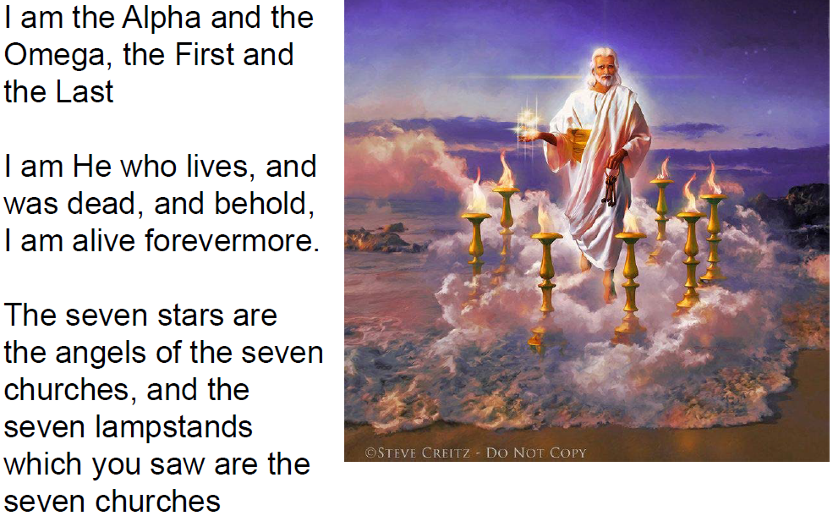
Chapter 1, the beginning

Slide 4
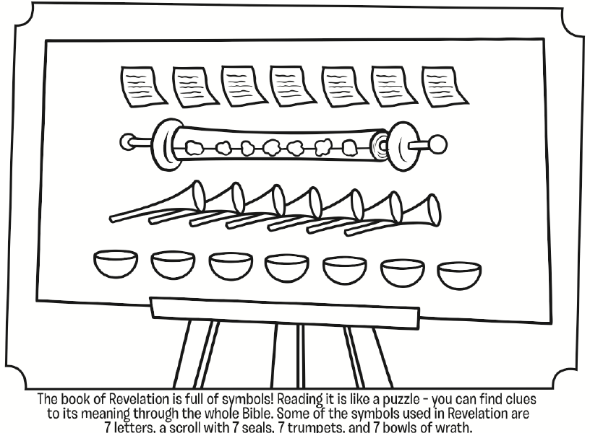
Revelations is about symbols

Slide 5
RECAP & OVERVIEW
God the king of kings
The divinity that we haven’t seen before so clearly
7
3
Churches
Seals (Ch 6-7)
Trumpets (Ch 8-11)
Bowls/Plagues (Ch 15-16)
Evil Triangle (Dragon & 2 beasts)
The end of Babylon (Ch 17-19)
Heavenly Jerusalem (Ch 20-22)

Slide 6
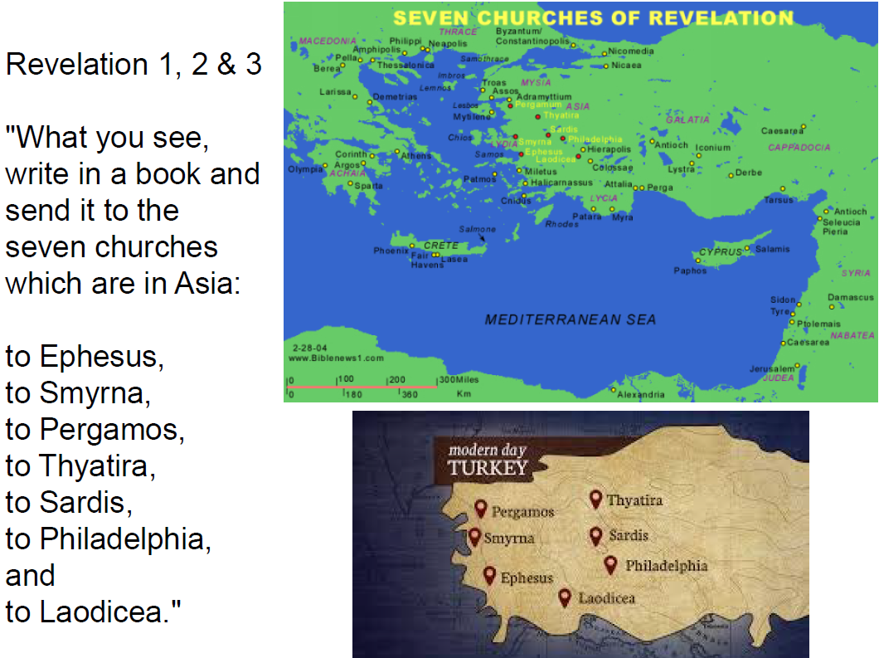
Chapters 1,2 & 3

Slide 7
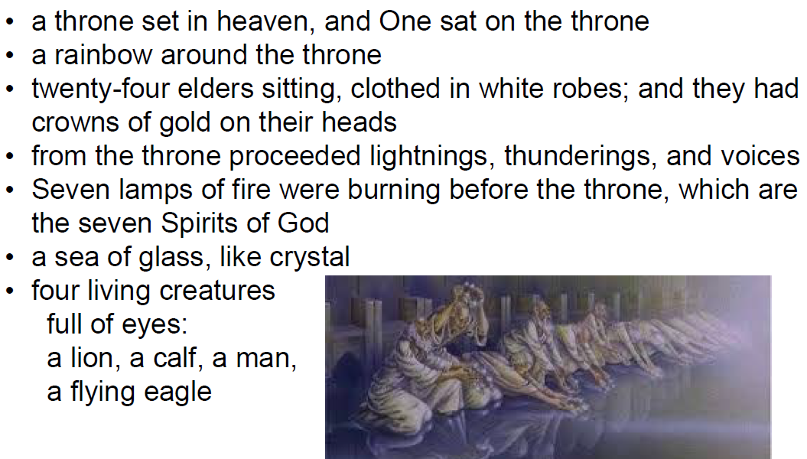
Chapter 5 - the throne

Slide 8
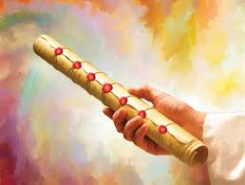
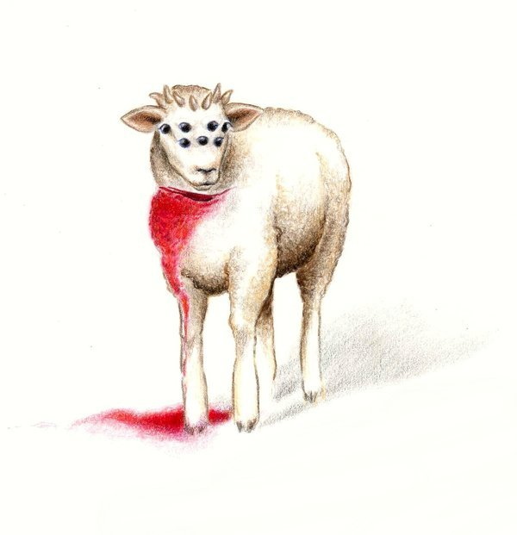
Ch. 5: Seals intro
God is holding a scroll with seven seals in his hand
The seals represent the history/present/future of the church
The lamb resembles Christ (in His sufferings and His resurrection)

Slide 9
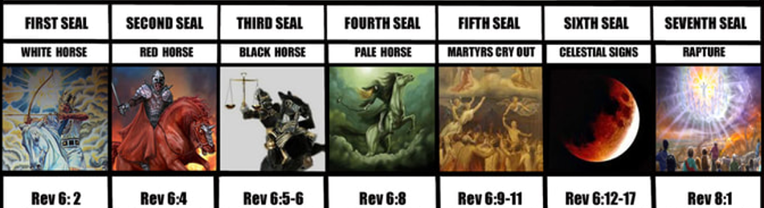
Ch. 6: THE seals
Ch 7 break ☺
Apostolic Era
White = resurrection
The rider is Christ who conquered death
Martyrdom
Red = blood
The rider is the devil (Roman emperors)
Famines &
Heresies
Black = darkness
Internal church problems
Death
Power over 1/4th of the people on the earth to kill with Sword, Hunger & Beasts
White Robes
End of Days
God gives them white robes and tells them to wait a little longer
Earthquake =shaken faith
Black sun = no proper teaching
Bloody moon = more martyrs
Falling stars = church rankings fall

Slide 10
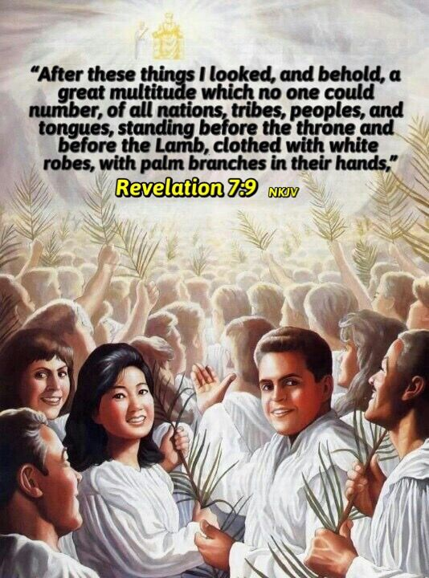
Ch. 7: Tickets to Heaven
A Happy Scene - Enough with the darkness
Four angels standing at the four corners of the Earth
The angel marks the foreheads of 144,000 elect ones to protect them from the coming devastation.
Who are the elect?
The victorious Christians who kept the faith
144,000
12x12 = 144
12 (disciples – church of NT) and 12 (tribes – church of the OT)
“And God will wipe away every tear from their eyes” Rev 7:17

Slide 11
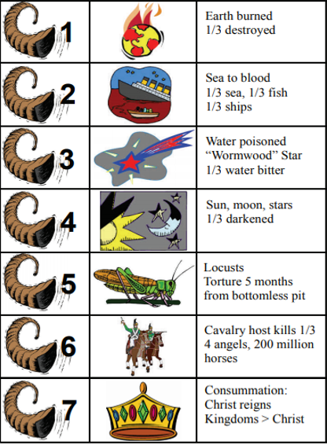
Ch. 8-9: TRUMPET WARNINGS
7th Seal: Silence for half an hour (prepare for a big event) and gives us time to repent before God’s warnings
Important religious people drifts away from faith – Ex: Arius, Nestorius
The lack of knowledge of God, the church, and less saints
Look at Europe now! – we’re probably living through this now..
The devil is attacking but with limits –5 months as a repentance period
The weirdest part is that the people that are left over still aren't convinced.
Remember – The Christians who kept the faith did not get affected!
Antichrist!
This will come later (ch 11) but there is a small scene in between

Slide 12
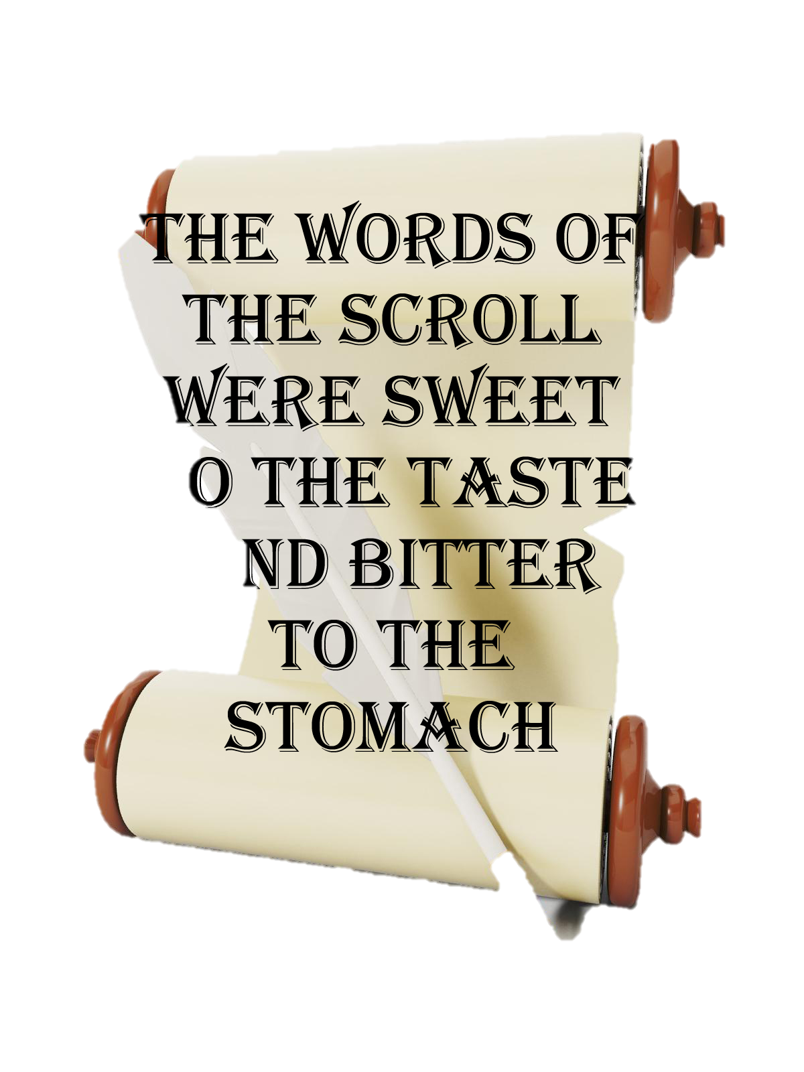

Ch. 10-11: God’s attitude
We’ve seen that the last trumpet was the 6th one – the Antichrist (the hardest)
The groom won’t leave his beautiful bride (the church) to fight alone
  The little scroll
  This is God’s word to us to reveal His intentions towards mankind, especially in the time of tribulation
  The scroll will taste like honey going down, but is going to leave a bitter taste (God’s commandments)
  Two witnesses
  God always sends us witnesses even in hard times. They stand in the face of the Antichrist to resist him and witnesses to the light, and jealous. They perform miracles and die as martyrs, then rise after 3.5 days, and God raises them to heaven
  Some church fathers say these two are Elijah and Enoch
Justice is here!! God's reign on Earth has begun.
It’s time for judgement - The faithful are going to be rewarded but non-believers are not

Slide 13
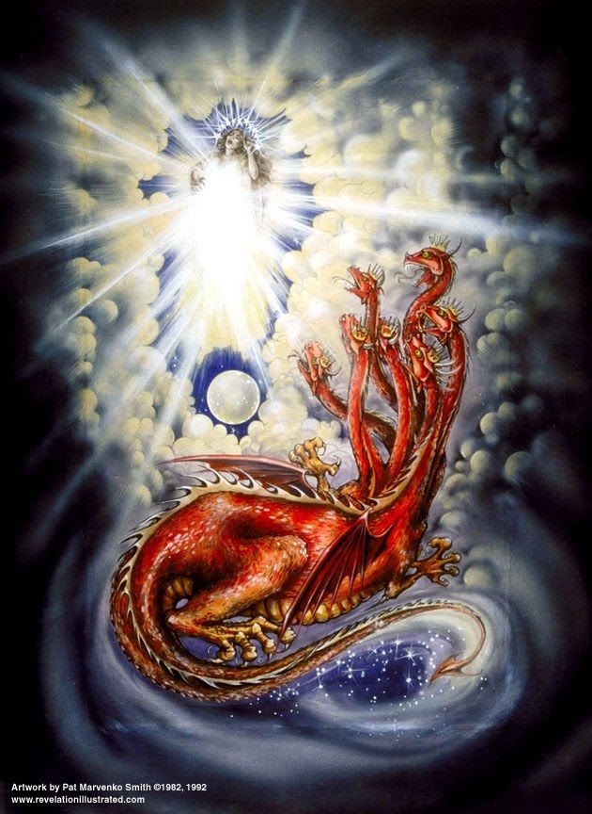
Ch.12: the church and the devil
John sees a woman (church) clothed with sun (united with Christ) with the moon (saints) under her feet, and she wears a crown of 12 stars (disciples – crown of the NT)
The woman is in the middle of giving birth (waiting for salvation)
A huge red dragon (the devil) heads over to the woman to gobble her up once she finishes giving birth.
The woman delivers a baby boy who is promptly taken up into Heaven (resurrection and ascension) and the woman runs away.
Despite of the severity of the war, the Church,
remains preserved in her Groom's hand
Then war breaks out in Heaven. Michael the Archangel and his band of angel soldiers attack the Dragon and manage to throw him out of Heaven.

Slide 14
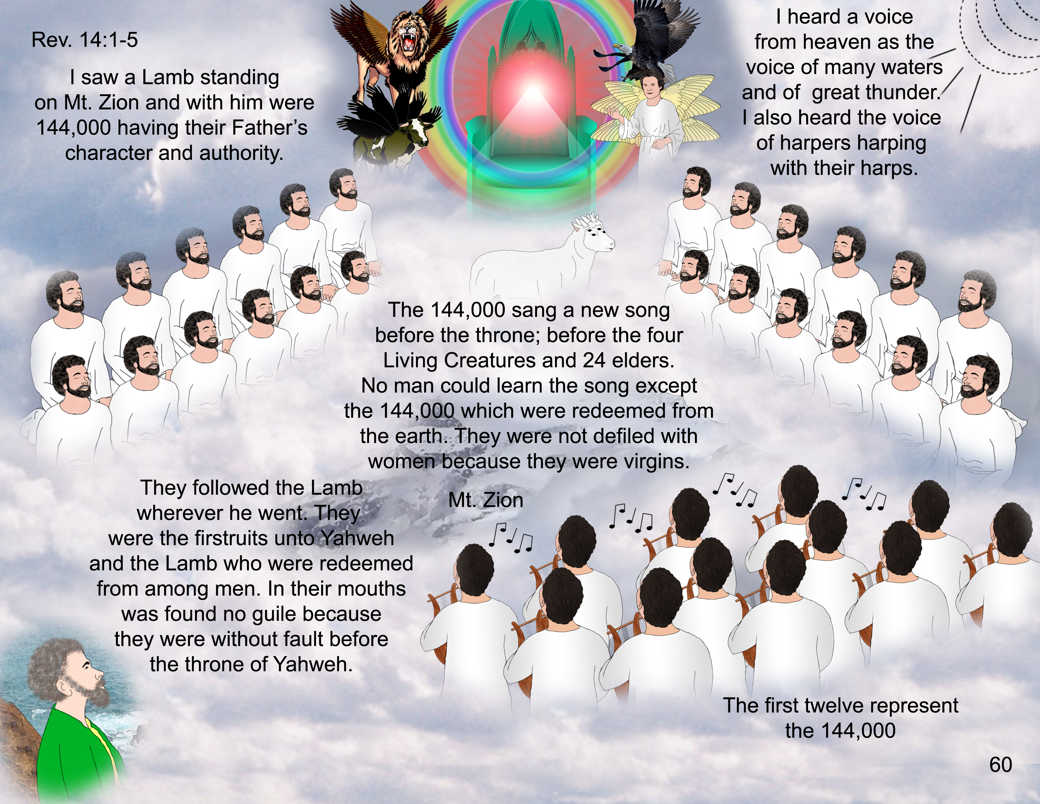
Ch. 13-14: Evil triangle but not for long
Ch 13
Ch 14
The war is tough – Dragon and 2 beasts!
  Sea beast: Some fathers say it’s atheism
  Earth beast: It is very powerful and will have a specific “sign” – may be Romans or ISIS, etc.
This stayed for 42 months
= 3.5 years (half the 7 – only temporarily)
The Lamb standing on Mount Zion with the144,000 Elect.
The Son of man is reaping the faithful people from the Earth

Slide 15
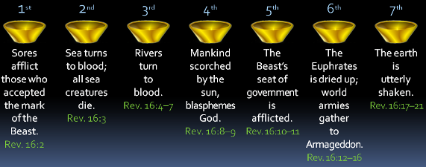
Ch. 15 – 16: FINAL WARNINGS (SERIOUSLY)
John sees seven angels carrying seven bowls (bowls of God’s wrath)
Why does God allow all this evil to happen?
No! God is doing everything for people to repent and go back to Him before it’s too late

Slide 16
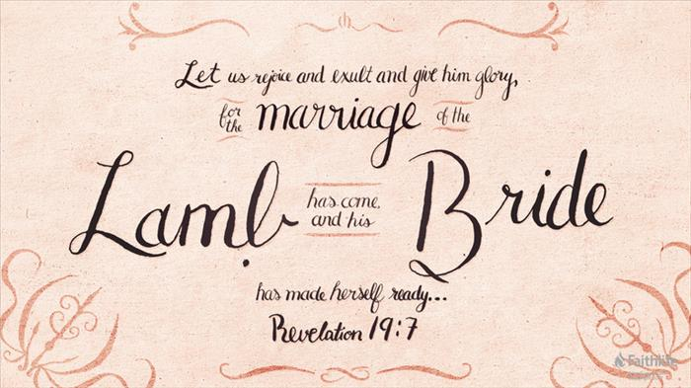
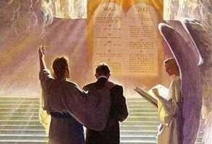
Ch. 17 – 20: The END
An angel came down from Heaven and announced that Babylon (resembles the evil empire) has fallen
Judgment Day!
Every one is resurrected and judged “according to their works” (20:12)
God will open up his Book and look over the records

Slide 17
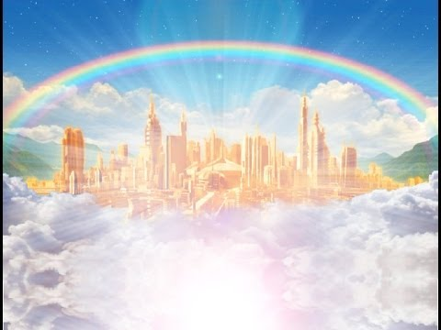
Ch. 21-22: HAPPILY EVER AFTER
The Elect will live there with God. No one will ever mourn or die or be in pain
The whole city is made of gold all different kinds of jewels and gemstones
It has 12 gates (with the names of the tribes of Israel written on them) and 12 foundations (with the names of the disciples written on them)
This New Jerusalem doesn't have a temple, though, because God himself is the temple
There is a beautiful river flowing from God's throne with the water of life
On the banks of the river is the tree of life, which grows twelve kinds of fruits

Slide 18
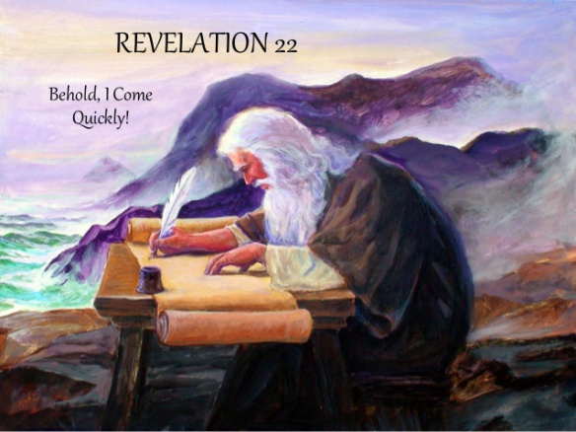
BE READY!
The angel tells John to go ahead and share all this with the world. “Do not seal up the words of the prophesy of this book, for the time is near” (22:10).
In the conclusion of Revelation, Jesus himself promises that God will come soon to reward the righteous and punish the wicked.

