Slide 1
The Book of Acts
Acts of The Apostles
Acts of Jesus & the Holy Spirit

Slide 2
The Coptic Orthodox Church is a BIBLICAL CHURCH
The Seven Sacraments
Altar Ballot
And they cast their lots, and the lot fell on Matthias. And he was numbered with the eleven apostles” Acts 1:26
Fasting :
“As they ministered to the Lord and fasted, the Holy Spirit said, “Now separate to Me Barnabas and Saul for the work to which I have called them.” ³ Then, having fasted and prayed, and laid hands on them, they sent them away” Acts 13:2-3

Slide 3
The Coptic Orthodox Church is a BIBLICAL CHURCH
Almsgiving :
“Nor was there anyone among them who lacked; for all who were possessors of lands or houses sold them, and brought the proceeds of the things that were sold, ³⁵ and laid them at the apostles’ feet; and they distributed to each as anyone had need: Acts 4:34-35
Midnight Hymns and Praises :
“But at midnight Paul and Silas were praying and singing hymns to God, and the prisoners were listening to them” Acts 16:25
Intercession :
“Peter was therefore kept in prison, but ^{[b]}constant prayer was offered to God for him by the church” Acts 12:8

Slide 4
The Seven Sacraments
Baptism :
“ So he commanded the chariot to stand still. And both Philip and the eunuch went down into the water, and he baptized him” Acts 8 : 38
Confirmation :
”When they heard this, they were baptized in the name of the Lord Jesus. And when Paul had laid hands on them, the Holy Spirit came upon them, and they spoke with tongues and prophesied” Acts 19 : 5-6
Confession :
“And many who had believed came confessing and telling their deeds” Acts 19 :18

Slide 5
The Seven Sacraments
Eucharist :
“And they continued steadfastly in the apostles’ ^{[n]}doctrine and fellowship, in the breaking of bread, and in prayers” Acts 2:42
Martimony (Marriage) :
Aquila and Priscilla who have a godly marriage
“After these things Paul departed from Athens and went to Corinth. ² And he found a certain Jew named Aquila, born in Pontus, who had recently come from Italy with his wife Priscilla and he came to them” Acts 18:1-2

Slide 6
The Seven Sacraments
Holy Orders (Priesthood) :
“ So when they had appointed elders in every church, and prayed with fasting, they commended them to the Lord in whom they had believed” Acts 14:23
“whom they set before the apostles; and when they had prayed, they laid hands on them” Acts 6:6
Anointing of the Sick :
“Then Peter said, “Silver and gold I do not have, but what I do have I give you: In the name of Jesus Christ of Nazareth, rise up and walk.” ⁷ And he took him by the right hand and lifted him up, and immediately his feet and ankle bones received strength” Acts 3:6-7

Slide 7
Author
Luke
2nd volume of book of Luke
A travelling co-worker with Paul
Well educated
Painter and Physician
Very Detail oriented
Greek

Slide 8
When & Where
Sometime in the early A.D. 60’s
Before the martyrdom of St.Paul
Missed lots of events that happened in the late A.D. 60’s and the early A.D. 70’s
Most probably written in Rome
Covers the period of around 32 years , between 33 A.D. and 64 A.D.

Slide 9
Theme
Luke tells the story of the church’s beginning and expansion , covering 32 years or so from Jesus ascension to Paul’s imprisonment

Slide 10
Theme Verse
“But you shall receive power when the Holy Spirit has come upon you; and you shall be witnesses to Me in Jerusalem, and in all Judea and Samaria, and to the end of the earth”
Acts 1:8

Slide 11
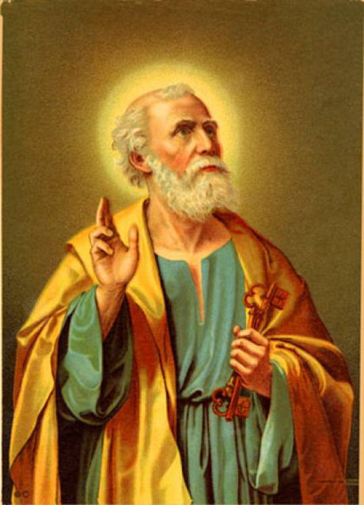
Prominent Figures
Peter :
His Ministries (12 chapters)
has now become a fiery speaker converting 3,000 and fearless in preaching the gospel.
Paul :
His Evangelism (18 Chapters)
Paul’s Journeys

Slide 12
Prominent Figures (cont.)
Stephen :
Among the 7 original deacons
Ordained a deacon to help organize and serve (Acts 6). He was the First martyr
Barnabas :
Brought Paul to the Apostles
James :
Leader of the Jerusalem Council
Silas , Luke , Timothy , Mark :
Traveling companions of Paul

Slide 13
Purpose of the Book
Stress the factuality of the Resurrection of Jesus Christ from the dead.
Intends to tell the story of how the church was assembled and grew as a result of Divine activity.
To show that it is the same God of Israel who forms, guides and empowers the church.

Slide 14
Characteristics of the Book
In the book of Acts, Divine activity is attributed to the Holy Spirit
54 times ”Holy Spirit”
In the book of Acts we see the Will of the Holy Spirit to preach to the gentiles.
We also see the Jewish nation hardened its heart to God.
We also see the first ever Church Council attended to resolve a dispute whether the gentiles had to be circumcised or not.

Slide 15
How does it end?
It doesn’t
Saint Luke, doesn’t end with “Amen” like he does in his Gospel.

Slide 16
Main Sections
Chapter 1 :
Replace Judas & the ELECTION of Matthias
Chapter 2 :
The Holy Spirit & the Tongue of Fire
Peter’s Sermon and the Baptism of the 3000
Chapter 3 & 4 :
The Lame Beggar
1st time Peter & John in Jail

Slide 17
Main Sections (cont.)
Chapter 5 :
Ananias & Sapphira
Chapter 6 & 7 :
The 7 deacons
The Sermon and the Martyrdom of Stephen
Chapter 8 :
Simon & The Sorcerer
Philipp & The Ethiopian eunuch

Slide 18
Main Sections (cont.)
Chapter 9 :
Saul
Chapter 10 & 11 :
Peter and Cornelius
Chapter 12 :
Martyrdom of St.James

Slide 19
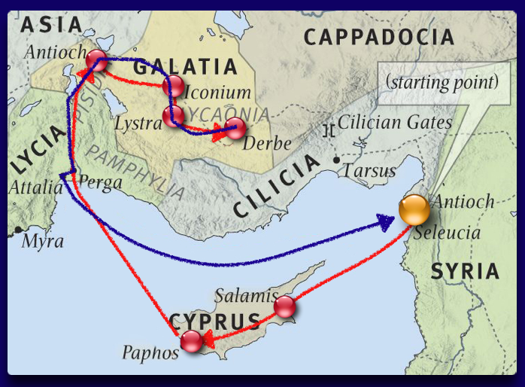
Main Sections (cont.)
Chapter 13 & 14 :
Paul’s First Missionary Journeys
Chapter 15 :
Council of Jerusalem

Slide 20
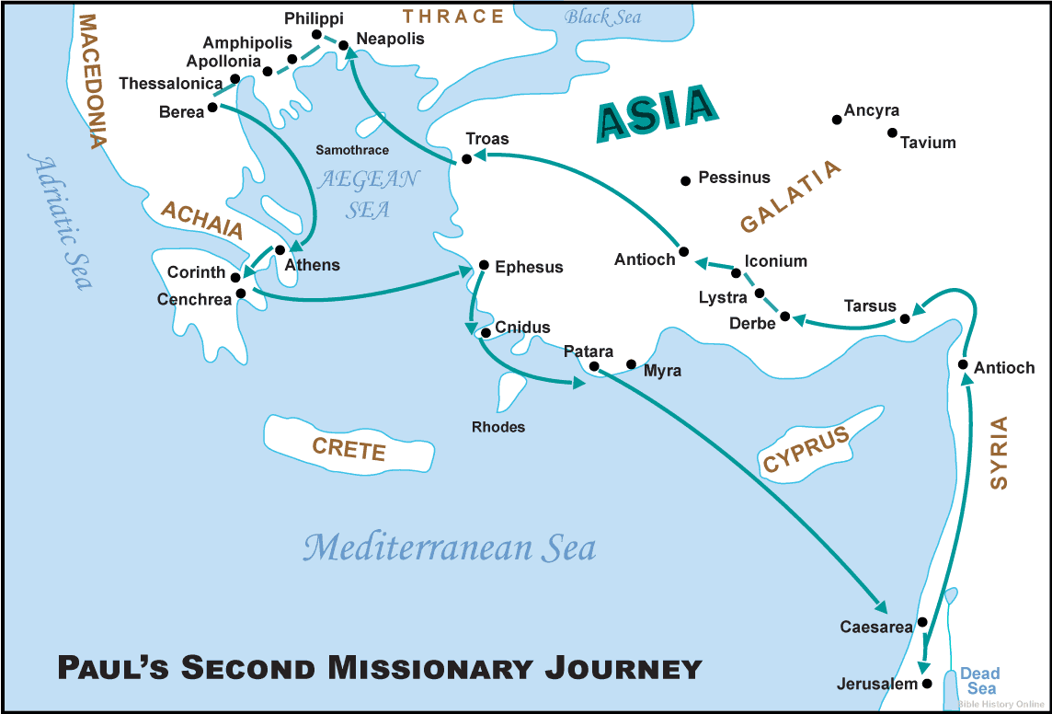
Main Sections (cont.)
Chapter 16 , 17 & 18 :
Paul’s Second Missionary Journeys

Slide 21
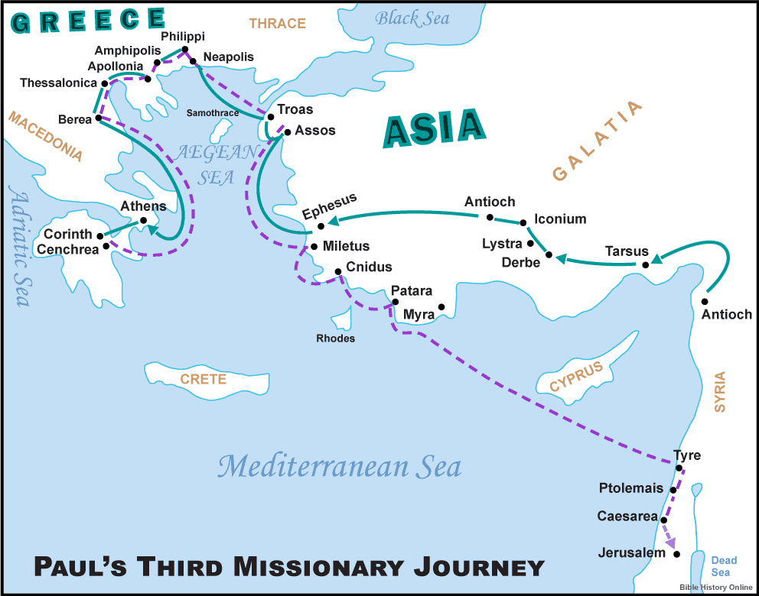
Main Sections (cont.)
Chapter 19 & 20:
Paul’s Third Missionary Journeys

Slide 22
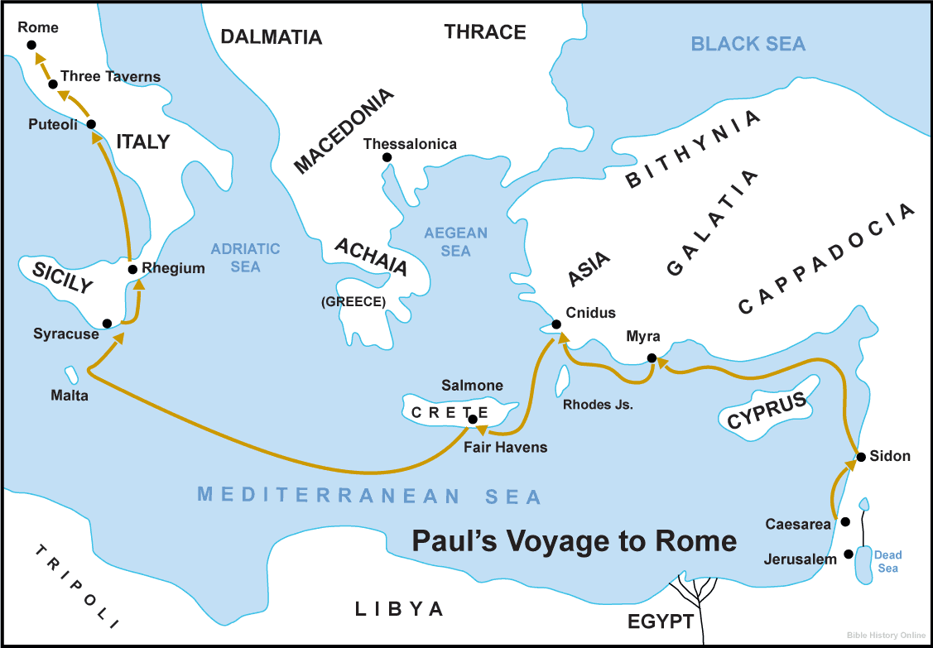
Main Sections (cont.)
Chapter 21 to 28 :
Paul in his way to Rome as a prisoner

Slide 23
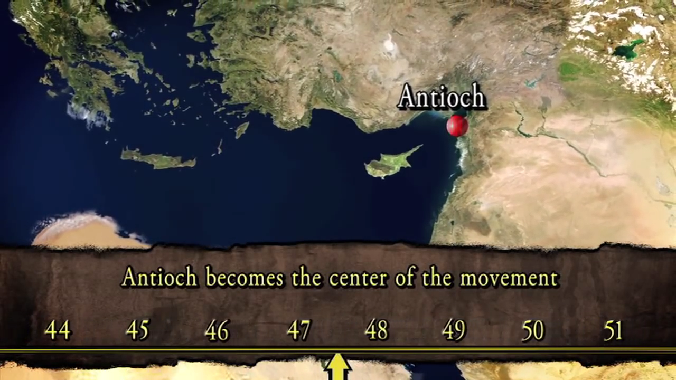
Paul’s Missionary Trips

