Slide 1
Life
Is the most important gift
we receive from God
Martyrdom is …
Passion, dedication, courage, preaching, and practical proof of the Christian faith and virtues
The Coptic Church offered more martyrs (witnesses to the Lord) than the rest of the world.
Monasticism is …
Passion, dedication, courage, preaching, and practical proof of the Christian faith and virtues
The Coptic Church is the world leader in monastic life.

Slide 2
Persecution - Biblical Truth
“Blessed are those who are persecuted for righteousness' sake, For theirs is the kingdom of heaven. Blessed are you when they revile and persecute you, and say all kinds of evil against you falsely for My sake. Rejoice and be exceedingly glad, for great is your reward in heaven, for so they persecuted the prophets who were before you.” (Mat 5:10-12)

Slide 3
Persecution - Biblical Truth
¹² But before all these things, they will lay their hands on you and persecute you, delivering you up to the synagogues and prisons. You will be brought before kings and rulers for My name’s sake. ¹³ But it will turn out for you as an occasion for testimony. ¹⁴ Therefore settle it in your hearts not to meditate beforehand on what you will answer; ¹⁵ for I will give you a mouth and wisdom which all your adversaries will not be able to contradict or resist. ¹⁶ You will be betrayed even by parents and brothers, relatives and friends; and they will put some of you to death. ¹⁷ And you will be hated by all for My name’s sake. (Luke 21:12-17)

Slide 4
Persecution - Biblical Truth
²⁹ For to you it has been granted on behalf of Christ, not only to believe in Him, but also to suffer for His sake, (Philippians 1:29)
¹⁰ that I may know Him and the power of His resurrection, and the fellowship of His sufferings, being conformed to His death, (Philippians 3:10)
²⁴ I now rejoice in my sufferings for you, and fill up in my flesh what is lacking in the afflictions of Christ, for the sake of His body, which is the church, (Colossians 1:24)

Slide 5
Martyrdom
Martyrs = Witnesses:
suffered persecution and death as witnesses for Christ "and you shall be witnesses to Me" (Acts 1:8)
Confessors:
suffered persecution and torture but were not killed

Slide 6
Martyrdom
The martyrs knew that
This world is temporary with respect to eternal life
The sadness, pain & suffering of this world will result in great glory in heaven if we remain faithful to our Lord
Therefore ...
They rejected everything carnal or worldly
They longed to leave the body and be with Christ
They did all of that with great love and joy

Slide 7
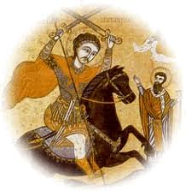

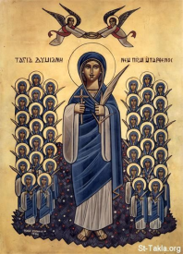
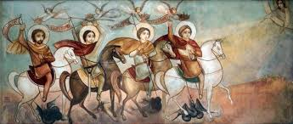
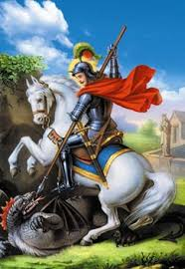

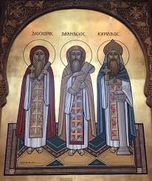
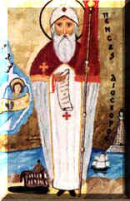
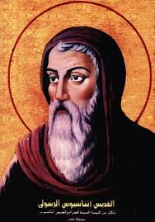
Martyrdom
Martyrs and Confessors were persecuted due to their firm stand regarding:
  The Christian Faith
  Chastity, Purity and Wealth Temptation
  The Orthodox (unaltered) Biblical & Church Doctrine

Slide 8
Roman Persecution
The Pope of Alexandria Dean of the School Emperor of Persecution
12. Abba Demetrius, The Vine-Dresser 199 A.D. Origen, Heraclas Septimus Severus
13. Abba Heraclas 232 A.D. Dionysius Maximinus
14. Abba Dionysius 249 A.D. Theognostus Decius, Valerian
15. Abba Maximus 270 A.D. Pierus Aurelian
16. Abba Theonas 282 A.D. Peter Diocletian (284)
17. Abba Petros (Peter), Seal of the Martyrs 293 A.D. Diocletian and
18. Abba Achillas 303 A.D. the leaders he
19. Abba Alexandros 303 A.D. Athanasius appointed
20. Abba Athanasius, The Apostolic 326 A.D. Didymius

Slide 9
Martyrdom - Revelation
⁸ “And to the angel of the church in Smyrna write, ‘These things says the First and the Last, who was dead, and came to life: ⁹ “I know your works, tribulation, and poverty (but you are rich); and I know the blasphemy of those who say they are Jews and are not, but are a synagogue of Satan. ¹⁰ Do not fear any of those things which you are about to suffer. Indeed, the devil is about to throw some of you into prison, that you may be tested, and you will have tribulation ten days. Be faithful until death, and I will give you the crown of life.
¹¹ “He who has an ear, let him hear what the Spirit says to the churches. He who overcomes shall not be hurt by the second death.” ’ (Revelation 2:8-11)

Slide 10
Martyrdom - Revelation
Fifth Seal: The Cry of the Martyrs
⁹ When He opened the fifth seal, I saw under the altar the souls of those who had been slain for the word of God and for the testimony which they held. ¹⁰ And they cried with a loud voice, saying, “How long, O Lord, holy and true, until You judge and avenge our blood on those who dwell on the earth?” ¹¹ Then a white robe was given to each of them; and it was said to them that they should rest a little while longer, until both the number of their fellow servants and their brethren, who would be killed as they were, was completed. (Revelation 6:9-11)

Slide 11
Ten Rounds of Persecution
(1) Nero 54-68 St. Peter, St. Paul
(2) Domitian 81-96 St. John the Evangelist
(3) Trajan 98-117 St. Ignatius of Antioch
(4) Marcus Aurelius 161-180 St. Justin (Philosopher and Defender)
(5) Septimius Severus 193-211 St. Leonidas (Origen's father), St. Potamina
(6) Maximinus 235-238
(7) Decius 249-251 St. Philopateer-Markorios (two-sworded)
(8) Valerian 253-260 St. Keprianos (The Bishop)
(9) Aurelian 270-275
(10) Diocletian 284-305 St. George, St. Peter (Seal of Martyrs), Maximian 286-305 St. Demiana, The Theban Legion, St. Mena (Wonder Maker), The Five (Kuzman, Demian & 3 monks) and Their Mother, Abba Paphnouti (Confessor)

Slide 12
The Year of the Martyr A.M.
What is the origin of the Coptic Calendar? How is it divided? When is the new year day?
  The Ancient Egyptian Calendar
  3 seasons and 13 months (12 months of 30 days and one intercalary month of 5/6 days)
  September 11 (September 12 in leap years)
When did the Coptic Calendar begin? Why? What Coptic year is it now?
  284 A.D. – Diocletian became emperor
  Commemorating the severest persecution and martyrdom
  2019/2020 A.D. corresponds to 1736 A.M. (the Year of the Martyrs)

Slide 13
The Change Over
* Persecuted Christians Augustus Caesars
Diocletian*
East Diocletian* Galerius* Galerius* after Diocletian had stepped down Maximinus Daza / Daia*(nephew of Galerius) Licinius* after defeating Maximinus Daza
West Maximian (Maximinus Hercules)* Constantius Clorus Maxentius (son of Maximian)* Constantine (The Great) after defeating Maxentius
Constantine (The Great)
Declarations of Religious Tolerance
313 by Constantine and Licinius - Milan

Slide 14
Monasticism
What is “monasticism”? What are the characteristics of the monastic life?
Give an example that shows the Biblical origin of the monastic life.
What are the forms of monasticism and who was the leader of each?
Chosen life of poverty, solitude, and abstinence.
Renouncement of social life and comfort for solitude, self-mortification, & religious devotion; leading a very austere (rigidly abstinent) and self-denying life.
MAT 16:26 "For what profit is it to a man if he gains the whole world, and loses his own soul? Or what will a man give in exchange for his soul?
LUK 18:22 So when Jesus heard these things, He said to him, "You still lack one thing. Sell all that you have and distribute to the poor, and you will have treasure in heaven; and come, follow Me."
MAT 25:1 "Then the kingdom of heaven shall be likened to ten virgins who took their lamps and went out to meet the bridegroom.
Anchoritic / Eremitic – St. Paul of Thebes, St. Mary of Egypt
Communal – St. Anthony: Eastern Desert; St. Amoun: Nitria; St. Macarius: Scetis
Cenobitic – St. Pachomius in Upper (Southern) Egypt

Slide 15
Monasticism
The Coptic Church offered the world several forms of monasticism
Anchoritic / Eremitic – St. Paul of Thebes, St. Mary of Egypt
Anchorites / eremites / hermits living in solitude; own prayer, clothing, food & work. Anchorites with no specific cells but wandered in the desert: "wanderers / pilgrims".
Communal – St. Anthony: Eastern Desert; St. Amoun: Nitria; St. Macarius: Scetis
Monks lived in a semi-eremitic life, in separate cells, and assembled occasionally for the Divine Liturgies and spiritual conferences.
Cenobitic – St. Pachomius in Upper (Southern) Egypt
Monks (cenobites) lived in a community inside the walls of the monastery, in association with each other, and governed by an abbot and by rules.
They all contributed to centuries of humble serving in educational, social and spiritual enrichment of humanity

Slide 16

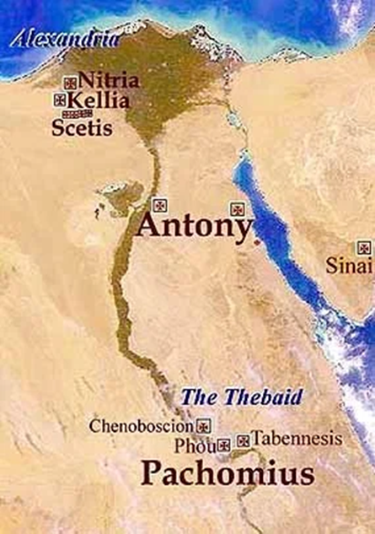
St. Makarius and St. Amoun
St. Antony and St. Paul of Thebes
St. Shenoute and St. Pakhomios

Slide 17
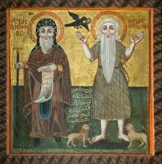
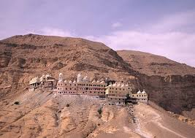
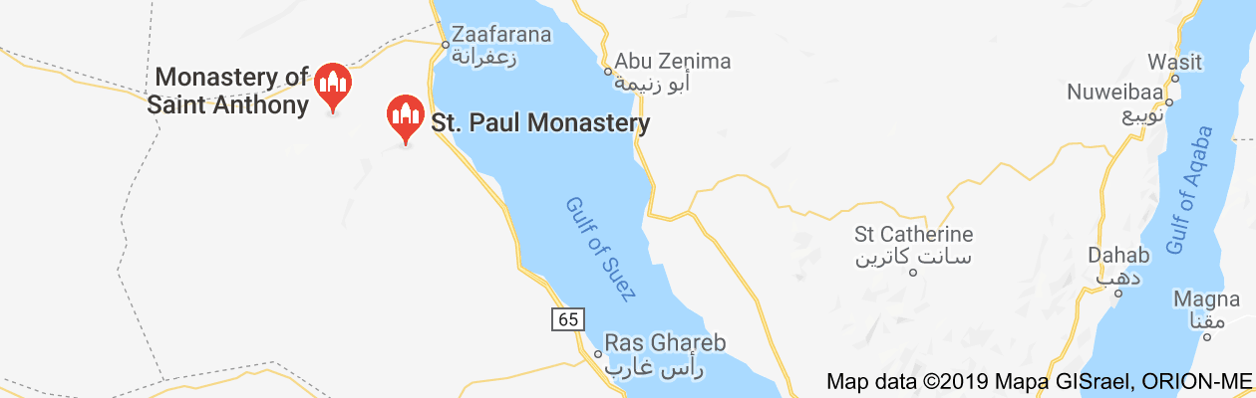
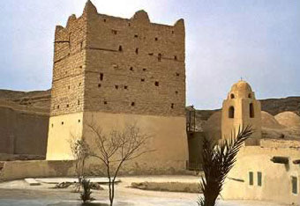
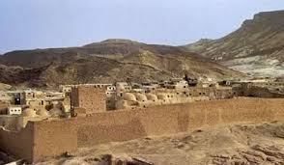
The Leaders of Monastic Life - Men
St. Paul of Thebes (the first hermit)
Born c. 230, near Thebes, Egypt—died c. 341, Theban desert.
During the persecution by Decius (250 A.D.), he fled to the desert as his brother-in-law threatened to betray him. He enjoyed his life of solitude and contemplation until his death in 341 after the Divine Providence allowed St. Anthony to visit him. His story was written by St. Jerome as told by the disciples of St. Anthony.

Slide 18
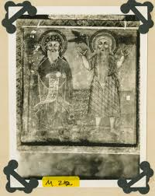
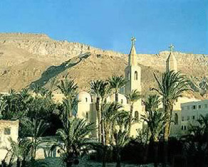
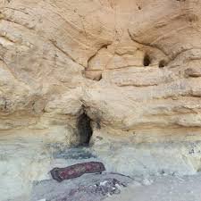
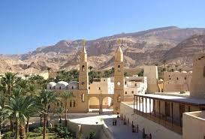
The Leaders of Monastic Life - Men
St. Anthony the Great (the father of the monastic family)
Born 251
Sold his possessions and devoted his life to asceticism 269
Took shelter in an abandoned tomb in the western desert
Lived in solitude in the "outer mountain" at Pispir to the east of the Nile 286
Became a leader in ascetic life to a group of followers 306
Lived in solitude in the "inner mountain", Qolozum, near the Red Sea 311
Visited Alexandria during the persecution of Maximinus Daza 316
Visited Alexandria to support Pope Athanasius against Arianism 352
Died at age 105 356

Slide 19
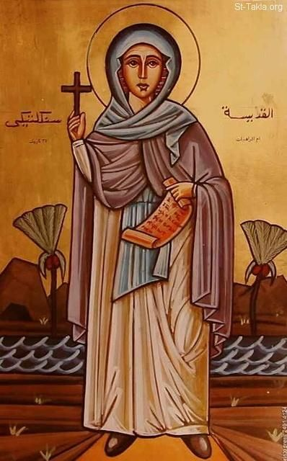
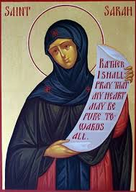
The Leaders of Monastic Life - Women
St. Syncletica of Alexandria
Born of very rich parents
Dedicated her life to God even in her parents' home
After parents died, she sold everything and lived outside Alexandria in solitude
She had many disciples and lived to be 80 (around 350 AD)
Became very ill and endured many sufferings the last three years of her life
St. Athanasius wrote her story
Amma Syncletica is regarded as a "Desert Mother" and her sayings are recorded with those of the Desert Fathers.
St. Sarah
Amma Sarah of the Desert was one of the early Desert Mothers who is known to us today solely through the collected Sayings of the Desert Fathers. She was a hermit and followed a life dedicated to strict asceticism for some sixty years.

Slide 20
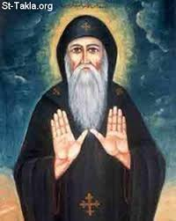
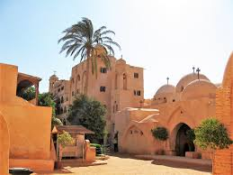
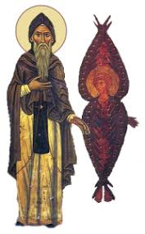
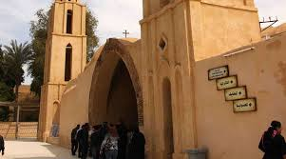
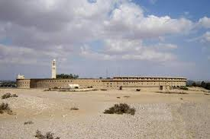
The Leaders of Monastic Life - Men
St. Macarius of Egypt (Scetis) 330 - 390
His parents forced him to marry but he became sick and left to Wadi-el-Natroun. He lived an ascetic life in a hut far from the village until he fled to Scetis. God send him a Cherub to guide him in establishing the monastic life in Scetis. This Cherub accompanied him almost all his life. He led the monastic life in Scetis where he had many disciples who followed his way of living. An Arian bishop exiled him to an island in the Nile in his old age. He died shortly after his return.

Slide 21
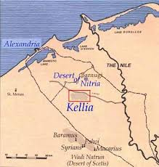
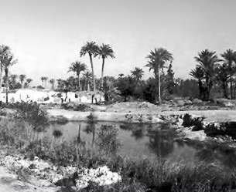
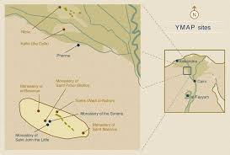
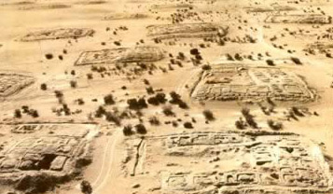
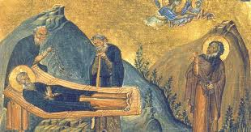
The Leaders of Monastic Life - Men
St. Amoun (Nitria and Cellia / Cells)
Born 275
Married but lived as ascetic in Nitria 297
Settled in cells in the inner part of the mountain of Nitria 315
In a visit by St. Anthony, the cells or Cellia was established as the area of solitude for the anchorite
Christian Nitria, Kellia
and the Life of their Ancient Monks

Slide 22
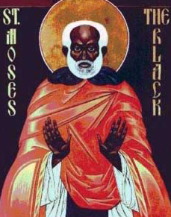
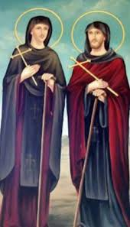
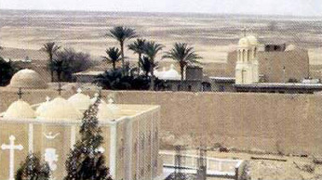
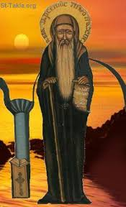
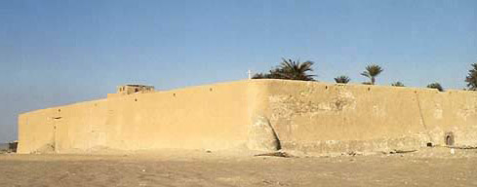
The Monastery of al-Baramus (Deir al-Baramus, Monastery of the Romans) At Wadi al-Natrun

Slide 23
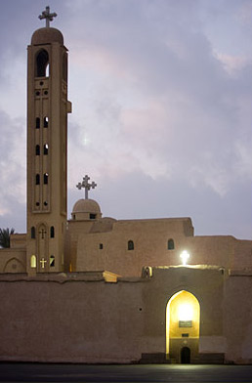
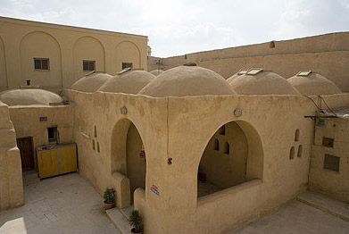
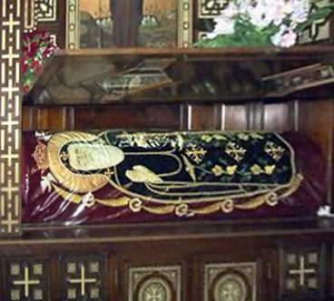
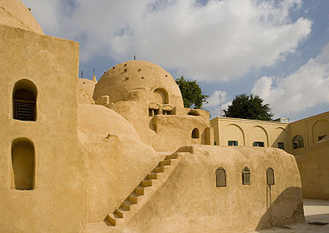
Deir Al Anba Bishoy
At Wadi El-Natrun

Slide 24
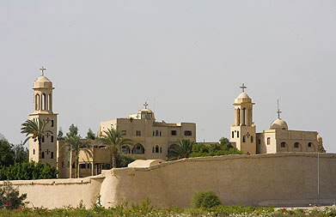
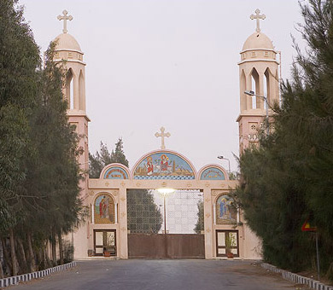
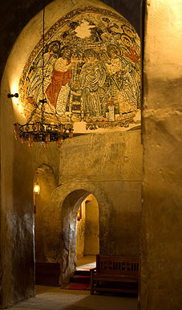
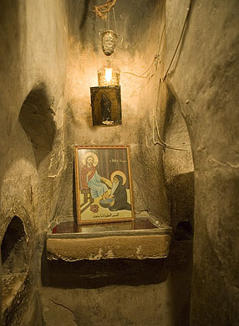
The Monastery of the Syrins in Wadi Natrun

Slide 25
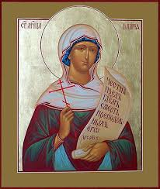
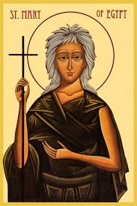
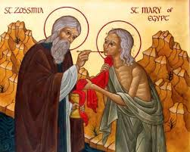
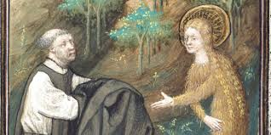
The Leaders of Monastic Life - Women
St. Talida
Leader of a group of nuns that sought ascetic excellence
Founder of a convent near Fayoum
Sixty nuns lived under her guidance and served the needy with cheerful hearts
St. Ilaria (Hilaria), Daughter of Emperor Zeno
The daughter of the Roman Emperor Zeno
Lived in hiding in Scetis as one of the monks in complete solitude
Her parents knew her place when she healed her sister who came seeking the prayer of the fathers in Scetis
St. Mary of Egypt
Life of repentance: from a disgraceful life in Egypt to a saintly life in the Jordan desert
She lived in total isolation until discovered by St. Zosima

Slide 26
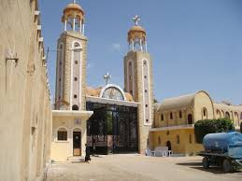
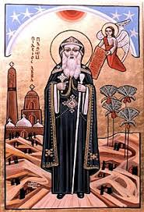
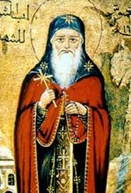
The Leaders of Monastic Life - Men
St. Pachomius (the founder of the cenobitic system)
Saint Pachomius, also known as Pachome and Pakhomius, is generally recognized as the founder of Christian cenobitic monasticism.
Born: 292 AD, Thebes
Died: May 9, 348 AD, Tabenna
Born 292
Was baptized at the time of Maximinus Daza 307
Became a disciple for a hermit named Palaemon 310
Established the first group at Tabennesis 315
Established monasteries for thousands of monks & a convent for 400 nuns
Became sick at the spread of the plague and died

Slide 27
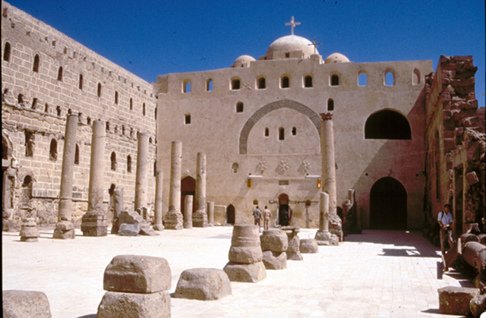


The Leaders of Monastic Life - Men
St. Shenouti (Archimandrite: the Head of Anchorites)
Lived an ascetic life since his childhood through long fasting and prayers
Lived with uncle Pygol, founder of the White Monastery
Succeeded his uncle as the Abbot of the monastery (383 - 451)
Accompanied St. Cyril to the Council of Ephesus in 431
Despite his love for solitude, he was a national leader (using the Coptic language, defending the oppressed) and a social reformer (helping and teaching the people)
He led 2200 monks and 1800 nuns according to Besa his disciple

