Slide 1
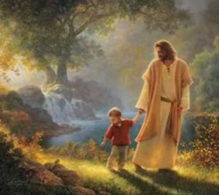
+ leading a child to Christ
Servants prep Sept 27, 2019

Slide 2


Slide 3
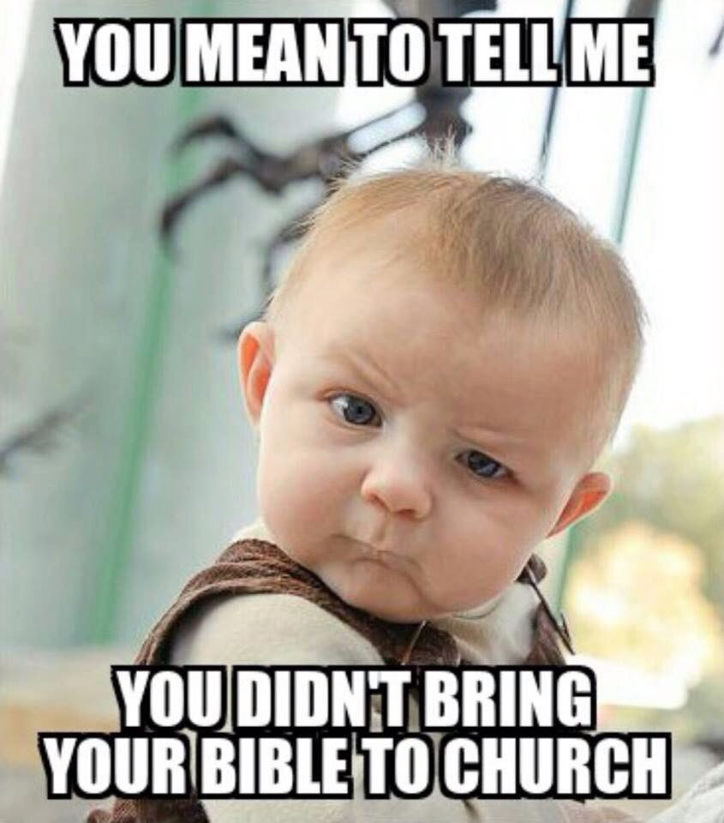
How to not lead a child to Christ?
If we don’t lead a child to Christ, who/what are we leading them to?

Slide 4


Slide 5

Spiritual gardening

Slide 6

Four fundamental needs
Love, Acceptance, & Security
Choices and Challenges
Praise, Recognition, & Encouragement
Responsibility and Independence
Be Christ-like

Slide 7


Slide 8

Love, Acceptance, and Security
Helps in developing the child’s sense of value, self-worth, and a healthy self—esteem
Love is taught through love. We must experience life in our life, to be able to love others.
Greatest example of utmost unconditional love is Christ’s love for us.
  “We love Him because He first loved us.” 1 John 4:19
  Do you feel unconditionally loved by God?
Unconditional acceptance of those we serve: independent of behavior and appearance
  We accept because He accepted us first. Do you feel unconditionally accepted by God?
  Be an example of God’s unconditional love and acceptance.

Slide 9


Slide 10

Love, Acceptance, and Security
Lack of acceptance may lead to:
  a sense of insecurity and worthlessness.
  Rebellion and aggression (attention
  seeking behavior)
Acceptance of people does NOT
mean acceptance of behavior.

Slide 11
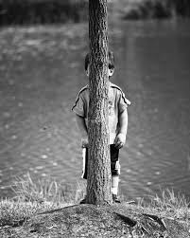
Love, Acceptance, and Security
Ways to show love and acceptance:
  Genuinely Listen & Understand
  Observe & be Perceptive
  Individual service
  Show sincere interest in their lives by visiting them at home, checking on them through phone calls or even texts.
My love, care and acceptance are independent of the child’s response and behavior.

Slide 12
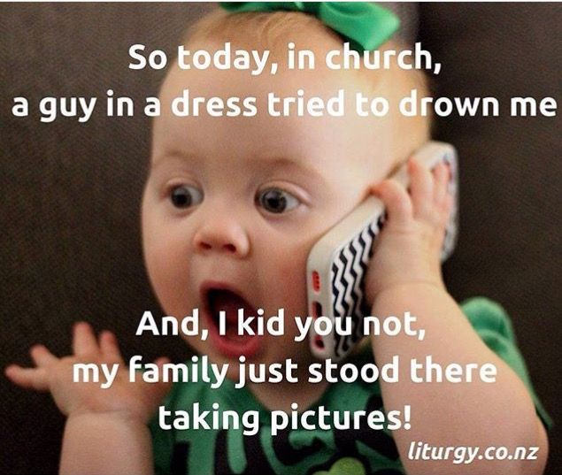

Slide 13
Choices and Challenges
Allow the children to make choices, and respect their choices.
Challenge them through discussions, questions, asking them to prepare topics of interest.
Always motivate and encourage
Try your best to be creative. Think of new ways of getting your message across.
Notes:
Who in the Bible (NT) was given a name that means “Son of encouragement”? (Acts 4:36)

Slide 14
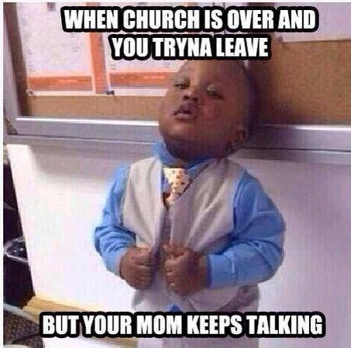

Slide 15
Praise, recognition, and encouragement
Crucial to a person’s growth!!
The Son of Encouragement:
  Acts 4:36 Acts 9:27
  Acts 15:36-41 2 Timothy 4:11
Look for strengths and encourage positive behavior. Use specific words/examples.
Praise even the small attempts. Do not differentiate between the children based on their abilities or strengths. Find something for everyone to do.
Notes:
Example of Dad and son fixing the car

Slide 16
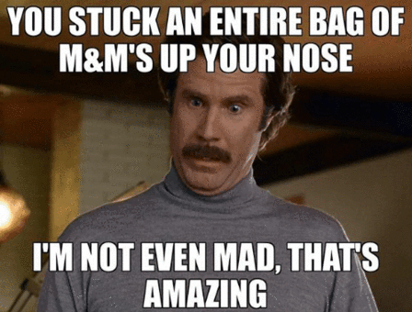

Slide 17
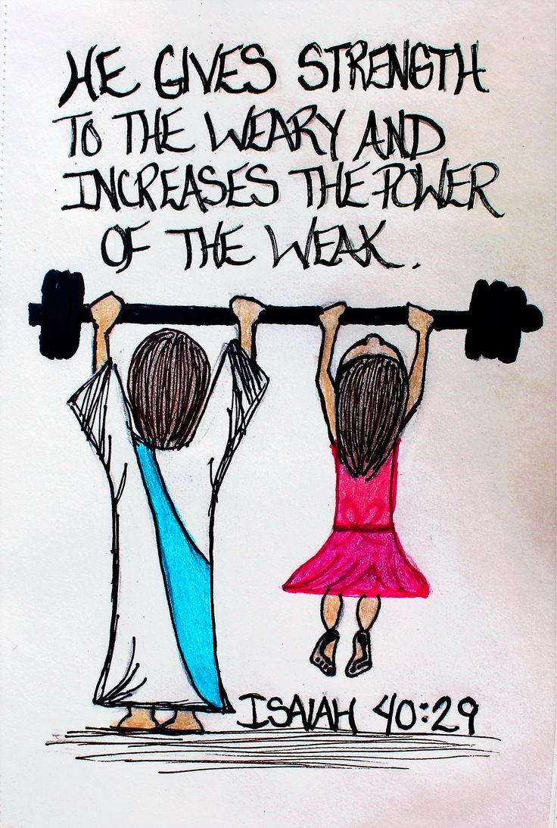
Praise, recognition, and encouragement
Christ’s encouragement and recognition of others
  To the centurion “Assuredly I say to you, I have not found such great faith, not even in Israel” (Matthew 8:10).
  Encounter with Peter (John 21:15-19)
All these lead to a strong sense of OWNERSHIP.

Slide 18
Independence and responsibility
Assign roles and responsibilities whenever possible.
Check and hold them accountable

Slide 19

Learn to wash the feet of whom you serve

