Slide 1
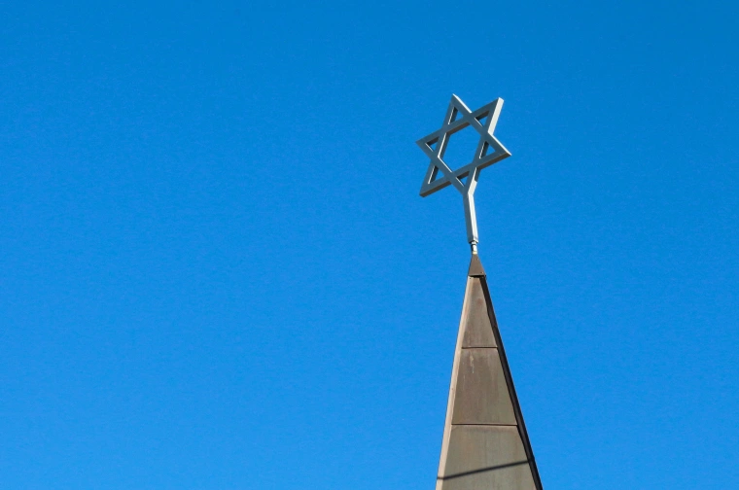
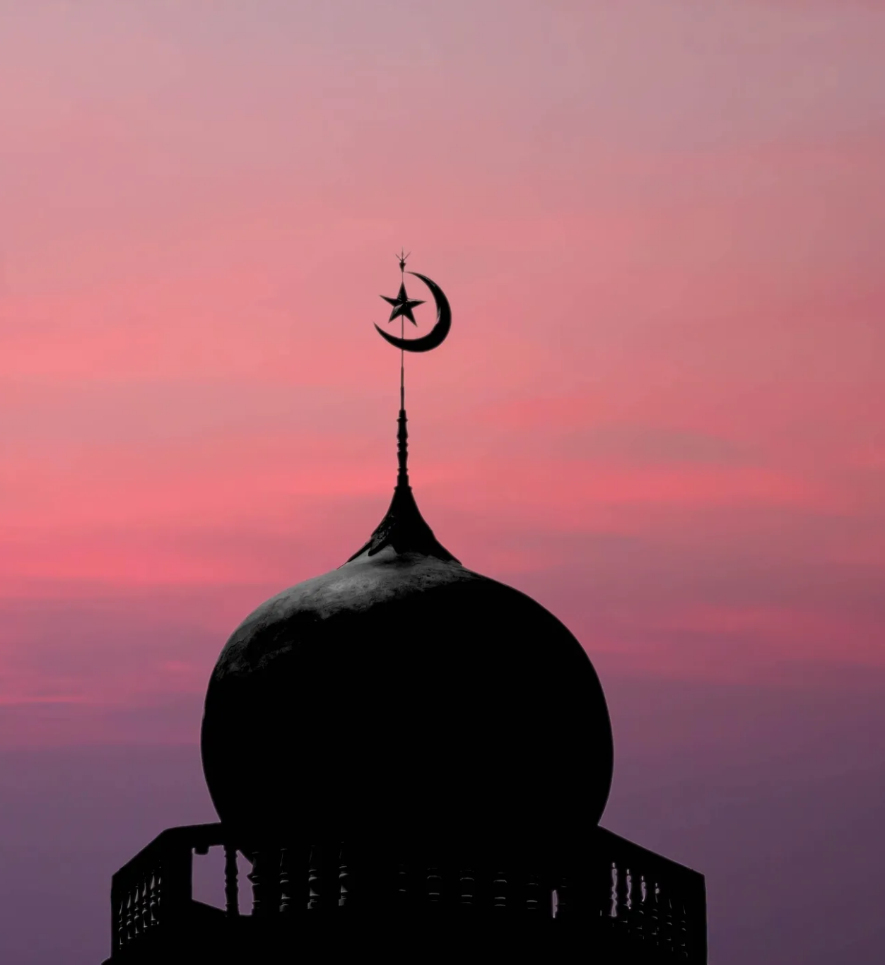
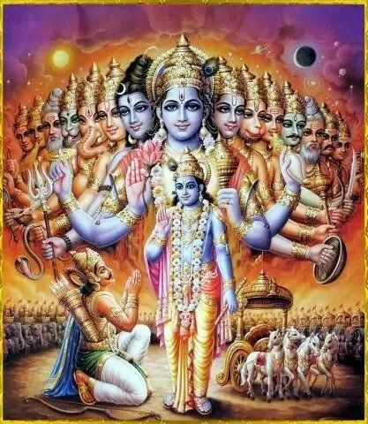
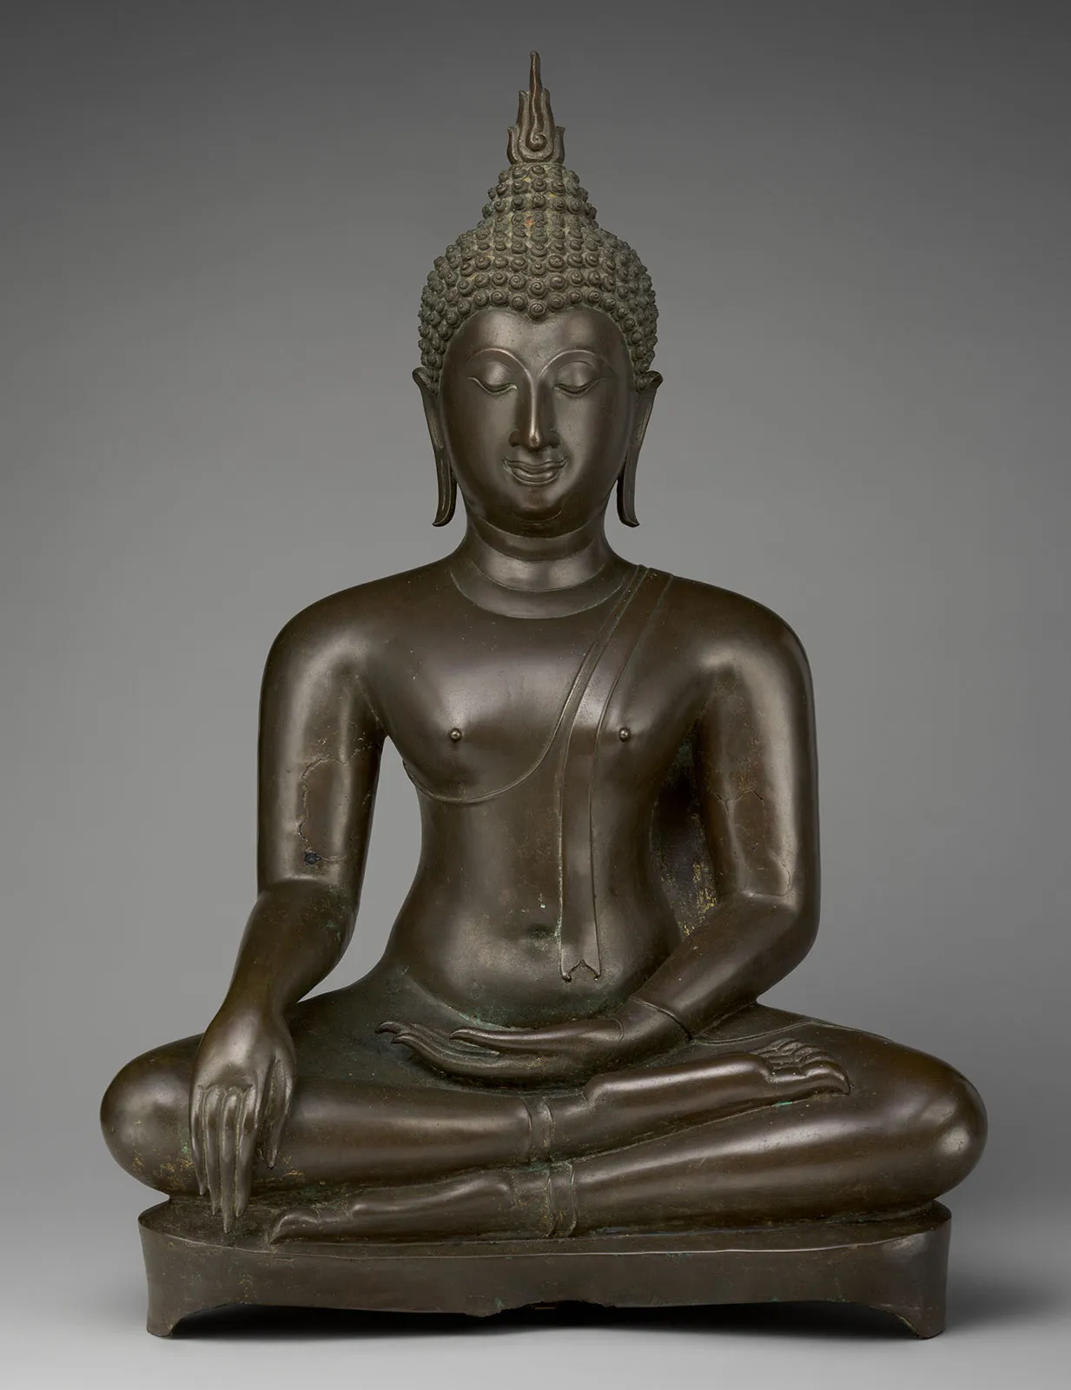
Judaism, Islam, Hinduism, Buddhism
Mark, Jan. 15, 2023
Notes:
https://www.google.com/imgres?imgurl=https%3A%2F%2Fmedia-cldnry.s-nbcnews.com%2Fimage%2Fupload%2Ft_fit-760w%2Cf_auto%2Cq_auto%3Abest%2Fnewscms%2F2019_41%2F3043821%2F191008-think-yom-kippur-star-of-david-se-606p.jpg&imgrefurl=https%3A%2F%2Fwww.nbcnews.com%2Fthink%2Fopinion%2Fyom-kippur-2019-best-thing-about-judaism-according-jewish-atheist-ncna1063986&tbnid=16lj1cc6bXcfMM&vet=12ahUKEwik3I-E8bj8AhXTMjQIHWkCC0MQMygvegUIARD0AQ..i&docid=fkqnGs-VB8cQAM&w=760&h=504&q=judaism&ved=2ahUKEwik3I-E8bj8AhXTMjQIHWkCC0MQMygvegUIARD0AQ
https://www.google.com/url?sa=i&url=https%3A%2F%2Fwww.opindia.com%2F2021%2F03%2Fthe-significance-of-spitting-in-islam-how-spitting-can-ward-off-satan%2F&psig=AOvVaw207ofhaeSg3T7InT7SlTQa&ust=1673298485877000&source=images&cd=vfe&ved=0CBAQjRxqFwoTCKi_0eDwuPwCFQAAAAAdAAAAABAE

Slide 2
Why is it important to learn about other religions?
Understand reasoning behind actions of others
Socialize with friends of other faiths without bias (using logic)
Think of these discussions like going to war
It’s like going to war with no weapon, no shield, no protective gear
Allows you to be rooted in your own religion more

Slide 3
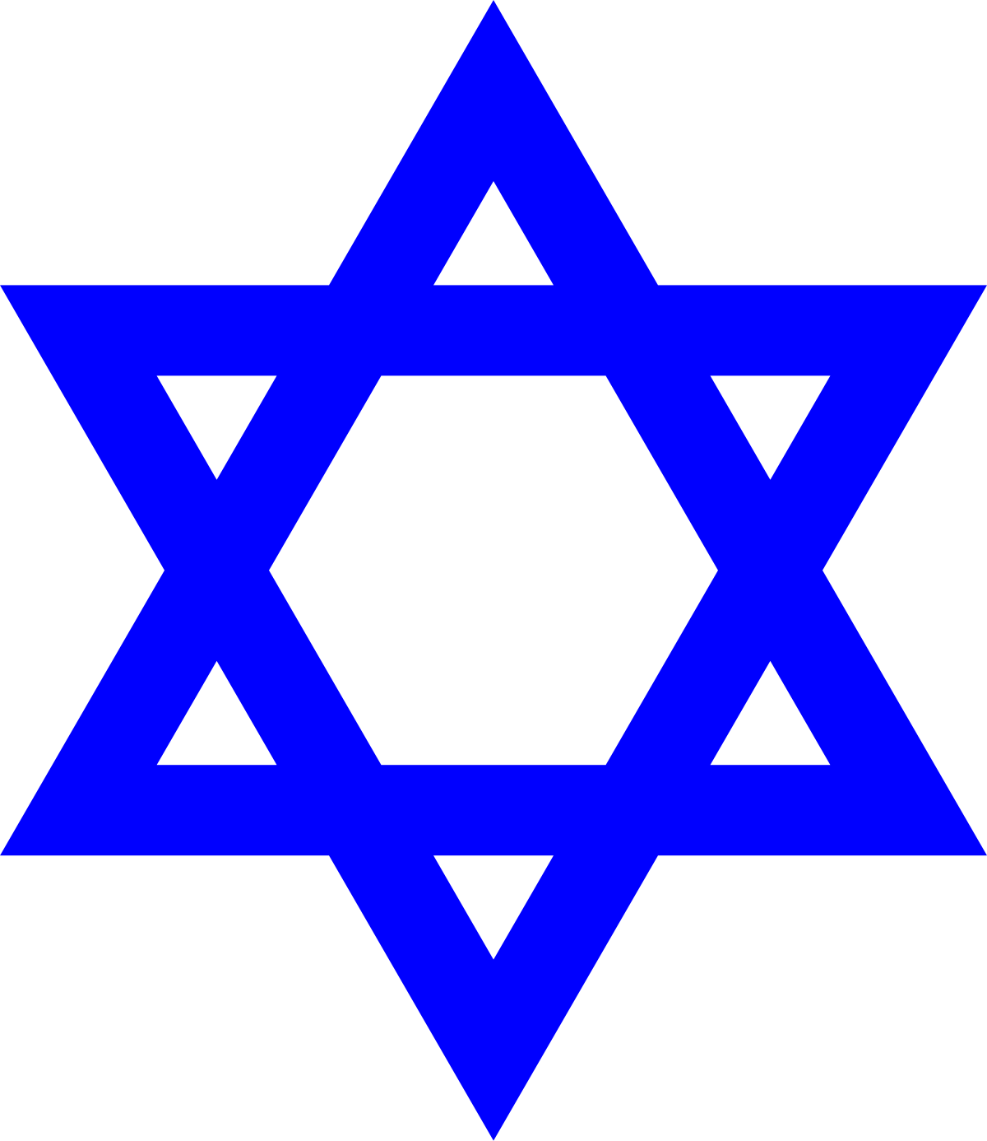


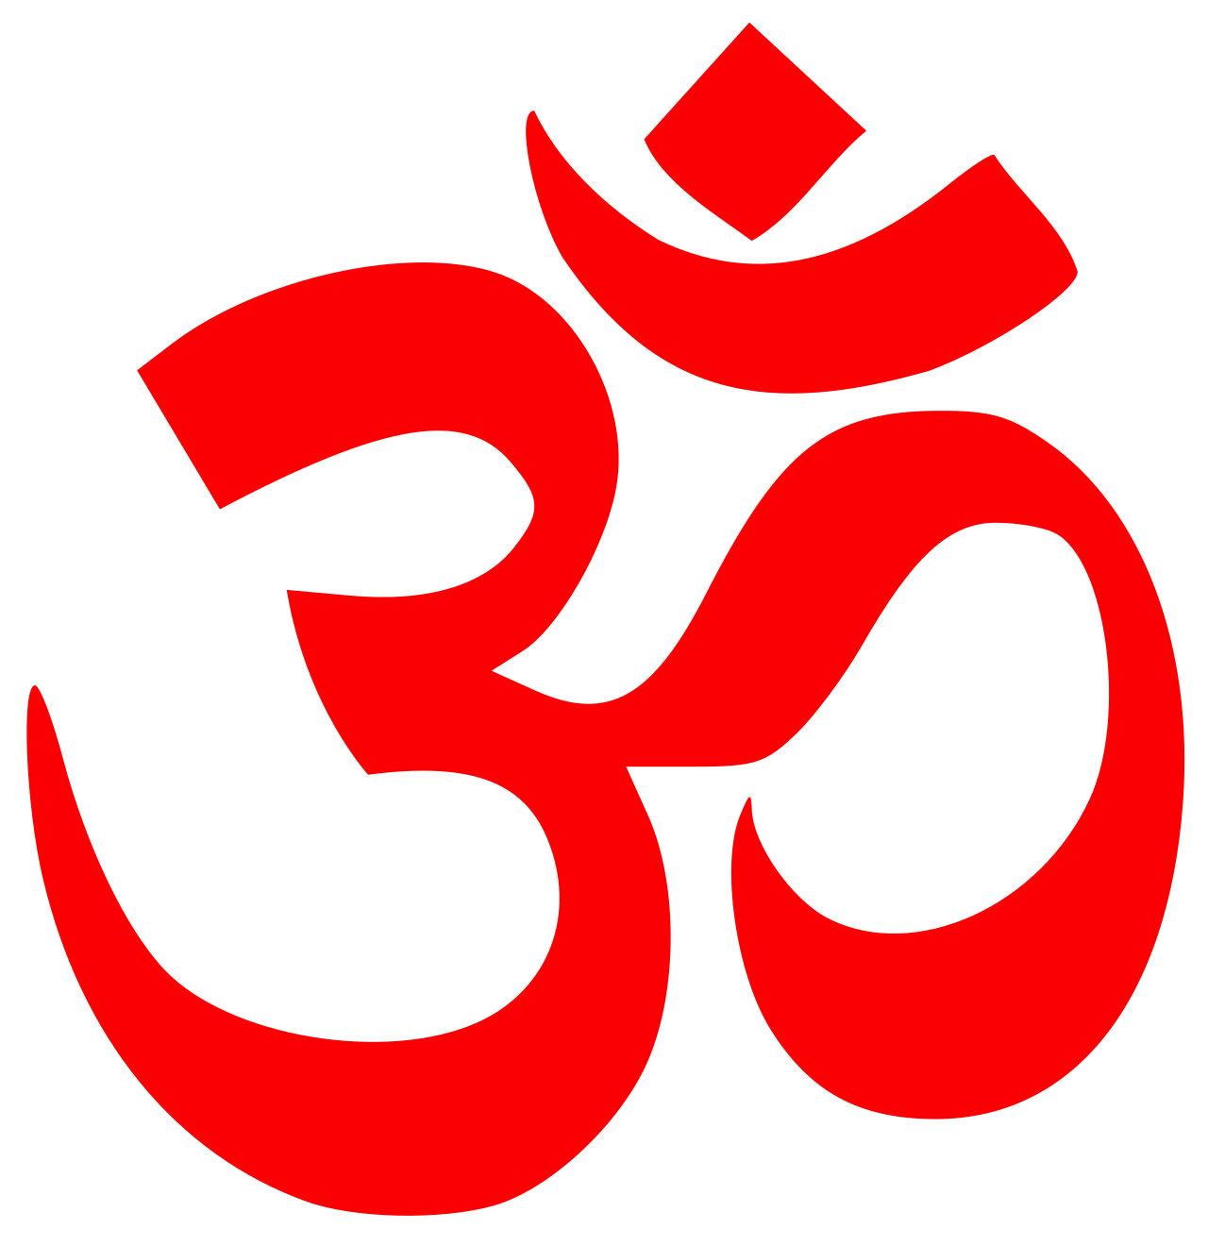
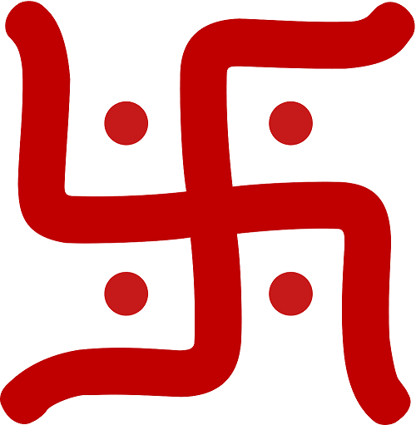
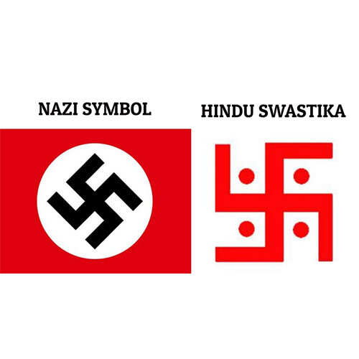
Symbols
Judaism
Islam
Buddhism
Hinduism
Star of David
Crescent and Star
Dharmachakra/Dharma Wheel
Om
Swastika
Notes:
Star of David
The yellow badge that Jews were forced to wear in Nazi-occupied Europe invested the Star of David with a symbolism indicating martyrdom and heroism.
Crescent and Star (Unofficial)
“They ask you, [O Muḥammad], about the crescent moons. Say, "They are measurements of time for the people and for ḥajj [pilgrimage]." Soorat albaqara (189)
Interpretation: reminder to pilgrimage and fasting Ramadan
Dharmachakra
The Sanskrit noun dharma ( धर्म ) is a derivation from the root dhṛ 'to hold, maintain, keep',[4] and means 'what is established or firm' and hence 'law', Chakra = wheel
Symbol represents the law of the Buddha, or the eightfold path (we’ll discuss in a bit) due to the 8 spokes
Om, Swastika
Swastika = “good fortune” in sanskrit
Mantra (i.e. sacred sound): It is variously said to be the essence of the supreme Absolute,^{[2]} consciousness,^{[5][6][7]} Ātman, Brahman, or the cosmic world.
the right-facing symbol (clockwise) (卐) is called swastika, symbolizing surya ("sun"), prosperity and good luck, while the left-facing symbol (counter-clockwise) (卍) is called sauwastika, symbolising night or tantric aspects of Kali.

Slide 4
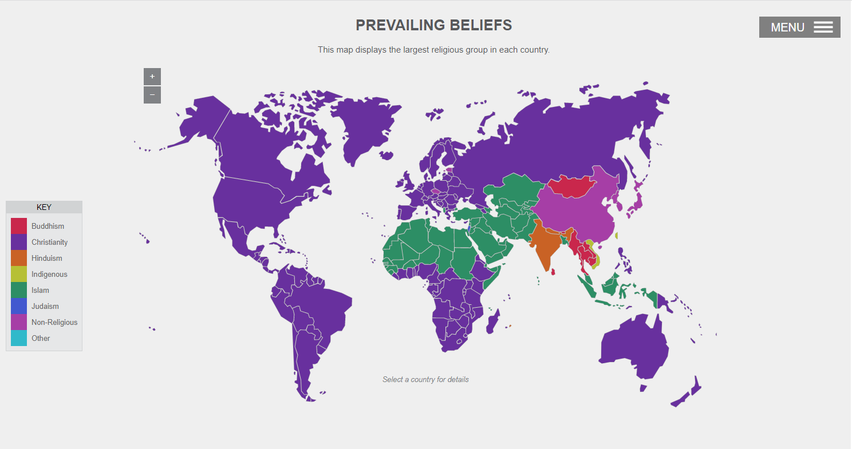
Geographic Distribution
https://www.pbslearningmedia.org/resource/sj14-soc-religmap/world-religions-map/
Notes:
Over 2500 studies across the world, diagram made in 2010
Map shows majority in a country
Middle-east
India
China
Mongolia, Thailand
How about total population?

Slide 5
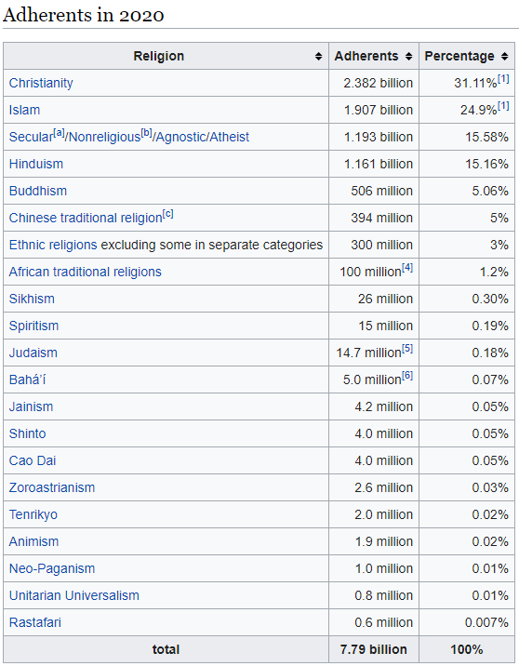
Overall Population Percentage
https://en.wikipedia.org/wiki/List_of_religious_populations
Updated 2020

Slide 6
Judaism

Slide 7
History + Origins
One of the most ancient religions (9th century - 5th century BC)
When there was a split between the kingdom of Israel + kingdom of Judah
When Yahwism converts to Judaism (Samuel and Kings)
Notes:
Kingdom of Judah + Kingdom of israel > 9th century bc
Yahwism is when worshipping of idols and other gods
Saul > David > Solomon (split due to unfair taxes)

Slide 8
Main Beliefs + Books
Books
  Tanakh/Miqra: Hebrew Bible (i.e. Old Testament)
    Torah (instructions)
      Genesis, Exodus, Leviticus, Numbers, Deuteronomy
    Nevi'im (prophets)
      Former Prophets: Joshua, Judges, Samuel, Kings
      Latter Prophets: Isaiah, Jeremiah, Ezekiel, Hosea, Joel, Amos, Obadiah, Jonah, Micah, Nahum, Habakkuk, Zephaniah, Haggai, Zechariah, and Malachi
    Ketuvim (writings)
      Psalms, Proverbs, Job, Song of Songs, Ruth, Lamentations, Ecclesiastes, Esther, Daniel, Ezra–Nehemiah, Chronicles (I and II)
  Talmud “primary source of Jewish religious law” -> example actual procedures on what to do vs what not to do to keep the Sabbath (Shabbat)
Beliefs
  Belief in one supreme God (introduced monotheism)
    Name: Yahweh (YHWH) -> very holy name, therefore replaced with “Adonay” or “My Lord”
    Created the world, man in his own image/likeness with free-will, since in His image -> good and free from sin, should preserve God’s creation by leading a holy and undefiled life
  Sin of Adam was not transmitted to next generations
  God made covenants with man, and in every covenant, it is God’s promise to His people that he will be their God and will guard them if they adhered to His commands
  Chosen people of God
  Don’t believe Jesus Christ is “God manifest in the flesh”
Notes:
Vs hinduism multiple gods, greek gods
(why they don’t actively seek new people to belief in their belief system + tahawwod)

Slide 9
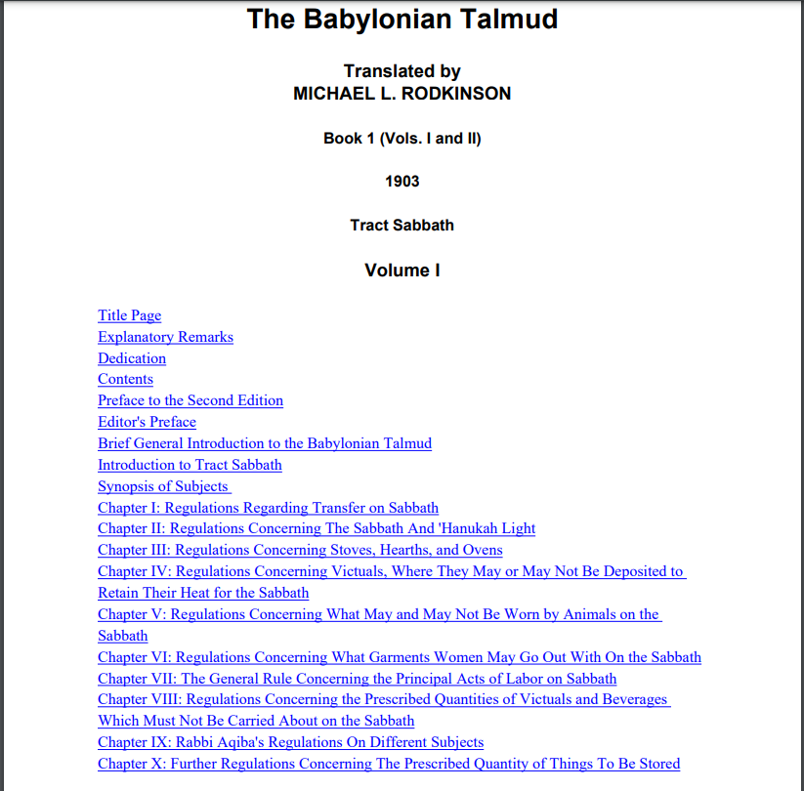
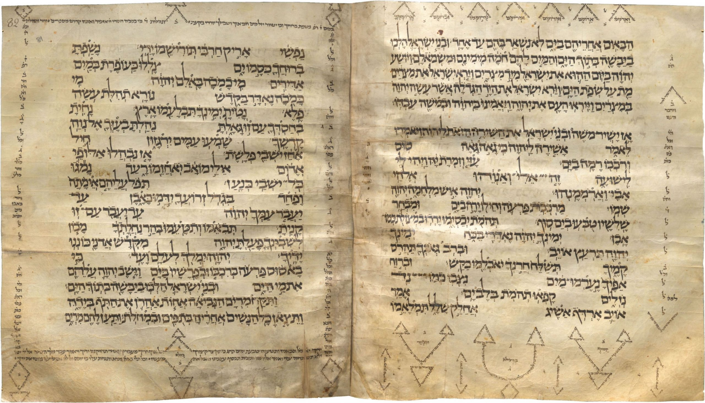
Tanakh + Talmud

Slide 10
Celebrations
Sabbath
  They uphold the belief that God created the world in six days and rested on the seventh. One of the commandments of God to the Jews is to “keep” the Sabbath and celebrate it as a day for rest and worship. From sunset Friday till sunset Saturday, the Jewish people do no work. It is the day for worshipping God in their synagogues.
Passover or “Pesach” and Feast of Unleavened bread
  Seven-day spring festival, commemorating the deliverance of the Jews from the slavery in Egypt by the power of God. It is the greatest of the Jewish festivities.
Shavuot/Feast of the Weeks
  is a spring harvest festival that marks the wheat harvest in Israel
“Rosh Hashanah” (meaning ‘head of the year’)
  This occurs in Autumn, preceding the “Yom Kippur” (The Day of the Atonement) by ten days. On this day the Jews repent and ask God’s forgiveness, as they also forgive one another. It is the season for improvement in spiritual rebirth. Following the “Yom Kippur” is the Feast of the Tabernacles, known also as Feast of Booths. It is primarily a feast for fruit harvest.
Hanukkah: (Festival of Lights)
  This is celebrated in December. The popularity of this feast has been on the increase. It is the feast of freedom and commemoration of the rededication of the Temple of Jerusalem after having been destroyed by the Romans in the Second Century A.D.
“Bar Mitsvah”/“Bat Mitzfah”
  The life of the Jewish individual is marked by personal celebrations: At thirteen years, a ceremony is held for the boy, called “Bar Mitsvah”, when he becomes a Son of the Commandment, i.e. a full member of the Jewish community. A ceremony is also held for the girl at thirteen, called “Bat Mitzfah”. On this occasion, the family celebrates their son’s or daughter’s reaching the age of legal maturity and thereby becoming obligated to observe all the commandments as an adult

Slide 11
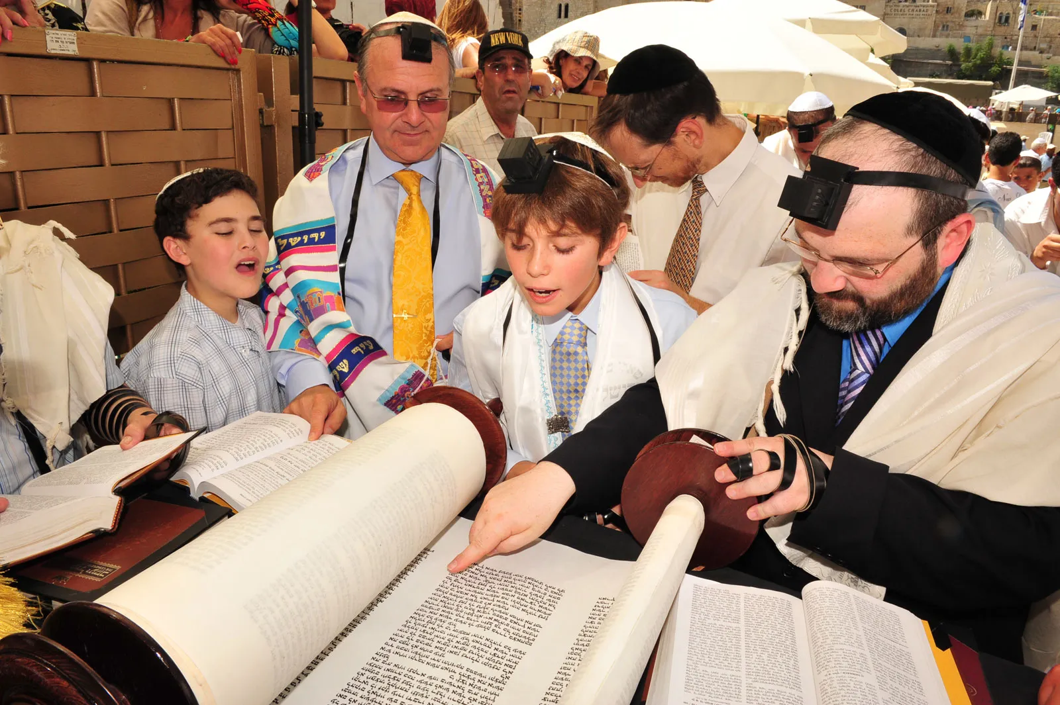
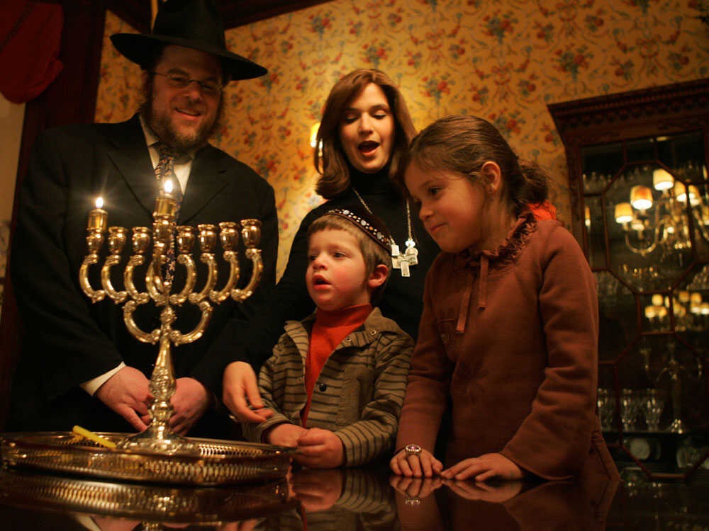
Barmitzvah + Hannukah

Slide 12
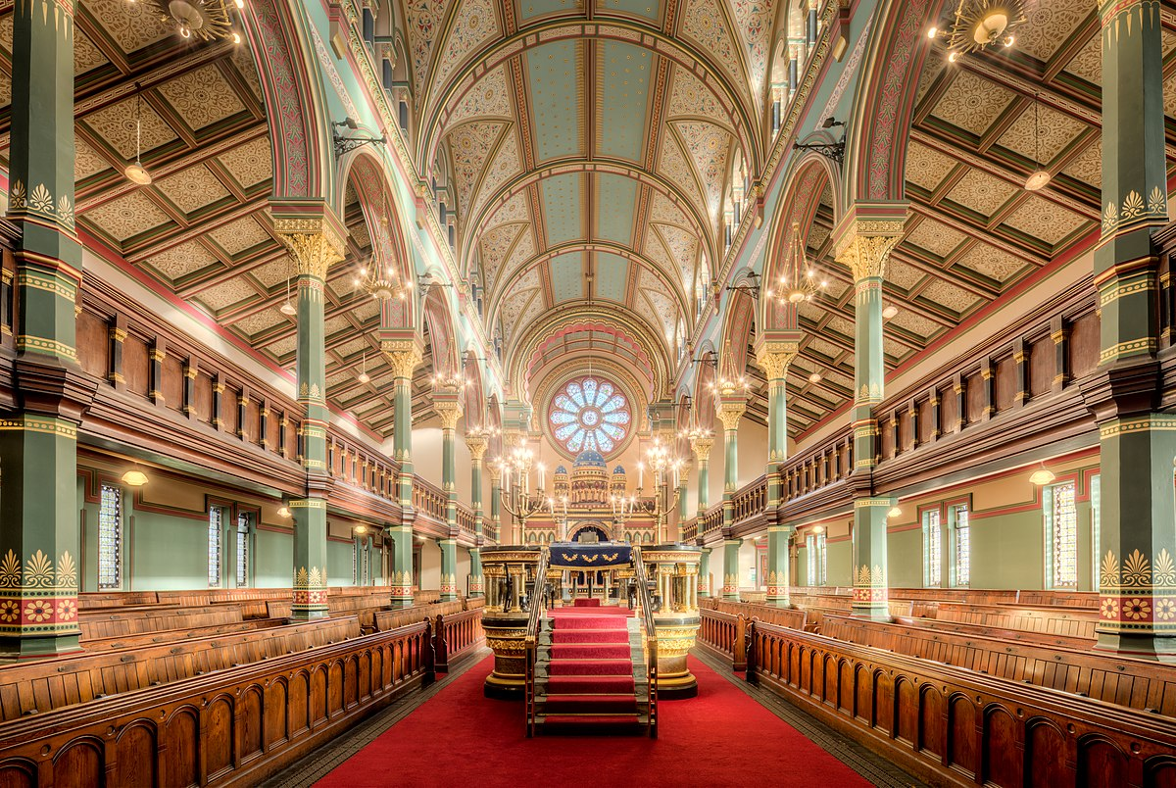
Sects
Place of Worship
Way of Life
Orthodox
  adhere strictly to Torah and Talmud - Hebrew
Liberal
  Torah as a symbol, women rabbis, English
Conservative
  middle stand between Orthodox and liberals, recently women rabbis, English + Hebrew
Temple in Jerusalem
  Got destroyed, so they built “synagogues”
Rabbi = My Master (interpreter of Torah and Talmud)
Israel became center for all Jews worldwide (1948)
Pray “SHEMA” morning + night daily (“Hear, O Israel!: The Lord our God, the Lord is One.” (Deuteronomy 6:4))
Judaism is a defined way of practical life rather than a mere belief and theology. However, they do not object to others having a relation with God as well
Judaism is an Ethnic Religion. The Jews make no attempt to entice others towards their grouping
They demand, however, freedom of worship and they detest any encroachment or interference.
It is difficult to understand a great deal about Judaism as a central authoritative body does not exist, neither does a definition of Judaism that is recognized by all the factions

Slide 13
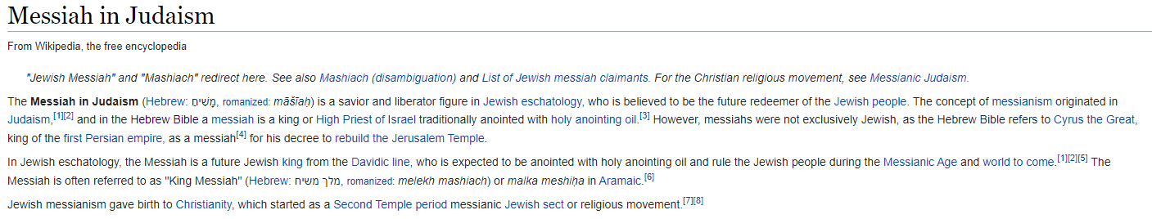
Judaism’s View on Christianity
Don’t believe that God is Jesus Christ manifest in the flesh
Therefore, don’t believe in the new testament
Talmud explains why Jesus disliked the way the jews kept the Sabbath and were quite strict
Jews still await the Messiah
Notes:
https://www.newtestamentchristians.com/bible-study-resources/351-old-testament-prophecies-fulfilled-in-jesus-christ/
Messianic Age: future time when a Messiah will reign and bring universal peace and brotherhood

Slide 14
Islam

Slide 15
History + Origins
Islam = Complete Submission (referring to one’s submission to Allah)
Modern + Ancient
  Modern: Started 7th century AD
  Ancient: Started from Adam
  Adam: Prophet
God = “Allah”
Quran is the only holy book, translations of Quran are permissible but Quran should only be recited in Quranic Arabic
Every prophet performed miracles, except for Mohamad (his miracle was the Quran)
Mohamed -> last prophet sent by God, writer of the Quran
  570 AD - 632 AD (Mecca <-> Medina, Arabian Peninsula: Now Saudi Arabia)
  Orphan brought up by his uncle
  After getting married, he managed his wife’s trading business
  Spent most of his time meditating and praying
  Felt he had a calling from God at age of 40 (610 AD) to be a prophet
    He had a revelation of the Quran in a vision that continued throughout his life at the hands of Archangel Gabriel
  Started mission in Mecca, proclaiming one God (warning of torment to others who believed in a religion with multiple gods)
    This angered leaders of Mecca, therefore left for Medina 622 AD (the Higra -> marks the beginning of Islamic Calendar)
  In Medina, formed first Islamic grouping (the Ummah) and gathered around him sizable forces (which he ruled for 10 years).
  Before death, he had taken whole of Mecca and instituted the Pilgrimage as a basic principle of Islam
Muslims believe that he was the highest example of a muslim life (by his deeds + words).
  His sayings and acts (i.e. what he said and did) = “Hadith” = conversation
    Memorized by closest advocates of Islam

Slide 16
Main Beliefs + Books
Books (only Quran stayed in its original format)
  Quran (given to Muhammad - word of God)
    Torah (given to Moses)
    Gospel (given to Jesus)
    Psalms (given to David)
    Scrolls (given to Abraham)
  Sharia (Islamic Law)
  Hadith (Mohamad’s actions, words, and silent approvals)
Beliefs
  Belief in only One God (no partner with Him)
  Belief in all the prophets sent by God.
  Acknowledge that there are angels who carry God’s messages.
  Accept all the books that were given by God.
  The Last Day of Judgement
  That the destiny of everyone is in God’s hand
    Even if you are righteous
Hadith
Sharia
Notes:
Vs hinduism multiple gods, greek gods

Slide 17
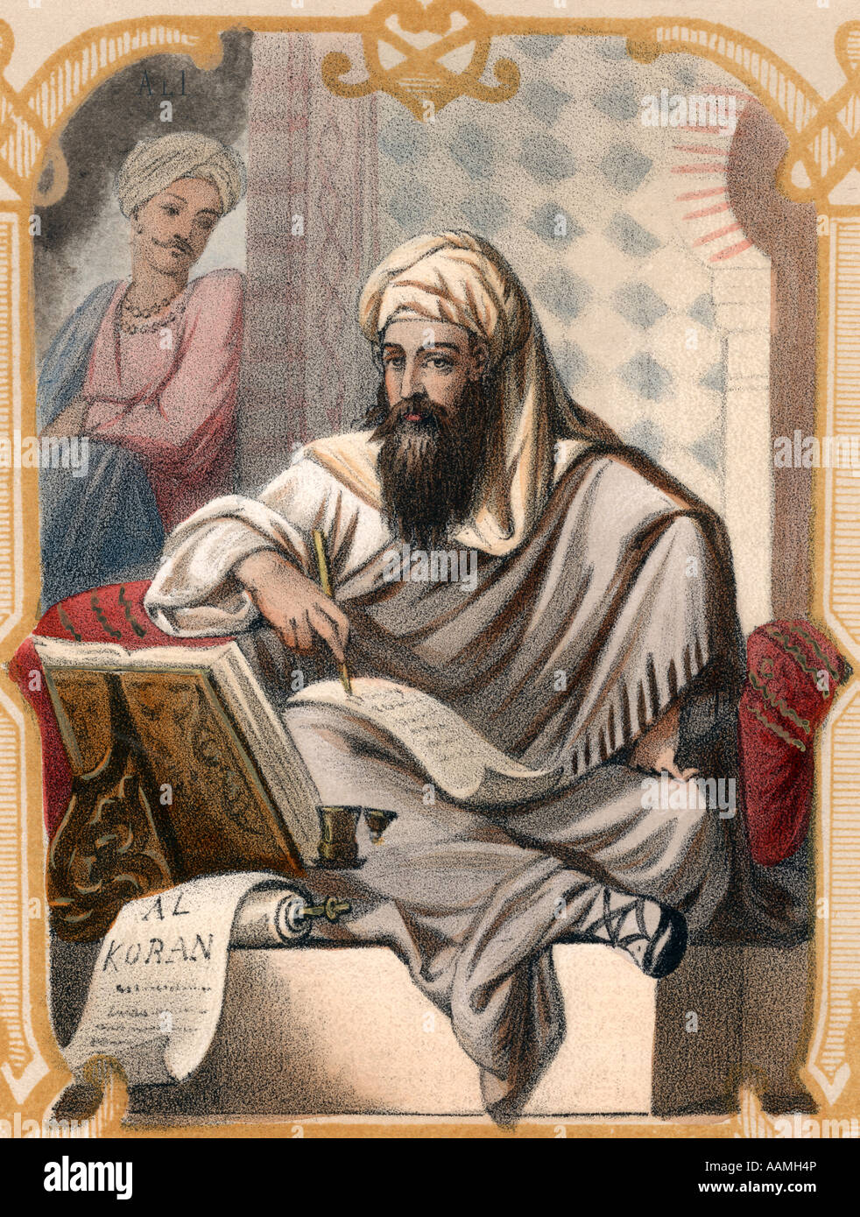
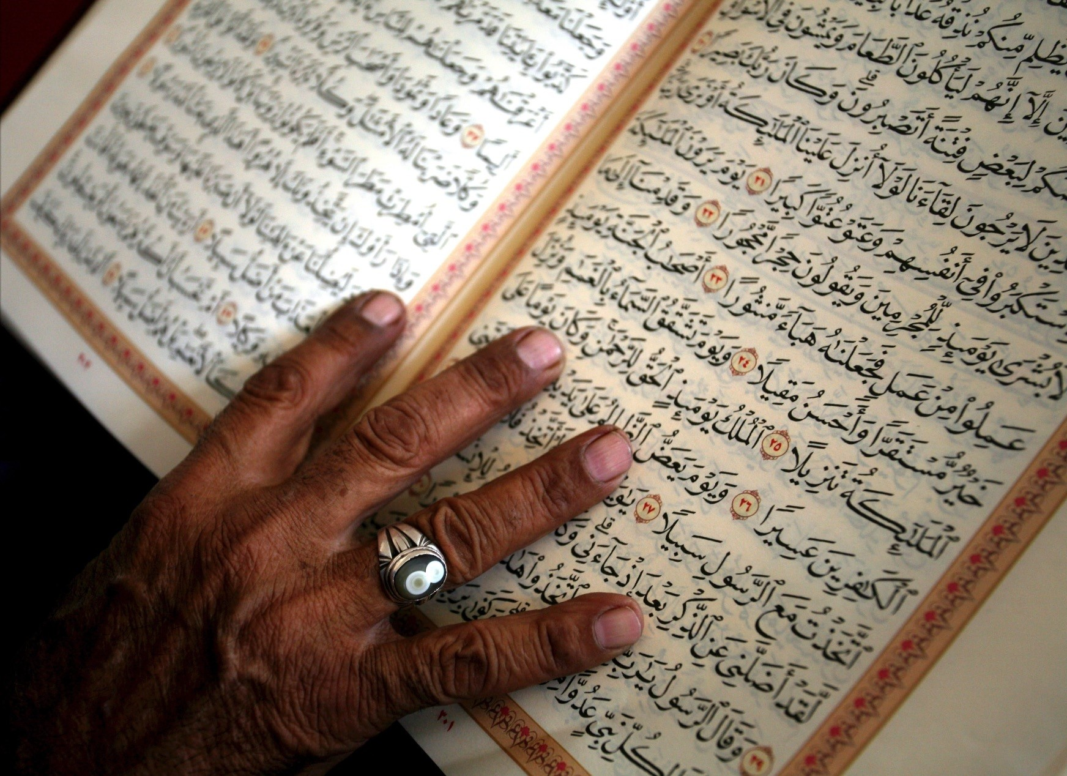
Quran + Illustration of Muhammad

Slide 18
Way of Life
A muslim must obey the Quran and the Sharia in all personal, family, social and economic affairs
Pillars of Islam (6) (from Hadith)
  Shehadah (Declaration)
    Declaring by tongue with full ascent of the heart “There is no god but Allah, and Mohamed is the Messenger of God”
    This makes one a true Muslim
  Salat (Prayer)
    Prayer 5 times a day
    Must face Mecca
    Kneel down, forehead to the ground, recite verses from the Quran
    Can pray alone, with a family, within a group, or at the mosque
    Friday prayer they go to mosque to hear sermon
  Zakat (Alms)
    Giving alms to the poor 2.5% of income into fund of “Zakat”
  Sawm (Fast)
    Fasting for the month of Ramadan (a month in Islamic calendar).
    Fast from sunrise to sunset
  Hajj (Pilgrimage)
    Muslims with financial means, must physically go to Mecca for Pilgrimage (Haj) at least once in their lifetime
  Jihad (“Holy War”/striving/struggling)
    Controversial because ambiguous
    From Arabic wikipedia:الجهاد أو الجهاد في سبيل الله هو مصطلح إسلامي يعني جميع الأفعال أو الأقوال التي تتم لنشر الإسلام، أو لصدِّ عدوٍ يستهدف المسلمين، أو لتحرير أرضٍ مسلمة، أو لمساعدة مسلمٍ ما والمسلمين عامة: All actions or sayings that spread the Islam religion, or fight BACK enemies that target muslims, or freeing muslim land, or helping a muslim and muslims in general (My translation)
Muslims are not allowed to:
  Eat or touch pork.
  Drink or handle alcoholic drinks.
  Gamble
  Borrow or lend money against usury (interest). However, profit sharing is permissible.
  Keep more than four wives at a time.
Notes:
Reason for terrorist groups: Current democratic state stands against Islamic state

Slide 19
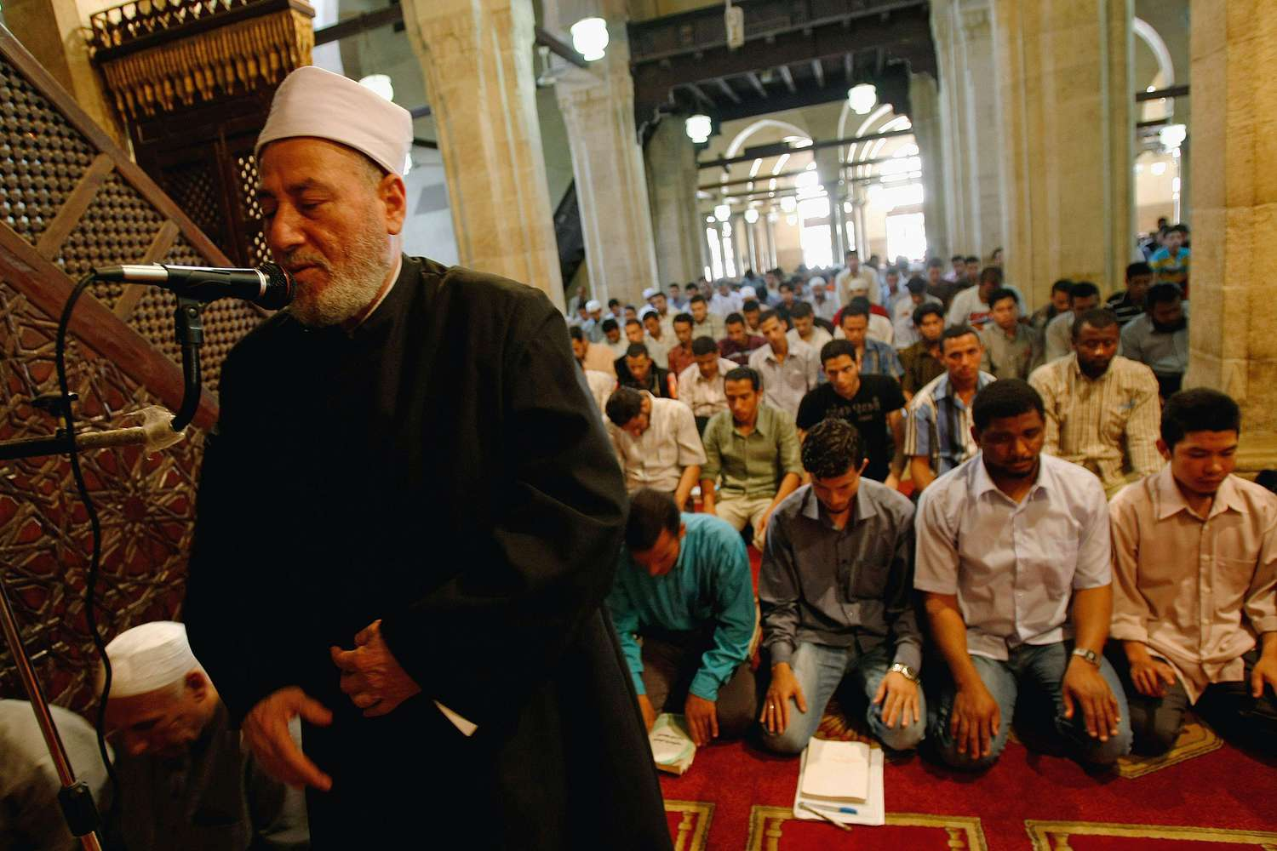
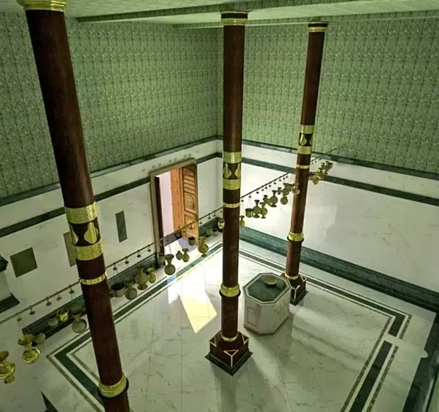
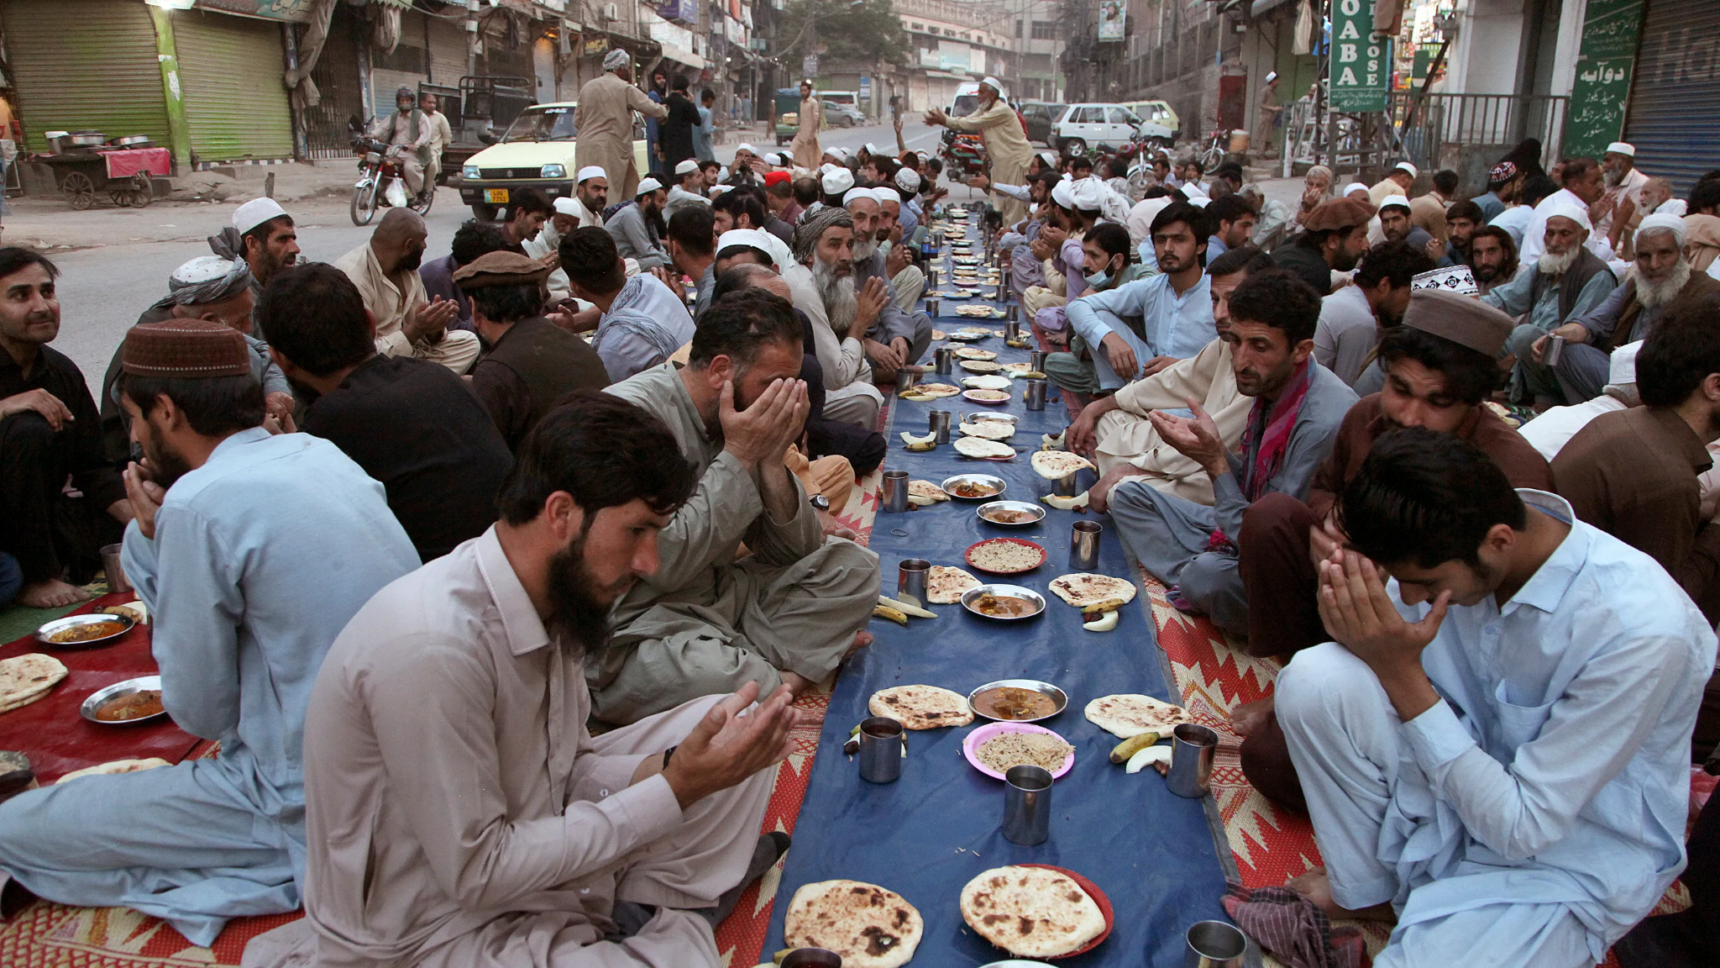
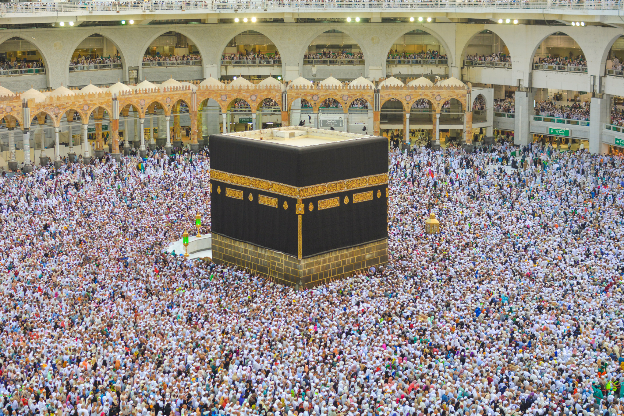
Iftar + Kaaba + Imam
Notes:
Kaaba = House of God

Slide 20
Sects
Place of Worship
Celebrations
Sunnis
  Accounts for 85% of muslims
  Believe in the 4 caliphs (leaders succeeding Mohammad that lead the Ummah)
    “Abu Bakr”
    “Umar” al Farooq
    “Uthman” Gani
    “Ali”
Shiites (or Shia)
  Second largest sect of Islam
  A Shiite believes that Mohammed's son-in-law, Ali, was his legitimate successor as political and religious leader (by blood)
  Shiites consider Ali and the leaders who came after him as imams. Most believe in a line of 12 imams, the last of whom, a boy, is believed to have vanished in the ninth century in Iraq after his father was murdered. Shiites known as Twelvers anticipate his return as the Mahdi, or Messiah.
Sufis
  Sufism may be best described as Islamic mysticism or asceticism, which through belief and practice helps Muslims attain nearness to Allah by way of direct personal experience of God.
Muslim Brotherhood
  Located in Saudi Arabia but are increasing in numbers (example in Egypt)
Ismailis
  Extremist Shiites (located in Asia and North Africa)
Mosque
  Imam leads prayer at mosque and gives the Friday sermon
Eid-al-fitr
  After fasting for 30 days of Ramadan
  Eid al-Fitr is celebrated at the end of Ramadan (a month of fasting during daylight hours), and Muslims may perform acts of zakat (charity) on the occasion, which begins after the new moon is sighted for the beginning of the month of Shawwal.
Eid-al-adha
  Eid al-Adha is celebrated on the tenth day of Dhu al-Hijjah, when the Hajj pilgrimage takes place and lasts for four days.
  Muslims may perform an act of zakat and friendship by slaughtering a sheep and distributing the meat to family, friends, and to the poor. Muslims are also encouraged to be especially friendly and reach out to one another during this period.

Slide 21
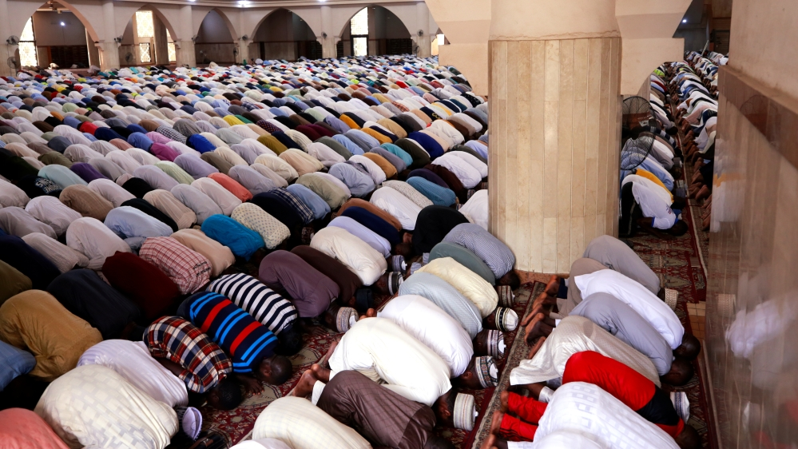
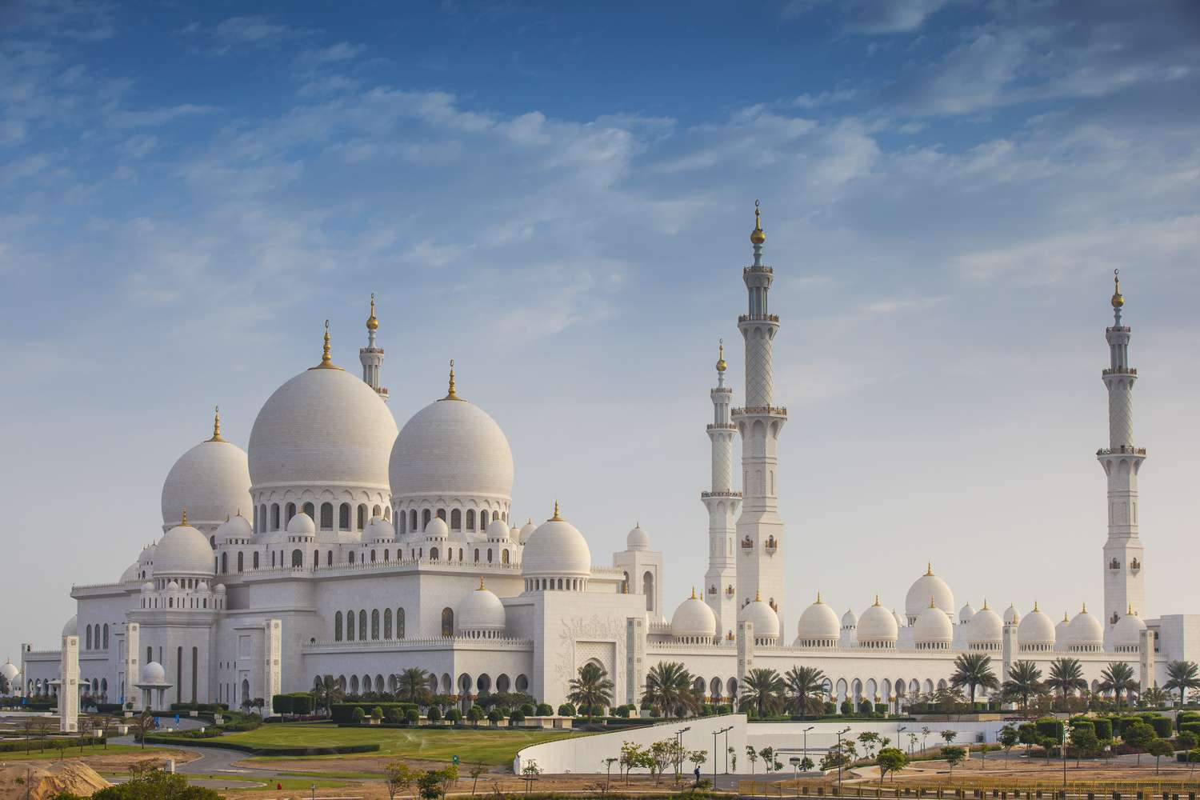
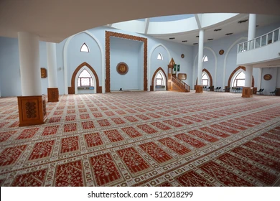
Mosque
Notes:
Kingdom of Judah + Kingdom of israel > 9th century bc

Slide 22
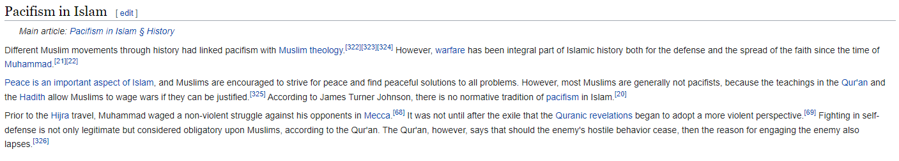
Islam’s View on Christianity
Do believe that Jesus is not God but is:
Prophet
Messenger of God
Messiah
Was not crucified
Will judge people on Judgement day (along with God)
Was born of the virgin Mary
Do believe the Christians are pagans because they believe in a “Triune” God
Al Maidah 72 (“Those who say, “Allah is the Messiah, son of Mary,” have certainly fallen into disbelief.”)
Al Maidah 73 (“Those who say, “Allah is one in a Trinity,” have certainly fallen into disbelief. There is only One God. If they do not stop saying this, those who disbelieve among them will be afflicted with a painful punishment.”)
Do believe that pagans should be slaughtered
Sword Verse: Al Tawbah 5 ("But when the forbidden months are past, then fight and slay the Pagans wherever ye find them, and seize them, beleaguer them, and lie in wait for them in every stratagem (of war); but if they repent, and establish regular prayers and practise regular charity, then open the way for them: for Allah is Oft-forgiving, Most Merciful.")
Do believe that the Bible has changed over time and translations therefore, not as holy as the Quran
What about all old manuscripts? https://en.wikipedia.org/wiki/Biblical_manuscript
https://en.wikipedia.org/wiki/Islam_and_violence#Pacifism_in_Islam
Notes:
More controversial topics in Islam like equality between men and women.

Slide 23
Hinduism

Slide 24
History + Origins
No historic founder
One of the oldest religions of the world (more than 4000 years ago)
  Hinduism has undergone many changes in its history
Hinduism and Indian culture are so inextricably intertwined that it is almost impossible to differentiate between them
~82.5% of people in India are Hindu
Hindu (name given to them by non-Hindus)
  They call their religion Sanatana Dharma or Eternal Truth
  As Eternal Truth, the religion is universal
Anyone who seeks the Eternal Truth is Hindu, no matter what his or her religion or rational affiliation (except for Abrahamic religions)
However, the two most common criteria for identifying a Hindu are: He or she accepts the authority of the sacred scriptures known as the Vedas, AND he or she belongs to one of the castes of India
Notes:
Kingdom of Judah + Kingdom of israel > 9th century bc

Slide 25
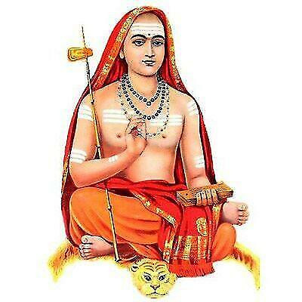
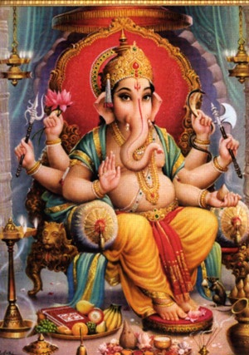
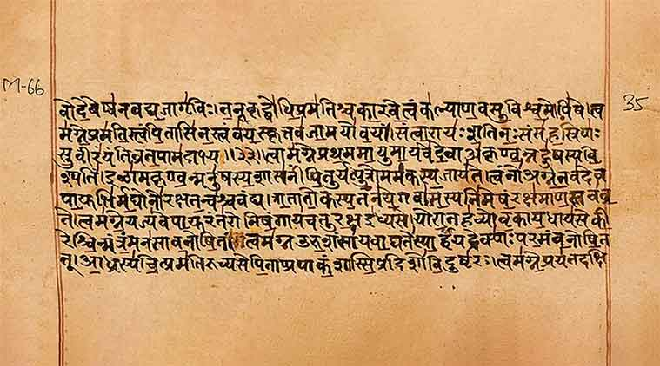
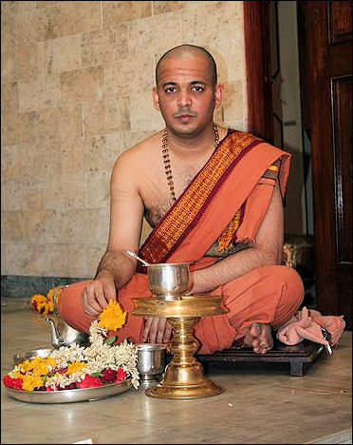
Vedas + Ganesha + Hindu Priest
Notes:
Mantra = word or sound repeated to aid concentration in meditation
Benediction = the utterance or bestowing of a blessing, especially at the end of a religious service

Slide 26
Main Beliefs + Books
Books/Scriptures
  Vedas (“knowledge” in Vedic Sanskrit)
    Rigveda (Hymns)
    Yajurveda (compilation of ritual-offering formulas)
    Samaveda (liturgical text mostly taken from Rigveda)
    Atharvaveda ("knowledge storehouse of atharvāṇas, the procedures for everyday life")
    Each has 4 subsections
      the Samhitas (mantras and benedictions)
      the Aranyakas (text on rituals, ceremonies, sacrifices and symbolic-sacrifices)
      the Brahmanas (commentaries on rituals, ceremonies and sacrifices)
      the Upanishads (texts discussing meditation, philosophy and spiritual knowledge)
Beliefs
  Hindus have many different beliefs, and they worship different gods and read different scriptures
    However all affirm that the highest calling of all Hindus is to fulfil their social role to the best of their ability, to strive for their liberation in the way appropriate to their disposition and needs, and to grow ever closer to the Eternal Truth
  Believe in god
    However, god means different things to different people
      For some: “god is the highest reality and the deepest truth”
    Some gods:
      Brahma (creator)
      Shiva (destroyer)
        Powerful but loving god
      Vishnu (Sustainer)
        Appears in many forms for the purpose of preserving good and destroying evil
        Best human forms are Rama (ideal human being) and Krishna (infant, boy, handsome youth, husband, prince)
      Shakti (mother goddess)
        Hindus worship god in female form as the goddess for they believe that god is greater than human ideas of gender
      All of whom appear in many forms
      Some forms of god are animals
      Worship = puja
      the devoted offer gifts of food and flower, and they dress and decorate an image of the god
      Hindus realize that all the names and forms of god they worship are really expressions of the one true reality (Brahman), which is beyond name and form.
Notes:
Mantra = word or sound repeated to aid concentration in meditation
Benediction = the utterance or bestowing of a blessing, especially at the end of a religious service

Slide 27
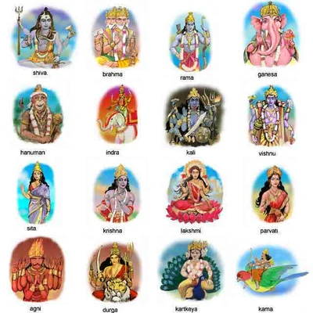
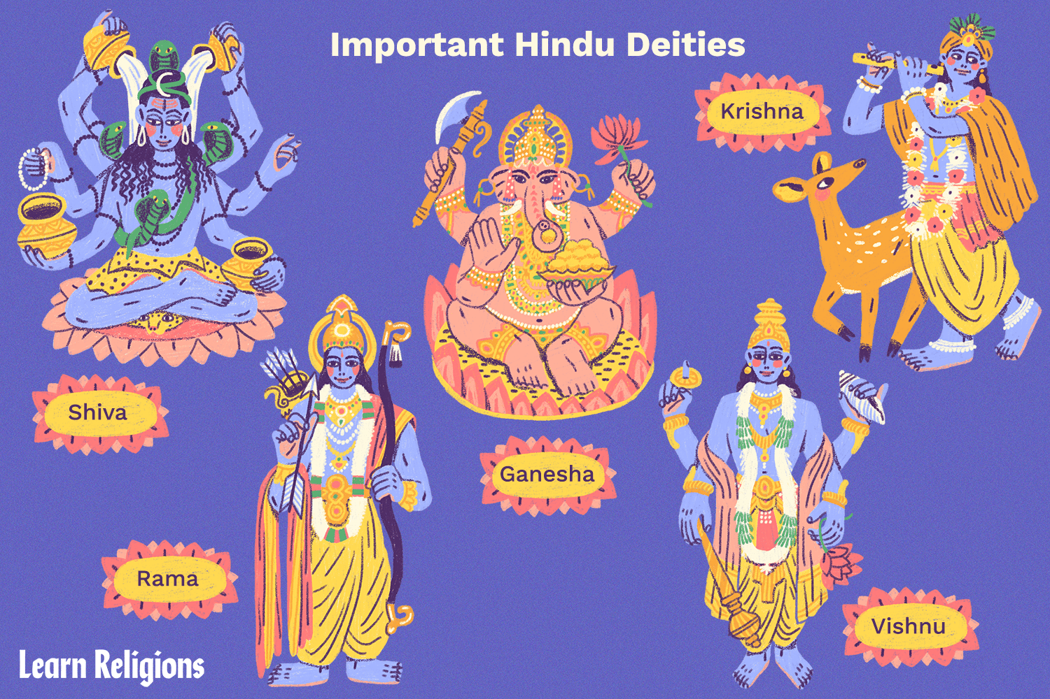
Hindu gods
Notes:
Mantra = word or sound repeated to aid concentration in meditation
Benediction = the utterance or bestowing of a blessing, especially at the end of a religious service

Slide 28
Way of Life
The Way of Activity: KARMA MARGA:
  Activity, or doing good work, is practised daily by millions of Hindus.
    Centres chiefly on offering gifts and sacrifices to the gods, goddesses, or spirits, through worshipping in the temple or at home shrines. In the temple is where the stored power of the gods resides.
    The priest or Brahmin is in charge of temple ceremonies that feed, bathe, decorate and commune with deity. Brahman can set free the power of the deity. Wealthy Hindus may build their own ornate temples as signs of devotion; thus aggregating greater works or merits.
The Way of Knowledge: JNANA MARGA:
  The way of knowledge is a more difficult path than the way of activity, for it requires a single-minded devotion and great sacrifice to attain the final step of becoming a holy man.
  A Hindu man's life has traditionally been divided into four stages: student; householder; forest dweller; and, for a few individuals, holy man. Virtually all Hindus will take the first two steps (student + householder), but the man who pursues the way of knowledge is required to take the third and fourth steps as well (forest dweller + holy man).
  The stages of the way to knowledge are somewhat blurred today, although there are still a sense in which each stage of life defines a person's attitude.
    The duty of a student is to study and learn the sacred literature
    while the duty of a married householder is to be a responsible husband, father, and citizen.
    The third stage, forest dweller, is not a duty, like the first two stages, but a choice. If a man continues on the way of knowledge, he leaves his home, business, and family in the good care of his sons and becomes a forest dweller. He becomes the disciple of a guru and learns the meditative and ascetic life.
    The fourth stage is becoming a holy man, using the meditative techniques (yoga) learned from the guru. One of the techniques of the ascetic life is self-mortification, such as lying on a bed of thorns. Self-mortification helps the Hindu man achieve the necessary concentration for yoga. Through his intense concentration, he hones the virtues needed to attain the final level of holiness that will lead to salvation or moksha. Since the way of knowledge is so intense, not many choose to follow it.
The Way of Devotion: BHAKTI MARGA:
  The third way is through devotion and is the most popular pursuit of moksha. One need not build a shrine or enlist the aid of a priest to offer devotion.
  The Hindu chooses one of the gods or goddesses as his personal deity and the object of his love and devotion. In return, the gods offer grace to provide good karma, which then breaks the cycles of transmigration of the souls. Vishnu, Shiva, Shaki, and Krishna (or one of their incarnations) are the gods most often chosen.

Slide 29
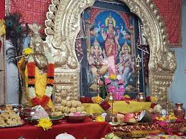
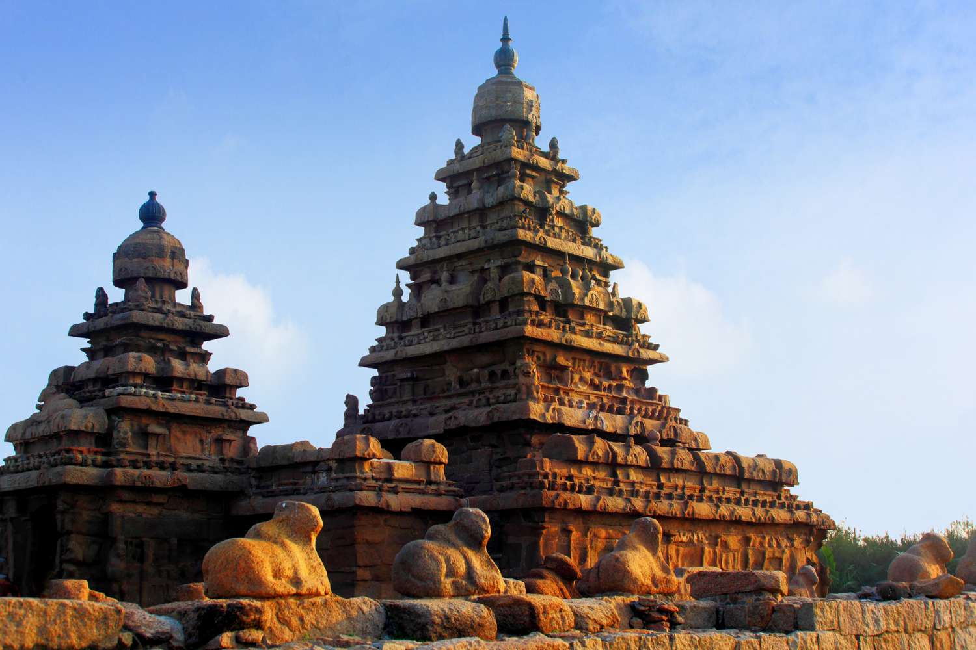
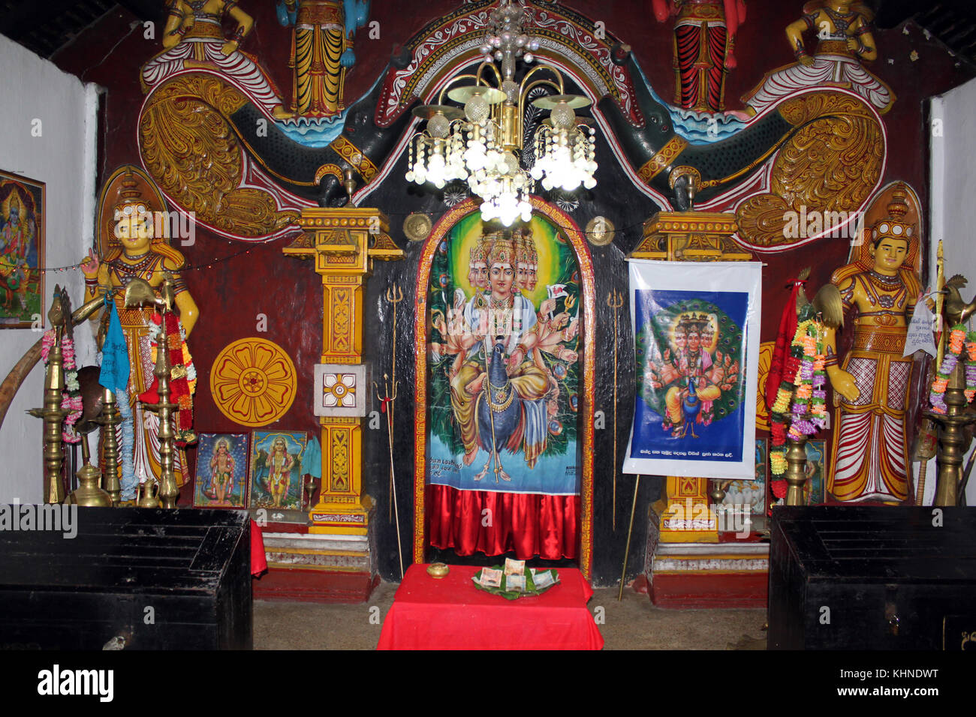
Temples
Notes:
Mantra = word or sound repeated to aid concentration in meditation
Benediction = the utterance or bestowing of a blessing, especially at the end of a religious service

Slide 30
Place of Worship
Sects
Celebrations
Mandir (temple)
Vaishnavism
  Vaishnavism is a devotional stream of Hinduism, which worships the god Vishnu as the Supreme Lord (Svayam Bhagavan). As well as Vishnu himself, followers of the denomination also worship Vishnu's ten incarnations (the Dashavatara).
Shaivism
  Shaivas or Shaivites are those who primarily worship Shiva as the supreme god, both immanent and transcendent. Shaivism embraces at the same time monism (specifically nondualism) and dualism.
Shaktism
  Shaktas worship Goddess as Mother Shakti, in different forms. These forms may include Kali, Parvati/Durga, Lakshmi and Saraswati. The branch of Hinduism that worships the goddess, known as Devi, is called Shaktism.
Smartism
  Smartas treat all deities as the same, and their temples include five deities (Pancopasana) or Panchadevata as personal saguna (divine with form) manifestation of the nirguna (divine without form) Absolute, the Brahman. The choice of the nature of God is up to the individual worshiper since different manifestations of God are held to be equivalent. It is nonsectarian as it encourages the worship of any personal god along with others such as Ganesha, Shiva, Shakti, Vishnu, Surya
Diwali
  Diwali is the festival of lights for Hindus and Sikhs. The celebration lasts for five days and is marked by sweets, fireworks and lights. It celebrates the triumph of good, light and knowledge over evil, darkness and ignorance. Diwali celebrates a good year of harvesting and honors the Goddess of Wealth.
  Diwali usually takes place in October or November, but the date is different each year because it is based on the Hindu calendar. During this holiday, all buildings are adorned with many Diyas, which are oil lamps. It is believed that the lamps guide Lakshmi, the Goddess of Wealth, to the homes of Hindus. Hindus thank Lakshmi by opening the windows of their houses and by drawing images of lotus flowers. They also draw colorful patterns on the floor called Rangolis. During Diwali, Hindus give and receive gifts — especially sweets. They also celebrate with feasts and gambling.
Holi
  Holi is the most colorful and happening festival of India. It is celebrated with great zeal, pomp, and joy in almost every part of India. Holi is celebrated on the full Moon day in the month of Phalguna which falls in the month of February or March. It is a two-day festival which starts with the “Holika Dahan.” The second day of the fiesta is known as “Dhulandi” wherein people celebrate by sprinkling colors, water, abeer, and gulaal on each other. People forget old enmity and enjoy with friends and loved ones. There is an atmosphere of joy and festivity all around.
Navratri and Dussehra
Krishna Janmashtami
Maha Shivratri

Slide 31
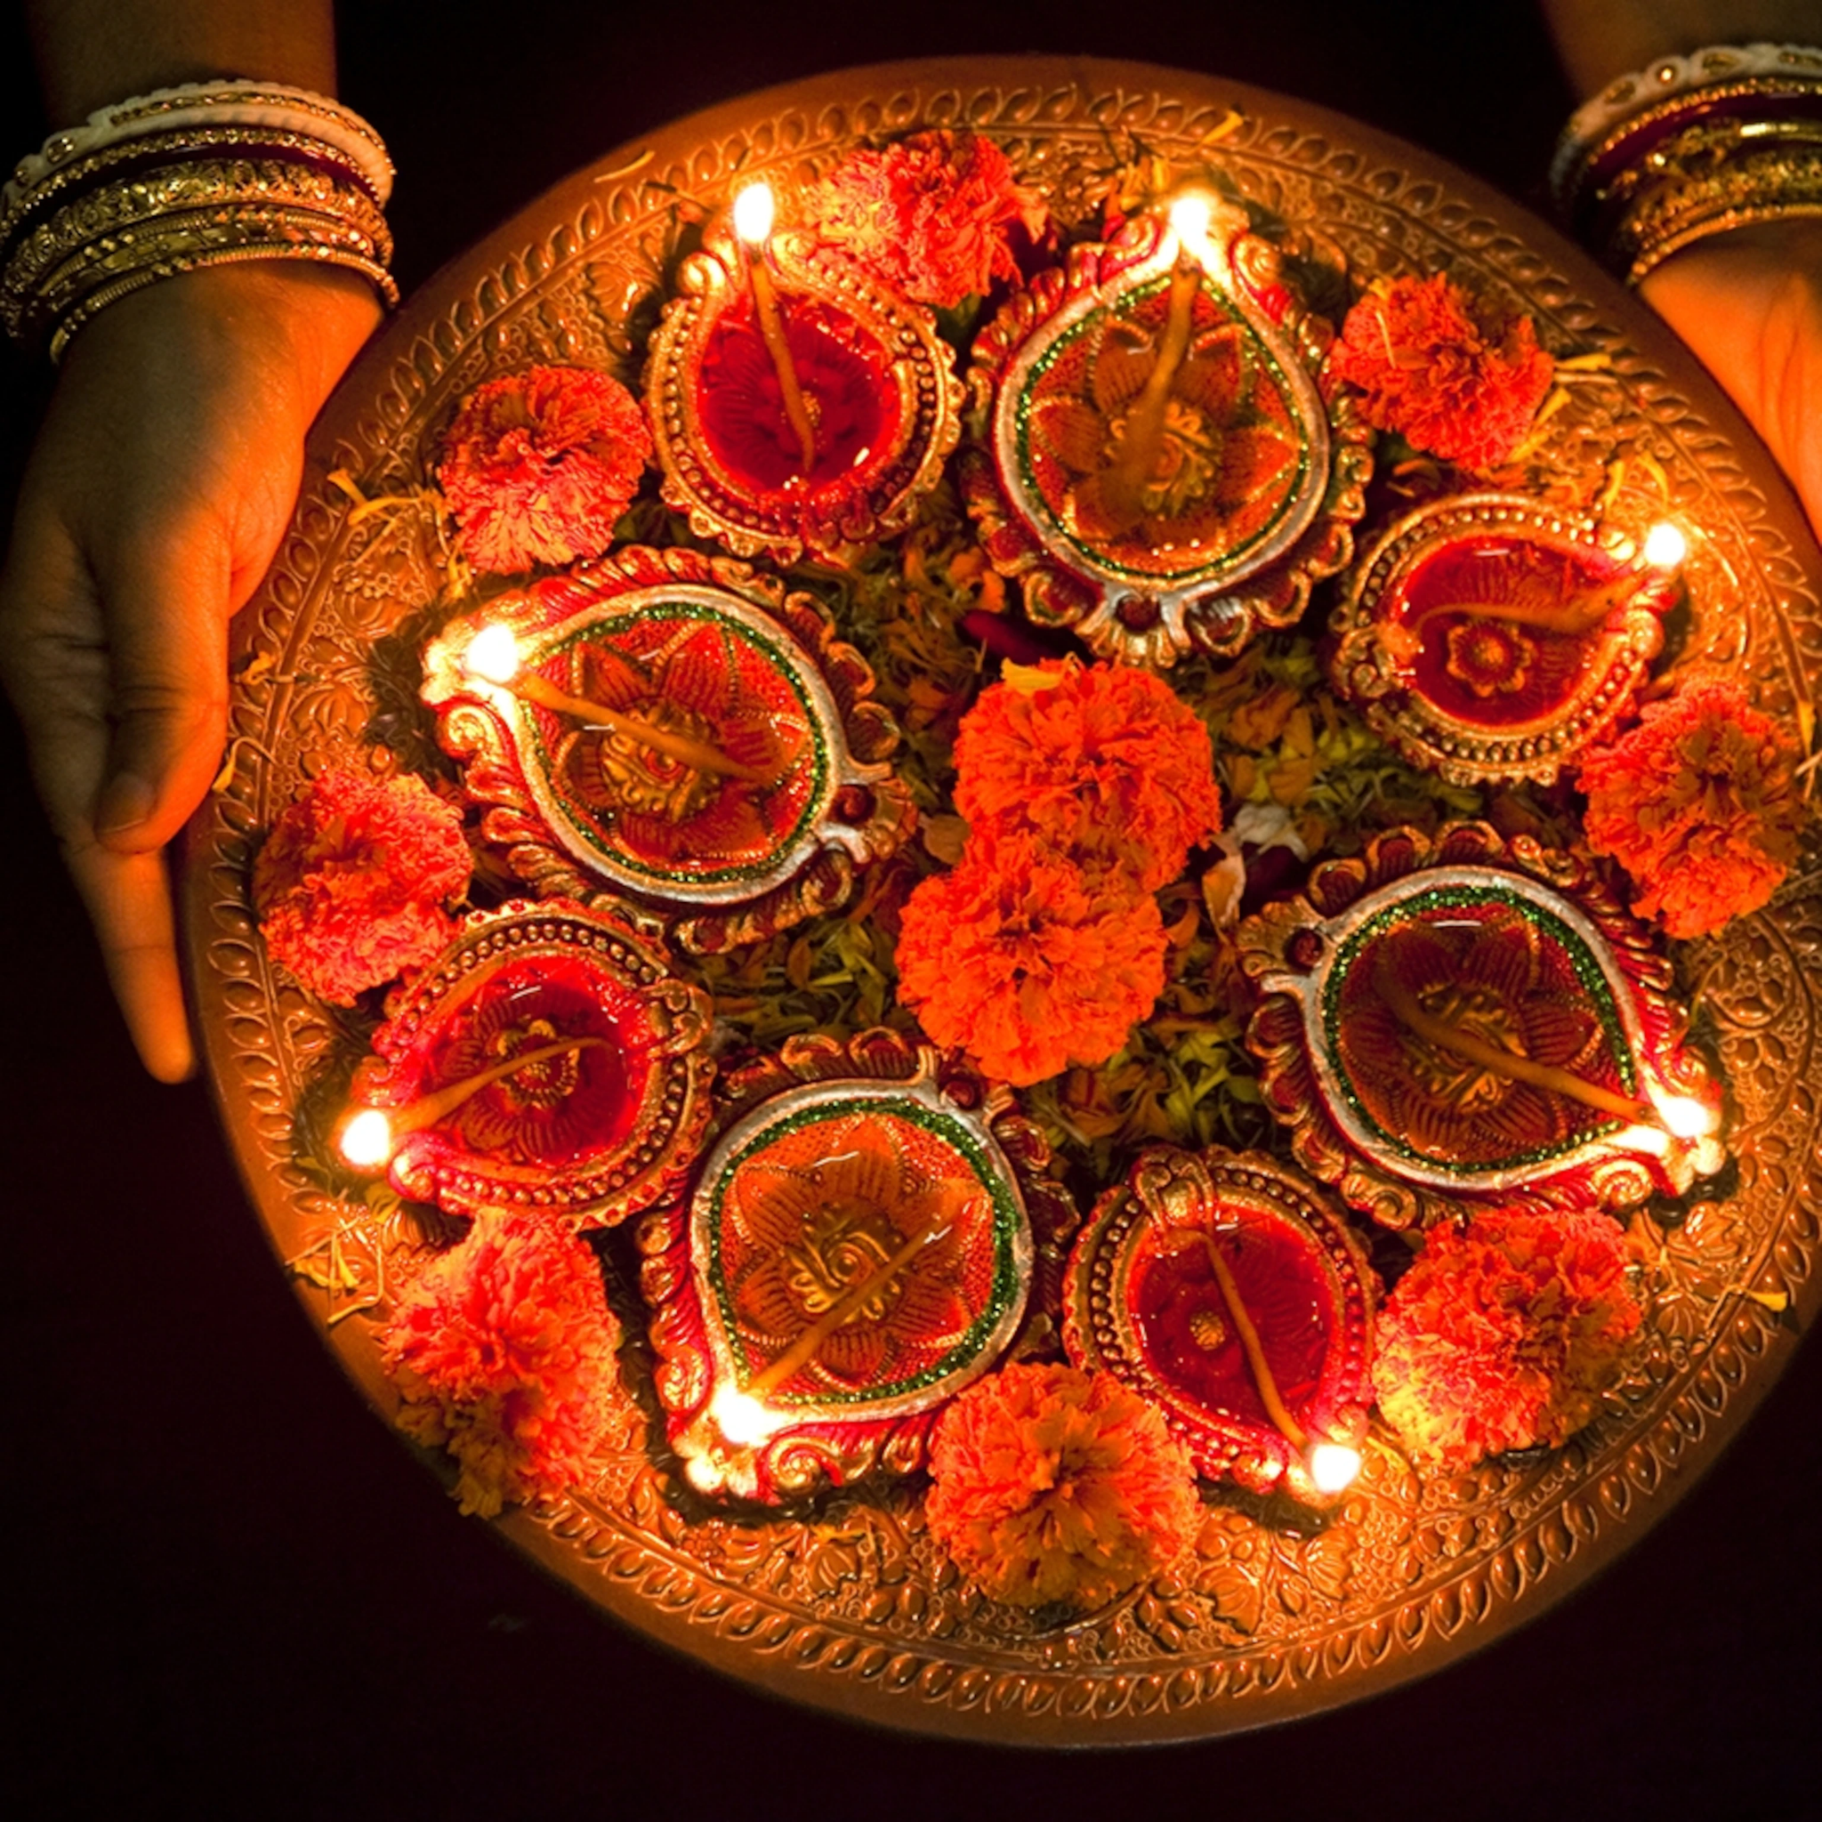
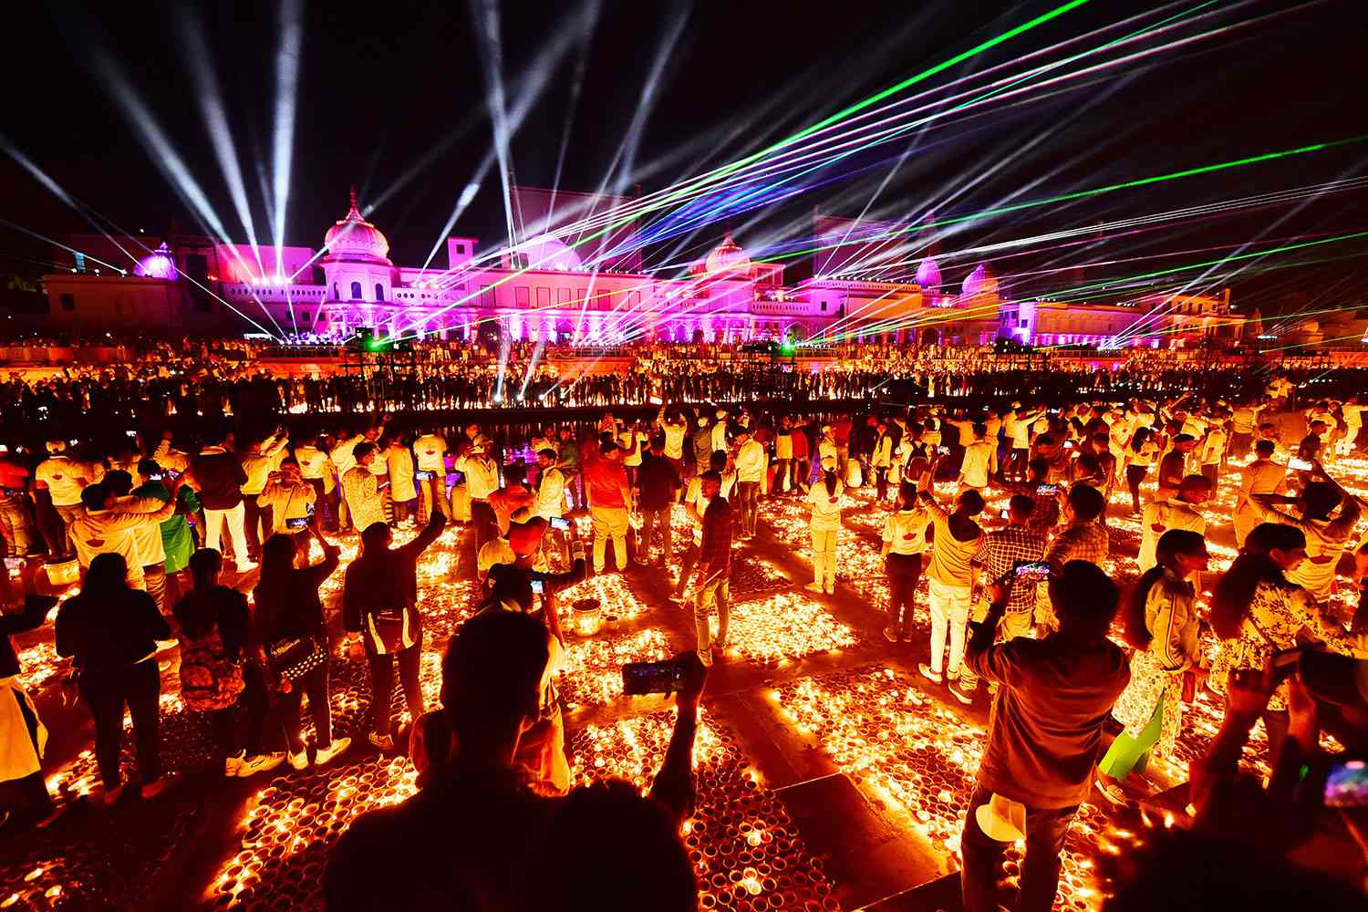
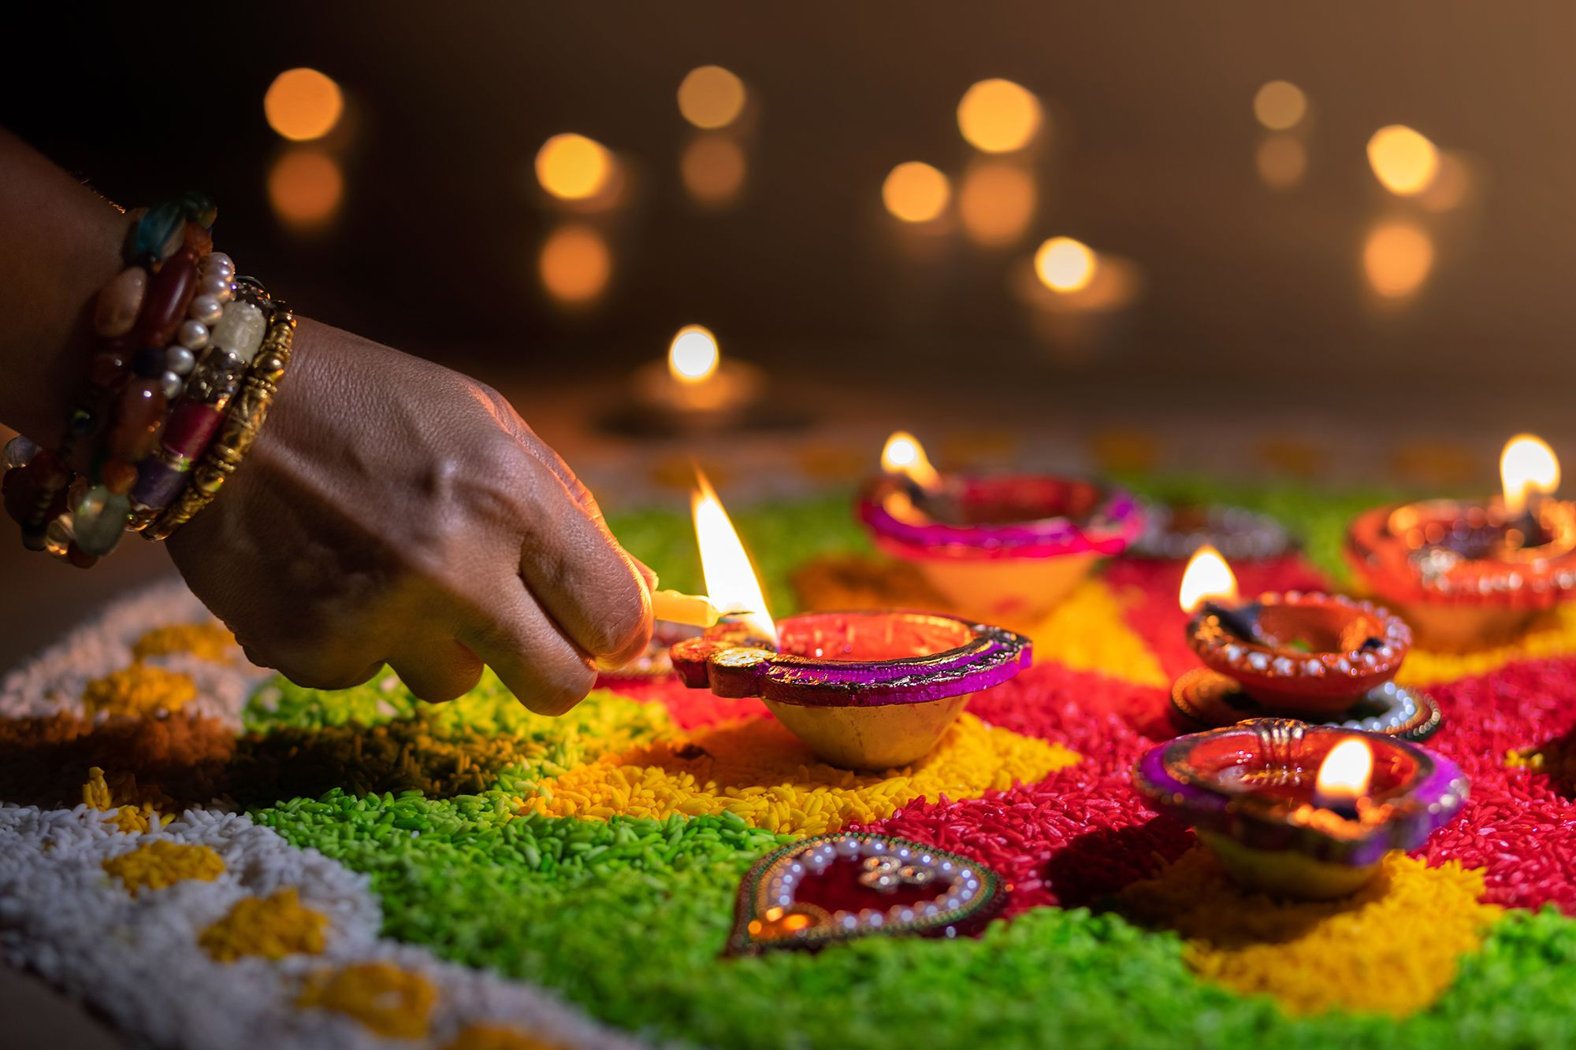
Diwali
Notes:
Mantra = word or sound repeated to aid concentration in meditation
Benediction = the utterance or bestowing of a blessing, especially at the end of a religious service

Slide 32
The Caste System
For centuries in Hindu society, caste has been the basis of social relationships, contact between members of different castes, or social classes, is strictly controlled.
At the present time, discrimination on the basis of caste is illegal in India; and in the urban areas and among more progressive Indians; caste is of little importance. However, in the rural villages of India and among the more traditional people, the caste system defines the way people relate to one another, especially in intimate relationships, when people eat together or marry.
Caste also plays a significant part in the Hindu pursuit of moksha. Hindus believe that in the transmigration of the soul, a person's karma determines his or her caste. There are five castes or classes in Hindu society. The most privileged is the Brahmin or priest. The second is Kshatriya, the warrior or governing class, followed by Vaisya, the middle class of merchants and tradesman. The fourth caste is Indra, the peasantry, farmers and normal labourers. The lowest caste is outcastes or untouchables, who perform the lowliest occupations and have no access to the rituals of the other classes.
Being in one caste or another is not unjust; a person's karma determines his or her social standing. And while there is no intermingling, a faithful Hindu, through the pursuit of Moksha and the attainment of good karma, may reach a higher caste in the next transmigration of his or her soul.

Slide 33
After Life
“After death, the soul is reincarnated, taking birth in another physical body or form. Passing from one life to the next, each soul is on a journey of spiritual development facilitated in part by karma, the concept that every thought and action has a corresponding reaction.”
  https://www.hinduamerican.org/blog/5-things-to-know-about-hindus-and-death
Notes:
Equanimity = mental calmness, composure, and evenness of temper, especially in a difficult situation.

Slide 34
Buddhism

Slide 35
History + Origins
During 20th century, Buddhism has suffered from the advance of Communism, especially in China, Tibet, North Korea, Vietnam, Laos, and Cambodia. At the same time, Buddhism is growing in North America because of refugees from Tibet and through the work of missionaries from other Buddhist countries. Many Theravoda, Zen, and Tibetan monasteries, temples and mediation centres have been established in North America, bringing the number of Buddhists in the world to over three hundred million.
Who is the Buddha? His name was Siddhartha Gautama, and he lived from about 563 to 483 BC, in the northern part of India. He grew up as an Indian prince in privileged and sheltered circumstances. He was Hindu
But as a young man, he ventured out and saw the negative aspects of life, such as sickness, old age, and death. He also learned about people who renounced the world in order to search for an answer to the problems of human suffering.
Gautama was well acquainted with the precepts of Hinduism and eventually reformed it into a new movement under his leadership. At the age of twenty-nine, Gautama decided to follow the Hindu course of renunciation. Leaving his wife and young son, he spent six years wandering, begging, fasting, studying, thinking, and meditating. Finally, after great struggle and temptations and after rejecting an unsatisfactory some of his Hindus beliefs, he became enlightened; he woke up. (Buddha means enlightenment or one who has awakened). After his enlightenment, he gathered followers and taught them until his death at eighty years of age.
Buddhists believe that because of this enlightenment, he was not reborn but entered into a state of peace called Nirvana (Buddha was a pathfinder, an example, a teacher, and an inspiration, but he was not a god or a Savior). The most holy pilgrimage sites of Buddhists are the places in northern India where the Buddha was born, where he was enlightened, where he preached his first sermon, and where he died.
Notes:
Buddha = enlightened one

Slide 36
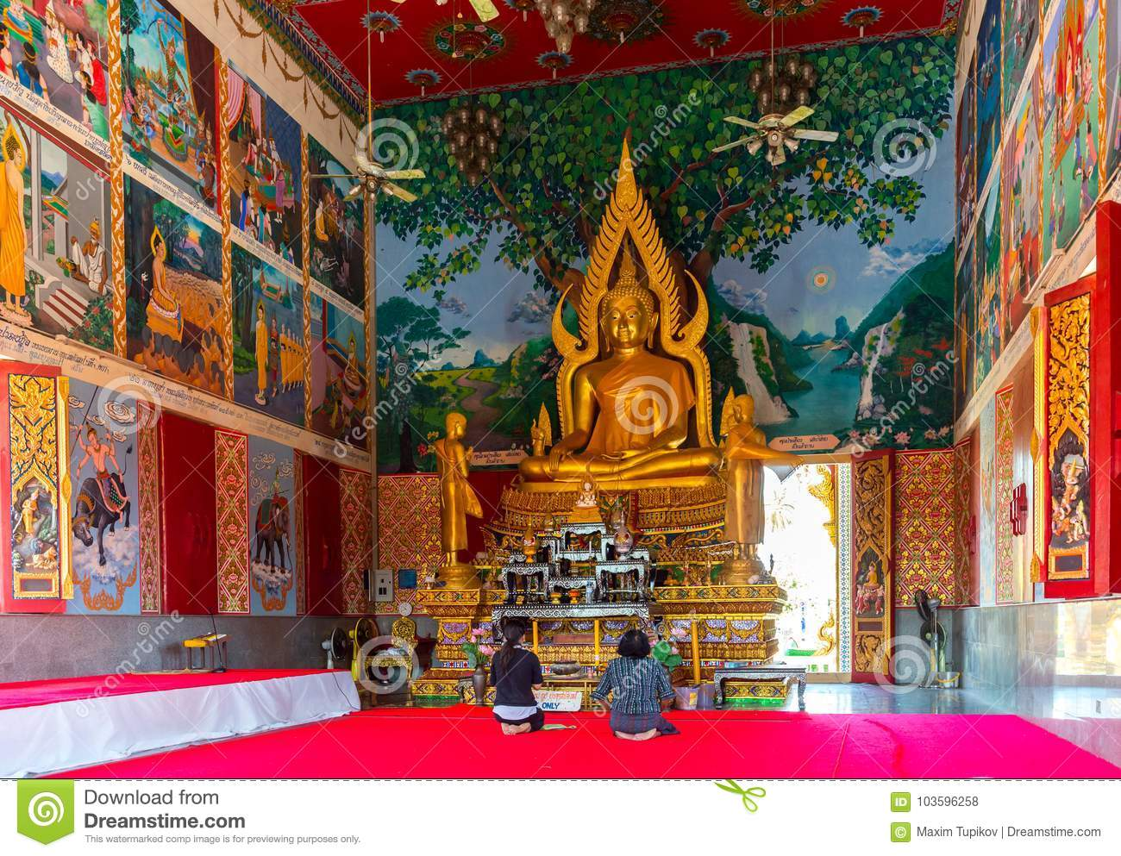
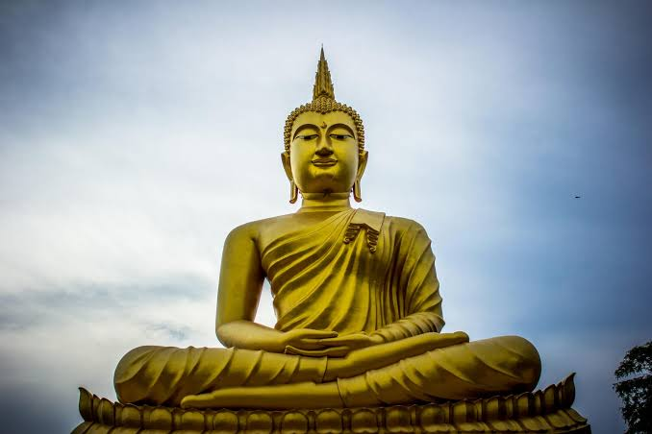
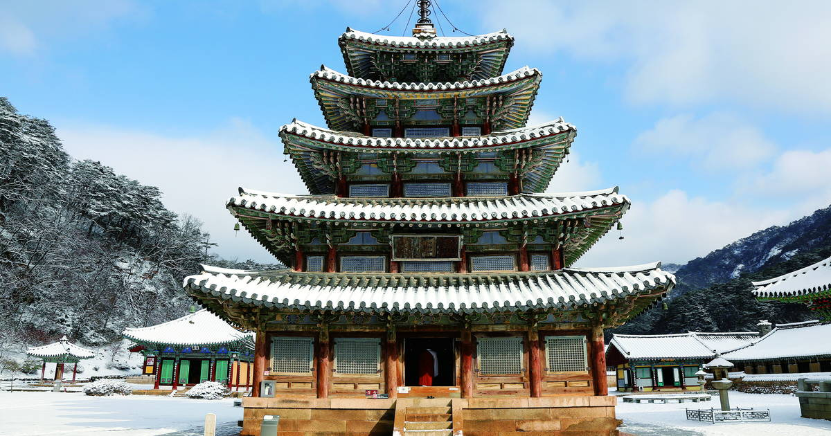
Siddhartha Gautama
& Buddhist Temples
Notes:
Kingdom of Judah + Kingdom of israel > 9th century bc

Slide 37
Main Beliefs + Books
Books/Scriptures
  Tripitaka (“three baskets” Buddha’s teachings)
    Tripitaka means "Three Baskets" in Sanskrit and refers to its three traditional divisions into the Vinaya basket of monastic regulations, the Sutta basket of the teachings and sayings of the Buddha, and the Abhidhamma basket of commentaries and explanations of Buddhist doctrines.
    Buddhism is known as Middle Way, the avoidance of extreme asceticism and self-denial on the one hand and of luxury and self-indulgence on the other.
Beliefs
  4 Noble Truths that describe Buddhism's view of the world
    1st: is that life in this world is precarious, undependable, changing, decaying, and temporary; it has no eternal essence. In short, life is full of suffering. Buddhists believe in seeing life realistically.
    2nd: The second is that people suffer because they desire something that life cannot give. They became attached to the things of the world, which are unreliable, so people are always disappointed. The human problem is that we always want what we cannot have; and if we could have what we want it would not satisfy us.
    3rd: Giving up desire and attachment to the things of the world can end suffering and bring about joy. Nirvana is the state of bliss brought about by the end of suffering. (Nirvana is not a place like heaven. It is the absence of desire, attachment suffering, greed, anger and delusion.)
    4th: The fourth Noble Truth explains that by walking the Noble Eightfold path a person can resolve suffering and attain Nirvana. The Noble Eightfold Path is divided into right beliefs or resolves, the moral life, and the mystical or meditative life.
Notes:
Mantra = word or sound repeated to aid concentration in meditation
Benediction = the utterance or bestowing of a blessing, especially at the end of a religious service

Slide 38
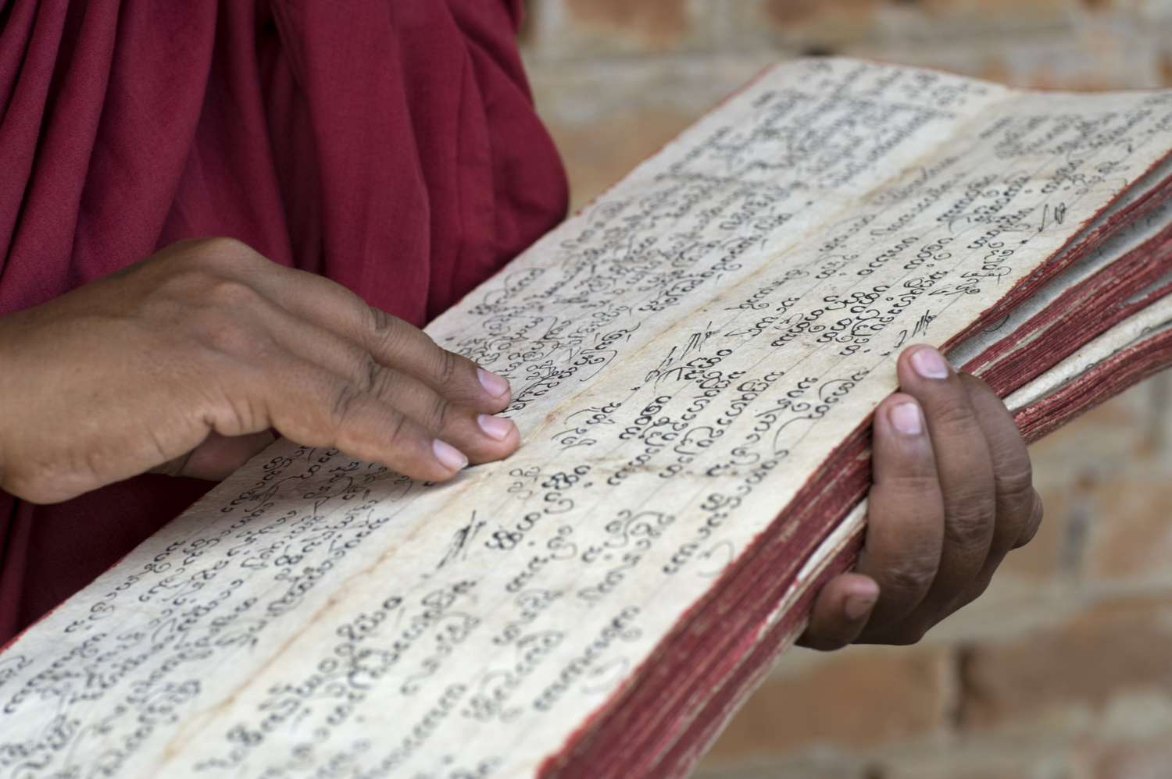
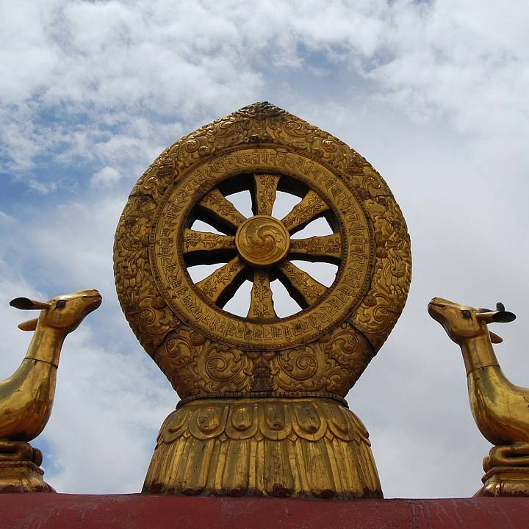
Tripitaka/Tipitaka + Dharmachakra
Notes:
"Triple Basket"
Pali + Sanskrit + other Asian languages
8 spokes

Slide 39
Way of Life
Buddhism is not so much a formal religion as a way of life, which is open to anyone who experiences suffering and wishes to find peace of mind.
Buddhism does not believe in an almighty creator god to whom one prays for benefits.
The problems people experience are their own problems; they caused them, and they alone can solve them.
Buddhism believes that things happen as a result of person's past actions (karma); not because of God’s punishment and not because of fate. In addition, a person’s future is determined, at least in part by his or her present actions, not by the grace or the wrath of God.
Buddhism is a radical way of self-help in which a person depends entirely on his or her own efforts to stop personal suffering.
There is also in Buddhism the community of monks and nuns (primarily monks today), who have given up their lives for worldly involvement (marriage, family, career, position, and wealth) and have taken upon themselves the monastic life.
  dedicate their lives to their own spiritual growth as well as to teaching and serving the laity.
  dependent on the laity for food, shelter, clothing and medical care.
  one of the most meaningful events in the life of a boy and his family is his entering to the monastery (brings great merit on the family)
  doesn’t have to be a monk for all his/her lifetime
Most Buddhist festivals celebrate events in the life of the Buddha. For example, in Southeast Asia, the celebration of the birth, enlightenment, and death of the Buddha is on the day of the full moon in May.

Slide 40
Sects
Place of Worship
Celebrations
Theravada
  means the way of elders or monks, and it offers salvation to monks alone.
  People in this group see themselves preserving the true teachings of Buddha and transmitting them faithfully from the time of Buddha until today,
  2500 years later. Theravoda is located primarily in Burma (Myanman), Cambodia, Laos, Sri Lanka (Ceylon) and Thailand. Though Theravoda is the older form of Buddhism, it is known as the little vehicle.
Mahayana, or the Great Vehicle,
  developed around the beginning of the Christian era. It incorporated new beliefs and practices, added more writings to the scriptures, and expanded the community to include laity as well as monks. Mahayana elevated the figure of Buddha to a transcendent and divine being and affirmed the presence of many Buddhas beyond the earthly Buddha, Gautama. Mahayana developed the human ideal –Bodhisattva-, a being whose life is characterized by wisdom and compassion and who remains in the world, forgoing Nirvana, to save a suffering humanity. Mahayana is found primarily in China, Japan, Korea and Vietnam. Zen is the popular school of Mahayana Buddhism.
Vajrayana
  is the most recently developed form of Buddhism, and it emphasizes elaborate rituals and rigorous mediation.
  It is found mainly in Tibet, although its leader, the Dalai Lama, now lives in exile in India.
Despite the fact that the three forms of Buddhism are quite different, they all believe in the Buddha, his teachings and the community of monks and nuns.
Vihara or Buddhist Temple (temple/center)
  Originally the term was used for a Buddhist monastery
Vesak
  The Buddha's birthday is known as Vesak and is one of the major festivals of the year. It is celebrated on the first full moon day in May, or the fourth lunar month which usually occurs in May or during a lunar leap year, June. In some countries this has become an occasion to not only celebrate the birth but also the enlightenment and parinirvana of the Buddha.
Asalha Puja Day
  Also known as "Dharma Day" celebrates the Buddha's first teaching on the full moon day of the 8th lunar month, approximately July.
Buddhist New Year
Parinirvana Day
Kathina

Slide 41
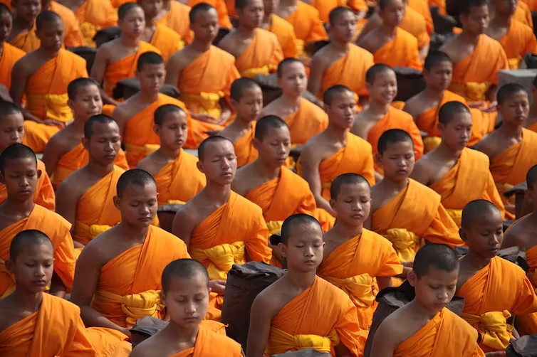
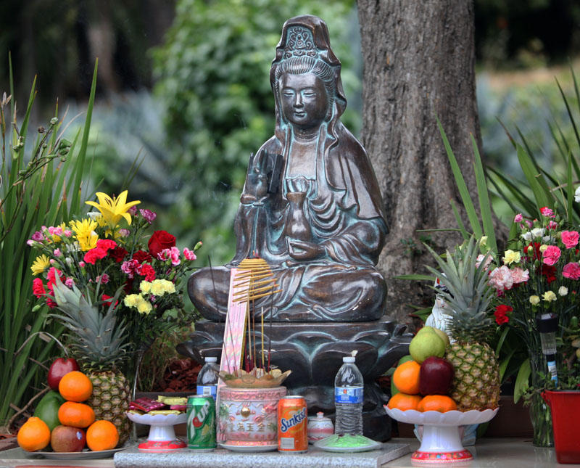
Bhikku + Buddha with Offerings
Notes:
Kingdom of Judah + Kingdom of israel > 9th century bc

Slide 42
The Eightfold Path
Right Belief:
  Right Understanding: which knows the truth, seeing the world as it really is.
  Right Thought: This is purity of mind with no thought of hate, lust, jealousy, or illusion. Instead it is purity of mind with positive thoughts of love and truth.
Right Morality:
  Right Speech: which is purity of words and speech avoiding lies, gossip, and meaningless Chatter. (If you do not have something good to say, do not say anything).
  Right Action: which is purity of behaviour and involves following the five moral and ethical Precepts. Do not kill (respect all life). Do not lie (speak only the truth). Do not steal or take what does not belong to you. Do not misuse sex. Do not use intoxicants.
  Right Livelihood: which is purity of vocation and involves making sure that your job or career does not cause you to harm anyone.
Right Meditations:
  Right Effort: This is setting goals and striving for them with energy.
  Right Mindfulness: to cultivate a deeply absorbed, secluded state of mind
  Right Concentrations: which means, by right of meditation, purifying the mind, controlling and disciplining the mind, focusing the mind and becoming fully attentive to everything that you do.
By following the Eightfold Path, a person can increase in wisdom, morality, and mediation and thus move closer to the experience of Nirvana. Otherwise, he or she will continue in the endless cycle of death and rebirth.
Perhaps the simplest statement of the Eightfold Path is this: Avoid evil, do good, purify your mind.
As people mature in their progress on the earth toward Nirvana, Buddhism calls them to four kinds of love:
  (1) Loving kindness for all creatures (human, animal, and otherwise) and wishing well-being for all creatures in all things;
  (2) Compassion for those who are less fortunate than they are;
  (3) Joy and respect for those who are more fortunate than they are; and
  (4) Equanimity in the face of upsetting and troubling situations.
Notes:
Equanimity = mental calmness, composure, and evenness of temper, especially in a difficult situation.

Slide 43
Belief in God + After Life
They don’t believe in God
  https://www.nationalgeographic.org/encyclopedia/buddhism/#:~:text=Buddhists%20do%20not%20believe%20in,that%20human%20life%20is%20suffering.
Believe that consciousness (the spirit) continues after death and may be reborn
  https://www.hse.ie/eng/services/publications/socialinclusion/interculturalguide/buddhism/care-dying.html#:~:text=Generally%2C%20Buddhist%20teaching%20views%20life,of%20life%2C%20death%20and%20rebirth.
Notes:
Equanimity = mental calmness, composure, and evenness of temper, especially in a difficult situation.

Slide 44
Conclusion
Don’t believe in what people tell you, do your own research
  Example, a friend can say:
    one can believe in all religions
    all religions are correct (i.e. no religion is wrong)
    Islam is a peaceful religion
  Simply not true
It’s okay if you don’t know the answer, LOOK IT UP
BE STRICT, this isn’t the time to be lenient
  Reminder: Many saints were tortured and died to protect our faith
Hope you had an insight/intro to these religions and can critically analyze their beliefs when compared to ours.

Slide 45
Credits
Images:
https://www.google.com/url?sa=i&url=https%3A%2F%2Fwww.opindia.com%2F2021%2F03%2Fthe-significance-of-spitting-in-islam-how-spitting-can-ward-off-satan%2F&psig=AOvVaw207ofhaeSg3T7InT7SlTQa&ust=1673298485877000&source=images&cd=vfe&ved=0CBAQjRxqFwoTCKi_0eDwuPwCFQAAAAAdAAAAABAE
https://www.google.com/url?sa=i&url=https%3A%2F%2Fwww.britannica.com%2Ftopic%2FBuddhism&psig=AOvVaw2AoOGweRgsgyxNIbjed9LX&ust=1673298301996000&source=images&cd=vfe&ved=0CBAQjRxqFwoTCMC5iInwuPwCFQAAAAAdAAAAABAE
https://www.google.com/url?sa=i&url=https%3A%2F%2Fwww.nbcnews.com%2Fthink%2Fopinion%2Fyom-kippur-2019-best-thing-about-judaism-according-jewish-atheist-ncna1063986&psig=AOvVaw0p3V5iKvNmUIkbl5pEdIG6&ust=1673298561421000&source=images&cd=vfe&ved=0CBAQjRxqFwoTCNjH2oTxuPwCFQAAAAAdAAAAABAT
https://www.google.com/url?sa=i&url=https%3A%2F%2Fwww.hinduismfacts.org%2Fhindu-gods-and-goddesses%2F&psig=AOvVaw3rtTDaKxjesxg9QKLzMStm&ust=1673308659662000&source=images&cd=vfe&ved=0CBAQjRxqFwoTCOjg-dOWufwCFQAAAAAdAAAAABAE
https://www.google.com/url?sa=i&url=https%3A%2F%2Fen.wikipedia.org%2Fwiki%2FJews&psig=AOvVaw38omOjH8r7L73v0-W79VXf&ust=1673311615344000&source=images&cd=vfe&ved=0CBAQjRxqFwoTCLD7qdWhufwCFQAAAAAdAAAAABAE
https://upload.wikimedia.org/wikipedia/commons/thumb/8/81/Symbol_of_Islam.svg/2361px-Symbol_of_Islam.svg.png
https://www.google.com/url?sa=i&url=https%3A%2F%2Fwww.hindusforhumanrights.org%2Fen%2Fblog%2Foutright-banning-of-swastika-will-be-hurtful-hindus-for-human-rights&psig=AOvVaw2ppYaCaoQUFhki7q1m4zCO&ust=1673312165523000&source=images&cd=vfe&ved=0CBAQjRxqFwoTCPDtyNujufwCFQAAAAAdAAAAABAE
https://www.google.com/url?sa=i&url=https%3A%2F%2Fen.wikipedia.org%2Fwiki%2FOm&psig=AOvVaw1IZ-nBNEXwigxFpSeAJTTL&ust=1673311987376000&source=images&cd=vfe&ved=0CBAQjRxqFwoTCJCGlfujufwCFQAAAAAdAAAAABAE
https://upload.wikimedia.org/wikipedia/commons/thumb/6/63/HinduSwastika.svg/1200px-HinduSwastika.svg.png
https://upload.wikimedia.org/wikipedia/commons/thumb/b/b7/Om_symbol.svg/1280px-Om_symbol.svg.png
These are not all image sources but feel free to search by image to find source
Sources:
https://www.pbslearningmedia.org/resource/sj14-soc-religmap/world-religions-map/
https://institute.global/policy/what-sufism#:~:text=Sufism%20may%20be%20best%20described,direct%20personal%20experience%20of%20God.
https://www.history.com/topics/religion/islam#:~:text=Muslims%20are%20monotheistic%20and%20worship,but%20humans%20have%20free%20will.
https://medium.com/@meraviahuja/5-most-popular-hindu-festivals-bfe0b5cd3ef0
https://en.wikipedia.org/wiki/Hindu_denominations
https://www.sutterhealth.org/health/preteens/relationships-social-skills/hindu-holidays
https://www.sutterhealth.org/health/preteens/relationships-social-skills/buddhist-celebrations
https://en.wikipedia.org/wiki/Buddhist_holidays#:~:text=Vesak%3A%20The%20Buddha%27s%20birthday%20is,a%20lunar%20leap%20year%2C%20June.
https://islamqa.info/ar/answers/1528/%D8%A7%D8%AA%D8%AE%D8%A7%D8%B0-%D8%A7%D9%84%D9%87%D9%84%D8%A7%D9%84-%D8%B4%D8%B9%D8%A7%D8%B1%D8%A7
https://en.wikipedia.org/wiki/Islamic_holidays
https://study.com/academy/lesson/the-three-baskets-and-the-dhammapada-description-overview.html#:~:text=Tripitaka%20means%20%22Three%20Baskets%22%20in,and%20explanations%20of%20Buddhist%20doctrines.
https://www.britannica.com/topic/Star-of-David
And other wikipedia pages

