Slide 1

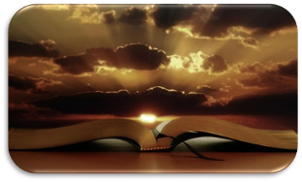
The Covenant
Introduction to the Old Testament
x
An Eternal Bond
Servants Prep Jan 2022

Slide 2
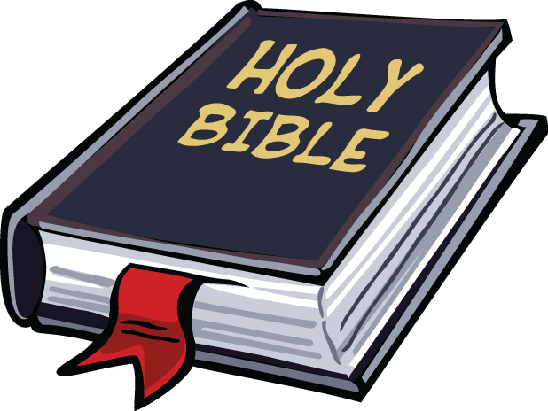
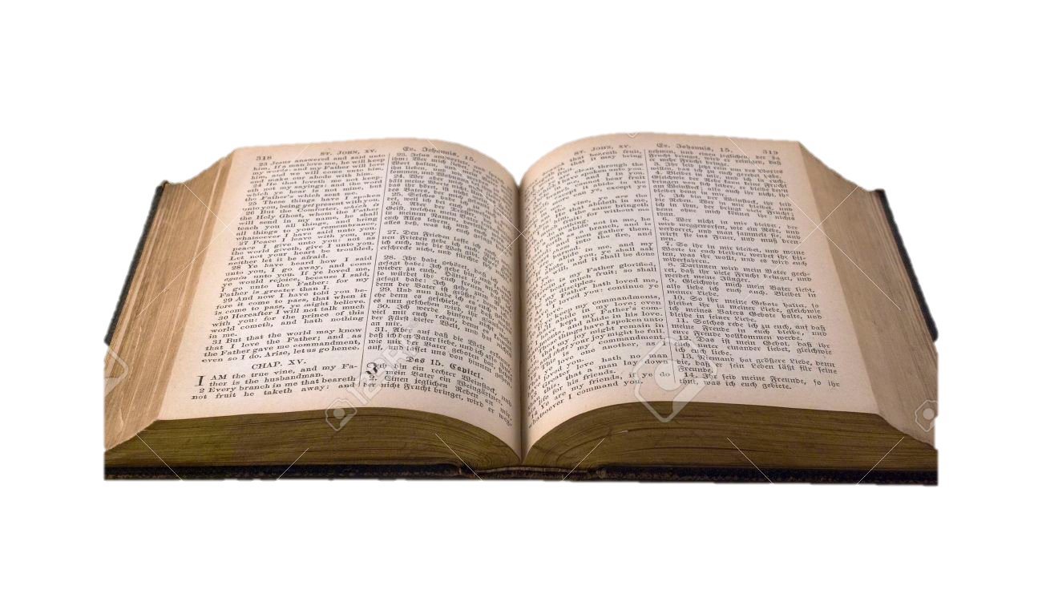
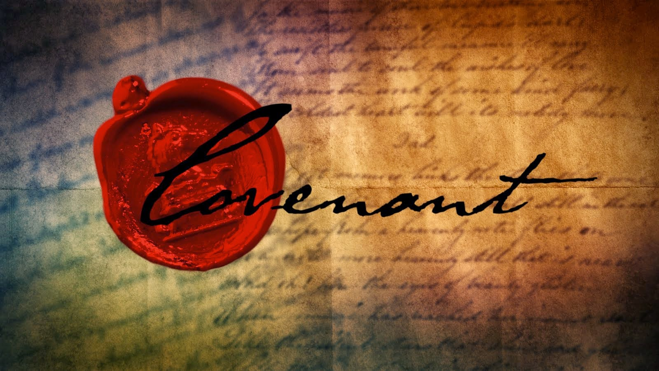
Introduction
Our Holy Bible - Can we divide it into two main parts?
What does the word Testament mean?
Latin word means covenant
The Bible tells the story of a covenant. What covenant?
Our Covenant with God
Notes:
It took several hundred years for the Bible to be written. People that did not know or even meet each other wrote this one book and all their writings are connected together with one message. There had to be a wisdom guiding them.
What is testament? It is a Latin word which means covenant.
The Bible tells the story of a covenant that God made with mankind and was kept so people would enter into it. The Bible tells us that people could not keep that covenant and God promised to renew His covenant in a totally different way. God became man to revamp this covenant. I, as an individual, enter into this covenant with God at a personal level and it becomes a guide in my life.
Genesis: The first book of the Bible. It talks about creation, freedom of choice and a symbol of disobedience. God created man to live with Him in happiness (paradise – a physical place on Earth, thought to be around Iraq in Mesopotamia). With the guile of the serpent, Adam and Eve chose not to depend on God in knowing good and evil. They chose to do this on their own. They chose to become their own source of knowledge (be like God) and thus became separated from God.

Slide 3
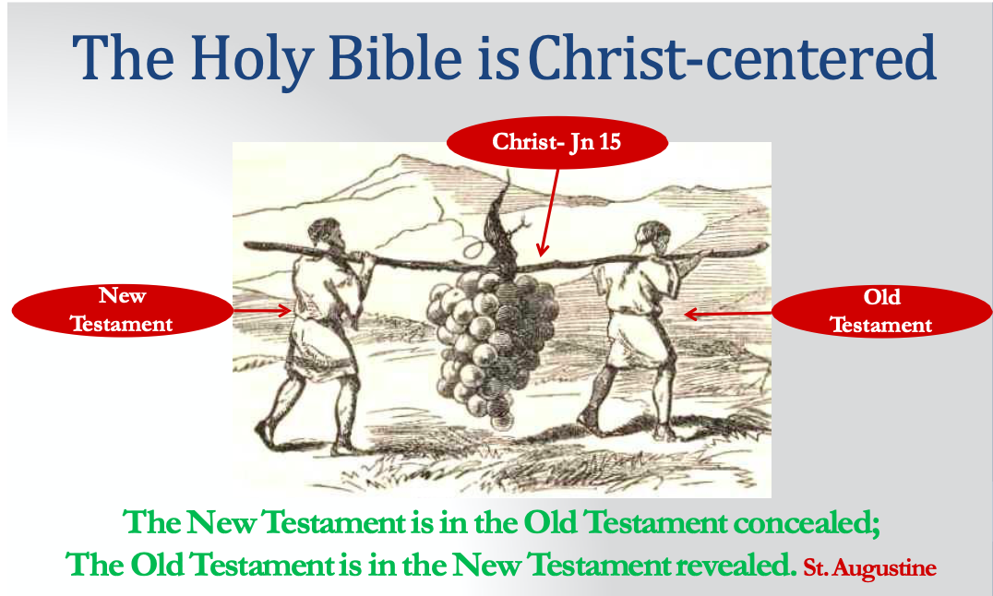

Slide 4
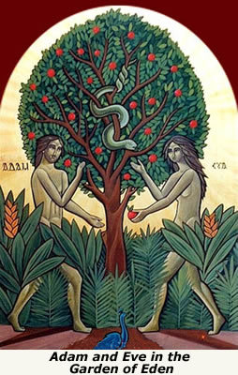
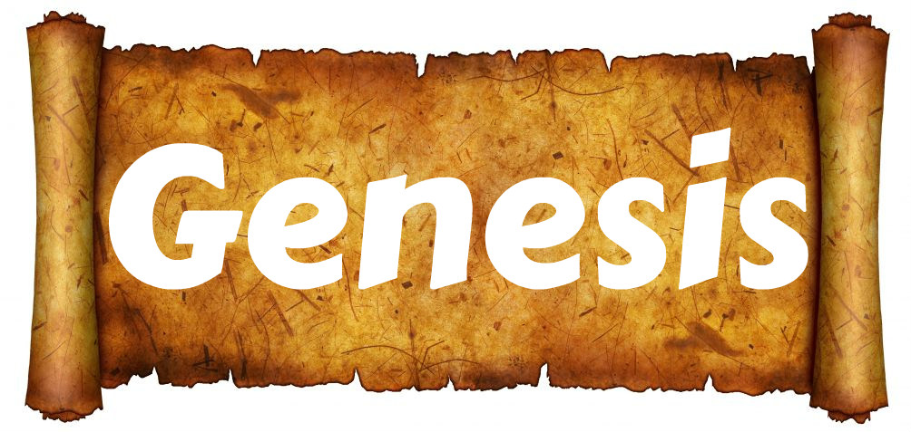
In The Beginning
Adam and Eve – The Original Sin

Slide 5

Adam +Eve
⬇
Cain & Abel Seth
Seth => Enosh
(Children of God)
Cain
(Children of Men)
Line is Blurred
(God through the flood wanted to bring that line back!)

Slide 6





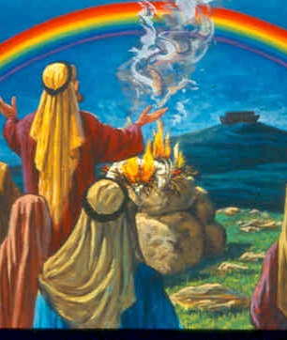
The Covenant with Noah
Genesis 9: 8 – 17
The Line Restored

Slide 7
A New Beginning
Evil prevails among humans (Genesis 6)
Only Noah and his family honour God
God orders Noah to build the ark and saves him from the flood
Noah starts the Godly line again and humanity was given a new start
However, God’s line of the faithful starts to get blurry once more and people dream of making a name for themselves (Genesis11)

Slide 8
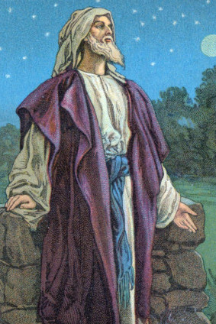
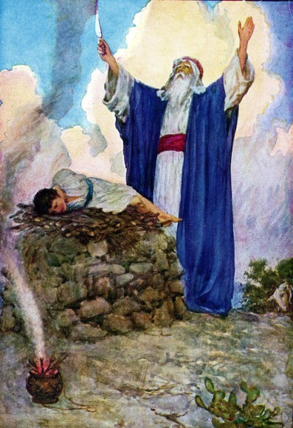

Abraham
(Major Covenant)
A new calling…and a covenant

Slide 9
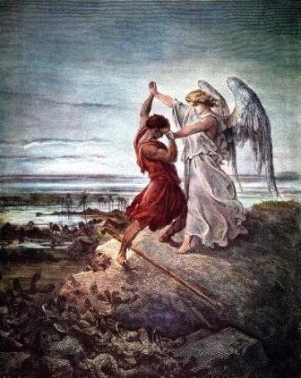
A new calling…and a covenant
From Ur of the Chaldeans to the unknown
  Abraham answers the call and leaves behind everything
God’s Promise: A binding Eternal Covenant
  Abraham is changed forever because he believed God’s promise. He will be a blessing to all nations (Genesis 15)
Abraham starts the Godly line of faith again
His two grandchildren are imperfect,
yet one, Jacob, clings to the Lord.
Notes:
A culture of making covenants:
Slaughter an animal, cut it in two and have both parties walk in the middle, as if saying that anyone who breaks the promise shall be split like this animal.
God asks Abraham to cut animals in half, who then sees light going through these animals. (Genesis 15).
An interesting observation is that there is no mention of God asking Abraham to do the same (walk through the split animals)! God entered into this covenant and is fully committed to it. Abraham needed to see the assurance that God is serious about this promise. God did not need the assurance from Abraham. He knew his heart

Slide 10
Timeline
Event | Year | Bible Reference
Birth of Abraham | 2001 BC | Genesis 12:4
God's Covenant to Abraham |  | Genesis 15
Abraham leaves Haran | 1926 BC | Genesis 16:16
Birth of Isaac | 1901 BC | Genesis 25:26
Birth of Jacob | 1841 BC | Genesis 47:9
Birth of Joseph | 1750 BC | Genesis 41:46, 53, 45:6
Jacob enters Egypt | 1711 BC | Genesis 47:28
Birth of Moses | 1576 BC | Exodus 7:7

Slide 11
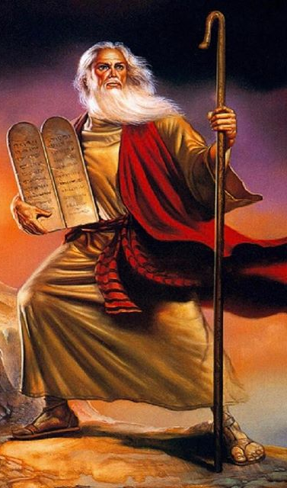
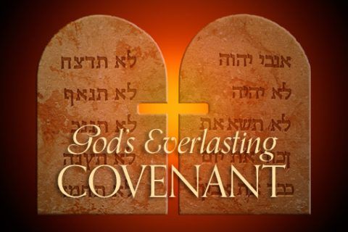
The Covenant of Sinai
Exodus 19-28
God Saves His People

Slide 12
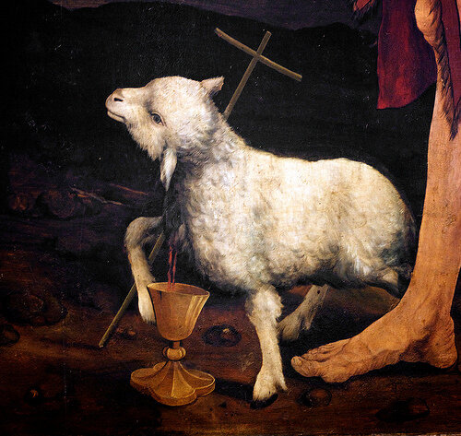
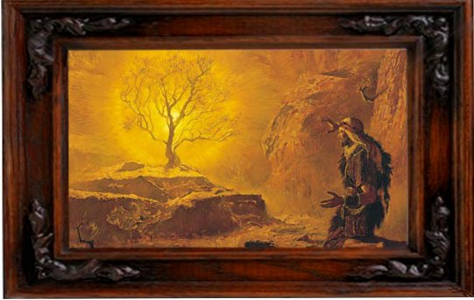
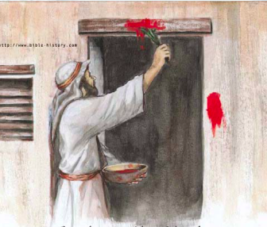
God Saves His People
Oppressed and crushed in Egypt, Jacob’s descendants call upon God to deliver them.
Moses Sees in himself a savior, but
things go wrong. He flees & gives up.
God calls when he least expected.
The bush lives despite the fire of suffering because God is inside it.
God delivers them with a strong hand.
Yet not without a sacrifice.
The blood of the Passover lamb
protects their firstborn.

Slide 13
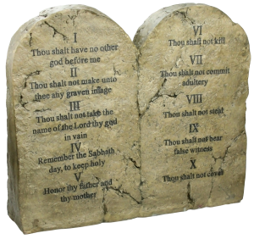
Covenant Renewed on Mount Sinai
God parts the sea for them
God renews His Covenant on Mount Sinai. His Greatness and Glory shown on the mountain with fire and smoke.
A Covenant between God and the people of Israel led by Moses
I am your God. You are My people. Keep my commandments (My Law) and I will protect you. God gave them the choice between life and death, but He recommended life!
“I have put before you life and death. Choose life” (Exodus 19-28)
They have to make a choice!

Slide 14
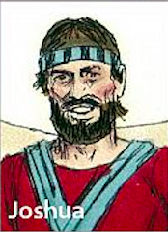
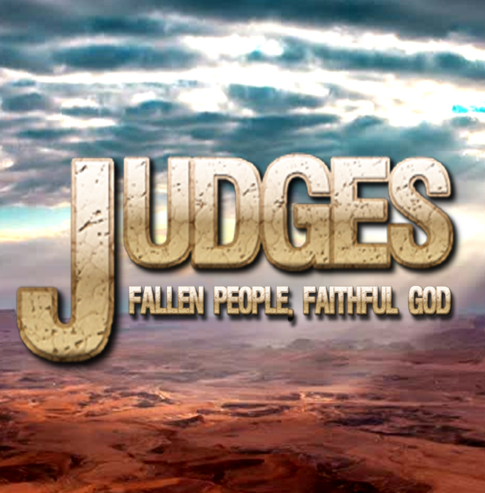
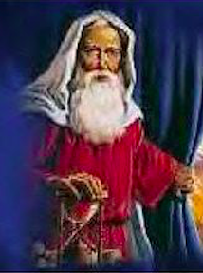
Another Generation
Joshua
Judges
Samuel

Slide 15
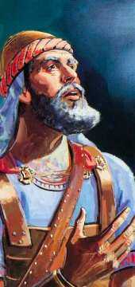
Another Generation
Only 2 out of that generation (Covenant of Sinai) were worthy to enter the promised land.
Joshua leads the people of Israel to the new land.
The book of Joshua tells the story of how the settlement was secured but how faithfulness was broken.
In the end they had to make a choice of whom to serve
Before his death, Joshua reminds the people of God’s faithfulness since the beginning.
Joshua leads the people in renewing their covenant with God before his death. (Joshua 24)

Slide 16
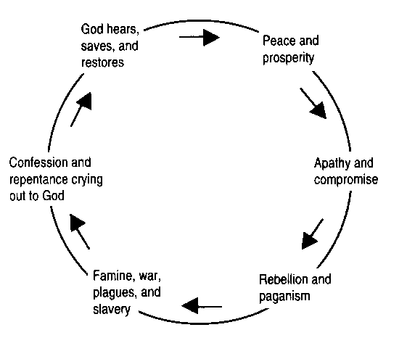
Faithfulness broken again and again: The Judges

Slide 17
Faithfulness broken again and again: The Judges
“…there arose another generation after them, who did not know the Lord or the work which he had done for Israel" (Judges 2:10)
“Whenever the LORD raised up a judge for them, he was with the judge and saved them out of the hands of their enemies as long as the judge lived; for the LORD had compassion on them as they groaned under those who oppressed and afflicted them.
But when the judge died, the people returned to ways even more corrupt than those of their fathers, following other gods and serving and worshiping them. They refused to give up their evil practices and stubborn ways.” (Judges 2:18-19)

Slide 18
Faithfulness broken again and again: The Judges
As each generation unfolded idolatry would prevail, a foreign invasion would take place and oppress the people of Israel in that local area, they would cry out to God for help
God would send a deliverer and another judge is appointed, renews the covenant, and the whole process repeats again.
This cycle repeated several times over a span of 350 years
It speaks clearly of the cycle of sin and its consequences, as well as God's love and willingness to send help when His people cry out to Him.

Slide 19
Faithfulness broken again and again: The Judges
Twelve judges:
  Othniel, Ehud, Shamgar, Deborah, Gideon, Tola, Jair, Jephthah, Ibzan, Elon, Abdon, and Samson
The First Book of Samuel
  Eli and Samuel

Slide 20
Faithfulness broken again and again: The Judges
Enemy | Years of Bondage | Judge | Deliverance and Rest | Scripture
Mesopotamia | 8 | Othniel | 40 | 3:3-11
Moab | 18 | Ehud | 80 | 3:12-21
Canaan | 20 | Deborah | 40 | 4:1-5:31
Midian | 7 | Gideon | 40 | 6:1-8:28
Ammon | 18 | Jephthah | 6 | 10:6-12:7
Philistia | 40 | Samson | 20 | 13:1-16:31
Total | 111 |  | 226 | 337

Slide 21
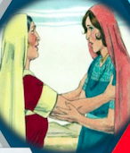
The Godly Line Redeemed:
Ruth
Famine strikes in the time of the judges
A man, his wife and two sons travel east from Bethlehem to Moab looking for a better life.
His sons marry two women from Moab
Elimelech, the father, dies followed by the two sons a few years later leaving the three women behind.
Naomi decides to go back home alone, but Ruth insists on going back with her
Through a series of events Naomi ends up bearing a lawful child, Obed from Boaz her husband
Obed is the Grandfather of David, the Godly King of Israel.
Notes:
Elimelech, his wife Naomi and his sons Mahlon and Chilion
Mahlon married Ruth, Chilion married Orpah, two Moa
bites

Slide 22
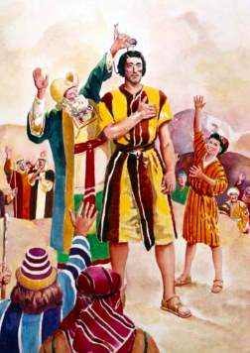
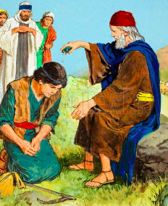
The Kingdom of God
The First King of Israel
Samuel, (forced by the people) anoints
Saul as their first king.
The United Kingdom:
Saul, then David, then Solomon,
then Rahoboam (Solomon's son)
Notes:
David established a strong kingdom after a series of wars with neighbouring nations.
Solomon made the kingdom prosper with the wisdom he received from God and his time was a time of peace. He became one of the richest kings on earth this made him lust after many foreign concubines. Eventually this makes him slip into offering incense to idols and this displeases God. God told him that he will allow the kingdom to break down but after his death just because of the faithfulness of his father.

Slide 23
Timeline
Event | Year | Bible Reference
Exodus from Egypt | 1496 BC | Exodus 16:35
Crossing of Jordan | 1456 BC | Joshua 14:7, 24:29
Dividing of the Land | 1451 BC | Joshua 14:7-10
Judges begin leading Israel | 1426 BC | Joshua 24:29
Saul (first king) begins reign | 1100 BC | Acts 13:21
David begins reign | 1060 BC | 2 Samuel 5:4
Solomon begins reign | 1020 BC | 1 Kings 6:1
Solomon begins to build Temple | 1016 BC | 1 Kings 11:42

Slide 24
The Kingdom Divided
The Great Schism: Jeroboam (leader of a great rebellion)
  Established the Northern Kingdom (Israel), whose capital was Samaria.
  Started a new priesthood and a new religion to prevent his people from going to the Temple in Jerusalem.
  All the kings of the Northern Kingdom were evil until its destruction by the Assyrian Empire.
Only two tribes remained (Judah and Benjamin) under the reign of King David’s descendants.
  Formed the Southern Kingdom (Judah), whose capital remained Jerusalem.
  Some godly kings, but most were also evil and allowed the worship of foreign gods and idols.
  The few godly people kept the line of the people of God
Notes:
Rahoboam was more heavy handed on his people than his father and this lead to a massive revolt by 10 of the 12 tribes.

Slide 25
The Covenant Renewed
The book of the covenant was lost due to neglect.
Josiah the Godly king ordered the restoration of the Temple.
During this process the book of the covenant was found.
When Josiah read it, he realized how far astray he and his people (God’s people) had gone.
He led his people in a public repentance and in renewing their covenant with God (2 Chronicles 34)

Slide 26
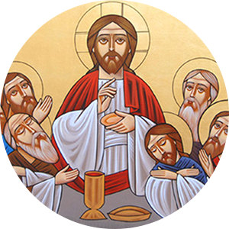
Invasion and Captivity
Assyrian Empire – biggest and first empire to invade the Northern Kingdom of Israel (772-771 BC)
Babylon – Almost 200 years later, during the reign of King Nebuchadnezzar, invades the Southern Kingdom of Judah, and this leads to the second exile! (589-586 BC)
A New Covenant Promised
Just before this second exile, a prophet called Jeremiah said that God will renew His covenant. He will make a NEW Covenant, one that surpasses their imagination. God will write this covenant not on stone, but in people’s hearts. He will forgive all their iniquities and they will all know Him. (Jeremiah 31:31)
Notes:
Just before this second exile. Jeremiah warned the King, Zedekiah, and the people of Judah about the impending Babylonian invasion
He rebuked them for breaking the covenant with God
But he said that God will renew that covenant. He will make a NEW COVENANT with them, one that surpasses their imagination.
God will write this covenant, not on stone, but in people’s hearts. He will forgive all their iniquities and they will all know Him.

Slide 27
A New Covenant Promised
“Behold, the days are coming, says the Lord, when I will make a new covenant with the house of Israel and with the house of Judah— not according to the covenant that I made with their fathers in the day that I took them by the hand to lead them out of the land of Egypt, My covenant which they broke, though I was a husband to them, says the Lord. But this is the covenant that I will make with the house of Israel after those days, says the Lord: I will put My law in their minds, and write it on their hearts; and I will be their God, and they shall be My people. No more shall every man teach his neighbor, and every man his brother, saying, ‘Know the Lord,’ for they all shall know Me, from the least of them to the greatest of them, says the Lord. For I will forgive their iniquity, and their sin I will remember no more.”
(Jeremiah 31:31-34)

Slide 28
Timeline
Event | Year | Bible Reference
Solomon's Son Rehoboam begins reign | 980 BC | 1 Kings 14:21
The Kingdom Divided | 931 BC | I Kings 1-12; II Chronicles 1-12
The ten tribes of Israel go into captivity (The first Exile) | 722 BC | 2 Kings 17:23
Jeremiah begins to prophesy | 627 BC | The Book of Jeremiah
Babylon besieges Judah's two remaining tribes (the second Exile) | 606 BC | Daniel 1:1
Destruction of the first temple | 588 BC | Jeremiah 52:12-13, 25:1, Daniel 2:1
Cyrus decrees rebuilding temple | 536 BC | 2 Chronicles 36:21, 23
Artaxerxes decrees rebuilding Jerusalem | 445 BC | Nehemiah 2:1

Slide 29
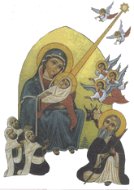
From Return of the Exiled to Christ
Babylonian Empire →→→ Persian Empire
(Babylon defeated and taken over by Persian Empire)
→→→ Alexander the Great
(Took over Persia. Died young at age 32 while in Persia. His Empire divided up amongst his four deputy leaders after a series of wars that spanned over 40 years)
→→→ The Western Roman Empire
(Roman Empire took over most of Europe, the Middle East, Asia Minor and Persia)
Our Lord Jesus Christ born during the reign of
the Roman Emperor: Augustus Caesar (Luke 2:1)
Notes:
Alexander the Great whose empire was divided between his four commanders after his untimely death,

Slide 30
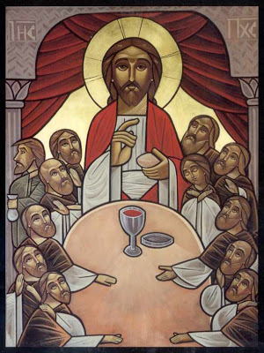
The New Covenant

Slide 31
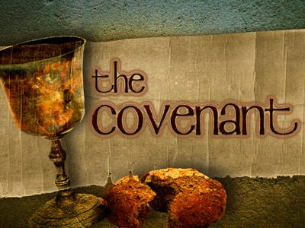
The Last Supper
The New Covenant
Jesus invites His disciples to eat with Him their last meal together. He then says: “This is the cup of the NEW covenant.” (Matthew 26-28).
Out with the Old, in with the New (Hebrews 8: 7-13)
The disciples take this new covenant and explain it in the New Testament. Shows how the early church lived this new covenant.
St. Paul explains that this brings us back to the first covenant God made with Abraham in which He promised him to bless all nations through him.
We become the true children of Abraham through faith. We are now the people of God, the keepers of the Godly line and witnesses to His mercy to all nations.
Back to Abraham- God’s People
Notes:
“…and as they were eating, Jesus took bread, blessed and broke it, and gave it to the disciples and said, “Take, eat; this is My body.” Then He took the cup, and gave thanks, and gave it to them, saying, “Drink from it, all of you. For this is My blood of the NEW COVENANT, which is shed for many for the remission of sins”. (Matthew 26-28).

Slide 32
Substance of The New Covenant
I am your Father, you are My children.
This is our identity
  But as many as received Him, to them He gave the right to become children of God, to those who believe in His
  name: who were born, not of blood, nor of the will of the flesh, nor of the will of man, but of God (John 1:12-13)
  Behold what manner of love the Father has bestowed on us, that we should be called children of God! (1 john 3:1)
  Now, we are no longer strangers and foreigners, but fellow citizens with the saints and members of the household of God, (Ephesians 2:19)

Slide 33
A Personal Covenant
We enter into this covenant through Baptism
by faith. This is an eternal personal covenant
(at least from God’s point of view).
Through it God gives us a new birth from up high (John 3). He then confirms us in His holy church as members of the body of Christ.
He bestows upon us His Holy Spirit. The same Spirit He poured on the early disciples on the day of the Pentecost and continued to give to those who believed in Him as we read in the book of Acts.
Repentance, Confession, and Holy Communion: Continuous Renewal of this New Covenant (individually and together as the community of God). Therefore, there is no need to repeat baptism if we break that covenant.
This covenant needs to be continuously renewed through a life of vigilance and repentance
Notes:
We need to brush it up and continuously renew it through repentance, confession and communion. Therefore, there is no need to repeat baptism if we break that covenant.

Slide 34
How can we neglect it?
Therefore we must give the more earnest heed to the things we have heard, lest we drift away. For if the word spoken through angels proved steadfast, and every transgression and disobedience received a just reward, how shall we escape if we neglect so great a salvation, which at the first began to be spoken by the Lord, and was confirmed to us by those who heard Him, God also bearing witness both with signs and wonders, with various miracles, and gifts of the Holy Spirit, according to His own will? (Hebrews 2: 1-4)

Slide 35
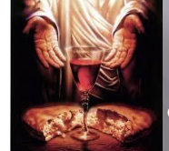
The Holy Bible
God’s Covenant with Us

Slide 38
The Old Testament | The Need for a Savior | The New Testament | The Savior Came and Will Come Again
1. The Pentateuch | - The Law or Torah. - Fallen Mankind need a Savior from the curse of the Law. | 1. The Four Gospels | - The Law of the New Testament. - The Coming of the Savior the life-giver.
2. The Historical Books | - History of God’s work with His People in the New Land and Captivity. - Getting to know the Coming Christ. | 2. The Book of Acts | - History of God’s work in the believers through His Holy Spirit. - The Lord Christ present in His Church.
3. The Poetic Books | - The Need for the divine wisdom. - Practical doctrine to live with God. | 3. The Epistles | - True wisdom is to unite with Christ. - Practical doctrine to live in Christ through the Holy Spirit.
4. The Prophets | - Precise prophesies about the Coming Messiah. - Prophets calling for repentance and asserting the need of His Coming. | 4. Book of Revelation | - Christ’s Second Coming and Eternal Life. - Encourages the believers to strive in the Lord, awaiting His Second Coming.

