Slide 1

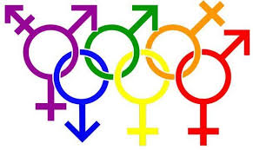
Prep to Serve
Answering Sensitive Issues 1

Slide 2
Prep to Serve
Homosexuality

Slide 3
Homosexuality
“Born” this way - The Scientific Perspective?
“Right” this way - The Human Rights Perspective
“Created” this way - The Biblical Perspective
Love and Acceptance as the Starting Point

Slide 4
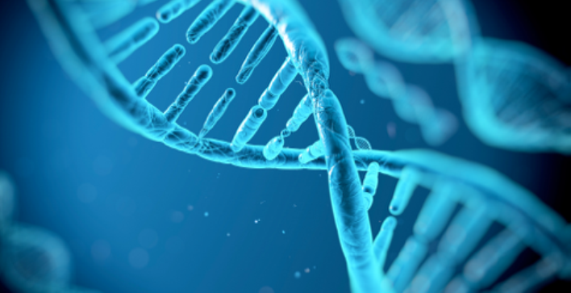
“Born” this way
The Scientific Perspective?

Slide 5
“Born” this way
The Scientific Perspective?
History
Homosexuality is as old as Sodom & Gomora
Biological theories of homosexuality trace their history to the 19th century - Karl Heinrich Ulrichs, considered homosexuals “female” souls in “male” bodies, argued that homosexuality was biological and therefore natural (1864)
Psychiatrists Carl Westphal (1869) and Richard von Krafft-Ebing (1903) began to research the traits which Ulrichs used to provide evidence for the naturalness of homosexuality. However, they considered these traits to be pathological
Notes:
a German writer & legal advisor - considered the father of the gay rights movement, was himself homosexual
Traits = caused by or involving disease
Pathological = caused by or involving disease

Slide 6
“Born” this way
The Scientific Perspective?
Areas of Research
Heredity (Genetics)
Constitutional Biology (Anatomy)
Endocrinology (Hormones)
Ethology (Behavioral)

Slide 7
“Born” this way - Genetics
The basic premise is that homosexuality is genetically determined - There have been hereditary models for over 140 years
Hirschfield (1914) applied these theories positively, as proofs of “naturalness” and attempted to remove pathology from the hereditary hypothesis
Nazi Germany: Lemke proposed that homosexuals be prohibited from any sexual acts, and the noncompliant be taken into custody or with their request castrated
Notes:
Pathology (from the Greek roots of pathos (πάθος), meaning "experience" or "suffering", and -logia (-λογία), "study of") is a significant component of the causal study of disease

Slide 8
“Born” this way - Genetics
Twin Studies proofing it’s NOT Genetics
Following the fall of Nazi, the premise of specific genetic determinative was further pursued.
Franz Kallmann (1952), conducted a research project to compare monozygotic with dizygotic twins - Habel(1950) and Rainer (1960)
The work was highly criticized - Lewontin, (1988) summarized: “The story is completely made up”
52% 22% 11%
Notes:
Mono = 52%, Di = 22%, Adoptive brothers = 11%

Slide 9
“Born” this way - Genetics
Xq28
Dean H. Hamer (1993) shocked the world when he claimed to have discovered the gene responsible for sexual
orientation, Xq28 - The story in the media, in the scientific
journals, and through the LGBT activists prematurely went “viral”, before real analysis and evaluation of the data was done - Sanders (1998), Rice(1999) & Hamer (2005) conducted a more thorough study, yet the results of Hamer were never replicated

Slide 10
“Born” this way
Anatomy
Kiernan(1884) postulated that a homosexual man has a female brain, where as Krafft- Ebbing(1903) disagreed saying that it was only a female psycho-sexual centre in a male brain. In 1991, Simon Levay reported subtle differences between the brains of homosexual and heterosexual men.
Byne (1994) stated that these results have not been replicated and this method has had a poor track record of reliability
Hormones & Behaviour
Notes:
✤ Ferdinand Karsch(1900), was the first to present a systematic work on the topic
✤ It is described in mammals, then in birds, and finally in insects and spiders
✤ A certain arbitrariness was shown in attributing meaning to animal behavior

Slide 11

      “Right” this way
      The Human Rights Perspective?

Slide 12
      “Right” this way
      The Human Rights Perspective?
The decrees Cyrus made, 539BC, when Persia defeated Babylon and freed the slaves where the earliest decrees on human rights.
The Universal Declaration of Human Rights (1948) “All human beings are born free and equal in dignity and rights.”
Freud was considered tolerant for his day. He signed a petition in 1930 to decriminalize homosexuality.
In June of 1969, the famous Stonewall Riots erupted in New York City’s Greenwich Village. This unplanned resistance to a routine raid on a gay bar developed into a riot which lasted for three days and is often conceptualized as the beginning of the current gay rights movement in the US
Notes:
History
The goal of the movement was aimed toward the acceptance of homosexuality as a natural variation of human sexuality and toward securing civil rights that will allow all homosexuals to live openly without fear of reprisal

Slide 13
      “Right” this way
      The Human Rights Perspective?
1955-68 African-American Civil Rights Movement
1960s Women’s Liberation Movement
1970s Gay Liberation Front (Later Gay Rights Movement)
GRM began to target the APA for pathologizing homosexuality. In 1970, San Francisco, they disrupted their annual convention.
1971, A panel was formed, and recommended the removal of homosexuality from the list of mental disorders and was voted in 1973.
I’ve read your book, Dr. Bieber, and if that book talked about black people the way it talks about homosexuals, you’d be drawn and quartered and you’d deserve it (Bayer, 1981)
Notes:
The goals were to end racial segregation and discrimination against black Americans and to secure legal recognition
APA = American Psychological Association
But this was felt by many psychiatrists to be such a violation of the standards, revote and 58% kept it as is

Slide 14

      “Right” this way
      The Human Rights Perspective?
Dear Gay Community:
Your Kids Are Hurting
I loved my mom’s partner, but another mom could never have replaced the father I lost. 2015
Heather Barwick was raised by her mother and her mother's same-sex partner. She is a former gay-marriage advocate turned children's rights activist. She is a wife and mother of four kids.

Slide 15

“Created” this way
The Biblical Perspective?

Slide 16
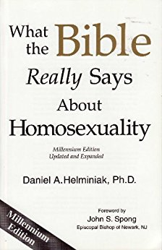
“Created” this way
The Biblical Perspective?
Some Christians have attempted to reinterpret the Bible to accept homosexuality
Bishop John S Spong - Daniel A. Helminiak - Rembert Truluck
We are at a point in history where it should be considered outrageous for an educated person to quote the Bible to condemn homosexuality. (Helminiak)

Slide 17
Scripture - Starting Point
Leviticus 18:22 (NIV) “‘Do not have sexual relations with a man as one does with a woman; that is detestable.
Leviticus 20:13 (NIV) “‘If a man has sexual relations with a man as one does with a woman, both of them have done what is detestable. They are to be put to death; their blood will be on their own heads.
Romans 1:26-27 (NIV) Because of this, God gave them over to shameful lusts. Even their women exchanged natural sexual relations for unnatural ones. 27 In the same way the men also abandoned natural relations with women and were inflamed with lust for one another. Men committed shameful acts with other men, and received in themselves the due penalty for their error.

Slide 18
Scripture - Starting Point
1 Corinthians 6:9 Or do you not know that wrongdoers will not inherit the kingdom of God? Do not be deceived: Neither the sexually immoral nor idolaters nor adulterers nor men who have sex with men
1 Timothy 1: 8-10 We know that the law is good if one uses it properly. 9 We also know that the law is made not for the righteous but for lawbreakers and rebels, the ungodly and sinful, the unholy and irreligious, for those who kill their fathers or mothers, for murderers,10 for the sexually immoral, for those practicing homosexuality, for slave traders and liars and perjurers—and for whatever else is contrary to the sound doctrine
Jude 7 In a similar way, Sodom and Gomorrah and the surrounding towns gave themselves up to sexual immorality and perversion. They serve as an example of those who suffer the punishment of eternal fire.

Slide 19
“Christ” & Homosexuality
Silence, signifying acceptance?
Why did Christ say nothing about homosexuality?
As this act was universally accepted as immoral, Christ did not speak about it, just as he did not speak about incest.
Christ did speak about topics that people did not comprehend in the right way Ex: Murder & Anger, Adultery in the heart, The sacredness of Marriage, Oaths to the Lord, The Second Mile, Love your enemies.
Notes:
Incest: sexual relations between people classed as being too closely related to marry each other.

Slide 20

The Didache
"You shall not commit murder, you shall not commit adultery, you shall not commit homosexuality, you shall not commit fornication, you shall not steal, you shall not practice magic, you shall not practice witchcraft, you shall not murder a child by abortion nor kill one that has been born" (Didache 2:2 [A.D. 70]).

Slide 21
The Church Fathers
St. Basil the Great "He who is guilty of unseemliness with males will be under discipline for the same time as adulterers" [A.D. 367].
St. John Chrysostom "All of these affections [in Rom. 1:26–27] . . . were vile, but chiefly the mad lust after males; for the soul is more the sufferer in sins, and more dishonored than the body in diseases" [A.D. 391].
St. Augustine "[T]hose shameful acts against nature, such as were committed in Sodom, ought everywhere and always to be detested and punished. If all nations were to do such things, they would be held guilty of the same crime by the law of God, which has not made men so that they should use one another in this way“ [A.D. 400].

Slide 22
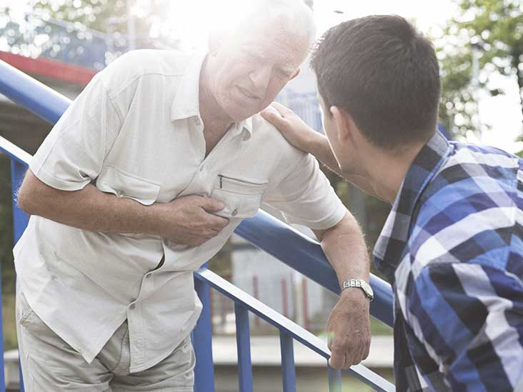
Christian Attitude
The first stage in helping is to build trust and to create an environment that allows exploring fears. Active listening skills are used, as well as reflecting back to help change behavior due to a desire for
obedience to God, not due to a desire to fit into social norms. Work to set realistic ways one might live with unwanted same sex attractions. Once these are established, the hard work of implementing them must begin.
Notes:
Always differentiate between the sickness and the sick man.

Slide 23
Review
“Born” this way - The Scientific Perspective?
“Right” this way - The Human Rights Perspective
“Created” this way - The Biblical Perspective
Love and Acceptance as the Starting Point

Slide 24

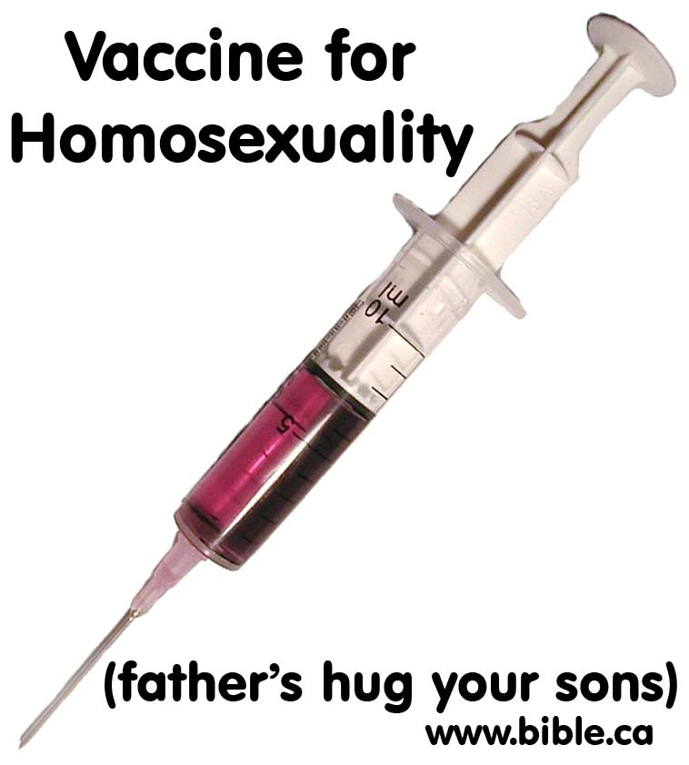
Love and Acceptance as the Starting Point

