Slide 1
The History and Role of Monasticism & Church Fathers Chrysostom and Athanasius

Slide 2
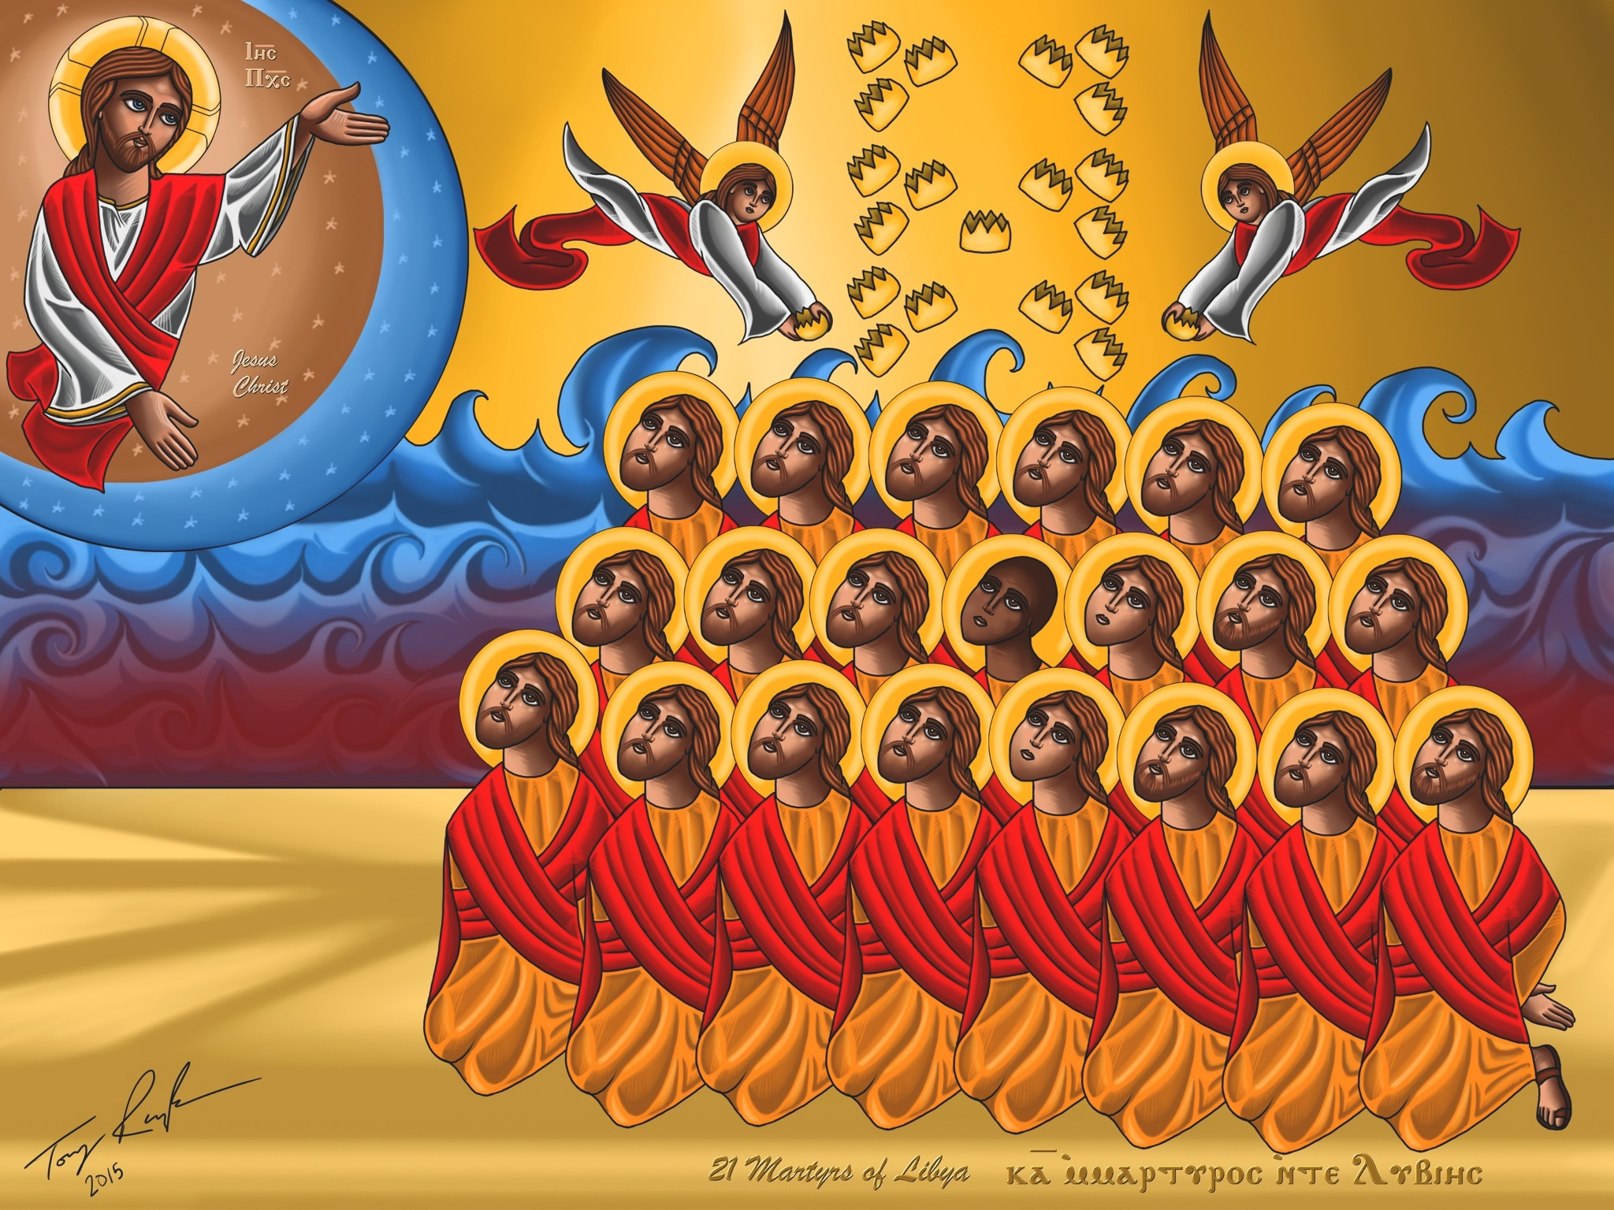
The Start of Monasticism (Historical Context):
Persecution began as early as the first few centuries after the resurrection of Christ
People would willingly give their lives to Christ by offering bloodshed on His behalf (Martyrdom → Martyrion → Witness).
Emperor Constantine (313 AD), creates an edict that not only allows the practice of Christianity, but actively abolished the notion of persecution against Christians
Although persecution was not completely gone, it did begin to dwindle down

Slide 3
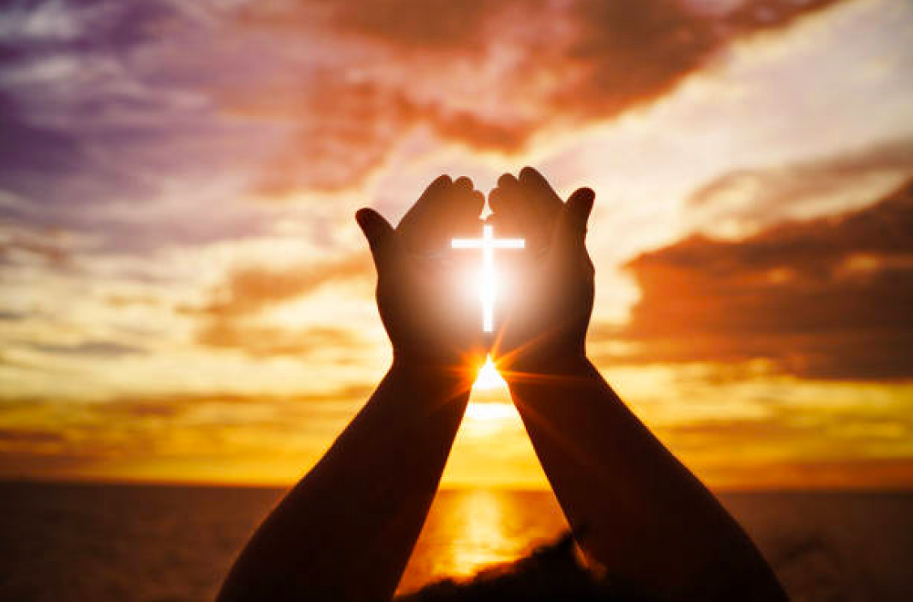
People still wanted to give their life to Christ. How would they go about achieving this?

Slide 4
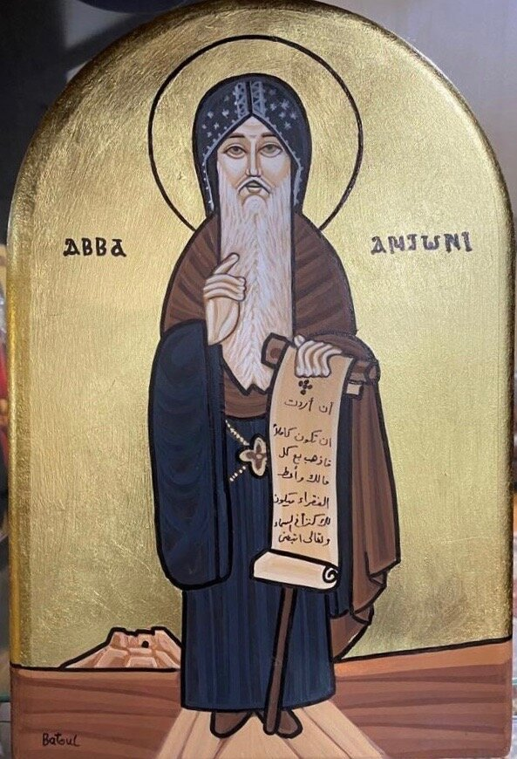
Saint Anthony the Great
“If you want to be perfect, go, sell what you have and give to the poor and you will have treasure in heaven; and come, follow Me.” (Matthew 19:21)
Left his worldly possessions (including 300 acres of fertile land!!), offered his soul, body, and spirit in complete focus and solitude, towards Christ alone
Along with Saint Anthony was saint paul of Thebes (the hermit, one of Saint Anthony’s disciples)
Saint Basil, bishop of Caesarea once visited Egypt and observed the spring of monasticism and him along with others would begin to spread this notion of people willingly giving their time if bloodshed was not necessary

Slide 5
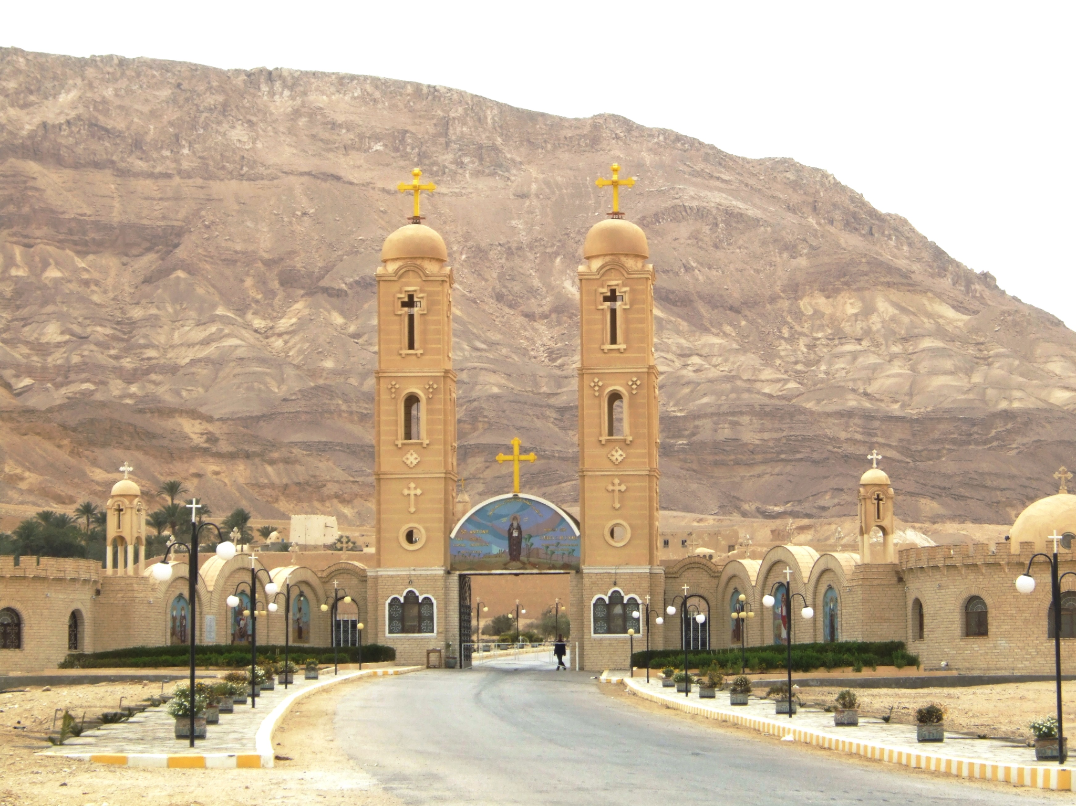
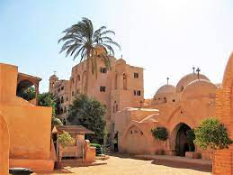
The Flourishing of Monasticism
Saint Pachomius (the successor of Saint Anthony) began to adopt the ascetic life and would compose rules/policies regarding the conduct of monasticism
Rather than dwelling in caves or hills, monasteries began to be built
Athanasius would refer to Saint Anthony as “a physician given by God to Egypt” (By Christians and even non-Christians) in his book “The Life Of Saint Anthony”

Slide 6
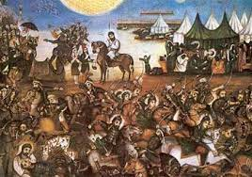
What Roles did the Monastery Take Part in During the Post Arab-Conquest?

Slide 7
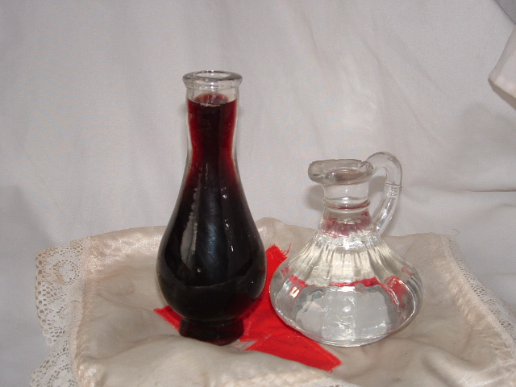
Production of Wine
During the 8th-14th centuries AD (Islamic Golden Age), wine began to be strictly prohibited by the mamalik/salateen (notably Al-Hakim bi amr allah, etc).
As there was no strict security in churches, muslims would often break into churches to find wine and steal/break the vessels
However, since monasteries were out in the dessert and far away from any government regulation/intervention, monasteries began to produce wine and often times the deacon or priest would secretly go and take the wine and store it in areas often hidden from the muslims

Slide 8
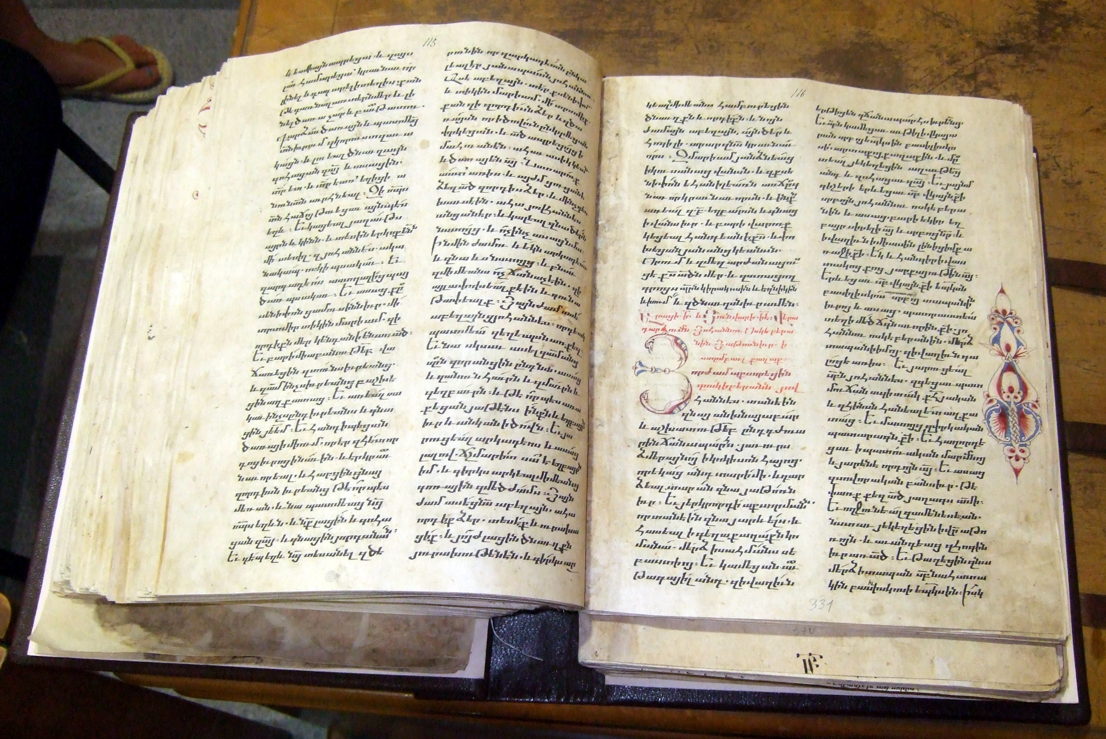
The Origin of The Synaxarium/Antiphonarium
Greek for “collection”
Exact date is unknown, but this book was initially put together by 3 bishops:
Anba botros (bishop of Meleeg), Anba Mikhail (bishop of Etreeb), and Anba Youhanna (bishop of el Borollos)

Slide 9
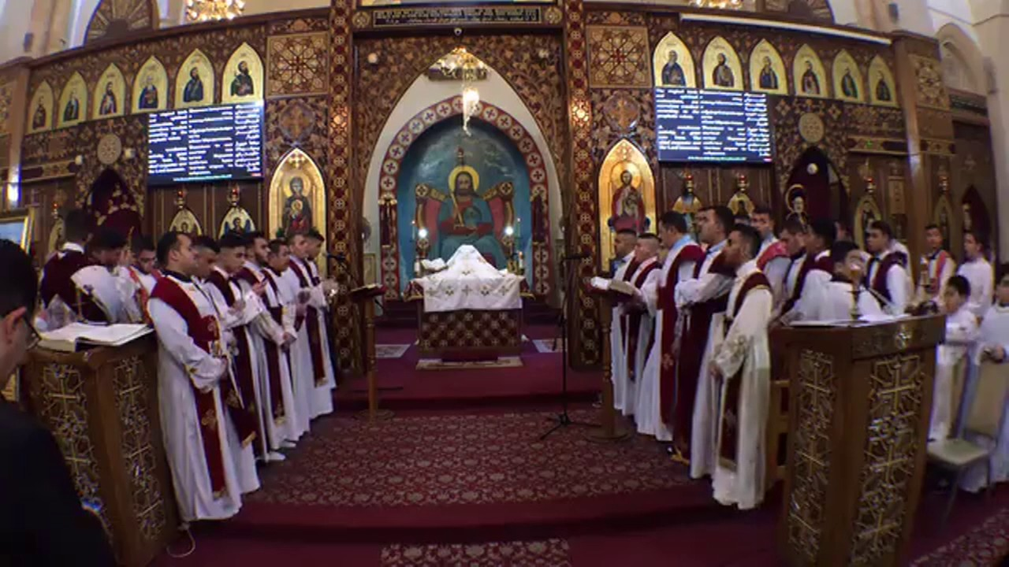
What is the Antiphonarium?
There remains till this day, not used as often but a book called the Coptic antiphonarium
Antiphon just means a short sentence or line chanted in a melody as an introduction to some reading, usually done between 2 separate choruses
It is undoubtedly true that the antiphonarium is older than the synaxarium in its composition
Is nowadays recited at the end of the midnight praises

Slide 10
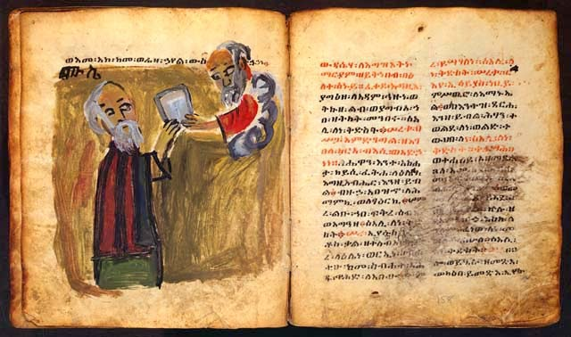
The earliest manuscript dates back to the monastery of the Archangel Michael in Hamuli which dates the 893 AD. However, this was not a complete book and only contained fragments
The first fully completed antiphonarium (difnar) was completed 1385 AD at the monastery of saint Anthony
In 1922, a monk named Domadius il-baramousi was able to restore this older copy and published the first half of the coptic year

Slide 11
Truly, today the morning star has risen upon us from the east with its rays surrounding it, for his honor is very great.
The church and the orders in it rejoice today, on the honorable commemoration of Saint George.
Many are the tortures that this saint bore, and many more are the honors that Christ granted him.
Seven crowns of pure gold adorned with precious stones, of whose honor no tongue could ever speak of.
On this day, Saint George was martyred. He was born in Cappadocia in the first half of the third century to a wealthy and Godly Christian family.
Their father died while they were still young and their mother took charge of raising them up on Christian piety.
When George grew to be a courageous and brilliant young man, Justus the governor of Palestine took interest in him and enlisted him in the Army.

Slide 12
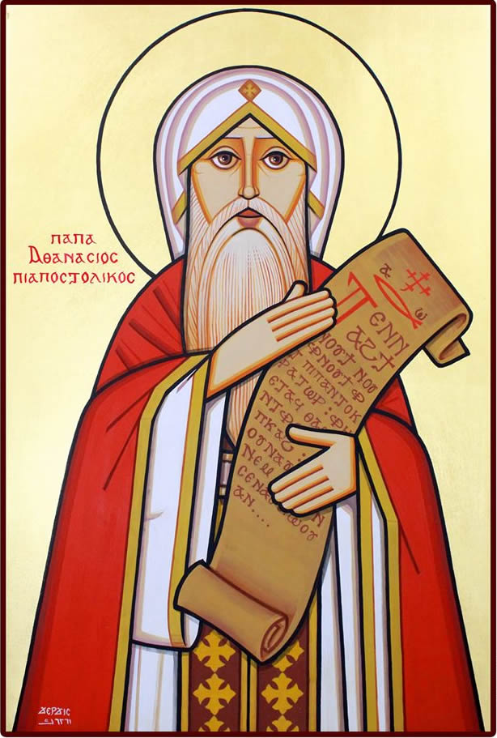
Saint Athanasius (The Apostolic)
Was born in 296 AD to Pagan parents
Studied and understood the Greek language proficiently, in addition to Coptic
Was ordained a Deacon by the hands of Pope Alexander I (19th pope)
Is referred to as “the apostolic” due to his steadfast contributions in preserving orthodox trinitarian faith.
Referred to as “the leader of Orthodoxy” in the Coptic Doxology.
Is accredited to have written one of the oldest Coptic texts “Omonogenis” → O Only Begotten Son (however others argue Severus of Antioch)
“Your truthful teachings pierced the hearts of the heretics, like a double edged sword, by the power of the Trinity.”
This verse within the doxology is actually used for Saints Severus of Antioch, as well as Athanasius and Cyril of Alexandria. It was a text often used and adapted by the Coptic church by the 9th century AD!

Slide 13
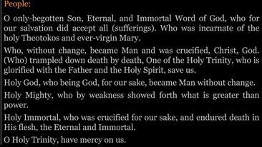


Slide 14
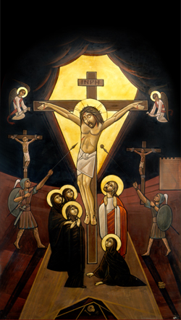
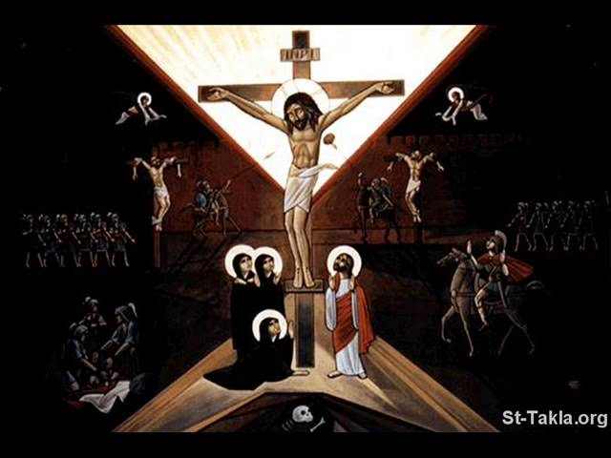
Let’s delve a bit more into Omonogenis
Actually holds a similar formation to the creed that we recite today
The Nicene creed was established and was introduced into the liturgy by the 6th century
Used to be chanted before the hymn of the Trisagion on a weekly basis!! (14th – early 20th century), and the ordination of the patriarch. WHY??
an affirmation of Christ’s Divinity, in perfect harmony and unison with His Humanity
Also chanted during the making of the holy Chrism (Myron)!
The hymn makes a constant reference to the son, who through his incarnation, suffered and was crucified, however while still being God (Who without change, became Man and was Crucified)
also emphasizes the ultimate sacrifice in which God willingly gave Himself up for us

Slide 15
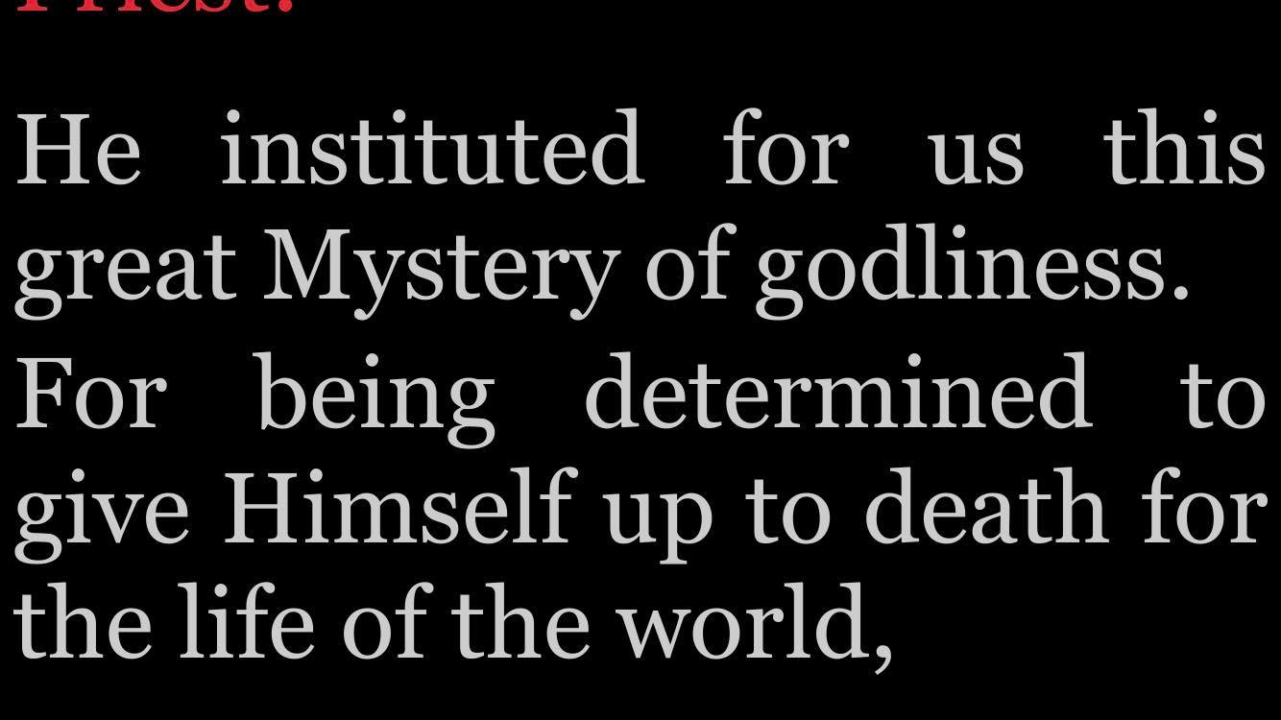




Slide 16
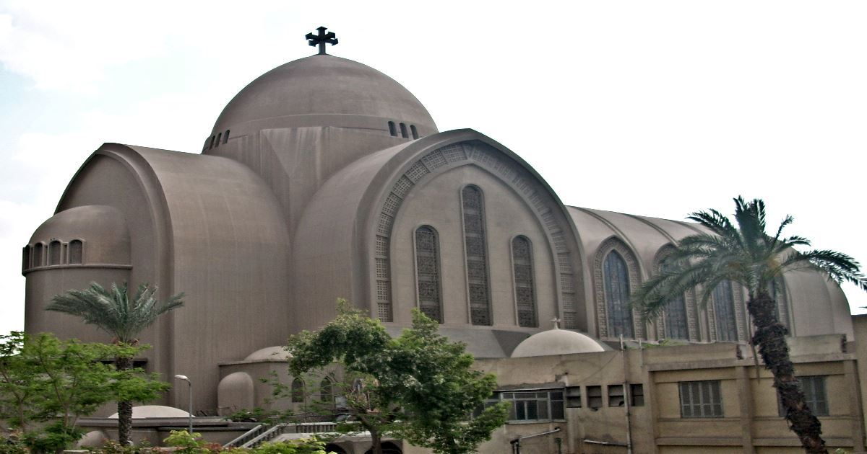
ORTHODOX
ORTHO
DOXA
STRAIGHT
PROPER
GLORY
OPINION

Slide 17
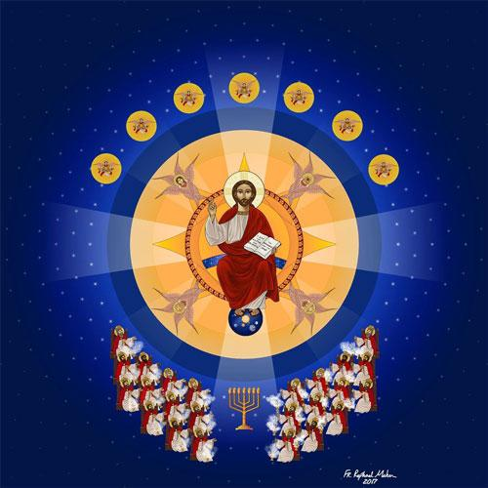
Homoousios vs. Heteroousios:
Same in being/person; same in essence
VS.
Absolutely distinct person
Thus, Homoousios was the exact form of language used when forming the Nicene Creed

Slide 18
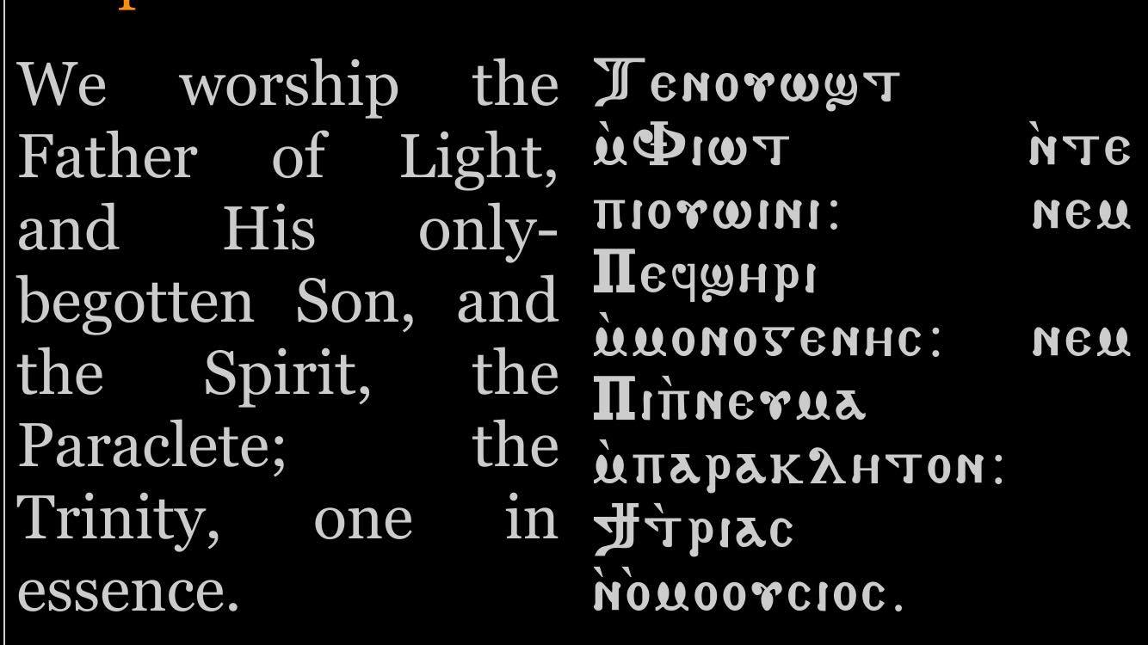

Slide 19
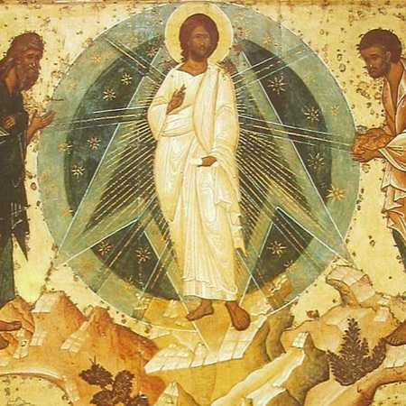
Saint Athanasius/Saint Anthony and the teaching of Theosis:
First off, WHAT IS Theosis?

Slide 20


Slide 21

“It is such a holy union with the divine life that we may reflect its brightness in OUR OWN humanity which shines with the Glory of God.”

Slide 22

"A true man is one who understand that the body is corruptible and short-lived, whereas the soul is divine and immortal and, while being God's breath, is joined to the body to be tested and deified."
Anthony the Great. "On the Character of Men and on the Virtuous Life 124." Philokalia. Ed. G.E.H. Palmer. Vol. 1. London: Faber and Faber, 1981. 348.

Slide 23
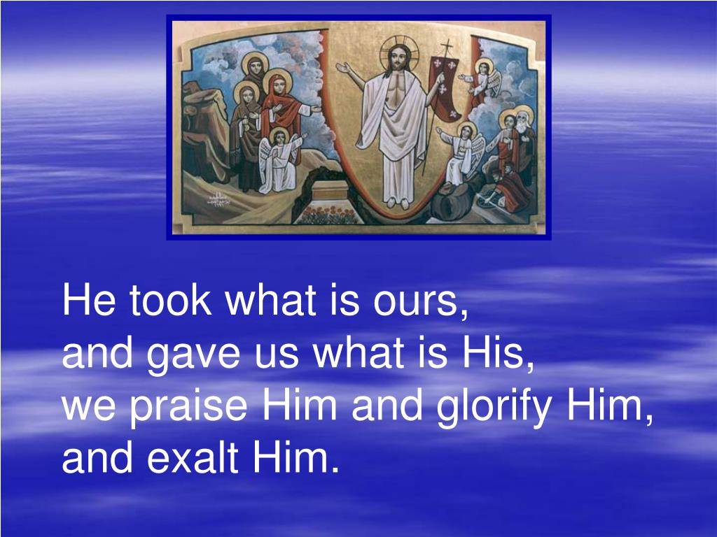
“He, indeed, became Man (assumed humanity) that we might become God”
Athanasius of Alexandria, on the incarnation, chapter 8
Athanasius is also attributed to have written the morning Gloria “let us praise with the angels saying, Glory to God in the highest, peace on Earth, and goodwill toward men. We praise You, we bless You,” to the end.

Slide 24
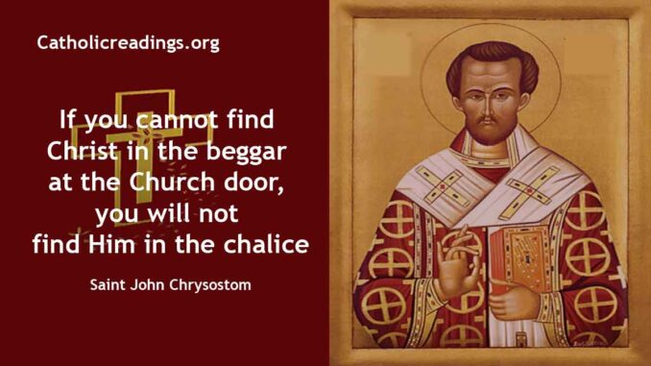
John Chrysostom:
Born in 347 AD to wealthy parents, received his education in Athens
Chrysostom → Golden mouth → From the Greek language
Became a monk, gave his money to the poor, and later was ordained patriarch over Constantinople
Wrote many homilies (commentaries on scripture, some we use during the paschal week)
Would also commonly quarrel with political and ecclesiastical (clergy) leaders of the state, denouncing their actions and abuse of authority which would lead to Chrysostom being exiled several times throughout his patriarchal era
Wrote quite a few prayers before communion that we have adopted in our church
Also has an anaphora (text used for liturgical prayer) predominantly used within the byzantine rites

Slide 25
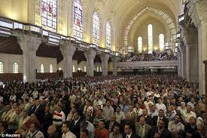
Chrysostom Banning Applause in Church…?
Back in the 5th century, it was commonly noted that bishops/lectors struggled to maintain control among the congregation. Why?
It was a common tradition within church to cheer or applaud when the people hear something they approve of, or to loudly shout of their disapproval if otherwise (McGuckin 2004)
This was a problem Cyril (the pillar of faith) had, and would be observed by Chrysostom

Slide 26
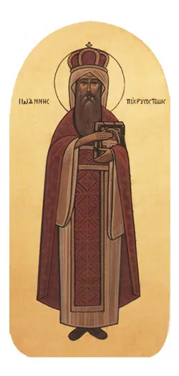
“Believe me, I am not speaking at random: when you applaud me as I speak, I feel pride at the moment as it is natural for a man to feel. Why should I not? I am delighted and overjoyed. And then when I go home and reflect that the people who have been applauding me have received no benefit, and indeed that whatever benefit they might have had has been killed by the applause and praises, I am sore at heart, and I lament and fall to tears, and I feel as though I had spoken altogether in vain, and I say to myself, What is the good of all your labours, seeing that your hearers don’t want to reap any fruit out of all that you say? And I have often thought of laying down a rule absolutely prohibiting all applause, and urging you to listen in silence.”
Chrysostom, John. Hom. xxx. In Act. Apost. c. 3, vol.ix. 238., quoted by Edwin Hatch in The influence of Greek Ideas and Usages upon the Orthodox Church, 1897, p111.

Slide 27



Questions/Discussion?

Slide 28
References
Chrysostom, John. Hom. xxx. In Act. Apost. c. 3, vol.ix. 238., quoted by Edwin Hatch in The influence of Greek Ideas and Usages upon the Orthodox Church, 1897, p111.
The Apostolic, A., & Behr, J. (2011). On the incarnation. St Vladimir's Seminary Press.
Anthony the Great. "On the Character of Men and on the Virtuous Life 124." Philokalia. Ed. G.E.H. Palmer. Vol. 1. London: Faber and Faber, 1981. 348.
il Makari, A., Mitri, M. S., Sami, N. N., & Mehanna, M. M. (2016). Chapter 3. In S. L. Mitri (Trans.), A summary of the liturgical history of the Church of Alexandria (pp. 96–97). essay, Saint Paul Brotherhood Press.
Mikhail, R. (2020). The presentation of the lamb: The prothesis and preparatory rites of the coptic liturgy. (H. Buchinger, T. Chronz, M. Farag, & T. Pott, Eds.) (Vol. 2, Ser. Studies in Eastern Christian Liturgies). Aschendorff Verlag.
McGuckin, J. A. (2004). The Context of the Ephesus Crisis. In Saint Cyril of Alexandria and the Christological Controversy (Vol. 1, pp. 10–12). essay, Saint Vladimir's Seminary Press.
Zakarīyā, Ibn Sabbāʻ, Yūḥannā ibn Abī, al-Asʻad, Ibn Kubr, Abū al-Barakāt ibn, & Gabriel V, P. (2022). Guides to the Eucharist in medieval Egypt three Arabic commentaries on the coptic liturgy: Yūḥannā Ibn Sabbāʻ, Abū al-Barakāt ibn Kabar, and pope gabriel V. (A. Mikhail, Trans.) (1st ed.). Fordham University Press.
Bradshaw, P. F., Johnson, M. E., Cuming, G. J., & Dudley, J. R. C. (2019). Prayers of the Eucharist: Early and Reformed. Liturgical Press.

Slide 29
Pillar of Faith, C. of A. P. (2000). Cyril of Alexandria - An Explanation of the Twelve Anathemas. (N. Russell, Trans.). Routledge.
Pillar of Faith, C. of A. P., & Wickham, L. R. (1983). First Letter of Cyril to Succensus. Clarendon Press.
Aleksandryjski, C., & McGuckin, J. A. (1995). On the unity of Christ. St Vladimir's Seminary Press.
Samuel, F. V. C. C. (2013). The Council of Chalcedon re-examined. ISPCK.
Brugarolas, Miguel. Gregory of Nyssa: Contra Eunomium I. An English Translation with Supporting Studies. Koninklijke Brill NV, 2018.
John of Damascus, J., & F., S. S. D. (2016). Exposition of the Orthodox Faith. Aeterna Press.
The Holy Pascha: Being the Liturgies of the Holy Week of Pascha According to the Current Usage in the Church of Alexandria. The Holy Virgin Mary Coptic Orthodox Church, 1996
Chrysostom, John, and Thomas Aquinas Goggin. Commentary on Saint John the Apostle and Evangelist. Catholic University of America Press, 2000
Shanūdah Pope. Thine Is the Power and the Glory: Contemplations on the Prayer of the Holy Week. St. Mark Coptic Orthodox Church, 2007.

