Slide 1
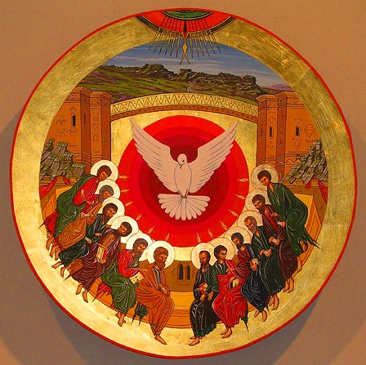
History of the Church (2nd and 3rd Centuries)

Slide 2
Main Outline
Review of the 1st Century
Approach & Development
The Apostolic Fathers
Ecclesial Development
The Catechetical School of Alexandria

Slide 3
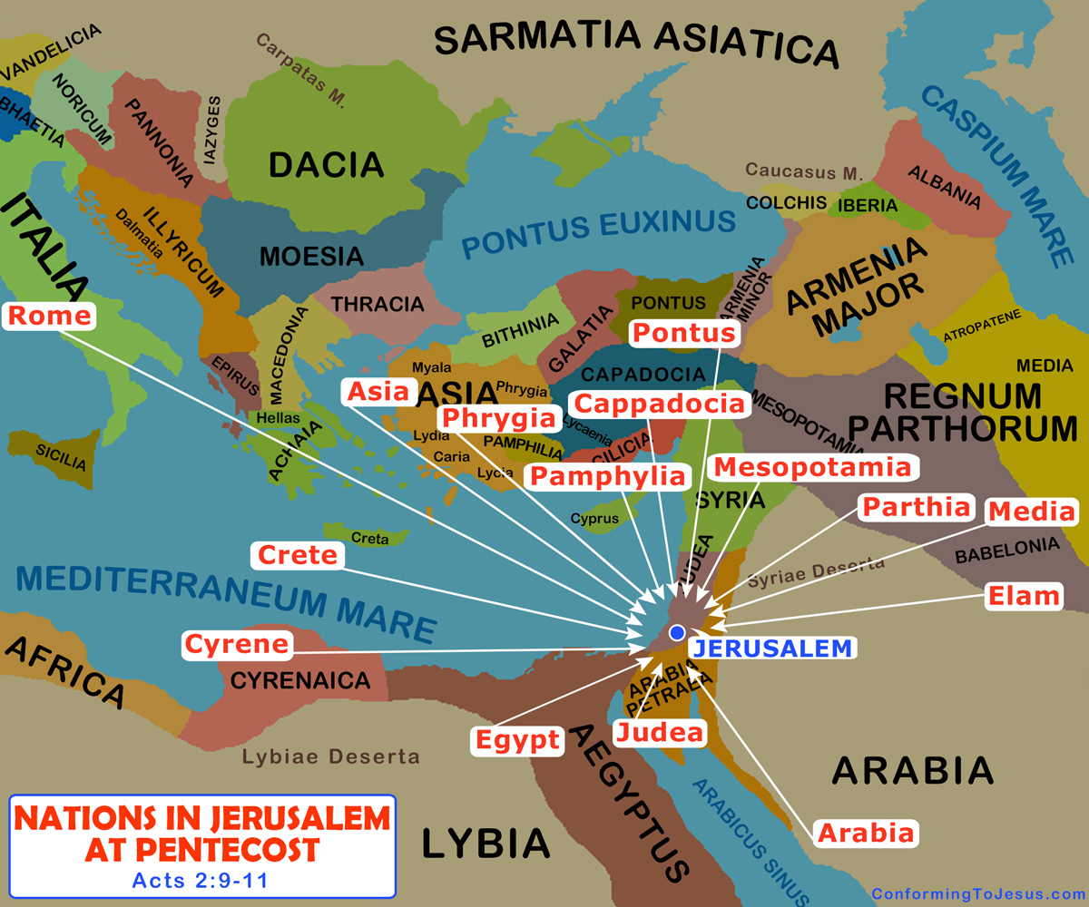
Review of the 1st Century
2-6 B.C. - The Birth of The Lord Jesus
1 B.C. - The Death of Herod
28-29 - John the Baptist begins his ministry
29-30 - The Lord Jesus begins His ministry
33 - Crucifixion & Resurrection
33 - Pentecost
36 - Paul’s escape from Damascus
49-50 - The First missionary journey
50 - Council of Jerusalem
Notes:
Things to note:
The Feast of Pentecost marks the beginning of God’s eternal kingdom on earth, His Church. The apostles only started ministering after they received the power that God promised them, His Holy Spirit
The scattered Jews that came on that day to worship at the temple in Jerusalem, went back to their cities with this new faith that St Peter spoke of. So God paved the way for when the apostles would then make their way to these cities
St Paul and the rest of the disciples and apostles started their ministry before any of the books were written (gospels or letters)
The Council of Jerusalem gave us a model and an example of how to deal with contradicting teachings in the Church. It also showed that the voice of one apostle had equal weight as another
There were constant clashes between the Jews and the Christians. The Jews did not want to let go of their traditions.

Slide 4
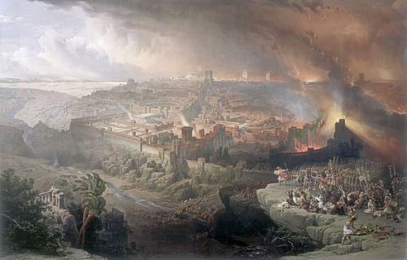
Review of the 1st Century
50-52 - The Second missionary journey
52-57 - The Third missionary journey
57 - Paul’s arrest in Jerusalem
57-59 - Paul imprisonment in Caesarea
60-62 - Paul imprisonment in Rome
66-70 - The Roman-Judean War
68 - The Death of Nero
70 - The Destruction of Jerusalem & Its Temple
Notes:
The Jews could not stand the Roman occupation any longer and started inciting rebellions against the empire.
The temple brought in huge revenue for the Jews (specifically the priests and the merchants and vendors operating in the temple)
Jerusalem was placed under siege by Titus and then destroyed
The Christians remembered the prophecies of the Lord and many fled from the city
This triggered a major change and that was the (almost) complete disconnection between any remaining ties to Judaism and Jerusalem in the worship and life of the Church.
It also meant that now the Church had to come up with its own order and system for worship (since now they had to place

Slide 5
Approach & Development
“But you shall receive power when the Holy Spirit has come upon you; and you shall be witnesses to Me in Jerusalem, and in all Judea and Samaria, and to the end of the earth.” (Acts 1:8)
“And Jesus came and spoke to them, saying, “All authority has been given to Me in heaven and on earth. Go therefore and make disciples of all the nations, baptizing them in the name of the Father and of the Son and of the Holy Spirit, teaching them to observe all things that I have commanded you; and lo, I am with you always, even to the end of the age.” Amen.” (Matthew 28:18-20)
“And He said to them, “Go into all the world and preach the gospel to every creature.” (Mark 16:15)

Slide 6
Approach & Development
“Then those who gladly received his word were baptized; and that day about three thousand souls were added to them. And they continued steadfastly in the apostles’ doctrine and fellowship, in the breaking of bread, and in prayers. Then fear came upon every soul, and many wonders and signs were done through the apostles. Now all who believed were together, and had all things in common, and sold their possessions and goods, and divided them among all, as anyone had need.
So continuing daily with one accord in the temple, and breaking bread from house to house, they ate their food with gladness and simplicity of heart, praising God and having favor with all the people. And the Lord added to the church daily those who were being saved.” (Acts 2:41-47)

Slide 7
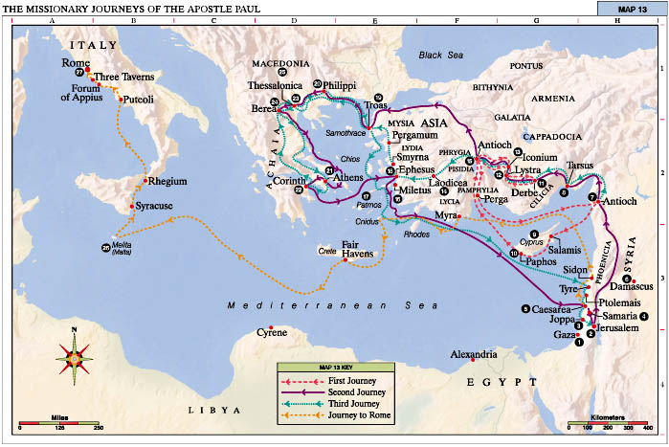

Slide 8
St Paul’s Method
“Therefore I have reason to glory in Christ Jesus in the things which pertain to God. For I will not dare to speak of any of those things which Christ has not accomplished through me, in word and deed, to make the Gentiles obedient— in mighty signs and wonders, by the power of the Spirit of God, so that from Jerusalem and round about to Illyricum I have fully preached the gospel of Christ. And so I have made it my aim to preach the gospel, not where Christ was named, lest I should build on another man’s foundation, but as it is written:
To whom He was not announced, they shall see;
And those who have not heard shall understand.” (Romans 15: 17-21)

Slide 9
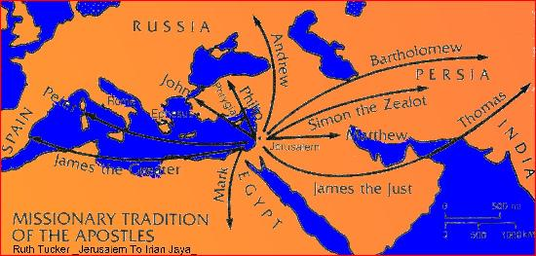

Slide 10
Scripture & Tradition
The disciples and apostles wrote accounts of the life of Jesus
They also wrote letters for two reasons:
  Reaching out to the believers in cities they were about to visit
  Most commonly, confirming the believers that they already met and dealing with issues that affect that particular community
These letters were seen as Authoritative
Nothing was canonized until the late 2nd century and early 3rd centuries
The Oral Tradition of the Apostles held a significant place in the development of the Church’s systems
Notes:
Many of the direct eyewitnesses were martyred or started to repose in the Lord
The authors of Scripture were inspired by the Spirit to write their experiences

Slide 11
Interlude: Writings (https://www.ccel.org/fathers)
Historical Events:
  The Book of Acts (Luke 75 AD – 85 AD)
  Flavius Josephus (37 AD – 100 AD)
  Eusebius (263 AD – 339 AD)
Liturgical & Apologetic:
  Justin the Martyr (100 AD – 165 AD)
Development & Ecclesiastical History:
  St Irenaeus of Lyons (130 AD – 200 AD) Against Heresies
  Eusebius (263 AD – 339 AD) Ecclesiastical History

Slide 12
Big Picture
The Founder and Author of the Faith, Jesus
The disciples and apostles had the duty:
  Expanding the members of the Body of Christ (Church)
  Maintain and develop the existing members
The disciples of the disciples (Apostolic Fathers) had to do the same thing (focusing more on the second point of maintenance and development
We are expected to follow in their footsteps!
Notes:
Our Lord showed the disciples how one ought to live.
He instituted the sacraments and left the affairs of the Church to be discerned by the apostles

Slide 13
Living Conditions of the Apostolic Fathers
The Jews did not want to give up their tradition and did not want to accept others (gentiles) into the faith
The Greek challenged the teachings of Christ and the Church. St Justin the Martyr was a philosopher that defended and compared Christianity with Paganism and other philosophies
The Roman Emperors wanted unison across the empire. This was also in the form of one religion (for the sake of stability). This caused persecution against the Church and its members

Slide 14
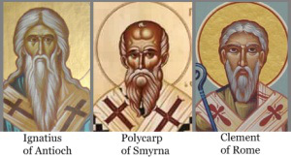
The Apostolic Fathers
St Clement of Rome
St Ignatius of Antioch, the Theophorus (God-bearer)
St Polycarp of Smyrna

Slide 15
St Clement of Rome
3rd bishop of the church in Rome
Aided St Paul with his ministry in Philippi (Philippi 4:3)
Believed to be a Roman citizen with an education in the Greek Septuagint
Famously known for his epistle to the Corinthians (asking them to maintain the love and unity of God’s Church)
Argued whether he reposed as a martyr or saint

Slide 16
St Ignatius of Antioch
Bishop of Antioch (discipled under St Peter, St Paul and St Barnabas)
He gave himself the title the Theophorus. According to tradition he is the young child that Jesus set in the midst of the disciples and said: “Whoever receives one of these little children in My name receives Me; and whoever receives Me, receives not Me but Him who sent Me.” (Mark 9: 36-37)
Captured during the reign of Trajan the emperor
Composed 7 letters on his way to execution in Rome. These letters covered many topics (Pastoral, Apologetic, Church Order)
Very powerful story of martyrdom

Slide 17
St Polycarp of Smyrna
Bishop of Smyrna (modern day Izmir in Turkey)
Was a disciple of St John the Beloved
He seems to have been the angel or Bishop of Smyrna who was commended above all the bishops of Asia by the Lord Jesus Christ himself in the Apocalypse, and the only one without a reproach. Our Savior encouraged him under his poverty, tribulation, and persecutions, especially the calumnies of the Jews, called him rich in grace, and promised him the crown of life by martyrdom (Revelation 2:8-10).
“For 86 years I have served Him, and He has never done me wrong; how then can I now blaspheme my King and Savior?”
Wrote a letter to the Philippians refuting heresies and addressing the subject of martyrdom

Slide 18
Interlude: Views on Martyrdom
St Ignatius and St Polycarp both saw the act of martyrdom as the perfect Corban (Offering) that a Christian can offer back to their Lord
They saw it as the partaking of the Passions of Jesus Christ Himself
They saw it as an honor and crown

Slide 19
Ecclesial Development
There were three major developments over that period of time:
Ecclesial Hierarchy
Doctrines in response to Heresies (Gnosticism mainly)
Canonization of Scripture

Slide 20
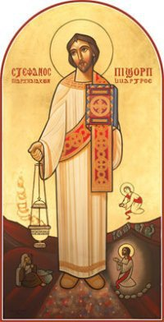
Ecclesial Hierarchy
Rank of Bishop
  Metropolitan: Bishop of a Capital
  Xoriepiskopos: Bishop of a Village
  Patriarch: Bishop of a Major See (ex: Antioch or Alexandria)
  Archbishop: Same rank as Patriarch but just not of a Major See
Rank of Presbyter
  Priests: Aided with ministering the Sacraments
  Hieromonk: Priest Monks
  Archpriests
  Archimandrite: Head of a Monastery
  Hegumens: An Elder Priest
Rank of Deacon
  Deacons
  Archdeacons
  Protodeacons: Head of Other Deacons
Notes:
These ranks began their development in the 2nd and 3rd centuries but do not take full shape until later on
The Didache tells us more about the selection process and of the duties of the main 3 ranks.

Slide 21
Gnosticism (Gnosis = Knowledge)
Good god vs evil god
The material world was created by the evil god
To be saved, you had to have the knowledge that was free from all material
Marcion said, Jesus was the word of God (the good god) that came to save us from the Old Testament god (the evil god)
Marcion created an edited version of the gospel of Luke (named it after Himself) & 10 epistles of St Paul
Valentinus and Marcion were opposed by Ignatius and Irenaeus (disciple of St Polycarp)
St Clement of Alexandria also showed the supremacy of Christian gnosis
Irenaeus formed a list of books that the church considered as canonical

Slide 22
Scripture
Irenaeus makes direct reference to the 4 gospels (Against Heresies)
Eusebius (Incomplete) and Athanasius provide a list of all the canonical books
Different communities had different lists (Catholic Epistles & Apocalypse of John)
In Athanasius 39th Festal Letter, the full list of 27 books are listed
“These are fountains of salvation, that they Who thirst may be satisfied with the living words they contain. And these alone is proclaimed the doctrine of godliness. Let no man add to these, neither let him take out from these. For concerning these the Lord put to shame the Sadducees, and said “You are mistaken, not knowing the Scriptures nor the power of God.” (Matthew 22:29) “You search the Scriptures, for in them you think you have eternal life; and these are they which testify of Me. (John 5: 39)” – 39th Festal Letter by Athanasius
Notes:
4 Incorporeal creatures = 4 gospels
4 winds, 4 directions, 4 gospels that are held together by one Spirit
Lion: Royal Character
Ox: Sacrificial and Priestly Order
Man: Coming in human form
Eagle: The Giving of the spirit to the Church

Slide 23
Interlude: Scripture & Tradition
Tradition kept the Scripture and Scripture kept the Tradition
The words cannot be understood without the Spirit
Cannot understand what the author meant without asking the author what they wanted to say

Slide 24
Date of Easter
The churches in the East (Asia) celebrated on the 14th of the Jewish month Nisan (Sunday or not). According to them: Date of Christian Passover = Date of Jewish Passover
The rest of the world celebrated on the Sunday
There were talks of excommunicating the churches that celebrated with the Jews. Irenaeus did not allow for that to happen. The churches remained in communion
The Church agreed to disagree
Unity ≠ Uniformity
This was then resolved in the first Ecumenical Council of Nicaea

Slide 25
Persecution
Continuous until today! Shows that the Kingdom of darkness is not happy with our progress
Since Day 1 from Jewish Leadership & Roman Emperors
Imperial (across all the empire) or Local waves
Tertullian (155 AD – 220 AD) said: “The more you mow us down, the more we grow. The blood of the martyrs is the seed of the Church.”
Major Waves of Persecution in 2nd and 3rd centuries:
  Maximinus Thrax (235 AD)
  Decius (250 AD)
  Valerian (257 AD)
  The Great Persecution under Diocletian (284/302 AD)

Slide 26
The Catechetical School of Alexandria
Founded by St Mark and viewed as a major Christian intellectual and theological centre as Alexandria was a Major See
Rich environment of theologians, bishops and deacons. Had one of the greatest libraries of the ancient world
Taught both spirituality and intellect
Did not only teach Christian theology, but also: science, mathematics and Greek & Roman literature, logic and the artsreligious philosophies
Adopted the format of Question and Answer for a Catechesis

Slide 27
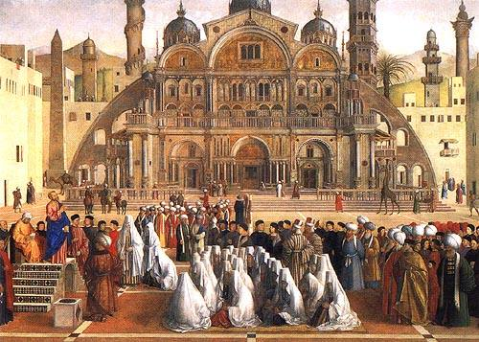
Notable Deans of The School
St Clement of Alexandria
Origen
St Dionysius
St Peter the Seal of the Martyrs
St Didymus the Blind
St Habib Girgis
Pope Shenouda III
Notes:
Fun facts:
The dean of the school from the 5th to the 19th centure was the Abbot of the Monastery of St Macarius the Great
St Didymus created a reading system for the blind centuries before the Braille was invented

Slide 28
Final Interlude: Deaconesses & Female Servants
“I commend to you Phoebe our sister, who is a servant of the church in Cenchrea, that you may receive her in the Lord in a manner worthy of the saints, and assist her in whatever business she has need of you; for indeed she has been a helper of many and of myself also.” (Romans 16: 1-2)
The Greek word used here is Diakonos
Assisted the apostles with baptism of women and other social services that involved young girls and women
Were also in charge of teaching and discipling
Notes:
Christianity teaches and lives an equality between men and women. This does not remove the need for order and unique roles.

Slide 29
Resources & References
الكنيسة المسيحية في عصر الرسل - الأنبا يؤانس أسقف الغربية - The Christian Church in the Apostolic Age
Theology Academy on YouTube – Church History Full Series
St George & St Rueis Syllabus
Collection of Church Fathers’ Writings https://www.ccel.org/fathers

