Slide 1

Exodus & leviticus

Slide 2
Exodus
At end of Genesis, Jacob and family move to Egypt
  Joseph was second-in-command in Egypt
Pharaoh offered the family to live as safety from famine
400 years later, Exodus starts
Exodus = deliverance from Egypt (out of way/road)
Several links to Genesis, mainly Gen 1:7
  “Israel was fruitful and multiplied and filled the land”
Part 1 - Chapters 1-18
Exodus from Egypt
Part 2 - Chapters 19-40
Covenant at mount Sinai

Slide 3
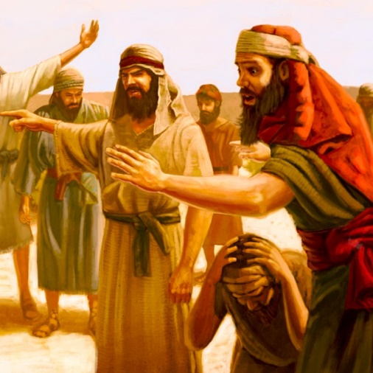
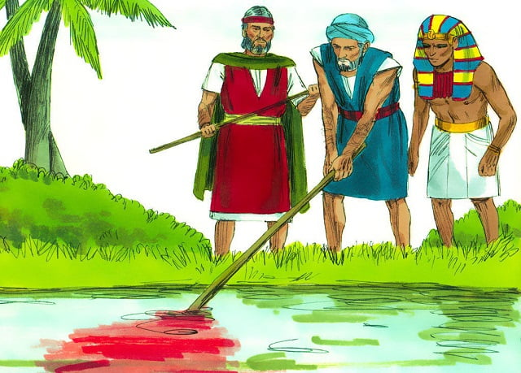
Exodus – Part 1
Chapters 1-4
Pharaoh corrupt
Moses commissioned
Chapters 5-15
“Let my people go”
Plagues
Chapters 16-18
Wilderness complaints

Slide 4

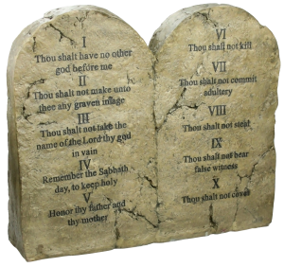
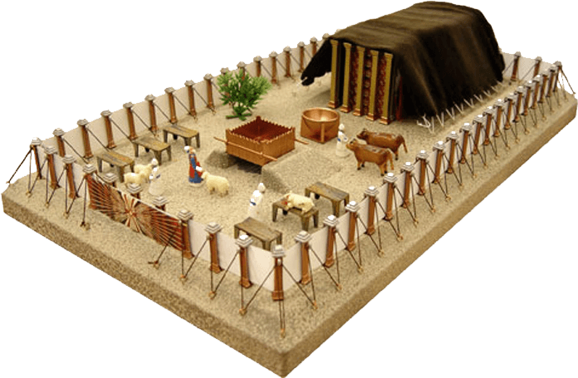
Exodus – Part 2
Chapters 19-24
Covenant
Commandments
Chapters 25-31
Instructions on building the Tabernacle
Chapters 32-34
Gold Calf
Chapters 35-40
Carry out instructions

Slide 5
Exodus – Part 1
Chapters 1-4
Pharaoh perceives Israel as threat
Oppresses and attempts to destroy
All boys be drowned in Nile
Israel cries to God and He responds
Moses is born an Israelite but raised with Pharaoh’s daughter
Moses and the burning bush
  Will harden Pharaoh’s heart

Slide 6
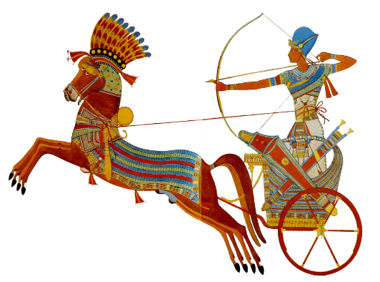

Exodus – Part 1
Chapters 5-15 – God’s saving presence
Hardened heart?
Ten plagues
  Blood (Nile)
  Frogs
  Gnats
  Flies
  Livestock death
  Boils
  Hail
  Locusts
  Darkness
  Firstborn death → PASSOVER
Red sea
Song of deliverance (Chapter 15)

Slide 7
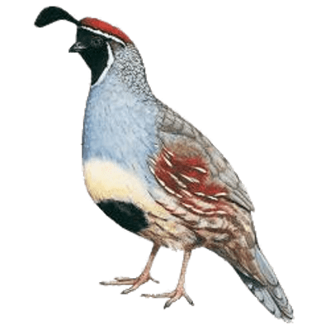
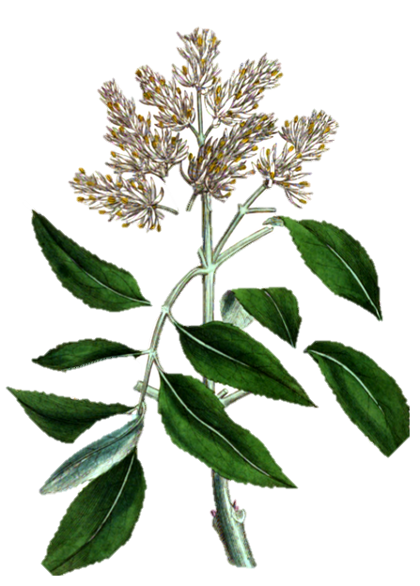
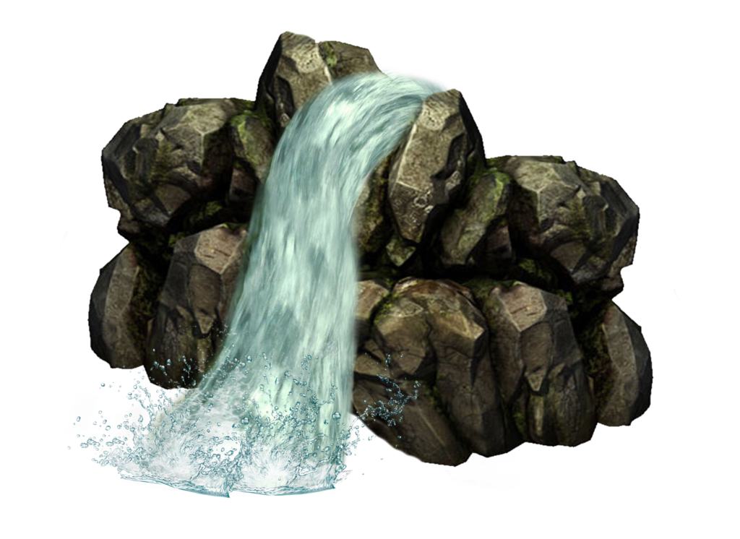
Exodus – Part 1
Chapters 16-18
Manna and Quail
  Lord gives, they collect – Two way
  Teaching order
  Sabbath
Water from rock
Jethro advises Moses
  People had troubles
  Moses appoints people of God

Slide 8
Exodus – Part 2
Chapters 19-24
Covenant
Commandments
Chapters 25-31
Instructions on building the Tabernacle
Chapters 32-34
Gold Calf
Chapters 35-40
Carry out instructions

Slide 9
Exodus – Part 2
Chapters 19-24
God’s covenant
  If Israel accepts – represent God in all nations
  Israel accepts
Ten commandments
  Followed by 52 more commands
  Israel accepts
God asks Moses to build a sanctuary
  God’s presence

Slide 10
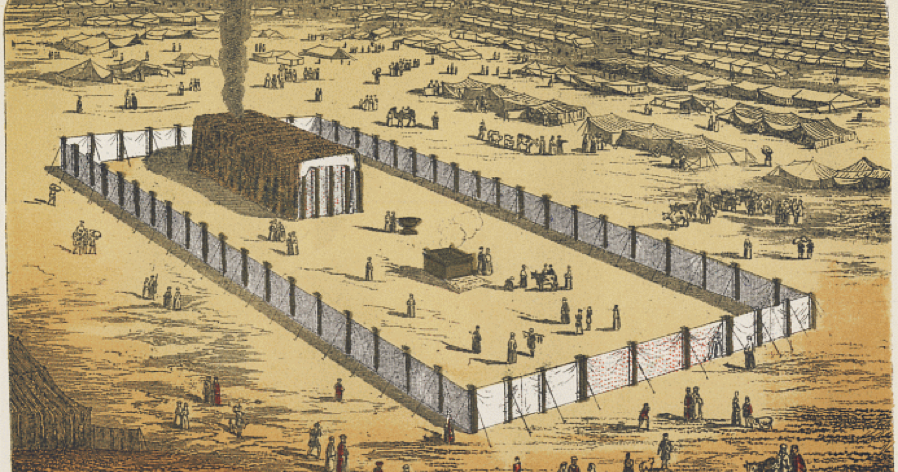
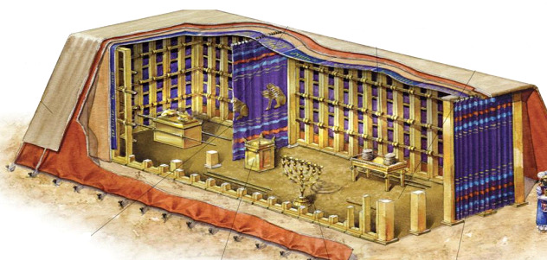
Exodus – Part 2
Chapters 25-31
God gives detailed instructions on tabernacle
  Like an engineering drawing
  With interior design details
Tabernacle symbolizes garden of Eden

Slide 11
Exodus – Part 2
Chapters 32-34
People grow impatient waiting for Moses
Aaron gives in to demands
Gold calf
God wants to destroy them
  Moses pleads with God
  Covenant renewed
  Sign of God’s patience, mercy and forgiveness

Slide 12
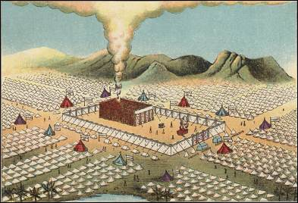
Exodus – Part 2
Chapters 35-40
Building of Tabernacle
Repetition of 25-31
Importance: man carrying out God’s instruction
  Two way relationship
  Obedience, discipline
God comes down and dwells

Slide 13
Leviticus

Slide 14
Chapter 16
Day of Atonement
Chapters 11-15
Chapters 17-20
Purity
Purity
Chapters 8-10
Chapters 21-22
Priesthood
Priesthood
Chapters 1-7
Chapters 23-27
Rituals
Rituals

Slide 15
Leviticus
Chapters 1-7 - Rituals
5 different sacrifices
  Meal offering
  Peace offering
  Burnt offering
  Sin offering
  Trespass offering
Meal & Peace
Burnt, Sin & Trespass
All 5 point to Jesus
Chapters 23-27 - Rituals
7 feasts
  Passover
  Unleavened bread
  First fruits
  Harvest/Pentecost
  Trumpets
  Day of atonement – Chapter 16
  Tabernacles

Slide 16
Leviticus
Chapters 8-10 - Priesthood
Rites of ordaining priests
Nadab and Abihu (chapter 10)
Offered unholy fire
Consumed by God’s fire
  Following God’s orders is a must
  Unholy actions are repelled
Chapters 21-22 – Priesthood
Qualifications of priests
Holiness of priests
  Priests represent the people before God
  Priests represent God to the people
Highest level of integrity and morals
Instructions on offerings
  What to accept
  How to accept
  How to offer

Slide 17
Leviticus
Chapters 11-15 - Purity
Ritual purity
5 ways to be impure:
  Skin disease
  Touching reproductive fluids
  Touching mold or fungus
  Touching dead bodies
  Eating off-limits animals
Impurity is not a sin
Impurity was limited (days/weeks)
Chapters 17-20 - Purity
Moral purity
Sexual sins and principles
Moral holiness
  No cheating
  No stealing
  No lying
  Fairness
Punishment for violation
  Mostly death

Slide 18
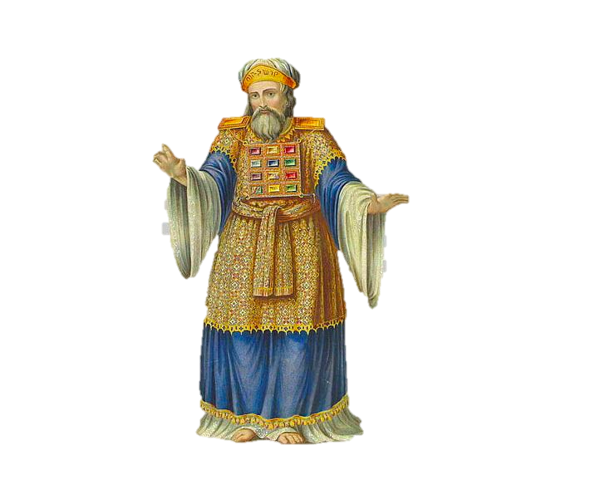
Leviticus
Chapter 16 – Day of atonement
Feast that happened once a year
High priest uses two goats
  One goat slaughtered (atone for people)
  One scapegoat
To cover for sins unconfessed or unknown
God’s desire to be with His people

Slide 19
Chapter 16
Day of Atonement
Chapters 11-15
Chapters 17-20
Purity
Purity
Chapters 8-10
Chapters 21-22
Priesthood
Priesthood
Chapters 1-7
Chapters 23-27
Rituals
Rituals

