Slide 1
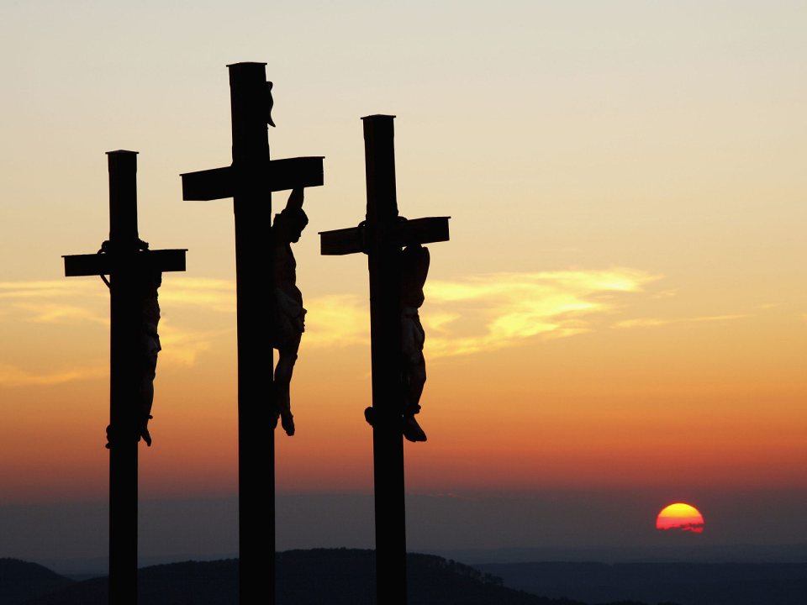
Conditions for Salvation
Servants Preparation

Slide 2

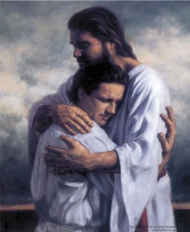
Salvation
SALVATION:
Is unity with Christ
Abide in Me, and I in you. As the branch cannot bear fruit of itself, unless it abides in the vine, neither can you, unless you abide in Me. (John 15:4)

Slide 3


Salvation
SALVATION - as we understand it:
Is unity with Christ
Abide in Me, and I in you. As the branch cannot bear fruit of itself, unless it abides in the vine, neither can you, unless you abide in Me. (John 15:4)
SIN
SIN OF ADAM
+
All other sins
SEPARATION FROM GOD!
LOST UNITY
Need to be reunited.

Slide 4


Salvation
SALVATION - as we understand it:
Is unity with Christ
Abide in Me, and I in you. As the branch cannot bear fruit of itself, unless it abides in the vine, neither can you, unless you abide in Me. (John 15:4)
Sin → disobedience to God
God → UNLIMITED
Man → Limited
Sin against God → unlimited sin
For unlimited sin to be forgiven → need unlimited propitiation

Slide 5
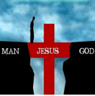
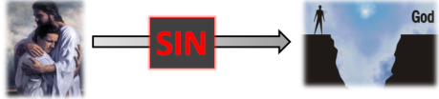
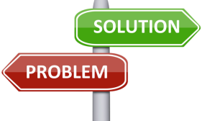
Salvation
SALVATION - as we understand it:
Is unity with Christ
Abide in Me, and I in you. As the branch cannot bear fruit of itself, unless it abides in the vine, neither can you, unless you abide in Me. (John 15:4)
For the remission of sin → God Himself becomes incarnate and die.
Sin → disobedience to God
God → unlimited
Man → limited
Sin against God → unlimited
For sin to be forgiven → unlimited propitiation

Slide 6
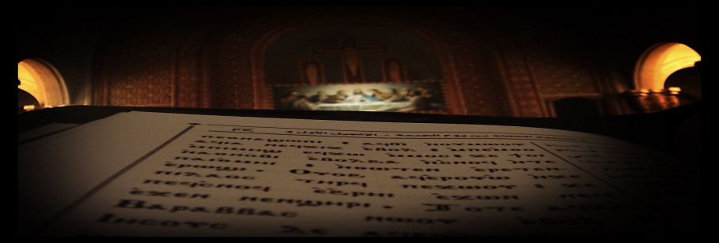
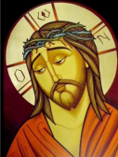
Salvation
SALVATION - as we understand it:
Is unity with Christ
Thok-te-ti gom…
The Lord is my strength, my praise, and has become my holy salvation

Slide 7
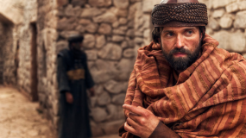
Salvation
SALVATION - as we understand it:
Is unity with Christ → which:
needed shedding of blood and death
leading to remission of “sins”.
Without shedding of blood (i.e. death) there is no remission (Heb 9:22)

Slide 8

THREE Conditions
“Essentials” for Salvation
Sacraments
Good
works
Faith

Slide 9

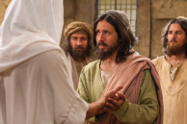
FAITH - The Christian Coptic Orthodox
“Now faith is the substance of things hoped for, the evidence of things not seen”
Heb. 11:1
→ Faith is complete trust in God, and believing without seeing. Once you see – there is no need for faith!
“because you have seen Me, you have believed. Blessed are those who have not seen and yet have believed.”
John 20:29

Slide 10
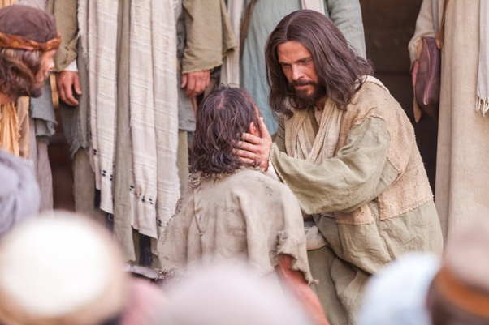
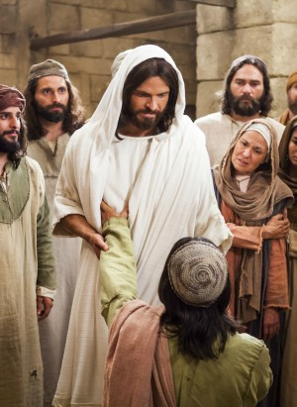
FAITH
The boy possessed by an evil spirit
“…If you can believe, all things are possible to him who believes.” Immediately the father of the child cried out and said with tears, “Lord, I believe; help my unbelief!””
Mark 9:23-24

Slide 11
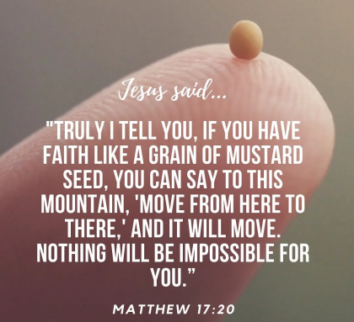
FAITH
We have some
faith in God
But our hearts
Can have weakness
And some confusion.
We have some
Trust in God
“…If you can believe, all things are possible to him who believes.” Immediately the father of the child cried out and said with tears,
“Lord, I believe; help my unbelief!””
Mark 9:23-24

Slide 12
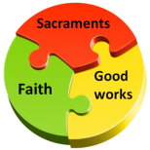


FAITH
"Even the demons believe and tremble!“
(James 2:19).
RECALL:
Is Faith ALONE
sufficient?

Slide 13
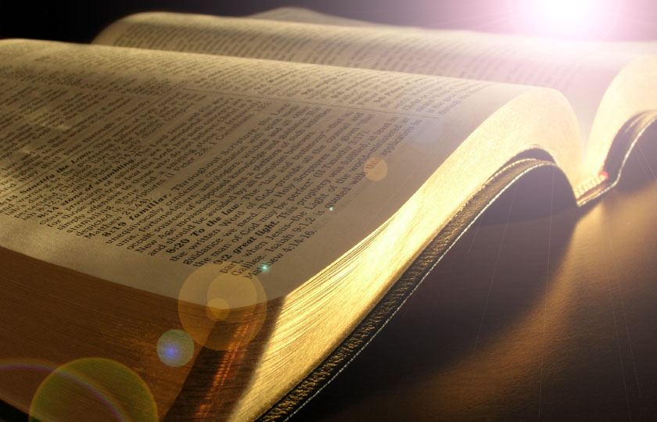
FAITH
How can we “examine” ourselves to see if we have “faith”?
  We have 2 important measures:
    WORKS
    LOVE

Slide 14

FAITH
WORKS & LOVE – as per the Bible…
"For as the body without the spirit is dead, so faith without works is dead also" (James 2:26).
  Faith – that is ALIVE
  Faith – that is DEAD!
  “and though I have all faith, so that I could remove mountains, but have not love, I am nothing"
  (l Cor. 13:1)
There is faith in BOTH cases.

Slide 15
FAITH
WORKS & LOVE
We have to JUSTIFY our LIVING FAITH with
WORKS and LOVE!
WORKS:
  If I have faith that there is Heaven and that my entire life will be judged by God, then my actions and daily life must actively demonstrate/reflect this faith – e.g. repentance, confession, how I treat other, etc.

Slide 16
FAITH
WORKS & LOVE
We have to JUSTIFY our LIVING FAITH with
WORKS and LOVE!
WORKS:
  If I have faith that I have the Holy Spirit, then I need to do the “works of the Holy Spirit”
    Comforting each other
    Teaching and preaching
    Strengthening others in need
    Praying for each other
    ………..
Fr. Anthony Paul.

Slide 17
FAITH
WORKS & LOVE
We have to JUSTIFY our LIVING FAITH with
WORKS and LOVE!
WORKS:
  “And if you call on the Father, who without partiality judges according to each one’s work” 1 Peter (1:17)

Slide 18

FAITH
WORKS & LOVE
We have to JUSTIFY our LIVING FAITH with
WORKS and LOVE!
LOVE:
  Not simply an expression of an emotion!

Slide 19
FAITH
WORKS & LOVE
We have to JUSTIFY our LIVING FAITH with
WORKS and LOVE!
How do I “love” as an Orthodox Christian ?
LOVE:
  L → Let go
    pride, superficiality, jealousy, money, lusts, selfish pleasures
  O → Opportunities
    give (smile, word, simple gift), time (pray, your spiritual life)
  V → value
    value every person you interact with no matter their status, accomplishments, knowledge, money, etc.
    value pain/hardships (e.g. the story of Joseph)
  E → Evaluate
    how much I let go? do I take opportunities? Do I value?
Fr Dawood Lamey

Slide 20
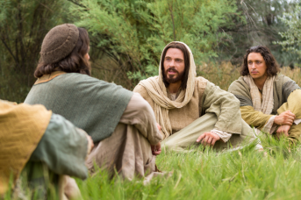
FAITH
WORKS & LOVE
We have to JUSTIFY our LIVING FAITH with
WORKS and LOVE!
LOVE:
How we treat each other reflects our love for God.
We cannot say we love God, and not “love” each other.
So when they had eaten breakfast, Jesus said to Simon Peter, “…do you love Me more than these?” He said to Him, “Yes, Lord; You know that I love You.” He said to him, “Feed My lambs.” He said to him again a second time, “…do you love Me?”
He said to Him, “Yes, Lord; You know that I love You.”
He said to him, “Tend My sheep.” He said to him the third
time, “…do you love Me?” Peter was grieved because He
said to him the third time, “Do you love Me?” And he said
to Him, “Lord, You know all things; You know that I love
You.” Jesus said to him, “Feed My sheep.
(John 21:15-17)

Slide 21
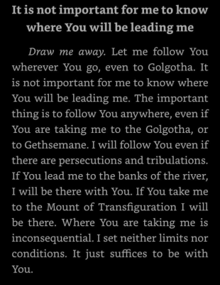

FAITH
WORKS & LOVE
We have to JUSTIFY our LIVING FAITH with
WORKS and LOVE!
LOVE:
  is a commitment!
  NOT situational!

Slide 22
FAITH
WORKS & LOVE
We have to JUSTIFY our LIVING FAITH with
WORKS and LOVE!
LOVE:
  “But I say to you, love your enemies, bless those who curse you, do good to those who hate you, and pray for those who spitefully use you and persecute you, that you may be sons of your Father in heaven”
  Matthew 5:44-45.
Taking love to the next level!
Love is NOT conditional!

Slide 23
FAITH
WORKS & LOVE
LOVE:
  for I was hungry and you gave Me food; I was thirsty and you gave Me drink; I was a stranger and you took Me in; I was naked and you clothed Me; I was sick and you visited Me; I was in prison and you came to Me….‘Assuredly, I say to you, inasmuch as you did it to one of the least of these My brethren, you did it to Me.’
  Matthew 25:35-40.
We have to JUSTIFY our LIVING FAITH with
WORKS and LOVE!
If we see Jesus in each other – we can easily love one another.

Slide 24

FAITH
WORKS & LOVE
KEY POINT
If I have LIVING faith in God and heaven, then my everyday life must demonstrate (justify) this faith, through my works. Furthermore, I have to prove my love with my actions – otherwise, this faith is only theoretical (dead).

Slide 25
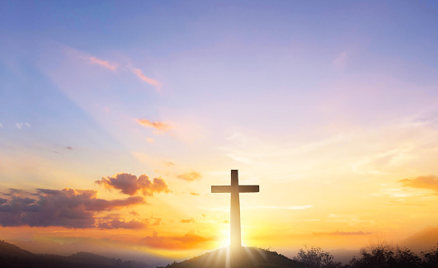

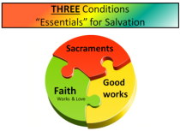
End result of LIVING FAITH
“Though now you do not see Him, yet believing, you rejoice with joy inexpressible and full of glory, receiving the end of your faith—the salvation of your souls.”
(1 Peter 1:8-9)
SALVATION is the end point and COMPLETES our faith!

Slide 26

THREE Conditions
“Essentials” for Salvation
Now, let’s
look at the
Sacraments!
Sacraments
Good
works
Faith
Works & Love

Slide 27
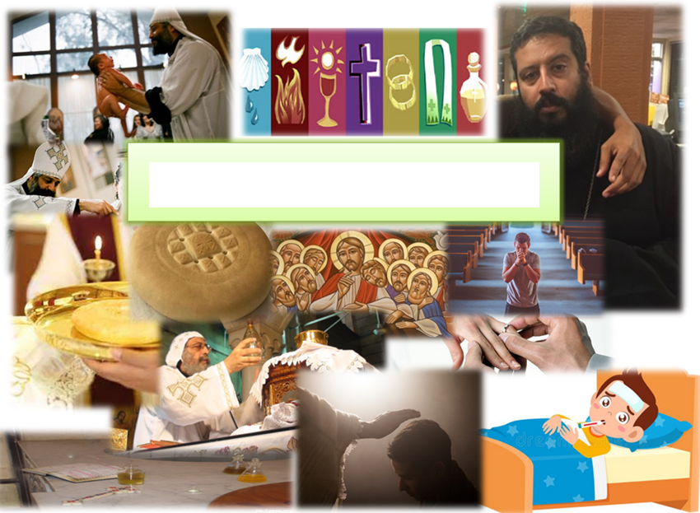
– BAPTISM – CONFIRMATION – CONFESSION – EUCHARIST - MATRIM
The Sacraments
– UNCTION OF SICK – PRIESTHOOD – BAPTISM –
ONY – UNCTION OF SICK – PRIESTHOOD – BAPTI
– CONFIRMATION – CONFESSION – EUCHARIST – MATRIMONY – MS

Slide 28
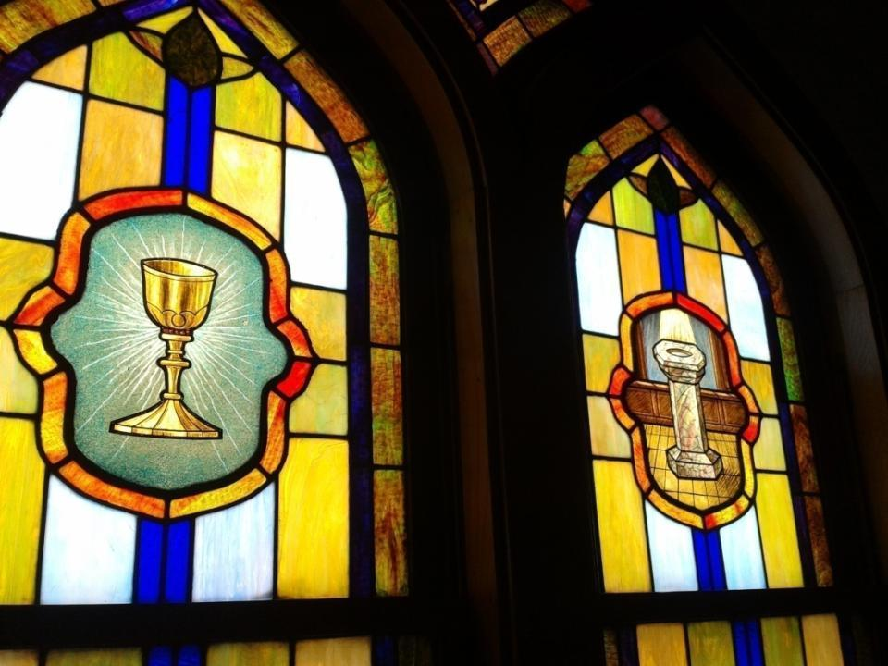
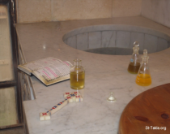
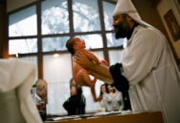
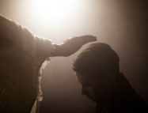
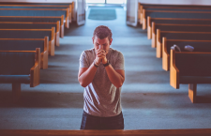

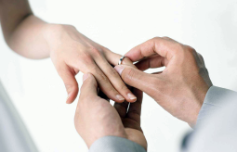
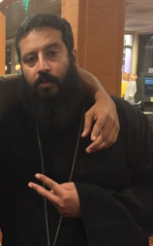
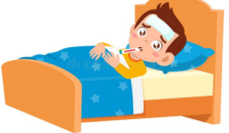
The 7 sacraments
Baptism
Chrismation (Confirmation)
Confession (Repentance)
Eucharist
Matrimony
Unction of the sick
Priesthood

Slide 29
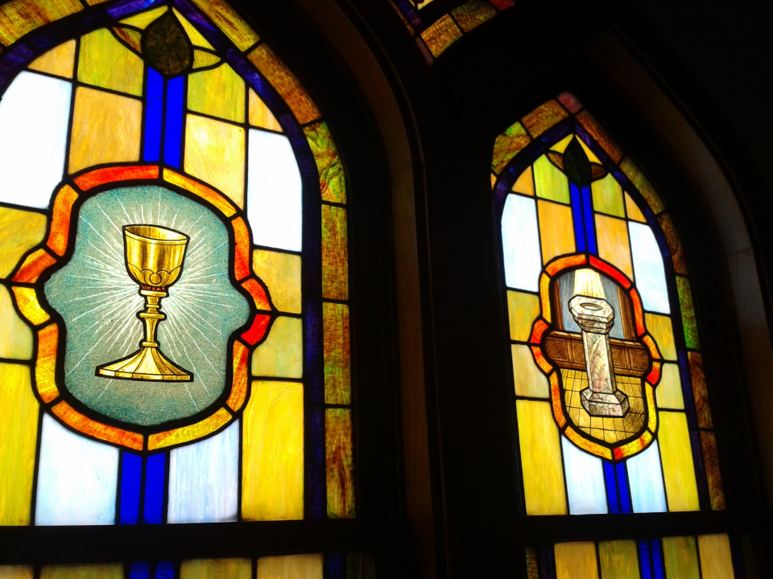
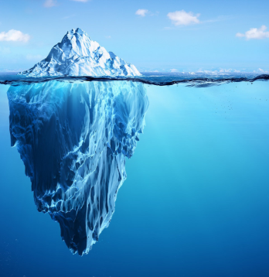


WHAT is a sacrament?
MYSTERY
“Mysterion” in Greek meaning:
“Mysteries”
VISIBLE
INVISIBLE
FAITH

Slide 30


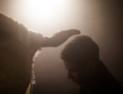




The 7 sacraments - visible & invisible
Water → new birth
Oil → dwelling of Holy spirit
Confession → forgiveness of sins
Bread/wine → true body and blood of Christ
Man&Woman → holy unity
Oil → healing of sick
Man → priest
Baptism
Chrismation (Confirmation)
Confession (Repentance)
Eucharist
Matrimony
Unction of the sick
Priesthood

Slide 31

WHAT is a sacrament?
In a general sense we can say:
“A church sacrament is an invisible grace we receive by practicing a visible rite, and a visible sign or substance performed by a priest.”
His Grace Bishop Mettaous
Abbot of El-SYRIAN Monastery

Slide 32

The Sacraments & the Invisible Grace
Through church, we receive the Holy Spirit in the sacraments.
Then Peter said to them, “Repent, and let every one of you be baptized in the name of Jesus Christ for the remission of sins; and you shall receive the gift of the Holy Spirit.”
Acts 2:38

Slide 33


WHY do we have sacraments?
Through (redemptive) sacraments, we are “SAVED” and receive “SALVATION”.
Without sacraments, we cannot access salvation.
Let’s look at that more closely……

Slide 34
WHY do we have sacraments?
Through (redemptive) sacraments, we are “SAVED” and receive “SALVATION”.
Without sacraments, we cannot access salvation.
The sacraments are :
“necessary for eternal salvation, and every believer should practice them in order to gain eternal salvation.”
SACRAMENTAL RITES IN THE COPTIC ORTHODOX CHURCH
2nd Edition
His Grace Bishop Mettaous
Abbot of El-SYRIAN Monastery

Slide 35
The 7 sacraments a common theme~ SALVATION ~
“He who believes and is baptized will be
saved” (Mark 16:16)
Baptism
Chrismation
Eucharist
Confession
Matrimony
Unction of the sick
Priesthood
“We can never be “saved” without this gift of the Holy Spirit ….It is a gift that we receive through
the Sacrament of the Holy Unction and for which we pray continually saying ‘Do not take Your Holy Spirit
from me’ (Ps 51:11) otherwise we shall perish.”
(Pope Shenouda III)
Whoever eats My flesh and drinks My blood has eternal life, and I will raise him up at the last day... He who eats this bread will live forever” (John 6:54,58)
“…accept and not reject me, for when You look at me with mercy and compassion, I will be cleansed and saved” (prayer before confession)
“..whatever you bind on earth will be bound in heaven, and whatever you loose on earth will be loosed in heaven" (Matthew: 18:18)

Slide 36

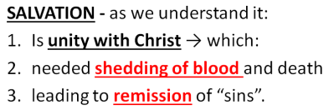
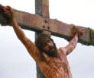
Sacraments and Salvation
RECALL
Sooooooo… how do I actually receive salvation through the sacraments?

Slide 37

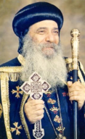
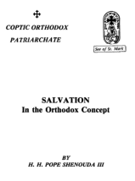
Sacraments and Salvation
RECALL
“Opened door”
of salvation
SALVATION
“Salvation began with the death of Christ on the cross paying for sin and purchasing us with His blood.. But how does salvation reach you? It reaches you through death.. in order that you may have a share in such salvation, you must share Christ His death.. You must die with Christ and rise with Him in order to be glorified with Him.”
(Pope Shenouda III)

Slide 38
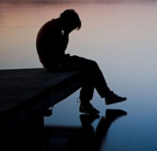

Sacraments and Salvation
~ Baptism ~
How do we share Christ His death?
BAPTISM
The first REDEMPTIVE sacrament

Slide 39
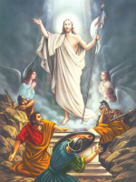
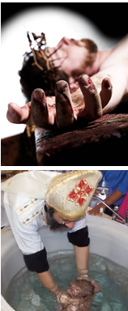

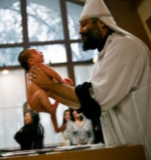


Sacraments and Salvation
~ Baptism ~
SIN
DEATH
“shedding of blood”
SALVATION
“remission of sins”
“..many of you were baptized into Christ Jesus were baptized into His DEATH? Therefore we were buried with Him through baptism into DEATH”
For if we have been united together in the likeness of His death [baptism], certainly we shall be in the likeness of His resurrection...
….now if we died with Christ, we believe
that we shall also live with Him” (Rom 6:3-8)

Slide 40
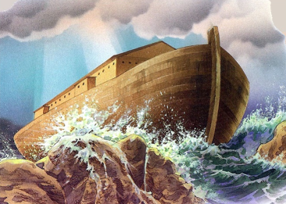
Baptism - OLD testament
“when once the Divine longsuffering waited in the days of Noah, while the ark was being prepared, in which a few, that is, eight souls, were saved through water. There is also an antitype which now saves us—baptism”
1 Peter 3:20-21.

Slide 41
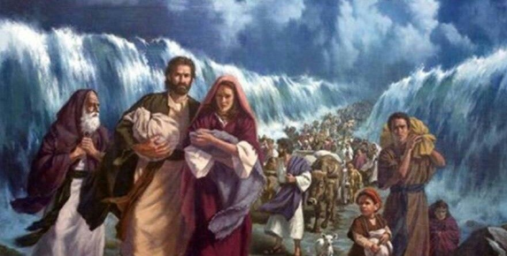
Baptism - OLD testament
“all our fathers were under the cloud, all passed through the sea, all were baptized into Moses in the cloud and in the sea”
1 Corinthians 10:1-2.
Tasbeha (1st hoos lobsh):
“Pharaoh and his chariots, were drowned, and the children of Israel, crossed the sea.”

Slide 42
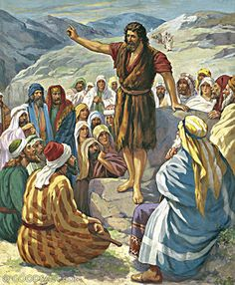
Baptism – transition into the NEW testament
Baptism of John the Baptist
“I indeed baptize you with water unto repentance, but He who is coming after me … will baptize you with the Holy Spirit and fire.”
Mathew 3:11
Baptism of John
the Baptist ≠ receiving the
Holy Spirit

Slide 43
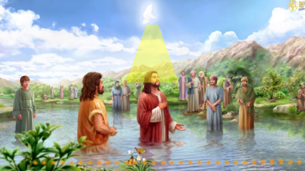
Baptism – transition into the NEW testament
Baptism of John the Baptist
“Then Jesus came from Galilee to John at the Jordan to be baptized by him. And John tried to prevent Him, saying, “I need to be baptized by You…When He had been baptized… the heavens were opened to Him, and He saw the Spirit of God descending like a
dove and alighting
upon Him. And suddenly
a voice came from
heaven, saying, “This is
My beloved Son, in
whom I am well pleased.””
Matthew 3:13-17

Slide 44
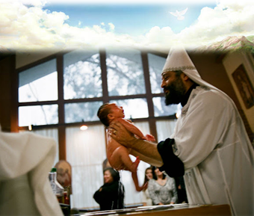
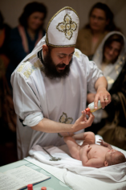
Baptism – in the NEW testament
The moment you are baptised, is the same moment heaven opens to you.
We are NOT baptised as per the baptism of John the baptist – we are baptised as per the baptism of Jesus.
It is NOT just a sign.
It is NOT just a symbol.
It is a miraculous
transformation.

Slide 45
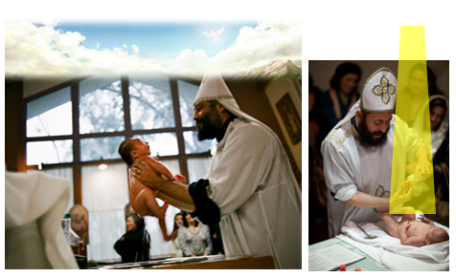
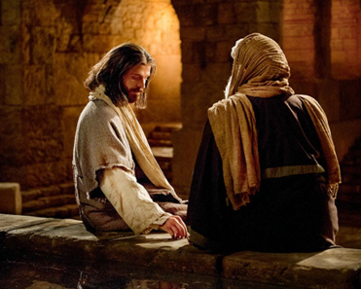
Baptism – in the NEW testament
New birth!
Jesus answered, “Most assuredly, I say to you, unless one is born of water and the Spirit, he cannot enter the kingdom of God.
John 3:5
Nicodemus

Slide 46
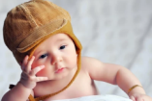
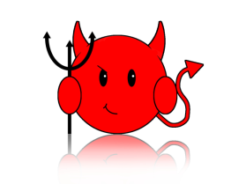
ANOTHER PROBLEM!
?
How do we “REUNITE” again with God?
BORN →
WELCOME BACK!!
MUAHAHA
SIN AGAIN

Slide 47
Solution:
REPENTANCE & CONFESSION
“If we say that we have no sin, we deceive
ourselves, and the truth is not in us" (1 John 1:8)
“No one is free from sin even though his life on earth be one single day“ (litany of the departed)

Slide 48
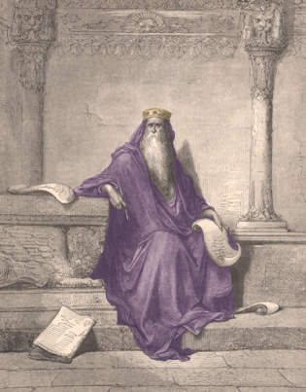
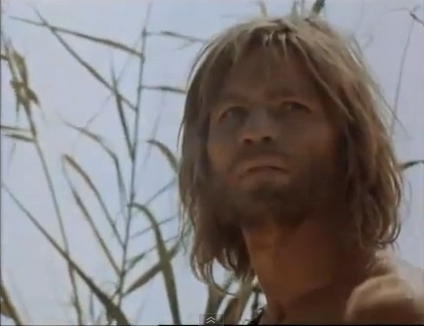
Biblical evidence of repentance and confession
REPENTANCE & CONFESSION
"He who covers his sins will not prosper, but whoever confesses and forsakes them will have mercy" (Proverbs 28:13).
John the Baptist preached repentance saying, "Repent for the Kingdom of Heaven is at hand ... then Jerusalem, all Judea, and all the region around the Jordan went out to him and were baptized by him in the Jordan, confessing their sins" (Matthew 3:1-6).
King Solomon

Slide 49

Christ himself asks us to repent…
REPENTANCE & CONFESSION
" unless you repent you will all likewise perish"
(Luke 13:3)

Slide 50

The Sacrament of Confession
REPENTANCE & CONFESSION
Repentance alone is NOT enough.
Confession alone is NOT enough.
One needs BOTH:
repentance AND confession.

Slide 51


How can I repent?
REPENTANCE & CONFESSION
True REPENTANCE has 4 conditions (R E P E N T):
Remorse & Realise
2. Plan and intention to improve
3. Never lose faith
4. Talk to Abouna (confession)

Slide 52

The Sacrament of Confession
REPENTANCE & CONFESSION
True REPENTANCE has 4 conditions:
Remorse for previous sins, a contrite heart,
and Realise that sin SEPARATES me from GOD.
2. Plan and steadfast intention to improve.
Never lose strong faith in Christ and hope in His
love to forgive.
4. Talk to Abouna – i.e. verbal confession of sins
before the priest.
Beware of “guilty conscience” – can be momentary and may not lead to repentance!

Slide 53

The Sacrament of Confession
REPENTANCE & CONFESSION
How do I feel remorse?
How do I improve?
How do not lose faith?
How and where to start:
1. Confession to one’s self (preparation) – alone time!
2. Do not give excuses and justifications for your sins – be honest with yourself!
3. Do not delay repentance!! – start now!

Slide 54

REPENTANCE & CONFESSION
The prodigal son
“he came to himself”
(Luke 15:17)
How and where to start:
1. Confession to one’s self (preparation) – alone time!
2. Do not give excuses and justifications for your sins – be honest with yourself!
3. Do not delay repentance!! – start now!

Slide 55

REPENTANCE & CONFESSION
The man given 1 talent
Do not give excuses!
How and where to start:
1. Confession to one’s self (preparation) – alone time!
2. Do not give excuses and justifications for your sins – be honest with yourself!
3. Do not delay repentance!! – start now!

Slide 56
REPENTANCE & CONFESSION
It is not that I can’t stop sinning, It’s that I don’t want to stop sinning
WHY?
Not wanting to stop →(leads to)→ I can’t stop
THUS
I CAN stop sinning IF I WANT to stop sinning!
How and where to start:
1. Confession to one’s self (preparation) – alone time!
2. Do not give excuses and justifications for your sins – be honest with yourself!
3. Do not delay repentance!! – start now!

Slide 57

REPENTANCE & CONFESSION
Continual delay of repentance = REJECTION of repentance.
How and where to start:
1. Confession to one’s self (preparation) – alone time!
2. Do not give excuses and justifications for your sins – be honest with yourself!
3. Do not delay repentance!! – start now!

Slide 58



REPENTANCE & CONFESSION
Pharaoh:
“I have sinned this time…Entreat the Lord, that there may be no more mighty thundering and hail, for it is enough. I will let you go” (Ex 9:27-28)
Plague of Hail
&thunder
Plague of locusts
Pharaoh to Moses and Aaron:
“I have sinned against the Lord your God and against you. ..entreat the Lord your God, that He may take away from me this death only” (Ex 10:16-17)
How and where to start:
1. Confession to one’s self (preparation) – alone time!
2. Do not give excuses and justifications for your sins – be honest with yourself!
3. Do not delay repentance!! – start now!

Slide 59
REPENTANCE & CONFESSION
One can have the expression of repentance in their mouth, due to situational hardships, but repentance was is not in the heart.
How and where to start:
1. Confession to one’s self (preparation) – alone time!
2. Do not give excuses and justifications for your sins – be honest with yourself!
3. Do not delay repentance!! – start now!

Slide 60

REPENTANCE & CONFESSION
How and where to start:
1. Confession to one’s self (preparation) – alone time!
2. Do not give excuses and justifications for your sins – be honest with yourself!
3. Do not delay repentance!! – start now!

Slide 61


REPENTANCE & CONFESSION
Delaying repentance demonstrates
lack of love to God
rejecting life and reconciliation with Him
love of sin still remains in the heart
lack of seriousness in the desire to repent
How and where to start:
1. Confession to one’s self (preparation) – alone time!
2. Do not give excuses and justifications for your sins – be honest with yourself!
3. Do not delay repentance!! – start now!

Slide 62





The Sacrament of Confession
REPENTANCE & CONFESSION
Pitfalls and barriers:
PREOCCUPATIONS
got no time for alone
time!
BLAMING others
LESSENING the seriousness of a sin.
Chilaaaaaax

Slide 63


The Sacrament of Confession
Born with sin
Baptised
Cleansed from sin
Reunited with God
I sinned in my life
I repented and confessed
BUT ….. How do I REUNITE with God?

Slide 64

EUCHARIST

Slide 65



The Sacrament of Eucharist
EUCHARIST
The Eucharist is the Sacrament of all Sacraments in which the faithful receive the REAL Body and Blood of Christ.
VISIBLE
INVISIBLE
“And now you ask how the bread becomes the body of Christ, and the wine and the water become the blood of Christ. I shall tell you. The Holy Spirit comes upon them, and achieves things which surpass every word and thought ... Let it be enough for you to understand that this takes place by the Holy Spirit” (St. John of Damascus).

Slide 66
The Sacrament of Eucharist
EUCHARIST
“Most assuredly, I say to you, unless you eat the flesh
of the Son of Man and drink His blood, you have no
life in you. Whoever eats My flesh and drinks My blood
has eternal life, and I will raise him up at the last
day. For My flesh is food indeed and My blood is drink indeed. He who eats My flesh and drinks My blood ABIDES
in Me and I in him” (John. 6:53-58).
“REUNITE”

Slide 67

The Sacrament of Eucharist and SALVATION!
EUCHARIST
“So, if anyone asks, 'Is salvation possible without the
holy communion?' I say, 'No, this this is impossible..
because the flesh of the Lord is given for us: salvation
and remission of sins and eternal life for whoever
partakes of it..”

Slide 68

The Sacrament of Eucharist
EUCHARIST
Unification of Believers
“For we, being many, are one bread and one body; for we all partake of that one bread” (1 Cor 10:17)

Slide 69

The Sacrament of Eucharist
when we receive communion, we actually participate in the body and blood of Christ, not just eat symbols of them!
St Paul’s Letter to the Corinthians
"The cup of blessing which we bless, is it not a participation in the
blood of Christ? The bread which we break, is it not a participation
in the body of Christ?" (1 Cor 10:16)
"Therefore whoever eats the bread and drinks the cup of the Lord
unworthily will have to answer for the body and blood of the Lord..
For anyone who eats and drinks without discerning the body, eats
and drinks judgment on himself" (1 Cor. 11:27, 29).

Slide 70
The Sacrament of Eucharist
Born + sin
Baptized
“salvation”
Sin again
Separate from God = “lose salvation”
repent
confess
Eucharist
Abide in God
Regain salvation

Slide 71

Salvation…MUST be attained through death of sin and the church sacraments !

Slide 72

What is Salvation
Importance of salvation
How we attain salvation
Conditions for salvation
  Faith
    Works and Love
  Sacraments (redemptive)
    Baptism, Holy Mayroon,
    Repentance & Confession
    Eucharist.

Slide 73


Take Home Messages
“I believe, help my unbelieve”
“I can’t stop sin vs. I don’t want to stop sin”
RPNT when you Repent!
Don’t just love, but L.O.V.E.!
Do not delay repentance
Beware of “lessening” the seriousness of a sin
My salvation is through the church and the sacraments!

Slide 74

THANK YOU! ☺
QUESTIONS?

