Slide 1

Christ's Divinity
SON OF GOD
Notes:
So it sounds like you've been tackling the very interesting subject of the Trinity the last few weeks. Today, we're hoping to continue this segment by delving deeper into Christ's Divinity.
This topic was at the core of some of the conflict that arose in the 3rd and 4th century and required several councils in order to address it. But some opponents of the Christian faith will challenge us with an important question, one that is worth investigating. They will say “If you believe that Jesus is God, show us where He himself makes that declaration.” And the truth of the matter is, if we search out scripture for words spoken by Jesus saying “I am God”, you simply won’t find them in the Bible! And yet, Christians have believed that He is God for as long as Christians have existed! And so, we begin by making a bold declaration – we do not need that statement to be spoken by Christ and recorded in Scripture for us to know and believe that He is indeed the Son of the Living God – who is of one Essence with God the Father and the Holy Spirit!
We have various different sources of evidence for the divinity of our Lord Jesus Christ which I'm hoping we can walk through together.
And if we examine these things, we will see that our faith does not hang on to a single sentence for us to know that He is indeed the God who became man.

Slide 2

The Eternal Word
In the beginning was the Word, and the Word was with God, and the Word was God. He was in the beginning with God. All things were made through Him, and without Him nothing was made that was made. In Him was life, and the life was the light of men.... That was the true Light which gives light to every man coming into the world. He was in the world, and the world was made through Him, and the world did not know Him. He came to His own, and His own did not receive Him. But as many as received Him, to them He gave the right to become children of God, to those who believe in His name: who were born, not of blood, nor of the will of the flesh, nor of the will of man, but of God.
And the Word became flesh and dwelt among us, and we beheld His glory, the glory as of the only begotten of the Father, full of grace and truth. John bore witness of Him and cried out, saying, “This was He of whom I said, ‘He who comes after me is preferred before me, for He was before me.’ ”
And of His fullness we have all received, and grace for grace. For the law was given through Moses, but grace and truth came through Jesus Christ. No one has seen God at any time. The only begotten Son, who is in the bosom of the Father, He has declared Him.
CHRIST'S DIVINITY | APRIL 2022
Notes:
St-John's gospel focuses primarily on the divinity of our lord Jesus Christ. And he starts his gospel with a very direct and impactful opening:
“In the beginning was the Word, and the Word was with God, and the Word was God” (John 1:1), then he continues saying: “And the Word became flesh and dwelt among us” (John 1:14) and then: “I and My Father are one.” (John 10:30). When the Lord Jesus says: “I and my Father are one” He's referring to their divinity and their essence even though they are still two different persons or hypostasis of the trinity.
The hypostasis of the Son is the knowledge or Logos of God and we often refer to Him as the Word of God. And St-John begins his unique gospel by not only identifying who the Word is but also what His relationship is to God the Father and much more.

Slide 3

SCRIPTURAL EVIDENCE
“FOR THIS REASON, THE JEWS PERSECUTED JESUS, AND SOUGHT TO KILL HIM, BECAUSE HE HAD DONE THESE THINGS ON THE SABBATH. BUT JESUS ANSWERED THEM, “MY FATHER HAS BEEN WORKING UNTIL NOW, AND I HAVE BEEN WORKING.
THEREFORE THE JEWS SOUGHT ALL THE MORE TO KILL HIM, BECAUSE HE NOT ONLY BROKE THE SABBATH, BUT ALSO SAID THAT GOD WAS HIS FATHER, MAKING HIMSELF EQUAL WITH GOD.” (JOHN 5:16-18)
CHRIST'S DIVINITY | APRIL 2022
Notes:
Let’s move on to John Chapter 5. Here are but a few of the many statements that the Lord declares that speak to His Divinity as God:
“For this reason, the Jews persecuted Jesus, and sought to kill Him, because He had done these things on the Sabbath. But Jesus answered them, “My Father has been working until now, and I have been working.
Therefore the Jews sought all the more to kill Him, because He not only broke the Sabbath, but also said that God was His Father, making Himself equal with God.”
The Lord Christ declares that God is His Father. This is of great importance because we must consider what this meant at the time of Jesus. Today, many of us, and surely all Christians, do not shy away from calling God our Father. We all call ourselves Children of God. But you see, at the time of Jesus, to even speak God’s name was inexcusable. The proof of this is the reaction that Jews Had when the Lord declared that He was the Son of God, and professed that God was His Father. This text is taken up immediately after the Lord heals the man who had an ailment for 38 years. The Lord heals him on the sabbath, and here is what happens next:
In this text, Scripture declares that even the people of that time understood that His claim to being the Son of God was a declaration of His divinity. As St John the evangelist clearly mentions, the jews believed that he was making himself “equal with God”. And so, whoever is equal with God, was declaring himself to be divine!

Slide 4

Scriptural Evidence
“THEN THE JEWS TOOK UP STONES AGAIN TO STONE HIM. JESUS ANSWERED THEM, “MANY GOOD WORKS I HAVE SHOWN YOU FROM MY FATHER. FOR WHICH OF THOSE WORKS DO YOU STONE ME?" THE JEWS ANSWERED HIM, SAYING, “FOR A GOOD WORK WE DO NOT STONE YOU, BUT FOR BLASPHEMY, AND BECAUSE YOU, BEING A MAN, MAKE YOURSELF GOD.” (JOHN 10: 31-33)
CHRIST'S DIVINITY - APRIL 2022
Notes:
Let’s look at another ex. of what Jesus says. In John 10 verse 30, the Lord makes an extremely bold statement, He says: “I and my Father are One.” Again, we can't understand how powerful this statement is unless we look at the reaction of the crowd around Jesus after He said it. Let’s see what scripture tells us happens next:
“Then the Jews took up stones again to stone Him. Jesus answered them, “Many good works I have shown you from My Father. For which of those works do you stone Me?" The Jews answered Him, saying, “For a good work we do not stone You, but for blasphemy, and because You, being a Man, make Yourself God.” (John 10: 31-33)
it is obvious from this text that even the Jews who heard Him speak did not need him to say the words “I am God”, because clearly they themselves understand that all that he was sating and doing was openly declaring that He is God.

Slide 5
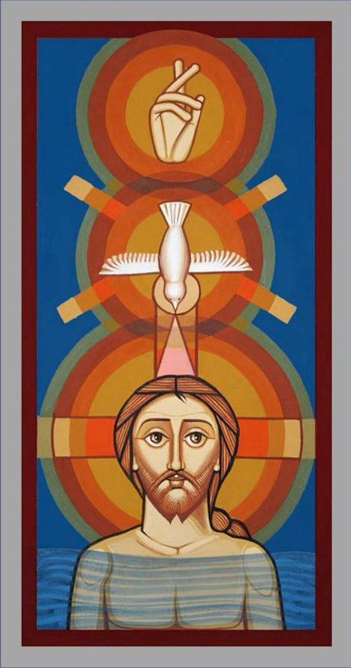
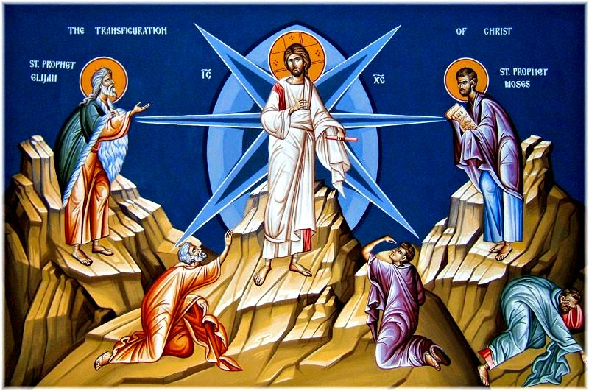
The Father's Declarations
"AND SUDDENLY A VOICE CAME FROM HEAVEN, SAYING, “THIS IS MY BELOVED SON, IN WHOM I AM WELL PLEASED.” MATT 3:17
WHILE HE WAS STILL SPEAKING, BEHOLD, A BRIGHT CLOUD OVERSHADOWED THEM; AND SUDDENLY A VOICE CAME OUT OF THE CLOUD, SAYING, “THIS IS MY BELOVED SON, IN WHOM I AM WELL PLEASED. HEAR HIM! MATT 17:5”
CHRIST'S DIVINITY | APRIL 2022
Notes:
So we looked in scripture at what Christ said about Himself, now lets examine scripture for God said about Christ. And both fatherly declarations are nearly identical; the first he declares at the begin of Christ's mission and the other towards the end.

Slide 6

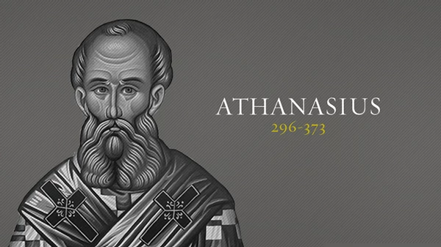
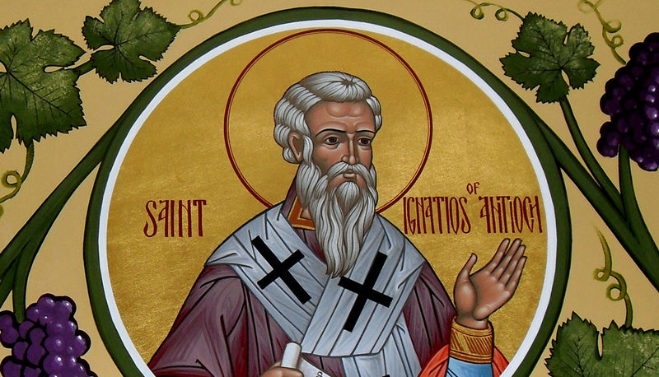
Patristic Teachings
ST. ATHANASIUS,
DE DECRETIS, III
ST-ATHANASIUS,
ON THE INCARNATION
ST-IGNATIUS OF ANTIOCH
“Ignatius, who is also called Theophorus, to the Church which is at Ephesus, in Asia, deservedly most happy, being blessed in the greatness and fullness of God the Father, and predestinated before the ages of time, that it should be always for an enduring and unchangeable glory, being united and elected through the true passion by the will of the Father, and Jesus Christ, our God: Abundant happiness through Jesus Christ, and His undefiled grace.” [The Epistle of Ignatius to the Ephesians]
"The Word (Logos)was made flesh in order to offer up this body for all, and that we partaking of His Spirit, might be deified , a gift which we could not otherwise have gained than by His clothing Himself in our created body" ~
"The Son of God became man, that man might become God."
Notes:
Who is the guy in the middle? The Coptic church maintains that Athanasius was the main author of the Nicene Creed, and has therefore given him the title of Defender of the Faith. He wrote several books where he defends the nicene definition of our faith including this statement:
He makes a very similar statement in one of most important books ever written about theology called On
One of the earliest Church Fathers, St Ignatius of Antioch, served as a bishop in the first century. St Ignatius wrote many letters or epistles of which we still have access to today. In his writings, he often refers to the Lord Jesus Christ as God. For example in his letter to the Ephesians, he starts off by saying:
“Ignatius, who is also called Theophorus, to the Church which is at Ephesus, in Asia, deservedly most happy, being blessed in the greatness and fullness of God the Father, and predestinated before the ages of time, that it should be always for an enduring and unchangeable glory, being united and elected through the true passion by the will of the Father, and Jesus Christ, our God: Abundant happiness through Jesus Christ, and His undefiled grace.” [The Epistle of Ignatius to the Ephesians]
In his letters, Ignatius speaks to a number of issues that have been disputed among Christians for centuries. Regarding the identity of Jesus Christ, he could not be more forthright in asserting His divinity. In the course of his letters he explicitly calls Jesus “God” and uses the word theos. There is no ques­tion of his meaning; he does not call Jesus God in a loose or merely honorific sense. Ignatius affirms that Christ is the invisible, Time­less (achronos) one, by nature incapable of suffering, who becomes both visible and vulnerable to suffering through his human birth. Two hundred years before the Council of Nicaea, Ignatius teaches that Christ is eternal, above time and all creation, God in the full sense of the term

Slide 7
CREED
GREGORIAN LITURGY
We believe in one Lord Jesus Christ, the Only-Begotten Son of God, begotten of the Father before all ages; Light of Light, true God of true God, begotten not created, of one essence with the Father, by whom all things were made;
"You, the Infinite, being God, did not consider equality with God a thing to be grasped, but emptied Yourself and took the form of a servant, and blessed my nature in Yourself, and fulfilled Your Law on my behalf.”
The Liturgy
PROTHESIS PRAYER
O Master, Lord Jesus Christ, the co-eternal Logos of the unblemished Father, who is of one essence with Him and the Holy Spirit - for you are the living bread which came down from heaven and formerly made Yourself a lamb without spot for the life of the world...
AGIOS
Holy God, Holy Mighty, Holy Immortal
Notes:
And of course, we have the liturgy which were written in the early centuries, and handed down by Christ himself at the last supper. Another Early Church Father and considered to be a Theologian, is St Gregory of Nazianzus. The Coptic Orthodox Church will often celebrate the Divine Liturgy by using the Anaphora that he wrote. Listen to the following excerpt that is taken from the Liturgy of St Gregory:
“You, the Infinite, being God, did not consider equality with God a thing to be grasped, but emptied Yourself and took the form of a servant, and blessed my nature in Yourself, and fulfilled Your Law on my behalf.”
Again, boldly proclaims that Jesus, who condescended and became man, was indeed God!
The Prothesis prayer prayed inaudibly by the priest during the offertory in st-basil's liturgy reads:
O Master, Lord Jesus Christ, the co-eternal Logos of the unblemished Father, who is of one essence with Him and the Holy Spirit - for you are the living bread which came down from heaven and formerly made Yourself a lamb without spot for the life of the world - we ask and entreat Your goodness, O Lover of Mankind, show Your face upon this bread, and upon this cup which we have set this Your priestly table.
And of course, we can't forget the creed which we receipt during every liturgy saying "We believe in one Lord Jesus Christ, the Only-Begotten Son of God, begotten of the Father before all ages; Light of Light, true God of true God, begotten not created, of one essence with the Father, by whom all things were made; Who for us men and for our salvation came down from heaven, and was incarnate of the Holy spirit and the Virgin Mary and became Man."

Slide 8
RESURRECTION: FOR THR SON
O Christ our God, the High Priest of the good things to come, King of the ages, the Immortal, the Everlasting, the Logos of the Father who are who granted us this great Mystery which is His holy Body and His precious Blood for the forgiveness of our sins. This is the Body which He took from our Lady, the Lady of us all, Saint Mary, and made one with His divinity.
NATIVITY
ANNUAL: FOR THR SON
O Master, Lord our God, co-creator, the invisible, the infinite, unchangeable, and immeasurable, who has sent His true Light, His only-begotten Son, Jesus Christ the co-eternal Logos. He who is in the Fatherly bosom at all times has come down and dwelt in the undefiled virginal womb.
The Fractions
O You, THE BEING, who were, the Eternal, who exists before all ages, the co-enthroned with the Father, the only One with Him in lordship, the Originator of mercies, who desired by His will to suffer for the sake of the sinners of whom I am chief.
SYRIAN FRACTION
Thus truly the Logos of God suffered in the flesh and was sacrificed and broken on the Cross. His soul parted from His body, while His divinity in no way parted either from His soul or from His body...One is Emmanuel who cannot be divided after the union; there is no division into two natures.
Notes:
And near the end of the liturgy, Abouna prays various different Fractions depending on the season or day. Lets quickly read these.
Nativity:
O Master, Lord our God, co-creator, the invisible, the infinite, unchangeable, and immeasurable, who has sent His true Light, His only-begotten Son, Jesus Christ the co-eternal Logos. He who is in the Fatherly bosom at all times has come down and dwelt in the undefiled virginal womb.
Annual for Son:
O You, THE BEING, who were, the Eternal, who exists before all ages, the co-enthroned with the Father, the only One with Him in lordship, the Originator of mercies, who desired by His will to suffer for the sake of the sinners of whom I am chief.
Resurrection for Son:
O Christ our God, the High Priest of the good things to come, King of the ages, the Immortal, the Everlasting, the Logos of the Father who are who granted us this great Mystery which is His holy Body and His precious Blood for the forgiveness of our sins. This is the Body which He took from our Lady, the Lady of us all, Saint Mary, and made one with His divinity.
Syrian:
Thus truly the Logos of God suffered in the flesh and was sacrificed and broken on the Cross. His soul parted from His body, while His divinity in no way parted either from His soul or from His body...One is Emmanuel who cannot be divided after the union; there is no division into two natures.

Slide 9
Divine Characteristics
OMNIPRESENCE
TIMELESS
CREATOR
LIFE-GIVER
"For where two or three are gathered together in My name, I am there in the midst of them" Matt 18:20
"...and lo, I am with you always, even to the end of the age." Matt 28:20
"Most assuredly I say to you, before Abraham was, I am." Jn 8:58
"And now, O Father, glorify Me together with Yourself, with the glory which I had with You before the world was." Jn 17: 5
"Then God said, “Let Us make man in Our image, according to Our likeness"" Gen 1:26
"All things were made through Him, and without Him nothing was made that was made."
5 loaves & 2 fish
Man born blind
“Father, the hour has come. Glorify Your Son, that Your Son also may glorify You, as You have given Him authority over all flesh, that He should give eternal life to as many as You have given Him. And this is eternal life, that they may know You, the only true God, and Jesus Christ whom You have sent." Jn 17:1-3
CHRIST'S DIVINITY | APRIL 2022
Notes:
Now lets take a look at Christ's godly or divine characteristics in order to further highlight his divinity.
1. Omnipresence: Just as God is present everywhere, so also is Jesus Christ. He reminds of this when He said "when two or three are gathered together in My name, I am there in the midst of them" Matt 28:20
And when He issues His great commission to the disciples saying "Go therefore and make disciples of all the nations, baptizing them in the name of the Father and of the Son and of the Holy Spirit, teaching them to observe all things that I have commanded you; and lo, I am with you always, even to the end of the age.”
2. Timeless
Christ is above time just as God the Father is. He reminds the Jews who considered Abraham as a patriarch saying: "Most assuredly I say to you, before Abraham was, I am."
He also prayed to God the father in Gethsemane: "And now, O Father, glorify Me together with Yourself, with the glory which I had with You before the world was." Jn 17: 5
3. Creator: God created the world by His Son, i.e. His mind. "Then God said, “Let Us make man in Our image, according to Our likeness"" Gen 1:26. And again in the first chapter of his gospel, John states that "All things were made through him, and without Him nothing was made that was made."
When God came to our world in the flesh, He also performed many miracles of creation. He fed 5k people w/ 5 loaves of bread & 2 fish (only miracle mentioned in all 4 gospels). He also created the eyes of the man who was born blind in John 9.
4. Life-giver: In His prayer to the Father on Gethsemane, He also ref. His ability to give life: “Father, the hour has come. Glorify Your Son, that Your Son also may glorify You, as You have given Him authority over all flesh, that He should give eternal life to as many as You have given Him. And this is eternal life, that they may know You, the only true God, and Jesus Christ whom You have sent."

Slide 10
Other Godly Attributes
HEALS THE SICK
AUTHORITY OVER DEMONS
POWER OF NATURE
FORGIVES SIN
Matt 4:20
Mark 3:10
Luke 22:51
John 9:6
Matt 9:2
Mark 2:5
Luke 5:20
Matt 8:16
Luke 7:21
Mark 5:13
Matt 8:26
Mark 6:49
Matt 17:27
Notes:
His divine attributes don't end there. The gospels are filled with exerts that highlight His ability to divinely heal the sick, His authority over demons, His authority over nature which and not to mention
And so we can clearly see, that both the words and the actions of the Lord Jesus Christ, clearly testify to the fact that he is indeed divine – HE is God.
Now while scripture is of great importance in identifying what we believe as Christians, so also we ought to turn to what the Church has been teaching in both oral and written tradition since the birth of the Church in the very first century. And so, lets take a look at what the early Church taught about the divinity of Jesus Christ.

Slide 11
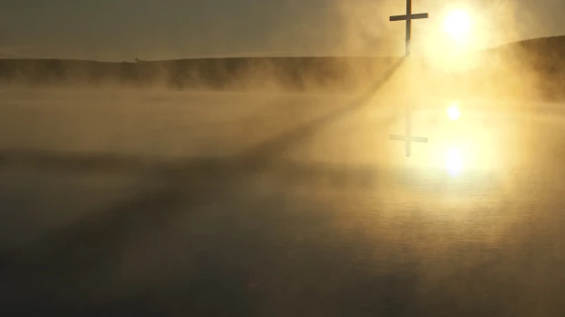
CONCLUSION
“As you therefore have received Christ Jesus the Lord, so walk in Him, rooted and built up in Him and established in the faith, as you have been taught, abounding in it with thanksgiving.
Beware lest anyone cheat you through philosophy and empty deceit, according to the tradition of men, according to the basic principles of the world, and not according to Christ. For in Him dwells all the fullness of the Godhead bodily; and you are complete in Him, who is the head of all principality and power.” (Colossians 2:6-10)
CHRIST'S DIVINITY| APRIL 2022
Notes:
I suppose the earliest and greatest witness of what Christians believed after the life of Christ comes from the great apostle Paul. After his conversion, he preached the gospel to many nations, and I believe that one of the most explicit and clearest statements of the divinity of Christ was spoken by him. Let us read together from Paul’s epistle to the Colossians:
“As you therefore have received Christ Jesus the Lord, so walk in Him, rooted and built up in Him and established in the faith, as you have been taught, abounding in it with thanksgiving.
Beware lest anyone cheat you through philosophy and empty deceit, according to the tradition of men, according to the basic principles of the world, and not according to Christ. For in Him dwells all the fullness of the Godhead bodily; and you are complete in Him, who is the head of all principality and power.” (Colossians 2:6-10)
And there we have it, “In him dwells all the fullness of the Godhead bodily”!
This is the faith of the Christian – that Jesus Christ, the Word is indeed the Son of God incarnate! He proved it through His words, through His actions, and the Church has taught nothing less since beginning her ministry. Jesus Christ is our Lord, our God, and our Savior; To Him be all Glory, Forever and Ever.

