Slide 1

Child development Stages
Traits of Children 3-7 years old
Like to move
Like to play and discover
Some can be stubborn, selfish, jealous, angry or possessive.
Like to copy people
Have big imagination

Slide 2
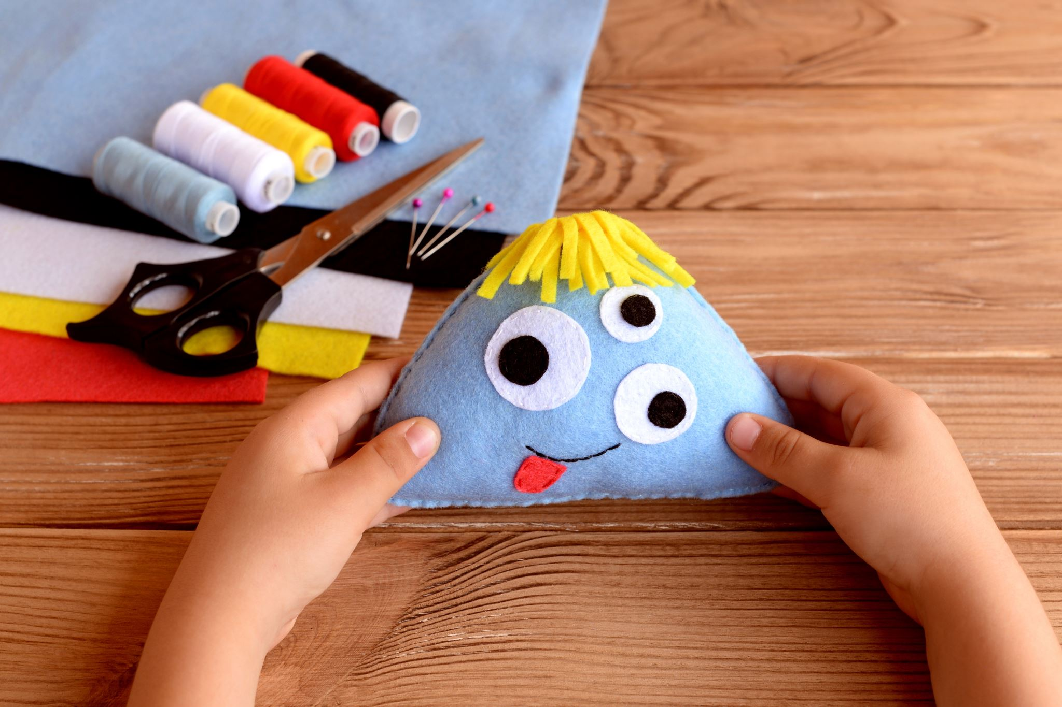
How to Guide them?
Use stories to teach.
Use activities like drawings, crafts, coloring and music.
Use demonstration tools
Help them memorize songs and hymns
Be truthful with them.
Show love, kindness and patience.

Slide 3
Traits of Children 6-8 years old
Acquire new behaviors from the outside world as they start school
Become more realistic
Like to do things with their hands
Prefer to be with kids their own age
Short focus span
Very active

Slide 4
How to Guide them?
Encourage attending church regularly to develop love of God and practice the sacraments.
Train them on good habits like cleanliness, obedience, respect of other people’s property.
Be patient and wise dealing with them
Show love, kindness and patience.

Slide 5
Traits of Children 8-13 years old
Physical, mental and psychosocial development
How to Guide them?
Give them chores and small jobs
Introduce Teamwork activities
Help them memorize hymns, songs and bible verses
Develop habits like prayer, confession, reading the bible and spiritual books
Show them how to serve the poor and orphans
Participate in group activities with a purpose, Christian conventions and clubs
Notice any problems like lying, stealing, swearing and anger.

Slide 6

General Tools to use
Always show love and care.
Be Cheerful.
Hug, greet, gift and praise them.
Do not suppress their feelings and opinions
Promote self-esteem.
Avoid any sort of accusations. It will lead to low self-esteem, lying, anger, resistance and disobedience.
Listen closely to them and give room to explain themselves. This will help you give them advice and offer comfort if needed.

Slide 7

Respect their mentality so they can be creative and innovative.
Lead and direct without cruelty or violence.
Offer emotional gratification without spoiling and dependance.
Do not promise what you cannot deliver and deliver what you promised.
Use incentives for working hard and success.
Focus on positives and not negatives
Offer fun and comfortable atmosphere
This Photo by Unknown Author is licensed under CC BY-SA-NC

Slide 8
Emphasize the importance of physical activities and sports
Promote curiosity
Treat everyone the same
Promote talent development like music, songs, drawings, and writing
Promote respect for elders and peers
Promote respect for the church

Slide 9
The child who acts naughty
Show love and kindness
Give responsibility in the class
Find suitable activities like acting, talent show, helping in celebrations
Find out the reason for acting like that and try to help

Slide 10

Introverted Child
Encourage to participate in group activities
Promote self-confidence by assigning shores
Encourage the other children to include them in their activities
Show love, acceptance and appreciation

Slide 11
The Child who worries too much
Tell stories about courage, faith and life of saints
Promote responsibility and self-esteem by participating in different activities
Focus on the loving God

Slide 12
Hyper-active child
Give in class responsibilities
Offer encouragement, praise and rewards for good behavior
Be a good role model
Redirect their energy towards sports, activities and chores.
Explain the good behavior that is expected of them
Promote self-control

Slide 13
The Child who lies
Reasons might be:
Copying others
Defending themselves
Exaggeration
Imagination
For Revenge
Sickness
What to do
Explain the wrongness of lying and use verses from the bible
Be a good role model

Slide 14
Encourage telling the truth
Encourage them to apologize for lying
Do not force them to confess and embarrass themselves
Commit to the truthfulness you ask of them
Discuss moral issues
Avoid repeated and harsh punishment
Use reasonable consequences for the lying
Find the reason and try to help

Slide 15
The Child who steals
Reasons might be:
Do not understand it is wrong
Do not understand ownership of things
To show off or impress their friends
Seek attention
Bad influence from relatives or friends
Think it is cool
Poor and needs things or wants to be like others
Anger or depression

Slide 16
What to do
Promote respect for private property
Promote honesty through games or activities
Keep temptations away
Ask them to return or compensate the aggravated
Encourage them to apologize
Explain the serious consequences
Always show love, control your temper and be calm.
Good supervision to avoid it happening again
Find the reason and try to help

Slide 17
References
https://Coptic-treasures.com

