Slide 1
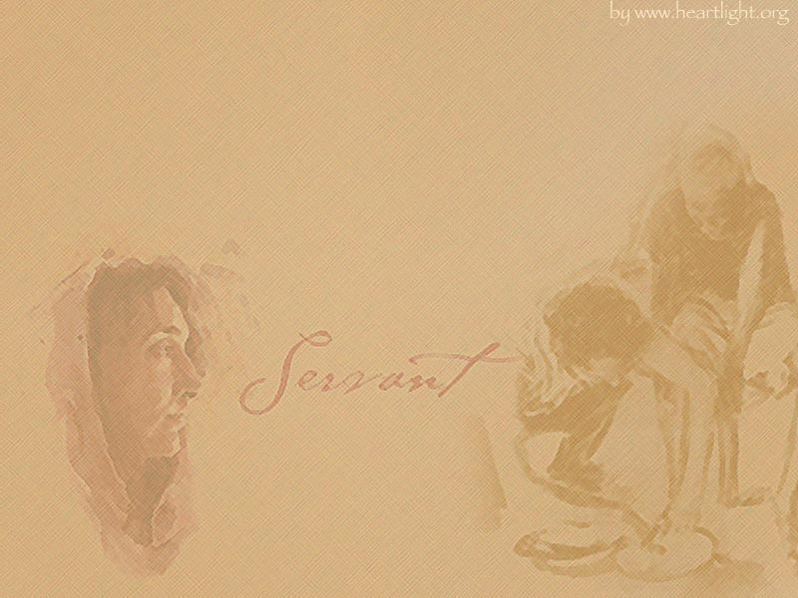
Pre-Servants Module 1:
Service 101
“ For we are god’s fellow workers!”
1 Cor 3:9
Notes:
Last week you had an introduction to service.
This week we will cover 3 important characteristics of service. But in order to get the full benefit and true meaning of these characteristics and in tern service in general, we need to change our perspectives a little bit.
We live in a self-centered society where everything revolves around me (my schedule, my plans, my goals, my needs, my wants).
When looking at and learning about service (and really our spiritual lives as whole), we need to eliminate the self-centered perspective and make everything Christ-centered.

Slide 2
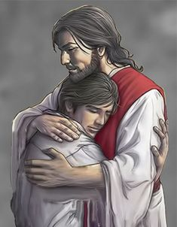
Love of God
“Teacher, which is the great commandment in the law?” Jesus said to him, “‘You shall love the Lord your God with all your heart, with all your soul, and with all your mind.’ This is the first and great commandment. And the second is like it: ‘You shall love your neighbor as yourself.’ On these two commandments hang all the Law and the Prophets.” Matt 22: 36-40
Notes:
Lets start by reading a short passage from the Gospel of Matthew:
But when the Pharisees heard that He had silenced the Sadducees, they gathered together. Then one of them, a lawyer, asked Him a question, testing Him, and saying, “Teacher, which is the great commandment in the law?” Jesus said to him, “‘You shall love the Lord your God with all your heart, with all your soul, and with all your mind.’ This is the first and great commandment. And the second is like it: ‘You shall love your neighbor as yourself.’ On these two commandments hang all the Law and the Prophets.”
Do you know how many commandments the Pharisees had found prior to testing Christ with this question? 613. So when Christ responds with “Love the Lord your God” and “your neighbor as yourself”, then concludes with the statement that all the other commandments hang from these, it really emphasizes the importance of this characteristic for us as servants.
But how can we accomplish these commandments? The bible again provides the answer in John 15: 10 and says “ If you keep My commandments, you will abide in My love, just as I have kept My Father’s commandments and abide in His love.” One cannot love God and disobey His commandments. To love God is to obey Him.
The second commandment must be understood as written; It is often misinterpreted, “You shall love your neighbor as you love yourself,” which destroys the force of the statement. How much we love ourselves is not the standard by which Christ is calling us to love others. Rather, we are called to love our neighbor as being of the same nature as we ourselves are, as being created in God's image and likeness just as we are. So just as we are heirs to His Kingdome and are loved unconditionally, this is how we are expected to love others since they too are sons and daughters of the Most High.
“He who does not love does not know God, for God is love.” 1 Jn 4:8
A servant is a person who knows God, whose heart is full of His love, and who has tasted how good life with Him is so he goes telling others about God. His words enter the hearts of those who hear him if his life corresponds with what he says.
But to do that, he has to be at a higher spiritual level than those whom he is serving. He has to be pure in his thoughts, his behavior and his life in general. Through his life, he shows to those whom he serves, the true way of life.
The bible is full of stories with references to mountains or hills within them. The Fathers teach us that generally, these references are a symbolism of the person leaving the earthly things for the heavenly things or in other words elevating themselves spiritually. Isaiah the prophet said, “O Zion, You who bring good tidings, Get up into the high mountain; O Jerusalem, You who bring good tidings, Lift up your voice with strength, Lift it up, be not afraid; Say to the cities of Judah, “Behold your God” (Isaiah 40:9). This means that whoever teaches others about the heavenly matters has to leave the earthly levels and has to stand on a high mountain. The servant has to be at a spiritual level higher than those whoever he is serving. It is obvious that the water flows from an upper level to a lower level and not the opposite.
It is not the duty of the servant to teach others the Word of God but to lead them to it. It is not his duty to describe to them the Lord’s way, but to let them walk in His way and to accompany them. It is not enough that he gives an overwhelming speech, but he must help them accept Christ. He must also be an example of virtue. The hand that cleans has to be clean itself to be able to clean, lest it makes other things dirty. Therefore, the prophet says, “Depart! Depart! Go out from there, touch no unclean thing. Go out from the midst of her, be clean, you who bear the vessels of the Lord” (Isaiah 52:11). Who are those who carry the vessels of the Lord except those servants who carry souls to bring them closer to God? The Lord said to Ananias concerning Paul, “He is a chosen vessel of Mine to bear My name before Gentiles, kings, and the children of Israel” (Acts 9:15).

Slide 3
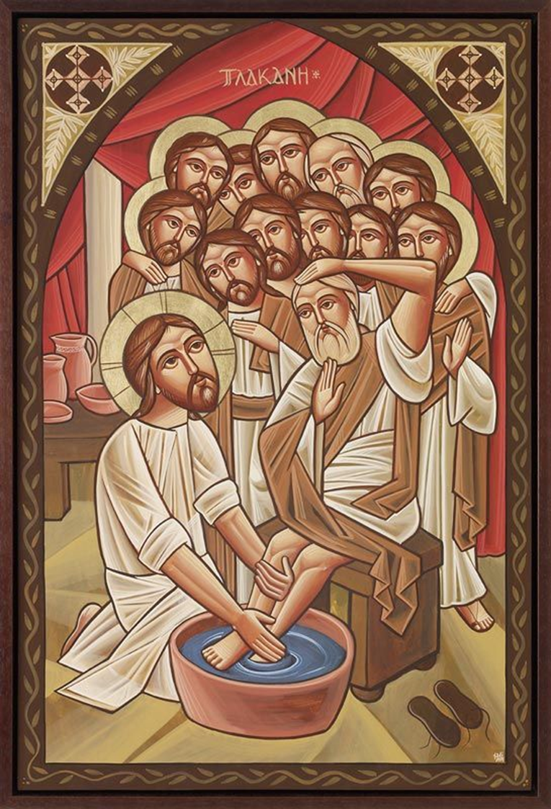
Action vs. Words
“You call Me ‘Teacher’ and ‘Lord’, and you say well, for so I am. If I then, your Lord and Teacher, have washed your feet, you also ought to wash one another’s feet. For I have given you an example, that you should do as I have done to you. Most assuredly, I say to you, a servant is not greater than his master; nor is he who is sent greater than he who sent him. If you know these things, blessed are you if you do them.” Jn 13:13-17
Notes:
Close your eyes and try to picture this:
The disciples enter the upper room, one by one, and take their places around the table. On the wall hangs a towel, and on the floor sit a pitcher and a basin. Any one of the disciples could volunteer for the job, but not one does. After a few moments Jesus stands and removes His outer garment. He wraps a servant’s girdle around His waist, takes up the basin, and kneels before Peter. He unlaces a sandal and gently lifts the foot, places it in the basin, covers it with water, and begins to bathe it. In Jesus’ day the washing of feet was a task reserved not just for servants but for the lowest of servants.
In this case the One with the towel and basin is the King of the universe. Hands that shaped the stars now wash away filth. And the One before whom all nations will one day kneel now kneels before His disciples. Hours before His own death, Jesus’ concern is singular. He wants His disciples to know how much He loves them. We want to define what it means to be a servant and He leaves them with the perfect example to follow:
“You call Me ‘Teacher’ and ‘Lord’, and you say well, for so I am. If I then, your Lord and Teacher, have washed your feet, you also ought to wash one another’s feet. For I have given you an example, that you should do as I have done to you. Most assuredly, I say to you, a servant is not greater than his master; nor is he who is sent greater than he who sent him. If you know these things, blessed are you if you do them.” Jn 13:13-17

Slide 4
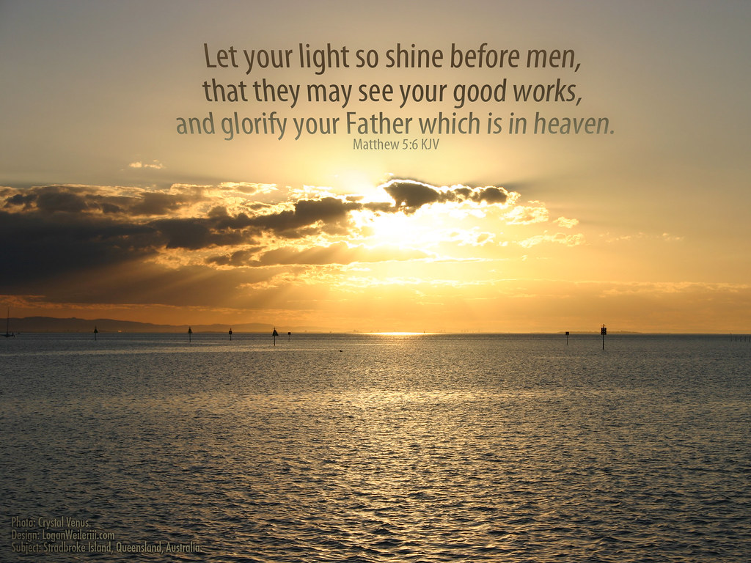
Action vs. Words
Role Model in EVERYTHING
Actions have greatest impact
“Thus faith in itself, if it does not have works, is dead!” (James 2:17)
Notes:
As servants, we are called to be role models in everything that we do; and yes that includes things that are seen and unseen. Romans 2 reminds us that “…you are a guide for the blind, a light for those who are in the dark, an instructor of the foolish, a teacher of little children…”
A fundamental aspect of a role model is serving by action and not just by words. And that’s because actions have a much great and longer lasting impact on our human psyche. So before we can start preaching or lecturing, we need to ensure that our actions are representative of a servant and his/her service.
Our key verse for this characteristic is: “Let your light so shine before men, that they may see your good works and glorify your Father in heaven.” Matt 5:16
Also, in the Epistle of St. James we read “Thus also faith in itself, if it does not have works, is dead.” (James 2:17).
I mentioned being a role model in everything we do, both seen and unseen; why is that important?
St. Paul emphasizes this in his writings to the Corinthians: “We give no offense in anything, that our ministry may not be blamed. But in all things we commend ourselves as ministers of God: in much patience, in tribulations, in needs, in distresses, in stripes, in imprisonments, in tumults, in labors, in sleeplessness, in fastings; by purity, by knowledge, by longsuffering, by kindness, by the Holy Spirit, by sincere love, by the word of truth, by the power of God, by the armor of righteousness on the right hand and on the left” (2 Corinthians 6:3-7). He wrote to his disciple Timothy saying, “Take heed to yourself and to the doctrine. Continue in them, for in doing this you will save both yourself and those who hear you” (1 Timothy 4:16). Notice how St. Paul is correlating the life of Timothy to his service among the people. Mere words emerging from an unrighteous soul cannot change the lives of those served and reach the depths of their souls.
Start by changing 1-2 things
Ex: eliminate swearing
Ex: help w/ church related activities
Result:
Living/experiencing these services will allow you to speak/preach of it later
People will notice your actions first and will be more receptive of your words later
But never forget, we aren’t meant to a role model in order to selfishly shout, “Look at me!” We do so so that our “light so shine before men, that they may see your good works and glorify your Father in heaven.”

Slide 5
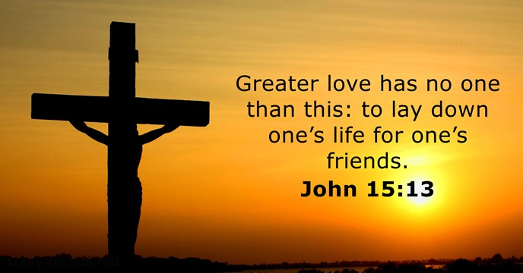
Self-Denial & Sacrifice
“Now they do it to obtain a perishable crown, but we for an imperishable crown. Therefore I run thus: not with uncertainty. Thus I fight: not as one who beats the air. But I discipline my body and bring it into subjection, lest, when I have preached to others, I myself should become disqualified.” 1 Cor 9:24-27
Notes:
Again, Christ provides the ultimate example when it comes to sacrifice and self-denial when
“Greater love has no one than this, than to lay down one’s life for his friends.” Jn 15:!3
Sacrifice for others as Christ sacrificed for you/us:
Ex: When a new pope is enthroned, two interesting things that happen before he enters the church for the first time
The church doors are locked; the keeper or the steward of the church gives him the keys to the church to open, symbolizing the hand-over of the responsibility of serving and shepherding the flock to the new pope
Next they begin singing O-Monogenise which is a hymn we sing on Good Friday at the 6th Hour which is the hour of His crucifixion. The hymns reminds us of the sacrifice that Christ made for us which also symbolizes the sacrifice that the Pope will need to make on behalf of the flock he’s been chosen to shepherd. The hymns ends with the words:
Holy God, who being God, for our sake, became man without change.
Holy Mighty, who by weakness showed forth what is greater than power.
Holy Immortal, who was crucified for our sake, and endured death in His flesh, the Eternal and Immortal.
We won’t sing this hymn for you guys when you graduate from this program, but similarly to the Pope who is entrusted to Sheppard the entire flock, you too might be entrusted to help shepherd one person or maybe even an entire class. And that will require self-denial and sacrifice. You will be asked to put the service and those being served ahead of yourself. And at times that will be difficult to do, but in those moments is when you need to remember this picture and the sacrifice that was made for you.
And rest assured that it is in those moments or partially because of those moments that we hope to hear “‘Well done, good and faithful servant; you were faithful over a few things, I will make you ruler over many things. Enter into the joy of your lord.’ Matt 25:21
Examples of sacrifice:
Put your service above your comfort
Serve instead of sleeping or hanging out with friends
Make peace with others even when you don’t think you are at fault
Serve when your body is at its prime not when its tired
Serve with a smile even though you may not be feeling it
Serve willingly even before being asked
Start by serving in areas of interest but progress into other areas of need as well

Slide 6

Notes:
Let me leave you with the rest of the verse we previously mentioned:
“You are the light of the world. A city that is set on a hill cannot be hidden. Nor do they light a lamp and put it under a basket. Instead they put it on , but on a lampstand, and it gives light to all who are in the house. Matt 5:14-15
And Glory be to God forever Amen.

Slide 7

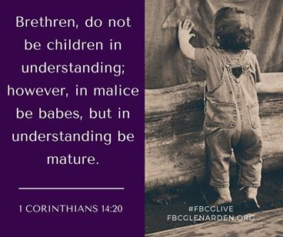
Maturity
  Christ-centered vs. Self-centered
  2 Types: Spiritual & Personal/Emotional
Notes:
Today we’ll delve into 3 additional characteristics starting with Maturity.
We live in a self-centered society where everything revolves around me (my schedule, my plans, my goals, my needs, my wants).
When looking at and learning about service (and really our spiritual lives as whole), we need to eliminate the self-centered perspective and make everything Christ-centered.
St-James confirms this and says “For where envy and self-seeking exist, confusion and every evil thing are there.” James 3:16
In the context of service, there are two types of maturity that we need to understand and work towards:
Spiritual maturity
Emotional/Personal maturity
St-Paul provides us with a high-level view of spiritual maturity (or immaturity) in Hebrews 5 saying: “ For though by this time you ought to be teachers, you need someone to teach you again the first principles of the oracles of God; and you have come to need milk and not solid food. For everyone who partakes only of milk is unskilled in the word of righteousness, for he is a babe. But solid food belongs to those who are of full age, that is, those who by reason of use have their senses exercised to discern both good and evil.
But to do that, he has to be at a higher spiritual level than those whom he is serving. He has to be pure in his thoughts, his behavior and his life in general. Through his life, he shows to those whom he serves, the true way of life.
The bible is full of stories with references to mountains or hills where the individual is either directed by God to climb or does so out of their willingness to serve others and in turn grow their spiritual maturity. The Fathers teach us that generally, these references are a symbolism of the person leaving the earthly things for the heavenly things or in other words elevating themselves spiritually. EX. Moses. God required him to climb mount Sinai in order to receive the commandments and then deliver God’s message to the people of Israel. “And the Lord called Moses to the top of the mountain, and Moses went up.” Gen 19:20
Other examples:
Isaiah the prophet said, “O Zion, You who bring good tidings, Get up into the high mountain; O Jerusalem, You who bring good tidings, Lift up your voice with strength, Lift it up, be not afraid; Say to the cities of Judah, “Behold your God” (Isaiah 40:9). This means that whoever teaches others about the heavenly matters has to leave the earthly levels and has to stand on a high mountain. The servant has to be at a spiritual level higher than those whoever he is serving. It is obvious that the water flows from an upper level to a lower level and not the opposite.
What about personal or emotional maturity?
Take a few minutes to write down a few examples in your handout.
Balanced in thought and action
Should not panic or lose control with anyone
Must have good self-control
Exercise authority with love as opposed to power
The book of James is very short (only 5 chapters) but its really focused on maturity. I recommend you read it this week. You’ll notice it highlights a lot of the examples you’ve mentioned here tonight.

Slide 8
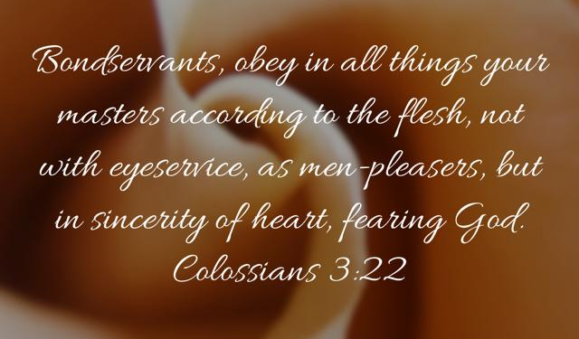
Sincerity
There is no place for superficiality in service
Superficiality is a disease which leads to spiritual stagnation & decline
“Now therefore, fear the Lord, serve Him in sincerity and in truth … Serve the Lord! Josh 24:14
Notes:
There is no place for superficiality in service. It’s a dangerous disease which leads to spiritual stagnation and decline! Which is the complete opposite of the spiritual maturity we spoke about in the previous slide.
When Christ began His mission and started selecting the disciples that were to follow Him, He made sure to highlight the importance of sincerity and delving deep.
Open your bible to Luke 5: 4-11
When He had stopped speaking, He said to Simon, “Launch out into the deep and let down your nets for a catch.” ⁵ But Simon answered and said to Him, “Master, we have toiled all night and caught nothing; nevertheless at Your word I will let down the net.” ⁶ And when they had done this, they caught a great number of fish, and their net was breaking. ⁷ So they signaled to their partners in the other boat to come and help them. And they came and filled both the boats, so that they began to sink. ⁸ When Simon Peter saw it, he fell down at Jesus’ knees, saying, “Depart from me, for I am a sinful man, O Lord!” ⁹ For he and all who were with him were astonished at the catch of fish which they had taken; ¹⁰ and so also were James and John, the sons of Zebedee, who were partners with Simon. And Jesus said to Simon, “Do not be afraid. From now on you will catch men.” ¹¹ So when they had brought their boats to land, they forsook all and followed Him.
St-Paul also makes a bold request saying: “For our boasting is this: the testimony of our conscience that we conducted ourselves in the world in simplicity and godly sincerity, not with fleshly wisdom but by the grace of God, and more abundantly toward you. 2 Cor 1:12
He goes on to say: For we are not, as so many, peddling the word of God; but as of sincerity, but as from God, we speak in the sight of God in Christ. 2 Cor 8:8
“Bondservants, obey in all things your masters according to the flesh, not with eyeservice, as men-pleasers, but in sincerity of heart, fearing God.” Col 3:22
“Now therefore, fear the Lord, serve Him in sincerity and in truth … Serve the Lord! Josh 24:14

Slide 9
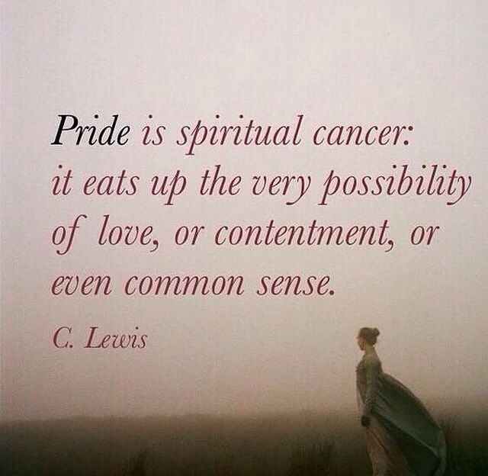
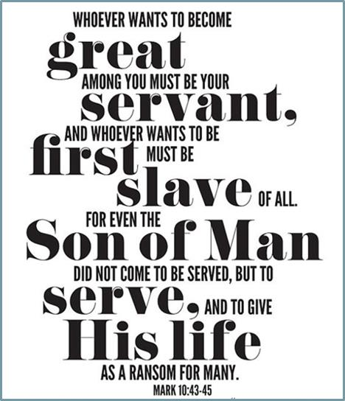
Humility
Humility is the foundation of service
Humility facilitates all service
Humility ≠ Pride
Lack of humility (pride) destroys all service and instead serves as a stumbling block to others
Notes:
We left humility as the last characteristic because humility is humble. All jokes aside, humility is not just the foundation of service and through which all service is facilitated, but it can also be categorized as the cornerstone to our spiritual lives. And we can’t talk about humility without referencing it’s antonym which is pride. As we all know, it was pride that brought down Satan who was originally an angel in heaven.
The famous author CS Lewis writes in his epic book Mere Christianity “ Pride is spiritual cancer; it eats up the very possibility of love, or contentment or even common sense.”
He adds, "As long as you are proud you cannot know God. A proud man is always looking down on thing and people: and, of course, as long as you are looking down you cannot see something that is above you.“ CS Lewis
Let’s open Matt 20:20 Then the mother of Zebedee’s sons came to Him with her sons, kneeling down and asking something from Him. And He said to her, “What do you wish?”
She said to Him, “Grant that these two sons of mine may sit, one on Your right hand and the other on the left, in Your kingdom.”
It goes on in verse 24: “And when the ten heard it, they were greatly displeased with the two brothers. But Jesus called them to Himself and said, “You know that the rulers of the Gentiles lord it over them, and those who are great exercise authority over them. Yet it shall not be so among you; but whoever desires to become great among you, let him be your servant. And whoever desires to be first among you, let him be your slave— just as the Son of Man did not come to be served, but to serve, and to give His life a ransom for many.” Matt 20:24-29
“But whoever desires to become great among you shall be your servant, and whoever of you desires to be first shall be slave to all.” (Mark 10:45)

Slide 10
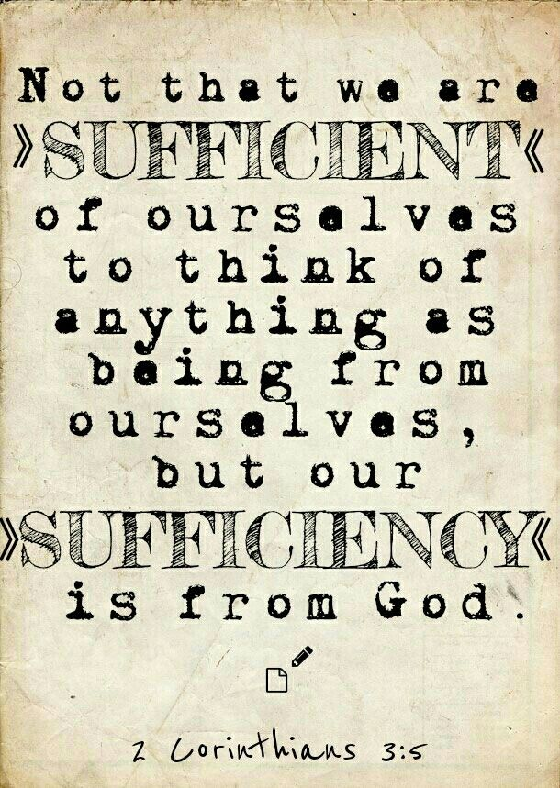
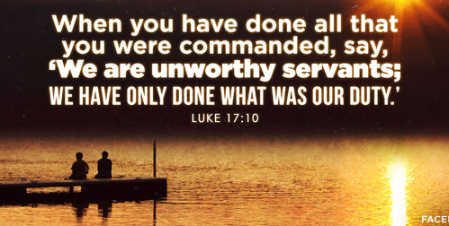
Humility
  Where you came from & where you are going
  We are all sinners:
  Service is not a right, it is a blessing & privilege
  God doesn’t need your service
Notes:
St- Luke reminds us that “We Are Unworthy Servants.” Luke 7:10
Anytime you notice that pride is trickling into your service, remind yourself that:
Where you came from & where you are going. God told Adam after pride got the best of him that “For dust you are, and to dust you shall return.” Gen 3:19
We are all sinners: We aren’t perfect; we won’t become perfect. We aren’t better than those we serve with or those we serve
Service is not a right, it is a blessing and a privilege. No one is qualified, no one is worthy to serve
God doesn’t need your service. He can easily manage His church + children w/o us. Instead we are the ones who are in need or serving in order to gain self-fulfillment, spiritual growth, and obviously to help us achieve the heavenly reward
Lastly remember this verse from 2 Corinthians: “Not that we are sufficient of ourselves to think of anything as being from ourselves, but our sufficiency is from God,” 2 Cor 3:5

Slide 11
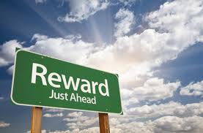

Heavenly Reward
Notes:
I’d like to end with a reminder of the heavenly reward that God is calling us to; lets open our bibles to Matt 25:31-40
“When the Son of Man comes in His glory, and all the holy angels with Him, then He will sit on the throne of His glory. All the nations will be gathered before Him, and He will separate them one from another, as a shepherd divides his sheep from the goats. And He will set the sheep on His right hand, but the goats on the left. Then the King will say to those on His right hand, ‘Come, you blessed of My Father, inherit the kingdom prepared for you from the foundation of the world: for I was hungry and you gave Me food; I was thirsty and you gave Me drink; I was a stranger and you took Me in; I was naked and you clothed Me; I was sick and you visited Me; I was in prison and you came to Me. Then the righteous will answer Him, saying, ‘Lord, when did we see You hungry and feed You, or thirsty and give You drink? When did we see You a stranger and take You in, or naked and clothe You? Or when did we see You sick, or in prison, and come to You?’ And the King will answer and say to them, ‘Assuredly, I say to you, inasmuch as you did it to one of the least of these My brethren, you did it to Me.’ Matt 25:31-40

Slide 12

“If anyone serves Me, him My Father will honor!”
Jn 12:26

