Slide 1
COMPARISON OF THE GOSPELS

Slide 2
HOW MANY? . . . ONLY 4
The Church relates the four Gospels to the four living creatures that Ezekiel saw in his revelation (Ezekiel 1: 1, etc.)
The same may be depicted from the Revelation to Saint John the Divine,
“And in the midst of the throne, and around the throne, were four living creatures full of eyes in front and in back. The first living creature was like a lion, the second living creature like a calf, the third living creature had a face like a man, and the fourth living creature was like a flying eagle.” (Revelation 4: 6-9 and 5: 6. etc.)
These incorporeal (body-less) four living creatures are also symbolic of the four Gospels.

Slide 3
HOW MANY? . . . ONLY 4
WARNING:
Heretics
throughout
history
have
tried to slip into the
Scriptures fake books and gave them a Gospel title in order to deceive and
Î
mislead the believers, the following are examples of such fake gospels:
1. The Gospel according to the Hebrews.
2. The Gospel according to the Twelve.
3. The Gospel according to the Egyptians.
4. The Gospel according to Peter.
5. The Gospel according to Matthias.
6. The Gospel according to Mary.
7. The Gospel according to Zechariahs, father of John the Baptist.
8. The Gospel according to Philip.
9. The Gospel according to James.
10. The Gospel according to Nicodemus.

Slide 4
HOW MANY? . . . ONLY 4
Î
11. The fake Gospel according to Matthew.
12. The Gospel of the birth of the Virgin Mary.
13. The Gospel of the infancy of the Savior.
14. The Gospel of the history of Joseph.
15. The Gospel according to Thomas.
16. The Gospel according to Basil.
17. The Gospel according to Bartholomew.
18. The Gospel according to Judah Iscariot.
19. The Gospel according to Andrew.
20. The Gospel according to James, the son of Zebedee.
21. The eternal Gospel.
22. In the middle ages a fake book appeared with the title, “The Gospel
according to Barnabas”.

Slide 5
Introduction . . .
GOSPEL
•The word "Gospel" is a translation into English of the Greek word "evangelion" which means "good news."
¿ ¿ ¿
SYNOPTIC GOSPELS:
is derived from the Greek words συν (syn = together) and οψις (opsis
= seeing).
indicate that the contents of these three Gospels can be viewed side- by-side, whether in a parallel synopsis, or a synoptic alignment.
¿ ¿ ¿
THE FOURTH GOSPEL:
the Gospel according to St. John is the Gospel of all Gospels, the Holy of Holies of the New Testament, the crown of the gospels and the spirit to the body (St. Clement).

Slide 6
Which of the following is NOT a SYNOPTIC Gospel
A. Matthew
B. Mark
C. Luke
D. John

Slide 7
Quick Facts . . .
AUTHORS
Matthew: Matthew or Levi, one of the Twelve, a Jew who worked as a Roman tax collector.
Mark: John Mark, son of Mary of Jerusalem, in whose house celebrated the Lord's Supper.
Jesus
Luke: Luke, a Greek Physician and companion of St. Paul on his second and third journeys, during his imprisonment and on the trip to Rome.
John: John, one of the original twelve disciples, referred to as "the one Jesus loved”

Slide 8


Slide 9
Quick Facts . . .
STYLE
Matthew: St. Matthew uses "extreme " examples and statements to make his points. He often speaks in striking contrasts. He organizes his material in groups of 3, 5 and 7. Matthew may have been written in Aramaic first, and then translated into Greek.
Mark: St. Mark gives a dramatic account, and nearly all paralleled by the other two Synoptic Gospels but sometimes he notes details (names, place, numbers, colors, thoughts, feelings) often left out of the other Synoptics.
Luke: Luke is warm and devotional, including hymns and prayers. He refers to Jesus' emotions. There is also significant reference to Jesus' ministry to the poor, the lowly and the outcast.
John: John was written in simple Greek, with a somewhat limited vocabulary. It is quite distinct from the others in style being much deeper and spiritual in tone. It emphasizes believing in the Gospel as the way to Eternal life.

Slide 10
Christ instituted the sacrament of Eucharist as this Gospel’s writer’s house.
A. Matthew B. Mark
C. Luke
D. John

Slide 11
This Gospel is warm and devotional. It focuses on Christ’s Ministry to the Outcast.
A. Matthew
B. Mark
C. Luke
D. John

Slide 12
This Gospel is deeper and spiritual. It focuses on Christ’s Divinity.
A. Matthew
B. Mark
C. Luke
D. John

Slide 13
Quick Facts . . .
ARRANGEMENT
Matthew: is structured around Jesus' teaching: organized topically in five collections of discourses. There are Six sections formed, divided by the phrase: "when Jesus had finished saying these things..." (7:28; 11:1; 13:53; 19:1; 26:1)
Mark: moves quickly from action to action. His book is full of events and activity, and any discourse is confined to dialogue. Mark lets Jesus' deeds and words explain themselves.
Luke: follows Mark's basic outline, but adds a significant (more thorough) amount of material. ‘About half of the Gospel is unique to Luke.’ He has the most complete nativity narratives.
John: is full of encounters of Jesus with people. His narrative focuses on Jesus in Jerusalem, and in particular His attendance at the major Jewish feasts. Half of the book is devoted to the last week of Jesus’ life.

Slide 14
Quick Facts . . .
PLACE & DATE
Matthew: Judea – Palestine
Written after Mark (around the same time as Luke)
*First to be written*
Written after Mark (around same time as Matthew)
** Last to be Written **
Mark: Rome Luke: Rome?
John: Ephesus (Asia Minor)
SOURCES
Matthew: Eyewitness accounts
Mark: Primarily Peter, with whom he was associated (1 Peter 5:13); however he started the first Missionary journey with Paul and Barnabas, his uncle; and may
have been the young man who lost his clothes in Mark 14:51.
Luke: Interviews with many eyewitnesses - for example, St. Elizabeth and St. Mary, the Centurion at the cross, etc. St. Luke testifies his Gospel is well researched and verified. (Luke 1:1-4 - **1:2**) – Not a disciple
John: the only eyewitness of the beginnings of Jesus' ministry and the crucifixion of Jesus.

Slide 15
Quick Facts . . .
MAJOR THEME
Matthew: Repentance and obedience to Jesus, the messianic king! Mark: Jesus Christ is the conquering and Servant of God!
Luke: The full and absolute forgiving grace of God revealed in the incarnate Savior.
John: Jesus revealed as the Divine Son of God
¿ ¿ ¿
KEY TERMS
Matthew: "fulfilled", "Kingdom" (50), "Kingdom of Heaven" (30), "King"
Mark: "Immediately", "Gospel", "Faith"
Luke: "Son of Man", "Lost", "Forgive", "Savior", "Salvation"
John: "Eternal life", "Son of God", "I AM" statements, "Believe"

Slide 16
Which Gospel dedicates its entire second half to Passion Week?
A. Matthew
B. Mark
C. Luke
D. John

Slide 17
This Gospel writer was a physician
A. Matthew
B. Mark
C. Luke
D. John

Slide 18
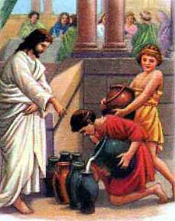
Quick Facts . . .
MIRACLES
Matthew: Two unique (9:27–31, 9:32–33) miracles are found only in Matthew. Mark: Records many miracles showing the supernatural power of the Lord over disease, nature, demons and death.
Luke: Luke records an number of miracles not recorded by the others. John: John records eight miracles, six of which are unique to his Gospel. He states that many things Jesus did were not recorded (21:25).

Slide 19
Quick Facts . . .
WRITTEN FOR
Matthew: Jews (Messiah).
A lot of reference to the Old Testament and fulfilled prophecies
Example Chapter 5:’21,22’ – ’27,28 “You have heard … but I say to you ….”
Mark: Romans (Power).
Written to Roman Christians, in particular new converts.
Hence his emphasis on Jesus as a man of action
St. Mark defines Jewish terms and customs for his readers.
Example Chapter 7:1-4
Luke: Greeks (Philosophy).
To Greek Christians.
He uses classical Greek conventions and style and a rich vocabulary and sometimes substitutes Greek names for Hebrew ones.
John: Whole World (Incarnation).
To all men (the world) lost and needing New Birth and Salvation.
Example: John 3:16

Slide 20
The Four Living Creatures
The Church relates the four Gospels to the four living creatures that Ezekiel saw in his revelation (Ezekiel 1: 1, etc.)
“The likeness of a man… each had the face of a man; each of the four had the face of a lion on the right side, each of the four had the face of an ox on the left side, and each of the four had the face of an eagle.”

Slide 21
St. John in his revelation saw, “Before the throne there was a sea of glass, like crystal. And in the midst of the throne, and around the throne, were four living creatures full of eyes in front and in back. The first living creature was like a lion, the second living creature like a calf, the third living creature had a face like a man, and the fourth living creature was like a flying eagle. The four living creatures, each having six wings, were full of eyes around and within. And they do not rest day or night, saying: ‘Holy, holy, holy, Lord God Almighty, Who was and is and is to come!’” (Rev4:6-8).

Slide 22
The Prophet Ezekiel also saw the same vision (Eze1:4-11), and the Prophet Isaiah saw their glory and talked about their honor (Isa6:1-3).

Slide 23
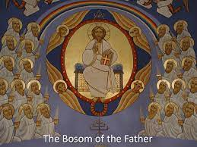
The Four Living Creatures

Slide 24
The one who has a face like a man represents the Gospel of St. Matthew who started his gospel by Christ’s Genealogy. He also wrote more than others about Christ the Son of Man.
o The one who is like a lion represents the Gospel of St. Mark who talks about Christ in His might. He wrote his Gospel to the Romans who believed in might, so he started it talking about a roaring sound in wilderness, and ended it by saying that those who believe in Christ will be able to do things similar to His miracles (Mk16:17). Therefore, not only Christ has mighty power but He also gives it to His followers.
o The one who is like a calf represents the Gospel of St. Luke who started his Gospel by the priesthood of Zachariah, and He talked about Christ the Priest who offered Himself for the salvation of the world by the blood of His sacrifice. The calf was used as a sacrifice for the sins of the priest.
o The one who is like a flying eagle represents the Gospel of St. John who proved that Christ is the Son of God in his Gospel.

Slide 25
This Gospel was written for the Jews (Hint: He was a tax collector)
A. Matthew
B. Mark
C. Luke
D. John

Slide 26
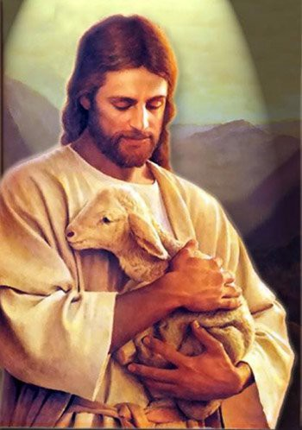
Quick Facts . . .
SYMBOL & JESUS PORTRAYED AS
Matthew (MAN): King
Mark (LION): Strong and Powerful
Luke (OX): Merciful Son of Man, the Sacrifice & the Priest offering the sacrifice.
John (EAGLE): the Incarnated Word.

Slide 27
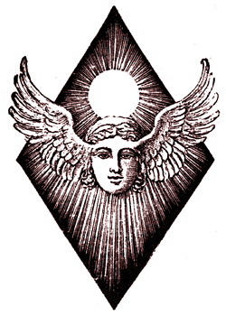
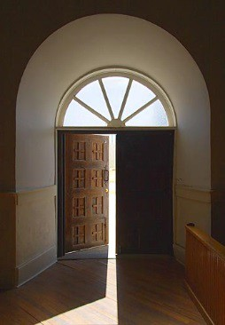
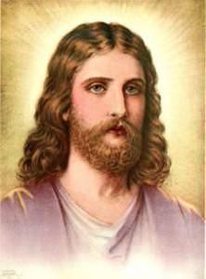
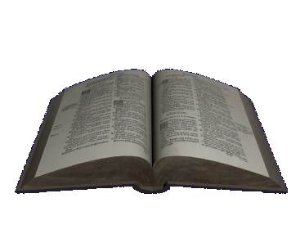
In Summary …
MATTHEW
GENEALOGY OF CHRIST
MAN
KING
VOICE CRYING IN
THE
WILDERNESS
Strong
MARK
LION
LUKE
OX
SACRIFICES
SACRIFICE
JOHN
EAGLE
IN THE BEGINNING
INCARNATED LOGOS

Slide 28
This Gospel’s symbol is an Eagle.
A. Matthew
B. Mark
C. Luke
D. John

Slide 29
This Gospel’s symbol is an ox.
A. Matthew
B. Mark
C. Luke
D. John

Slide 30
COMPARISON OF THE FOUR GOSPELS
Name: ____________
_ __
 | MATTHEW | MARK | LUKE | JOHN
About the Author | One of the Twelve, a Jew, worked as a Roman tax collector. | Son of Mary of Jerusalem, in whose house Jesus celebrated the Lord's Supper. | Luke, a Greek Physician and companion of St. Paul | One of the original twelve disciples, referred to as "the one Jesus loved”
Place | Judea – Palestine | Rome | Rome? | Ephesus (Asia Minor)
Date | Written Second or Third | Written First | Written Second or Third | Last
Style | "extreme" examples and statements | Brief | Warm and Devotional | Spiritual in tone
Symbol | Man | Lion | Ox | Eagle
Source (s) | Eyewitness accounts | Primarily Peter, Might have been the young man at Jesus’ arrest, | Interviews with many eyewitnesses | the only eyewitness to certain events
Key Terms | "fulfilled", "Kingdom" (50), "Kingdom of Heaven" (30), "King" | "Immediately", "Gospel", "Faith" | "Son of Man", "Lost", "Forgive", "Savior", "Salvation" | "Eternal life", "Son of God", "I AM" statements, "Believe"
Written For (Audience) | Jews | Romans | Greeks | Whole World
Opening of the Gospel | Genealogy of Christ | Voice crying in the Wilderness | Sacrifices | In the Beginning
Jesus is Portrayed As … | King | Servant of Mankind | Sacrifice | Incarnated Logos

