Slide 1
The Book of Acts
Acts of The Apostles
Acts of Jesus & the Holy Spirit

Slide 2
Author
Luke
2nd volume of book of Luke
A travelling co-worker with Paul
Well educated
Painter and Physician
Very Detail oriented
Greek

Slide 3
When & Where
Sometime in the early A.D. 60’s
- Before the martyrdom of St.Paul
- Missed lots of events that happened in the late A.D. 60’s and the early A.D. 70’s
Most probably written in Rome
Covers the period of around 32 years , between 33 A.D. and 64 A.D.

Slide 4
Theme
Luke tells the story of the church’s beginning and expansion , covering 32 years or so from Jesus ascension to Paul’s imprisonment

Slide 5
Theme Verse
“But you shall receive power when the Holy Spirit has come upon you; and you shall be witnesses to Me in Jerusalem, and in all Judea and Samaria, and to the end of the earth”
Acts 1:8

Slide 6
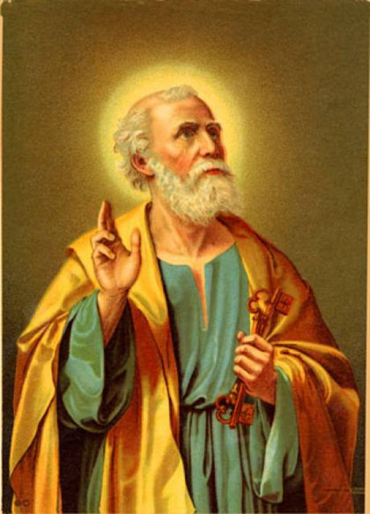
Prominent Figures
Peter :
His Ministries (12 chapters)
has now become a fiery speaker converting 3,000 and fearless in preaching the gospel.
Paul :
His Evangelism (18 Chapters)
Paul’s Journeys

Slide 7
Prominent Figures (cont.)
Stephen :
Among the 7 original deacons
Ordained a deacon to help organize and serve (Acts 6). He was the First martyr
Barnabas :
Brought Paul to the Apostles
James :
Leader of the Jerusalem Council
Silas , Luke , Timothy , Mark :
Traveling companions of Paul

Slide 8
Purpose of the Book
Stress the factuality of the Resurrection of Jesus Christ from the dead.
Intends to tell the story of how the church was assembled and grew as a result of Divine activity.
To show that it is the same God of Israel who forms, guides and empowers the church.

Slide 9
Characteristics of the Book
In the book of Acts, Divine activity is attributed to the Holy Spirit
54 times ”Holy Spirit”
In the book of Acts we see the Will of the Holy Spirit to preach to the gentiles.
We also see the Jewish nation hardened its heart to God.
We also see the first ever Church Council attended to resolve a dispute whether the gentiles had to be circumcised or not.

Slide 10
How does it end?
It doesn’t
Saint Luke, doesn’t end with “Amen” like he does in his Gospel.

Slide 11
Main Sections
Chapter 1 :
Replace Judas & the ELECTION of Matthias
Chapter 2 :
The Holy Spirit & the Tongue of Fire
Peter’s Sermon and the Baptism of the 3000
Chapter 3 & 4 :
The Lame Beggar
1st time Peter & John in Jail

Slide 12
Main Sections (cont.)
Chapter 5 :
Ananias & Sapphira
Chapter 6 & 7 :
The 7 deacons
The Sermon and the Martyrdom of Stephen
Chapter 8 :
Simon & The Sorcerer
Philipp & The Ethiopian eunuch

Slide 13
Main Sections (cont.)
Chapter 9 :
Saul
Chapter 10 & 11 :
Peter and Cornelius
Chapter 12 :
Martyrdom of St.James

Slide 14
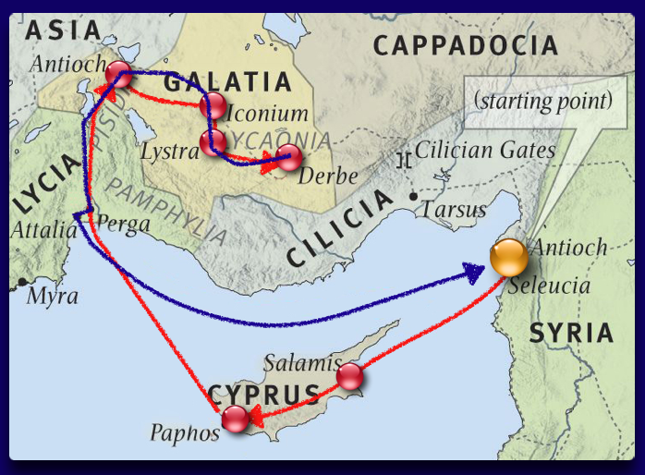
Main Sections (cont.)
Chapter 13 & 14 :
Paul’s First Missionary Journeys
Chapter 15 :
Council of Jerusalem

Slide 15
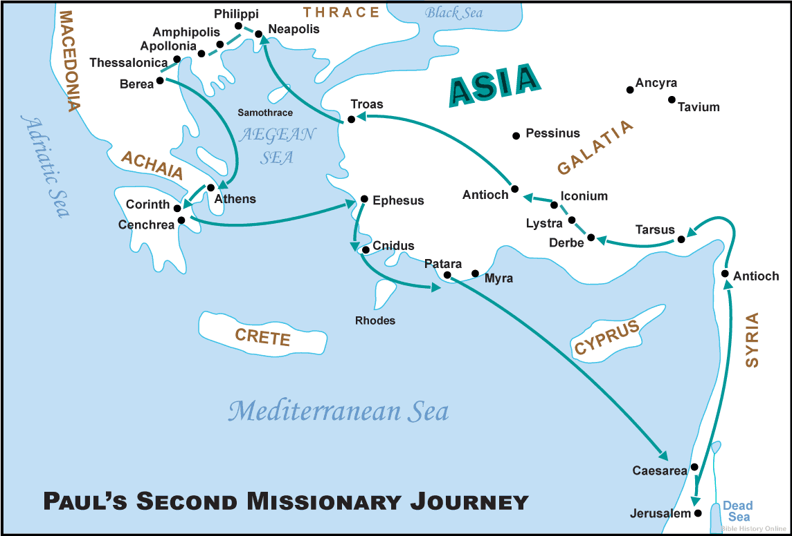
Main Sections (cont.)
Chapter 16 , 17 & 18 :
Paul’s Second Missionary Journeys

Slide 16
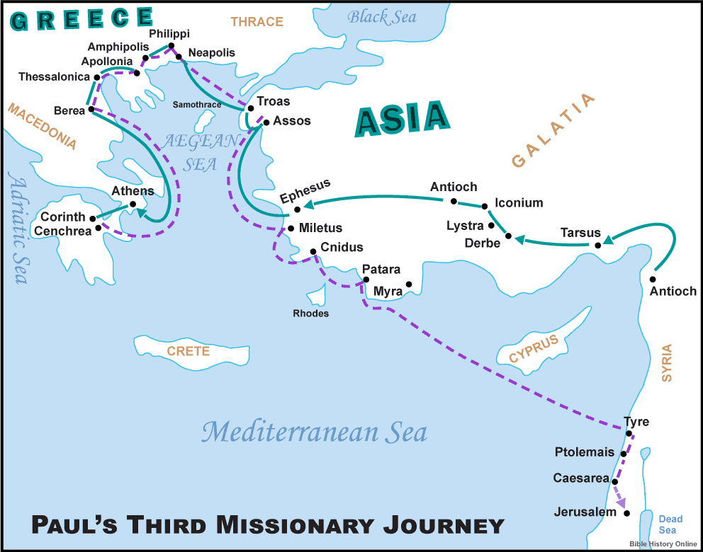
Main Sections (cont.)
Chapter 19 & 20:
Paul’s Third Missionary Journeys

Slide 17
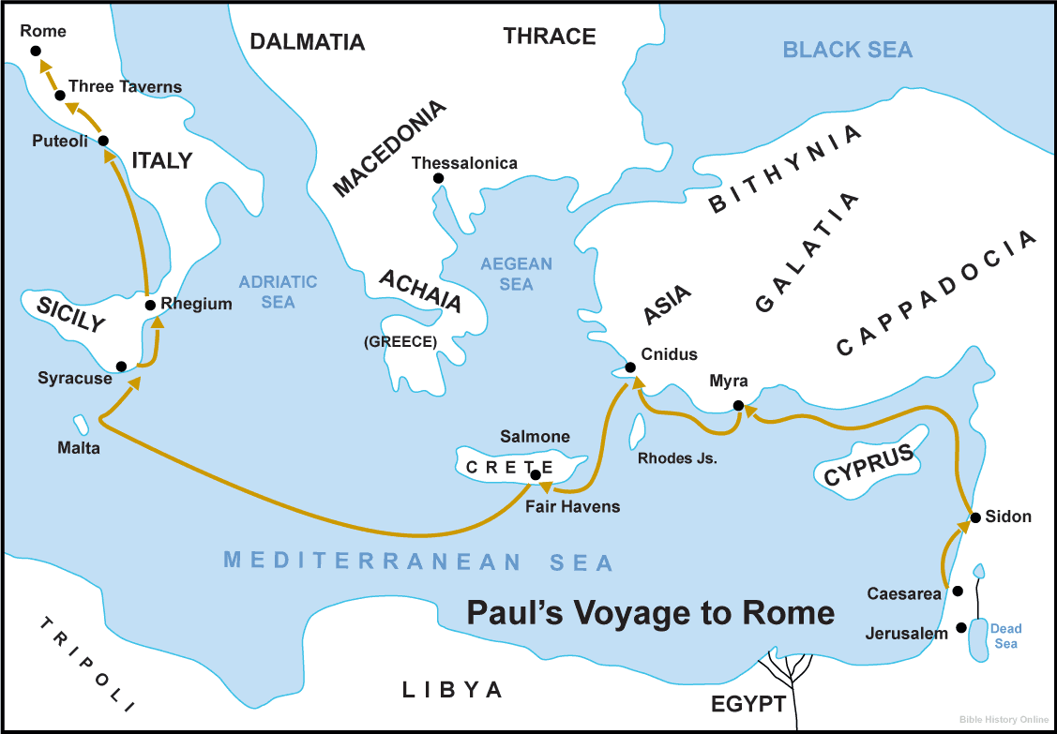
Main Sections (cont.)
Chapter 21 to 28 :
Paul in his way to Rome as a prisoner

Slide 18
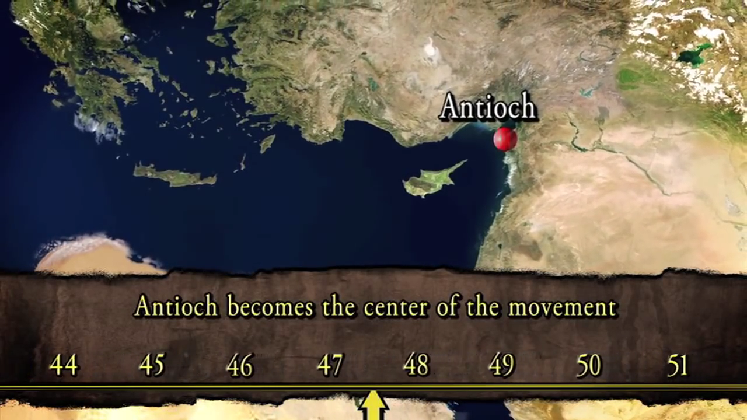
Paul’s Missionary Trips

