Slide 1

Effective Presentation
Module 5 – Week 5

Slide 2
Purpose of Sunday School?
"Him we preach, warning every man and teaching every man in all wisdom, that we may present every man perfect in Christ Jesus" Col 1:28

Slide 3

FACTS- The Obvious
Kids always talk!
Kids are BORED
Kids may not want to be here
Kids have a short attention span

Slide 4

FACTS- The Not so Obvious
You are their first introduction to Christianity
This may be the only time in the week they actually connect to God
As their Sunday school teacher, you may have a huge impact on their spiritual life

Slide 5
The Lesson
The lesson needs to be an:
INTERACTIVE
USEFUL
ORTHODOX
PRACTICAL

Slide 6

INTERACTIVE
Be intentional!
If you do not plan for it, it probably won't happen!
Lesson Metric: How will the kids participate in this lesson?

Slide 7

USEFUL
Kids will be bored if they are not sufficiently challenged
You need to give them new info
Lesson Metric: What did the kids learn today that they didn't know?

Slide 8

ORTHODOX
Our Church is so RICH
IMPORTANT, Present the CHURCH’s opinion, not yours.
Lesson Metric: How different is my lesson from anything else they listen to?

Slide 9

PRACTICAL
There must be an actual TAKEAWAY
Something to DO
Lesson Metric: Is there something I can follow up on?

Slide 10
Outline
Readiness
Appearance and Presence
Audience
Voice and Body Language
Visual Aids
Interaction and Engaging the Class
Answering the Questions
Time Management

Slide 11

Is THIS for you?

Slide 12
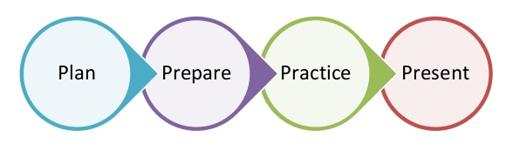
The 4 P’s
Pray /
REFLECT

Slide 13

1. Readiness
Plan ahead...
PRAY
Do your homework!
What are you required to cover?
What was presented before you...what will be presented after?
Resources – ALWAYS fact check
Know the place and time (Don’t be late!!!)
Do you need to bring
a laptop? Cable? Etc.

Slide 14

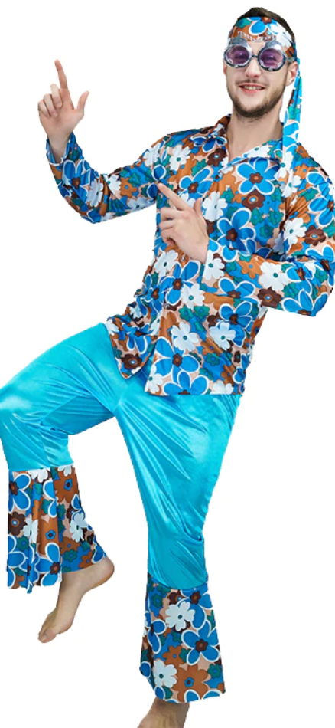
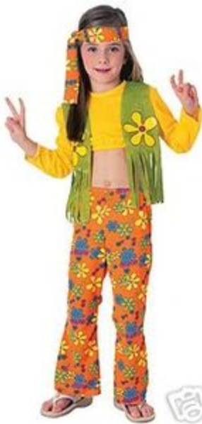
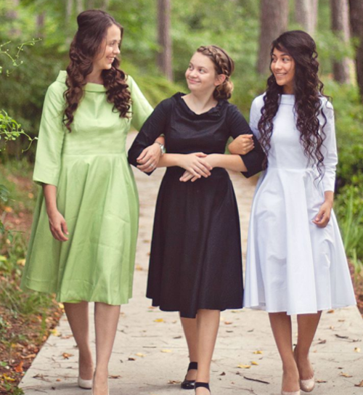


2. Appearance and Presence

Slide 15
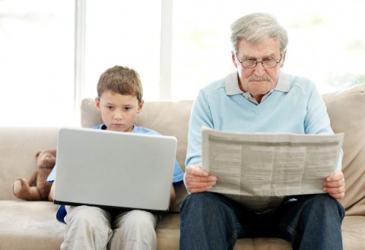
3. Audience
Make sure your lesson is age appropriate
Determines everything in the outline
  Means of presenting
  Tone
  Level of detail

Slide 16
Outline
Readiness
Appearance and Presence
Audience
Voice and Body Language
Visual Aids
Interaction and Engaging the Class
Answering the Questions
Time Management

Slide 17
TARGET
T = Testament (We need to have a Word of God component from the Bible).
A = Audience (We need to have something to share with the Audience; Visual, Audio, Reading, etc. A mix is always good to reach kids with different learning styles).
R = Realistic (We need to share a realistic story that they can relate to like Christ shared parables with people to understand the teachings).
G = Games (We need to have some type of game for the kids to participate in and make the lesson interesting).
E = Effect (God gives the grace for our work to take effect. Remember to "LIVE WHAT YOU PREACH" because kids are very sensitive to this).
T = Transformation (God is the only one able to truly Transform peoples hearts).

Slide 18
4. Voice and Body Language
Voice
Body Language
Clear
Project
Confident
Pace yourself
Tone
Eye contact
Don’t slouch
Some like to walk
Hand gestures
Notes?

Slide 19
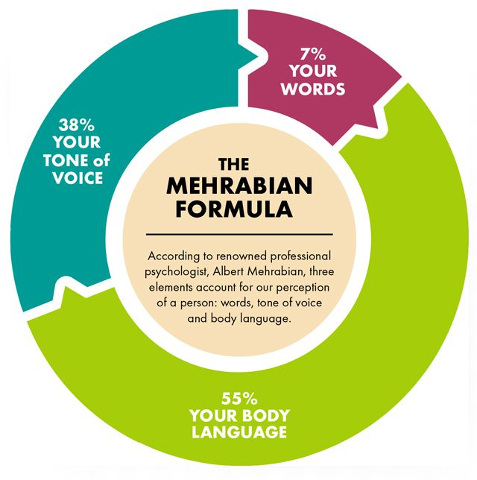

Slide 20
Confidence
Be over-prepared
Know the material you are covering
Rehearse and practice...over and over!
Be positive and optimistic
You can use relaxation techniques
It’s not about you...
  Focus on your goal
  What is your point?

Slide 21
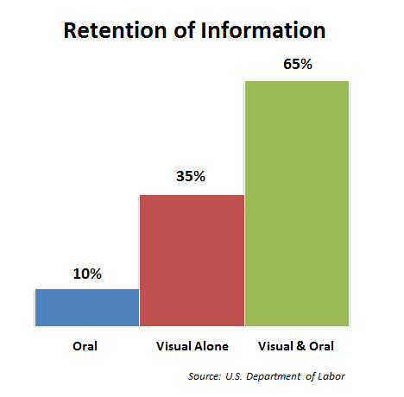
5. Visual Aids / Styles
PowerPoint presentation
Handouts
Board
Play / Costumes
Puppets
Circle / Discussion Style
Song
Game
You!!!

Slide 22

PowerPoint Presentation
1 Slide per Minute
Legible Font / Size
Avoid Distractions

Slide 23
Noah’s Ark
The primary account of Noah in the Bible is in the Book of Genesis.
Noah was the tenth of the Pre-Flood (Antediluvian) Patriarchs. His father was Lamech and his mother is not named in the biblical accounts.^{[3]} When Noah was five hundred years old, he became the father of Shem, Ham and Japheth (Genesis 5:32).
After the flood, Noah offered burnt offerings to God, who said: "I will not again curse the ground any more for man's sake; for the imagination of man's heart is evil from his youth; neither will I again smite any more every thing living, as I have done" (8:20–21).
"And God blessed Noah and his sons, and said unto them, Be fruitful, and multiply, and replenish the earth" (9:1). They were also told that all fowls, land animals, and fishes would be afraid of them. Furthermore, as well as green plants, every moving thing would be their food with the exception that the blood was not to be eaten. Man's life blood would be required from the beasts and from man. "Whoso sheddeth man's blood, by man shall his blood be shed: for in the image of God made he man" (9:6). A rainbow, called "my bow", was given as the sign of a covenant "between me and you and every living creature that [is] with you, for perpetual generations" (9:2–17), called the Noahic covenant or the rainbow covenant.

Slide 24
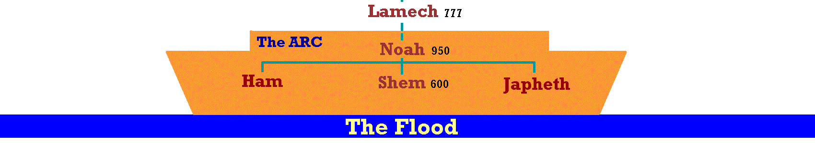
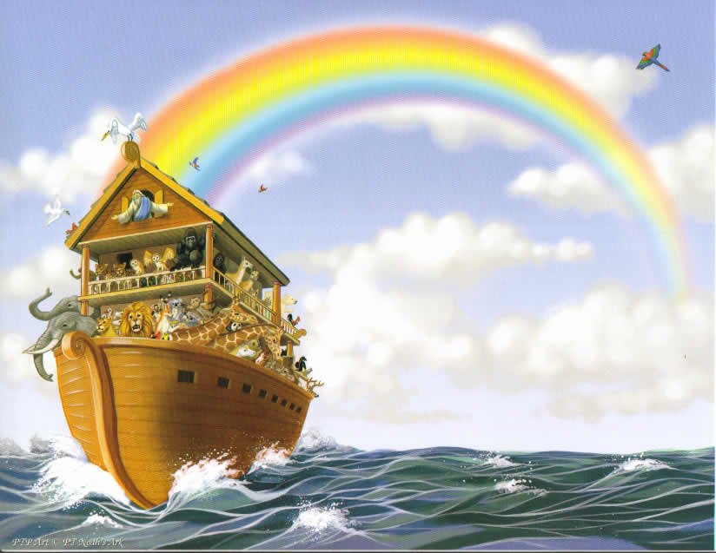
Noah’s Ark (Genesis 9)
God offers ALL living creatures as food to Noah and his family
“I set My rainbow in the cloud, and it shall be for the sign of the covenant between Me and the earth.” Gen 9:13

Slide 25
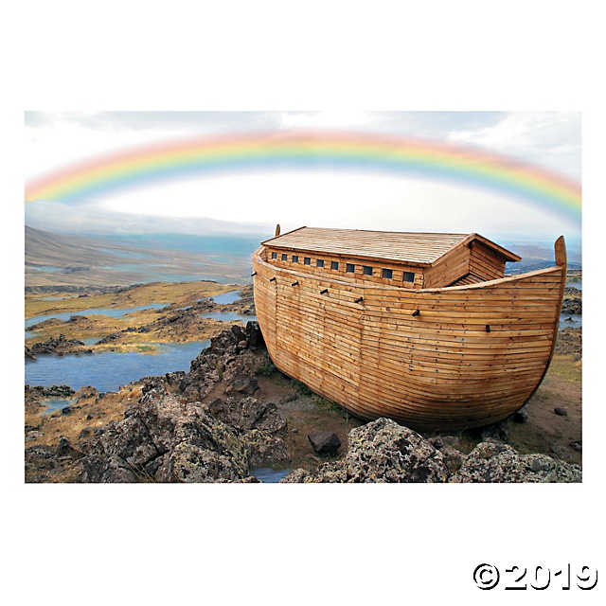

Slide 26

6. Interaction and Engaging the Class
Conversational tone
Class participation
  Ask questions
  Point system / prizes
Circle time
Group discussions / presentations
Activity Sheets

Slide 27
7. Answering the Questions
  Repeat the question
  Answer the question
  Check with the questioner if they are satisfied
  Thank them to encourage participation
What happens if you don’t know the answer???

Slide 28

8. Time Management
Time can STILL be an issue with a well prepared presentation
Keep an eye on the clock as you give your lesson
Running out of time...what to do?
Pace yourself
Always remember to come back to your take home message

Slide 29
Questions?

