Slide 1
Interpretation
Gospel Of Luke
Selvana Soreal

Slide 2
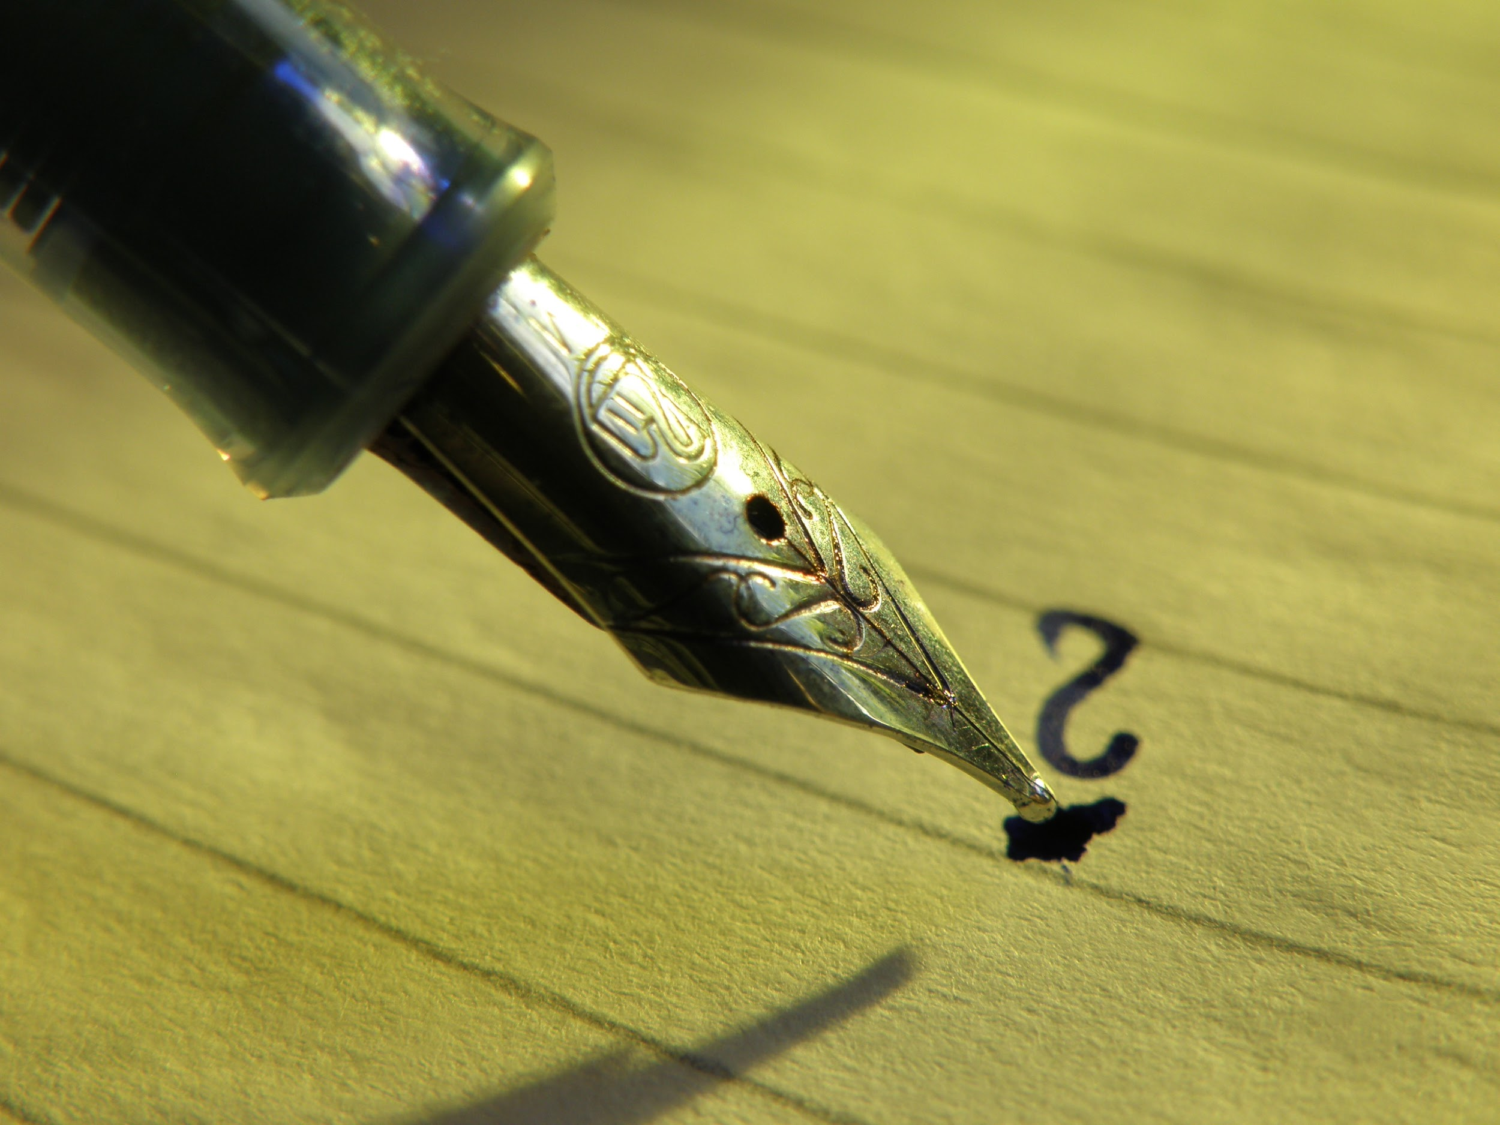
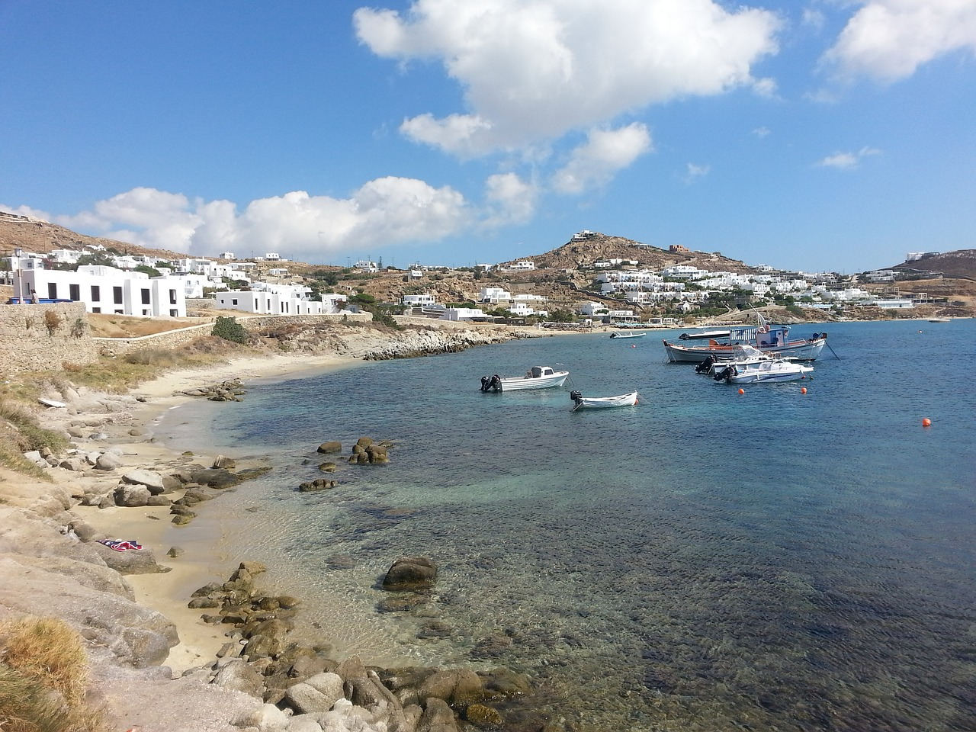
Intended Audience
Luke's Intended audience were christian Greeks. This was shown in his writing style. He used classical greek conventions and a wide vocabulary.

Slide 3
Themes

Slide 4
The forgiveness of God through Jesus Christ!
Key Words: “Salvation”, “Son of man”, “Forgiveness”
Throughout this Gospel God's intentions to save and forgive humanity is highlighted
Ex 1. The birth of christ: this would lead to the sacrifice of god and the forgiveness of our sins.
“ Then an angel said to them ‘don’t be afraid for behold, I bring you good tidings of great joy which will be to all people. For there is born to you today a savior who is christ the lord’.” luke 2:10-11
2. John’s preaching after hearing the word of God
“ prepare the way of way of the lord; make his path straight. Every valley shall be filled, and every mountain and hill brought low. The crooked place shall be made straight and the rough ways smooth. And all flesh shall see the salvation of God” Luke 3:4-6

Slide 5
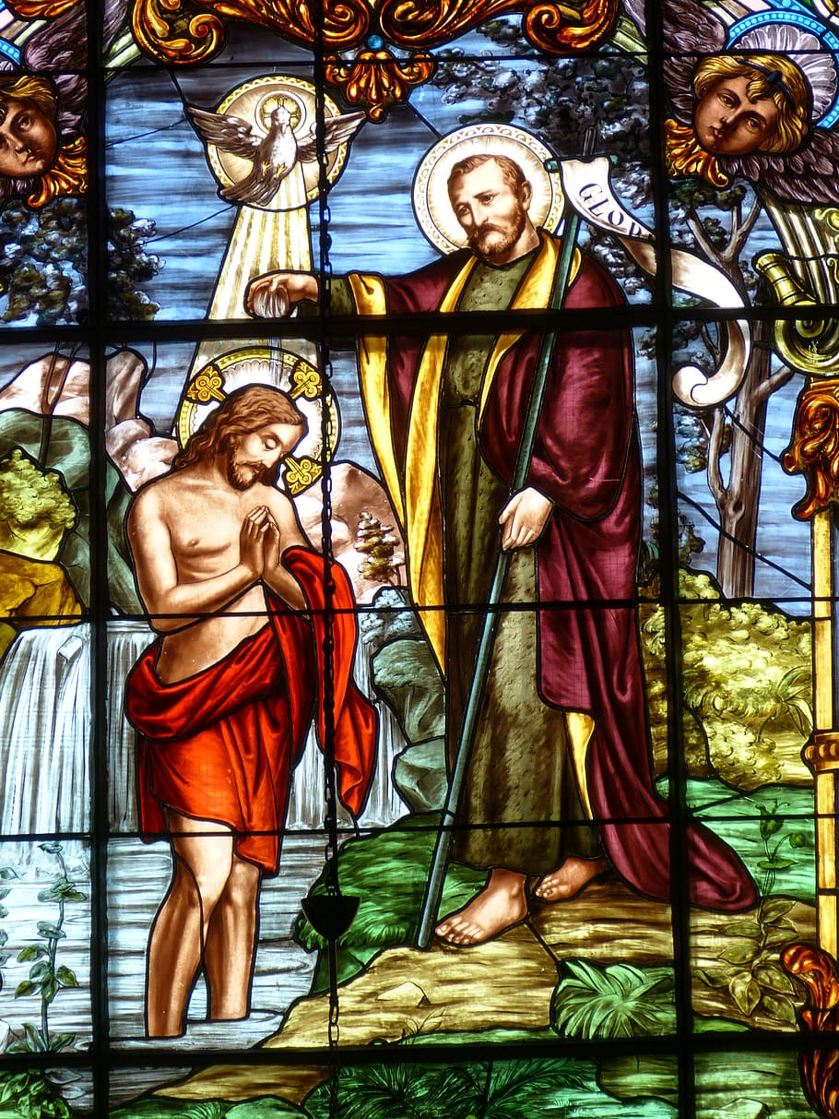
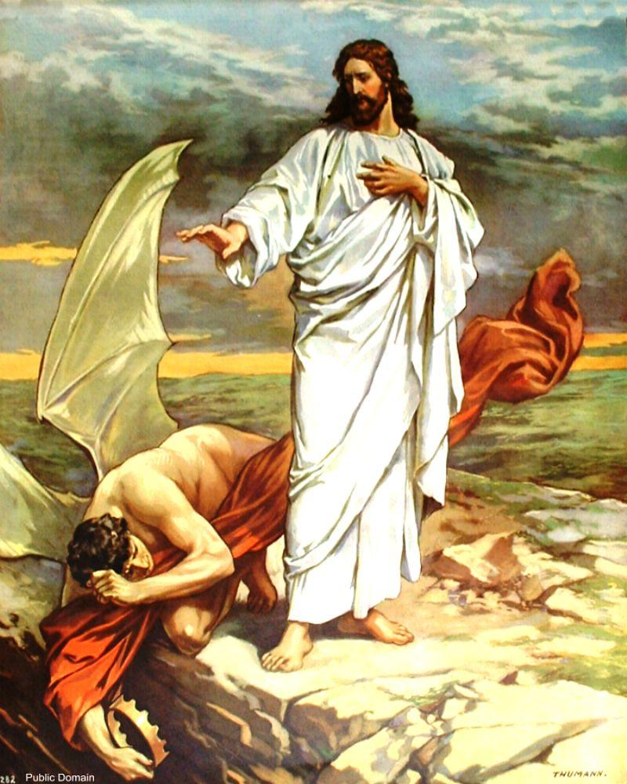
Fighting to Show us The way
Baptism Leading Through example
Tempted for 40 days after baptism
Through the 40 days the lord was tempted by the devil in many of the same ways we get tempted everyday. This was the first thing he did after being baptized.
I view this as God beating the devil in his own home. Getting him out of the way so he can reach his children.
Notes:
“

Slide 6
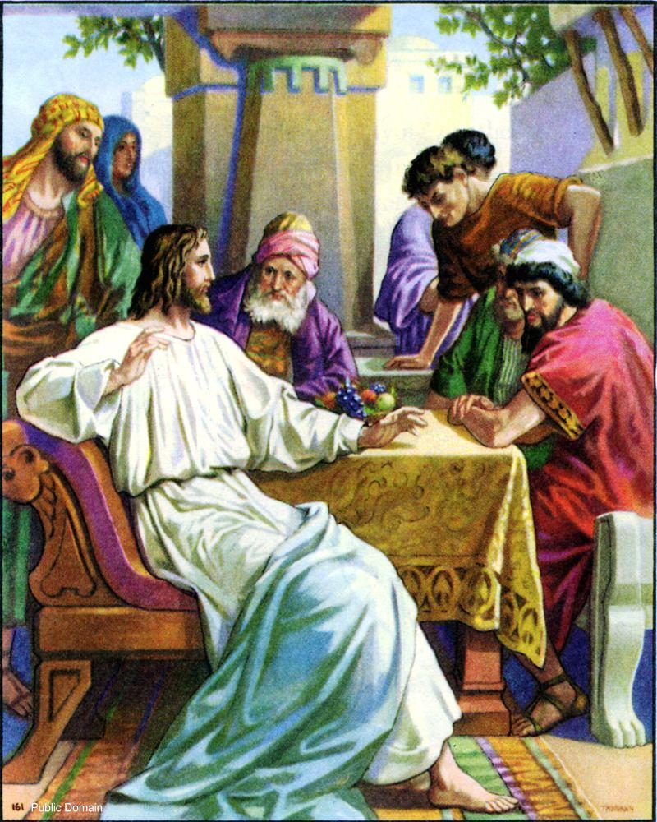
While Jesus choose to have dinner with the tax collector Levi people questioned him; asking why he would choose to sit down with a sinner. Jesus answered “ I have not come to call the righteous, but sinners to repentance” Luke 5:32. This firstly reiterates the intentions behind Jesus coming to the human world. Secondly and importantly, he challenges the belief that people that may sin should be shunned and judged. He demonstrates patience and respect to people who may be sinner.
Who in our day to day lives do we look away from because of their actions? Do we have a right to judge? Do we owe the same compassion to others as God shows us?

Slide 7
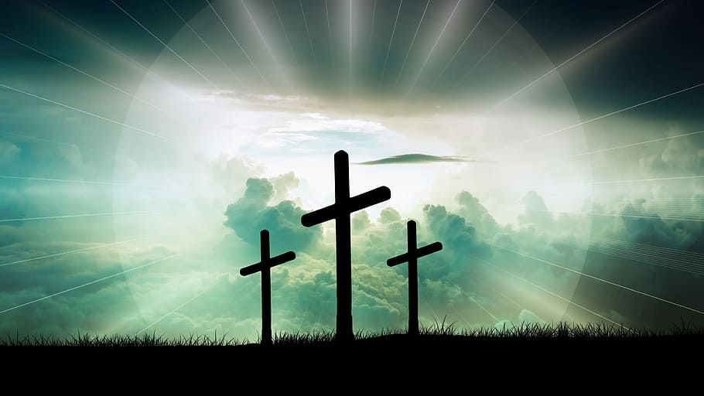
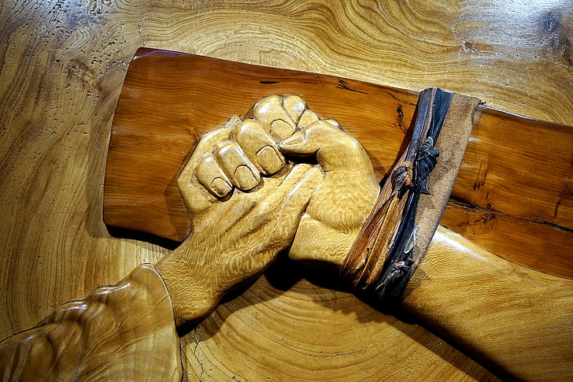
Oh foolish one’s, and slow of heart to believe in all the prophets have spoke! “Ought not the christ suffer these things and to enter into his glory” Luke 24:25-26
“Father forgive them for they do not know what they do” Luke 23:34
“You do not know what manner of spirit you are of. For the son of man did not come to destroy men’s lives but to save them” Luke 9:55-56
“If anyone desires to come after me, let him deny himself take up his cross daily, and follow me” Luke 9:23
“Your faith Has saved you. Go in peace” Luke 7:50

Slide 8
Unique Aspects Of Luke's Gospel

Slide 9
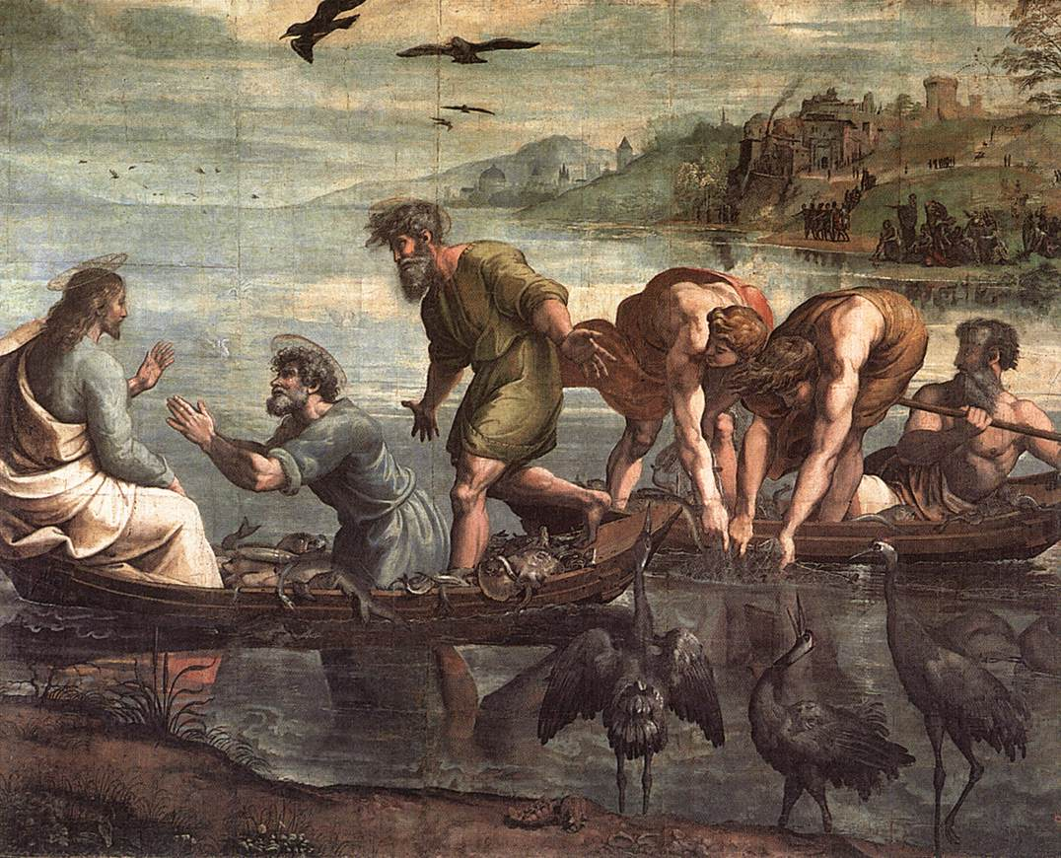
Luke's Gospel Contains Emphasis on Miracles
“Launch out into the deep and let your nets for a catch” Luke 5:4
This was the first of many miracles Mentioned in the gospel of Luke. What I found Interesting about this miracle is that god used it to foreshadow what he would use simon for Jesus said to after simon trusted god; god said “ Do not be afraid. From now on you will catch men” Luke 5:10. I believe this was a reference to once again the theme of this gospel which is of salvation, gods plan to save us .

Slide 10


Even More Miracles!!!!
Surrounding the mercy of the God

Slide 11
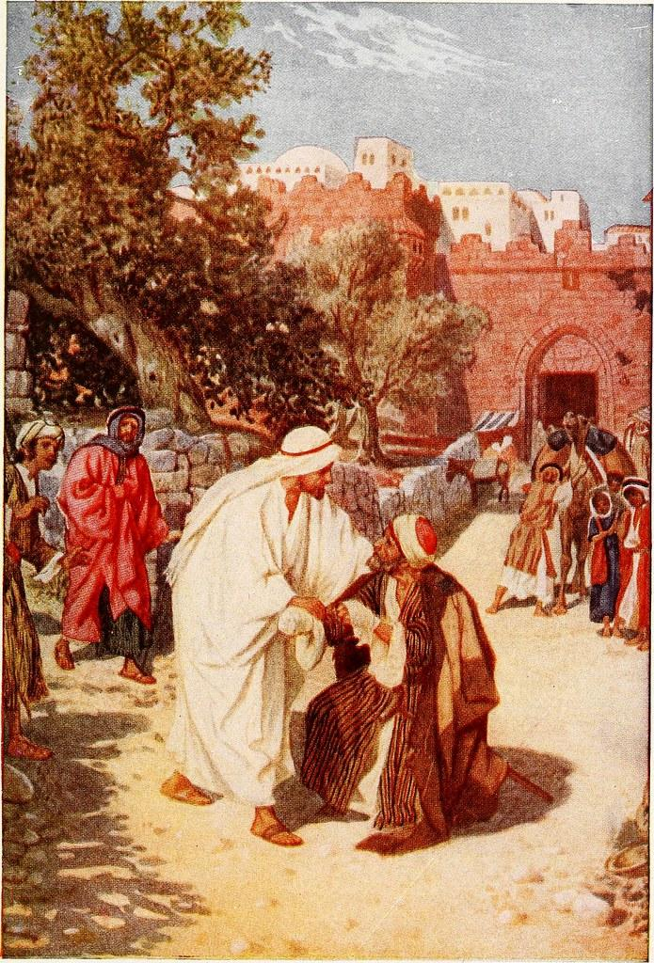
As Jesus was in the center of the city a man with leprosy approached him and fell to his face he said “Lord if you are willing , you can make me clean” luke 5:12. When Jesus saw him he put his hands on him saying “I am willing; be cleansed” Luke 5:13 and immediately the leprosy left him. This is an example where God is showing his mercy through his works. Like the man we are sick. We are sick with our sin. So what we must do is go to God and admit our flaw, admit that we need help. When we do so god will be “willing” to help us and we will “immediately” be cleaned.
God uses miracles to demonstrate to us what he wants from our relationship. He wants us to come seek him, and he wants to heal us.

Slide 12
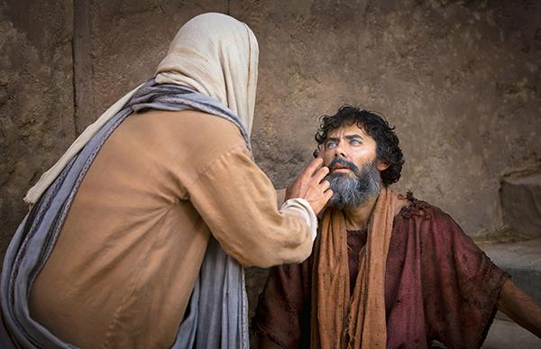
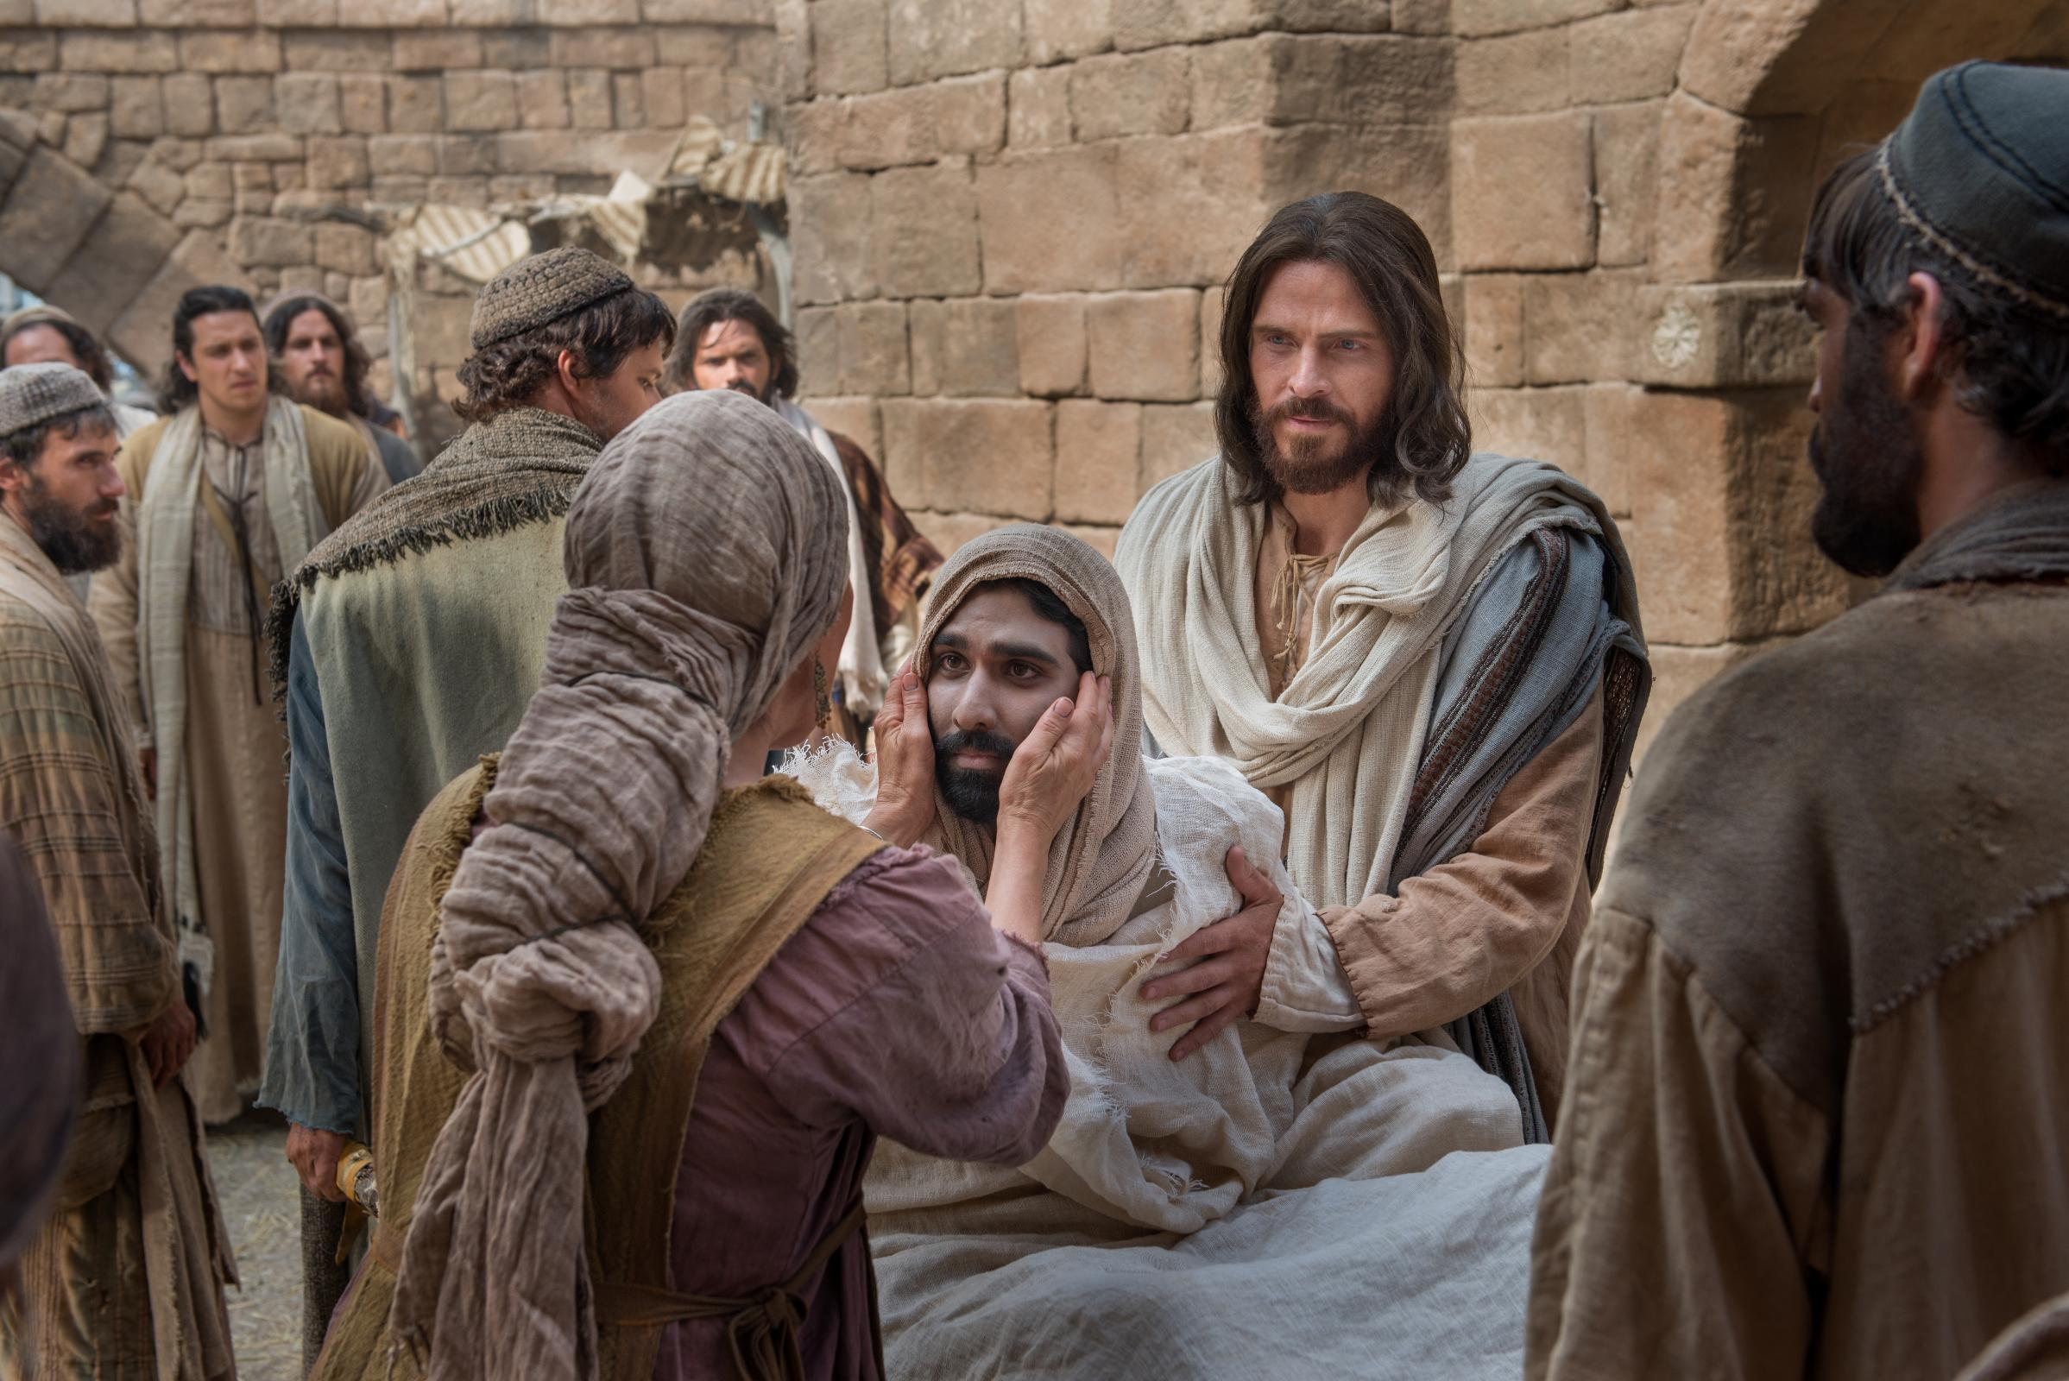
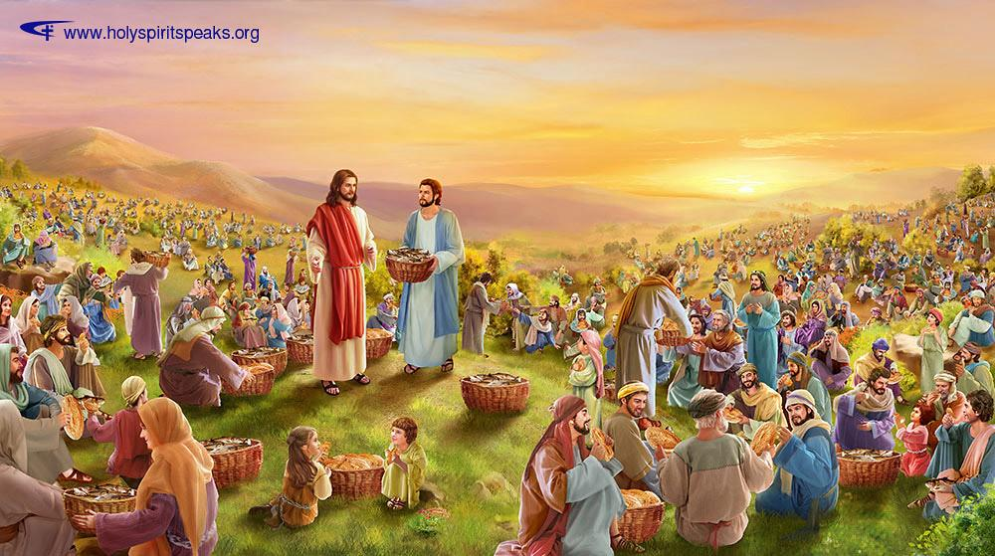
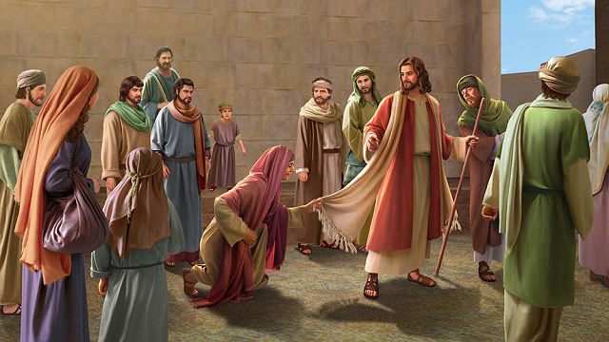
“Go tell John the thing you have seen and heard: that the blind see, the lame walk, the lepers are cleansed, the deaf hear, the dead are raised, the poor have the gospel preached to them” Luke 7:22

Slide 13
Healing Of the 10 Lepers
Luke 17:11-19
Father Athanasius of Alexandria’s thoughts:
Jesus loved the one of the ten that came back to give thanks to the lord for curing him.
Jesus was saddened with the 9 that left. He was saddened because they were to happy with the cure to remember the deliverer.
Interpretation:
When we forget to thank God when things go our way in life, or when we get a chance to wake up another morning are we doing to God the same as the 9 men who left? Do we become too happy with the world we forget who delivered or life and this world to us?

Slide 14
The End

