Slide 1
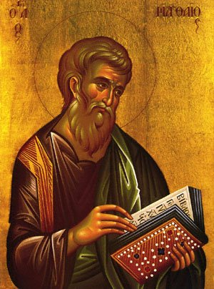
Gospel of Matthew Presentation
By: Kyrollos and Marina Ghaly

Slide 2
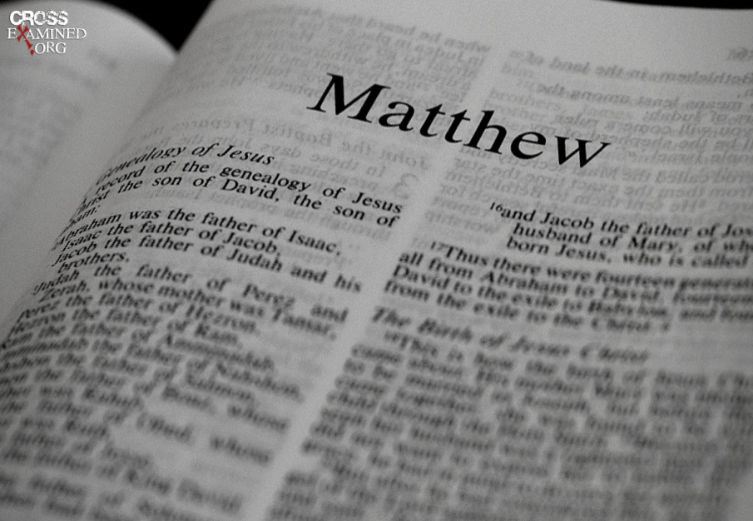
Observation
Written by Matthew
For salvation of fall of humanity & for Jews
Antioch
50 AD-70AD
Wrote it for Jews to tell them Messiah has already came & gave them proof from the prophecies in the Old Testament

Slide 3
Interpretation
Intended audience: Jews
Main themes:
  Fulfillment of the Old Testament Prophecies
  It’s like a bridge from the Old Testament to the New Testament
  He clearly shows the incarnation Son of God, the prophecies of the Old Testament.
  He establishes the new covenant through his death & resurrection and continue to guide people to the end of age
Revelation of Kingdom of God
  Emphasizing the second coming and how his power manifested in his Son
  Truly there is life after death
Call to discipleship
  Being a servant to God
Repentance/obedience

Slide 4
Interpretation pt.2
Unique Attributes:
  Strengthen Jewish Christian Faith that Jesus Christ is Messiah
  the Genealogy of Jesus Christ starting from Abraham (through Joseph)
  Bethlehem children martyrdom
  Sermon on the Mount. Matthew 5:1 - 16
  How should I fast? Matthew 6: 16 – 18
  Miracle of the two blind men. Matthew 9: 27 - 31
  Mute demoniac. Matthew 9: 32 – 34
  Ten virgins (5 foolish and 5 wise) Matthew 25
  Good stewards of God’s talent. Matthew 25: 14 - 29
  Earthquake that occurred and how Christ crushed the Hades. Matthew 27: 51 -54
  The Guard telling the Pharisees that the disciples took Jesus’ body away

